Slide 1

Segregation Modeling and Simulation
SYSC 4906G Modelling and Simulation
Arthur Atangana - 101005197

Slide 2

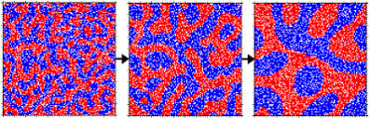
Segregation Overview
How do groups separate in spaces or society?

Slide 3


Current behaviour
Two groups
Pseudo random assignment

Slide 4
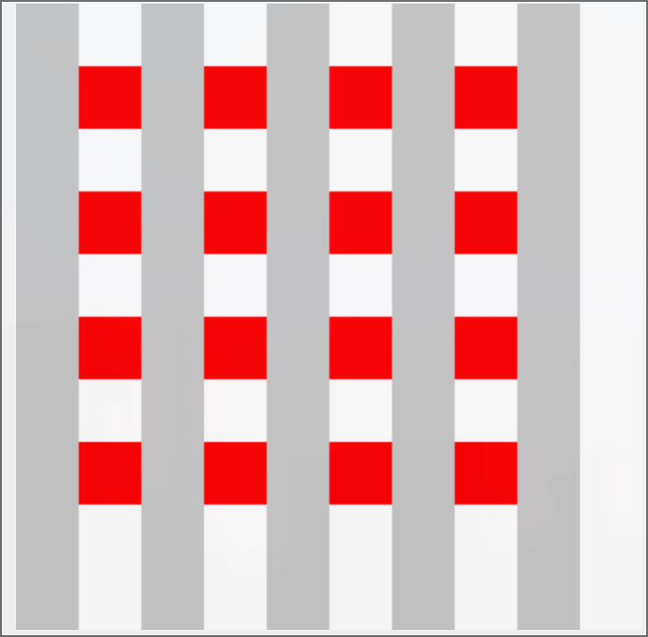

Initial State
Final State

Slide 5

Future behaviours
Truly random assignment
Progressive assignment
New segregation factors
Variable Thresholds

Slide 6

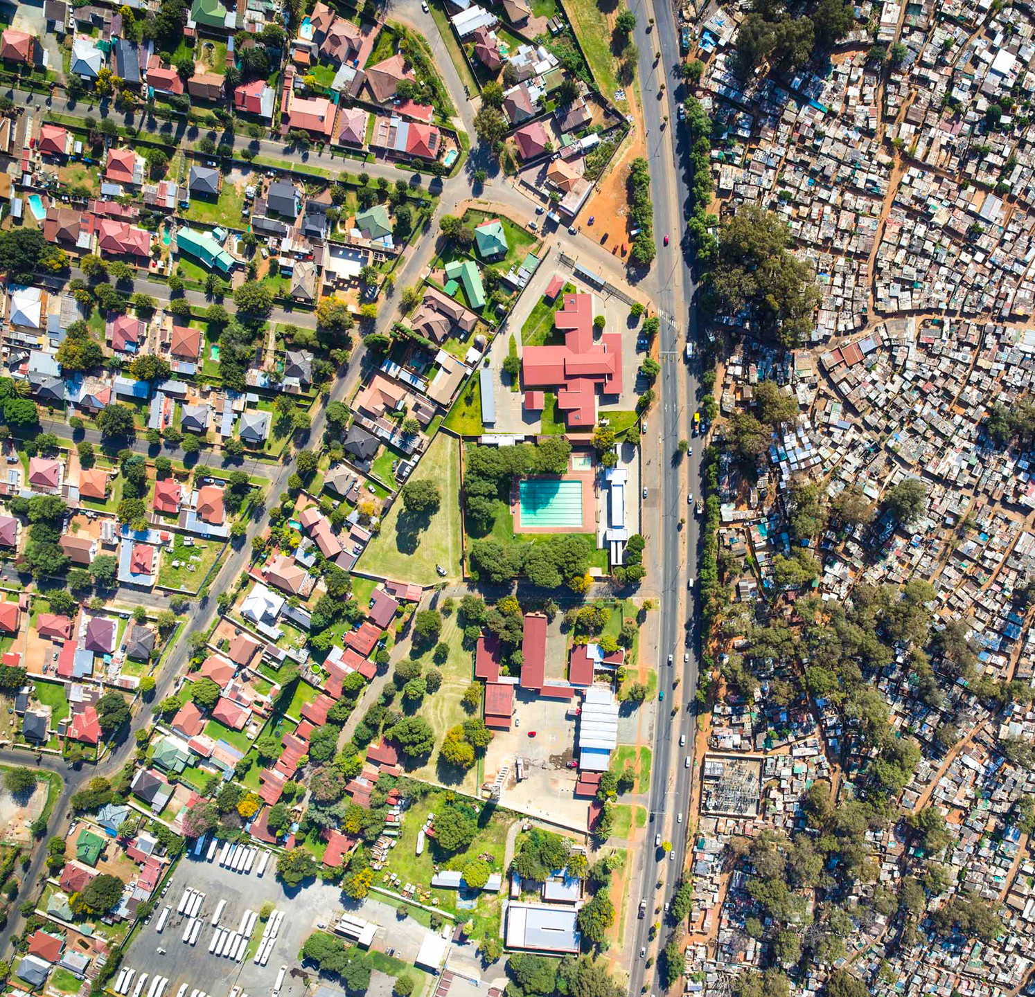
Future behaviours
Asymmetric model
  Weighted neighbors
  Partial vision
Outside pressures

Slide 7
Questions

