Slide 1
Random Number Generator
A quick start guide to the random number generator

Slide 2
Objective
The goal of the random number generator is to choose unique random number based on the user’s options.

Slide 3
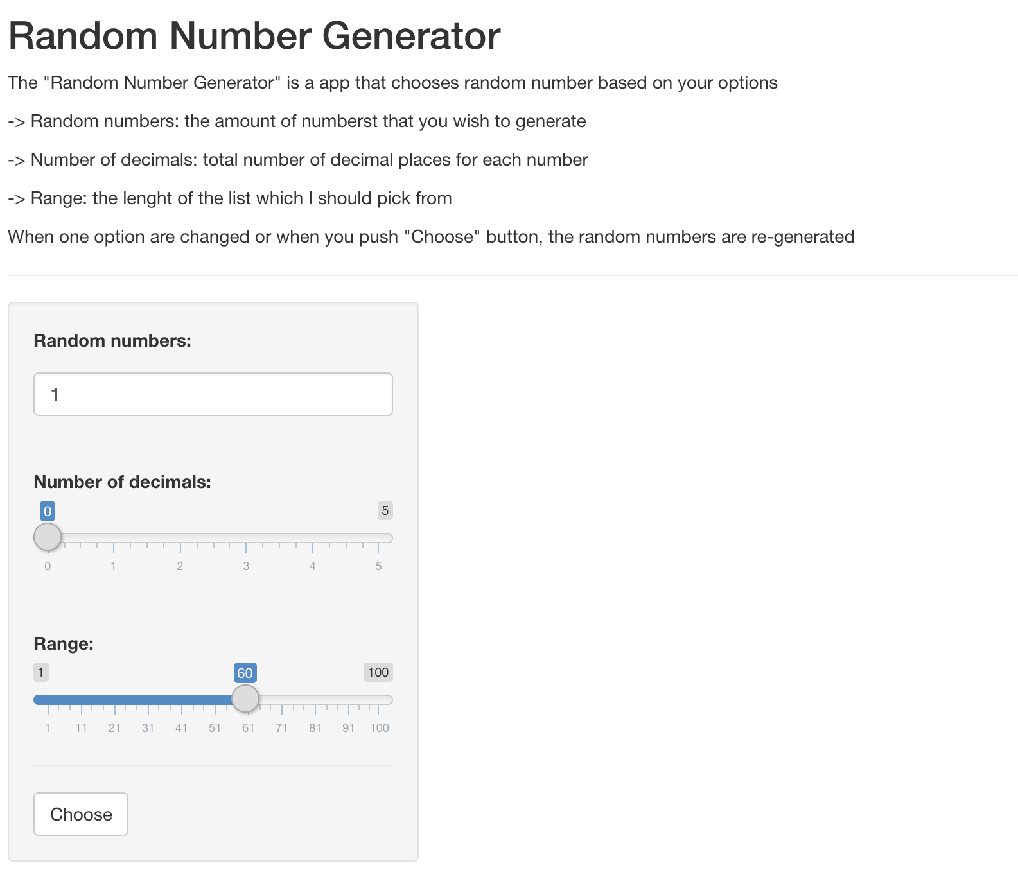
How to use
First: Read the instructions. This will
ensure that you make the most out of
this simple app.
Second: Select how many number you
will need. Select any number bellow 100,
for example, if you want 6 numbers
to play in the lottery write 6 in this box.
Third: Will you need decimal numbers?
If the answer is no, you do no have to
use this slider.
Fourth: Select the upper limit of the
number generator.

Slide 4
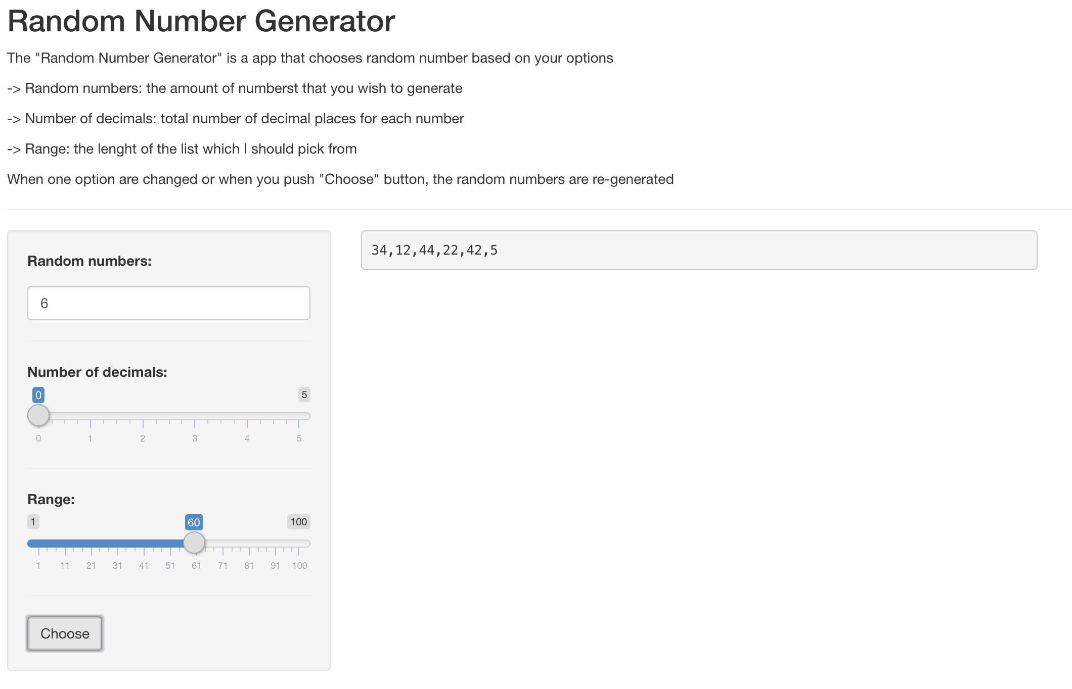
How to use
The result will appear here

Slide 5
Thank You

