Slide 1
Forecasting Total Standing Dry Matter in Agriculture
Arthur Guillaume
Notes:
Hello everyone!
Today, I will present my research on predicting pasture food availability using machine learning.
Why should we care about the amount of food in pastures? Mainly because it serves as feed for livestock, which is a major contributor to the Australian economy. Grazing is the most common and sustainable way to feed cattle, but it requires careful planning and monitoring. This work is crucial for improving how farmers manage grazing resources, ensuring that livestock has sufficient feed, and ultimately contributing to food security.

Slide 2




The Importance of Feed Availability
Grazing livestock is an important source of food.
TSDM: Total Standing Dry Matter, in kg per hectare, is the amount of plant material available, without water.
Yield depends on seasonal and environmental factors.
Forecast availability of feed is paramount.
Notes:
By the end of this presentation, you will become familiar with a term: Total Standing Dry Matter, or TSDM. TSDM refers to the amount of plant material available without water. This is significant because water itself does not provide nutritional value for grazing livestock. Hence, to predict the total amount of calories available, it is a relevant metric. Plant growth is highly seasonal and susceptible to environmental factor, like the climate, making the study of what affects the TSDM complex.

Slide 3
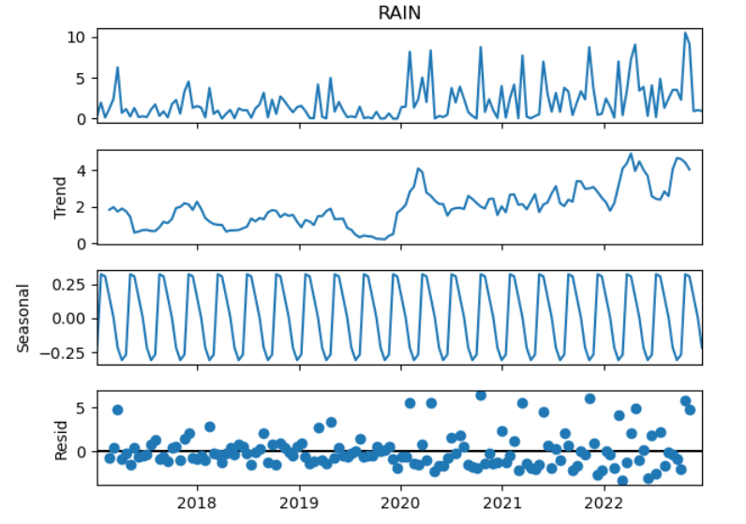
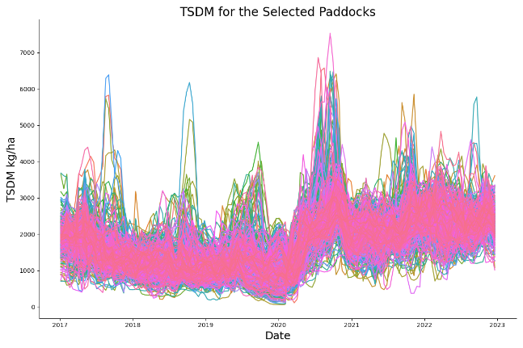
Climate Variability
The Sum of 3 Components
Observations: the sum of 3 components
Linear trend
Periodic changes
Random residual
A seasonal pattern is clearly observable in the yearly TSDM variations over the five-year period. This figure illustrates how TSDM mean values fluctuate throughout each year, showing consistent peaks and valley that correspond to seasonal changes.
Notes:
“In this project, we have been working with time series, which are measurements collected repeatedly over time. The measurements variability is split along three axes:
Trend: The overall direction influenced by predictors, which we aim to study.
Periodic Changes: Seasonal variations that affect outcomes but cannot be controlled. We want to account for them and threat them as variable.
Residuals: Random variations not explained by trend or seasonality.
In our data, we observe cyclical effects in rainfall patterns and TSDM profiles, with noticeable peaks."

Slide 4
Goal and Dataset
Data
Inputs
Climate data:
Max and min temperature, max and min relative humidity,
rain, radiation, evaporation
Paddock Metadata
Crop content, paddock usage, location
TSDM data
Bi-weekly averaged yield
Selected
963 Paddocks
Allocation: grazing
Crop type: natural grass
Between 2017 and 2022
Bi-weekly repeated measurements
LSTM
VAR
Models
Statistical: Vector Autoregression – statmodel
Neural Net: Long Short-Term Memory - tensorflow
TSDM
Predictions
Short term predictions: 1 month
Longer term predictions: 3 and 6 months
Notes:
The aim of my study is to explore how machine learning techniques can predict the future availability of TSDM. The data used included meteorological data, mainly related to temperature and relative humidity. We also had information regarding the pastures, such as paddock content, activity, and average TSDM.
Two models were investigated: a statistical model, Vector Autoregression (VAR), and a neural network commonly used in time series studies,
the Long Short-Term Memory (LSTM) network. 963 grazing paddocks were selected, with no missing data, and data were available for a period of five years.
These models were selected because they use previous values to make futur predictions
VAR is a member ARIMA family, auto regressive moving average. Autoregressive meaning it current value depends on it s own previous value and a stochastic term

Slide 5




Evaluation and Specifics
Paddocks were split between training and testing
Performances were evaluated by predicting the last months in the dataset for VAR, and averaged over all time and outputs for the LSTM
For VAR, the input was the mean values for each parameter
For LSTM, the input consisted of all parameters for each paddock
Notes:
The training and evaluation modality differ for the two methods, for the NN, the training and test set were created with care of not having the same paddock in both set. For the statistical model, measures were averages, and the last months of available data were used for testing.

Slide 6
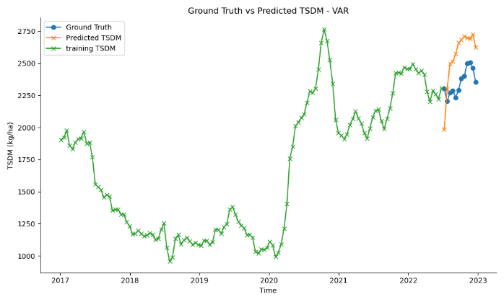
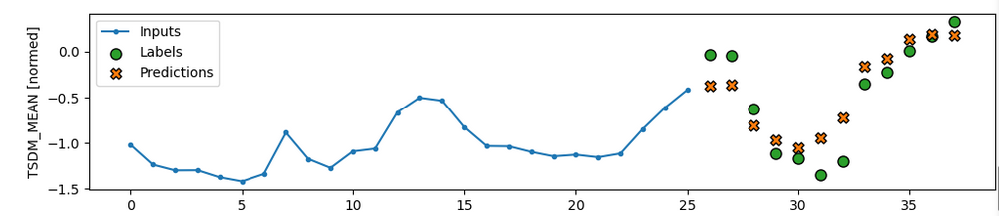
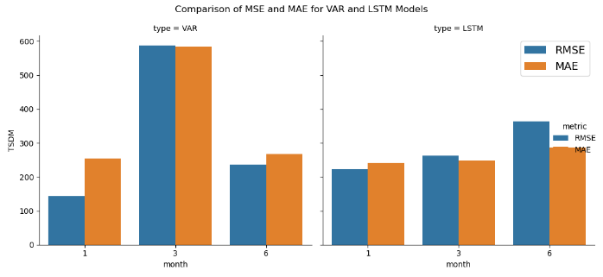
Results
The current method of evaluating results does not allow for direct comparisons between the two models.
Metrics for the LSTM were calculated and averaged over the entire testing set, which comprised 20% of the data.
For the VAR model, metrics were calculated over 20% of the time series.
A figure is missing for LSTM due to an inability to combine predictions for all windows in the testing set.
The figure represents a sample prediction, normalised. The input was the previous year worth of data (26 datapoints), to predict the next 6 months (12 datapoints)
Comparing performance within each model, we observed consistent results as the prediction period increases.
Notes:
On the upper left corner, you can observe the predicted timeframe in orange, compared to the actual values in blue. Below is display the prediction from the NN, which takes as input the previous year worth of data (26 data points ) to predict next 6 (12 datapoints) month here.
Both models where able to forecast the next 6 month of data with a decent accuracy, with an error of around 20%
These results are hard to put in context: to evaluate the error, it would be better to compare it with the mean intra paddock TSMD variation. However, the data we were working with were averaged by paddocks.

Slide 7
Analysis and Limitations
Analysis
Successfully demonstrated that ML can be an efficient tool to predict future available feed from historical data
Limitation and Future Work
It was not demonstrated that the models can be used at the paddock level.
Does not account for paddocks as a variable.
The current study does not provide any insights into the impact of each meteorological factor.
Using the global mean for the statistical model reduces its power.
This approach is not state-of-the-art, current work utilises remote-sensing data.

Slide 8
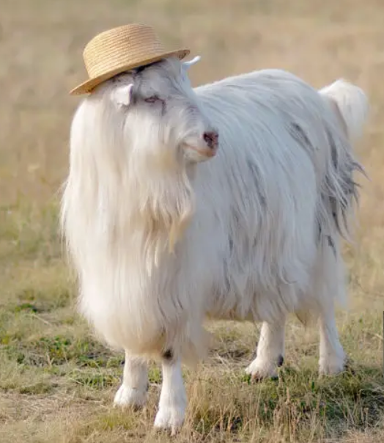
Questions?
Thank you for your time

Slide 9
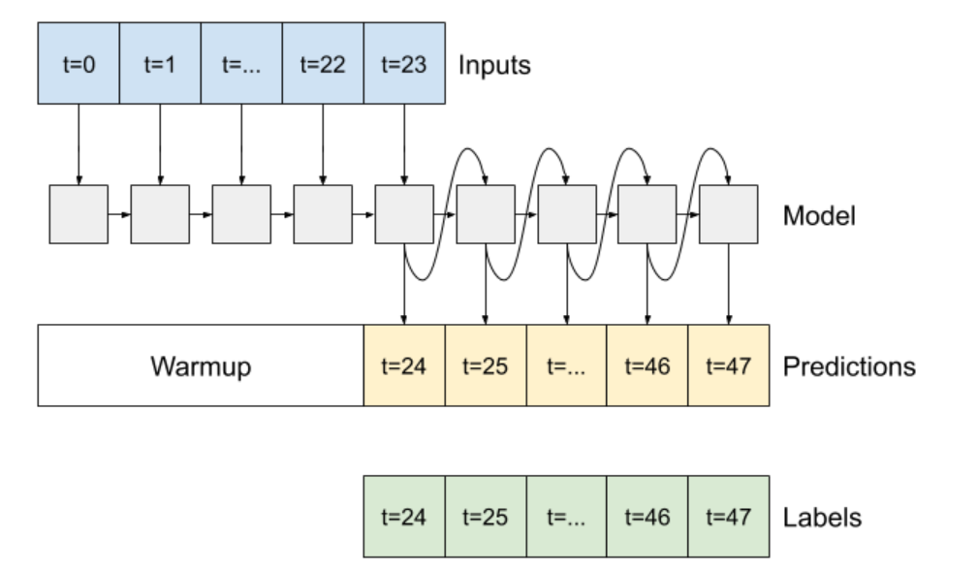
Auto-regressive LSTM
Architecture
53436*8
LSTM cell
Dense (8)

