Slide 1

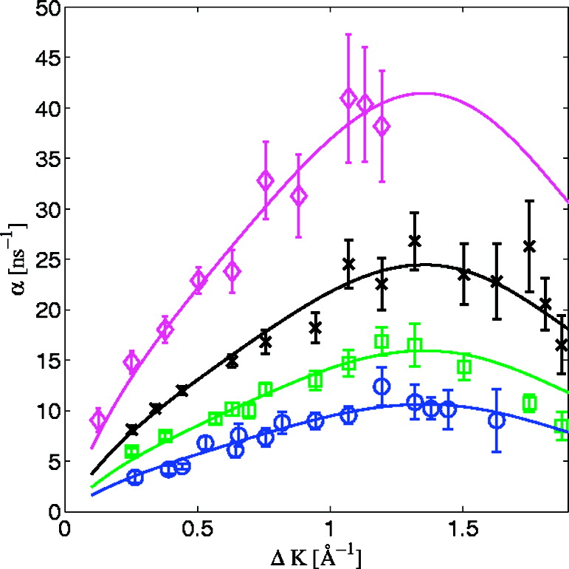
Inverse lifetime as a function of the momentum transfer, α(ΔK), measured for CO/Pt(111) at 340 K along the <112̅> crystal azimuth. The circle, square, cross, and diamond markers were measured for coverages of Θ = 0.065, 0.165, 0.22, and 0.3 ML, respectively. The solid lines show the same polynomial function scaled by a factor of 1.0, 1.5, 2.3, and 3.9 for the four different coverages. The fact that a simple scaling factor is sufficient to fit the coverage dependency within the accuracy of the data illustrates the constant shape of α(ΔK) and the lack of correlation in the motion of the CO molecules.
Published in: Gil Alexandrowicz; Pepijn R. Kole; Everett Y. M. Lee; Holly Hedgeland; Riccardo Ferrando; Andrew P. Jardine; William Allison; John Ellis; J. Am. Chem. Soc. 2008, 130, 6789-6794.
DOI: 10.1021/ja800118x
Copyright © 2008 American Chemical Society

