Slide 1

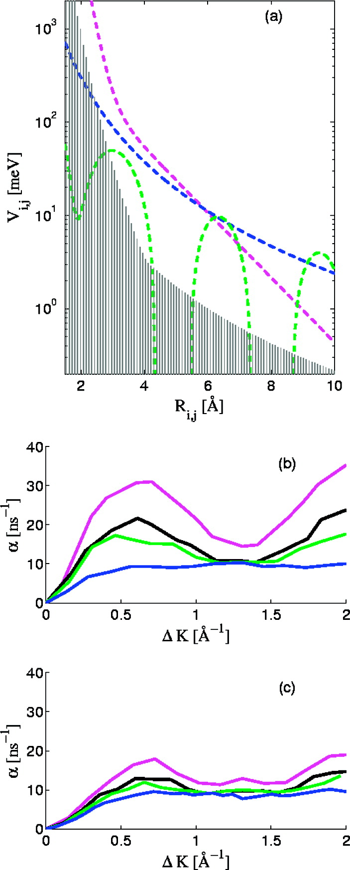
(a) Pairwise interactions considered in the text. The dashed blue line is the CR−3, C = 2.1 × 103 meV Å3, fit to the the McEwen interaction,(7) whereas the dashed magenta line and the dashed green line are the interaction models used by Persson(6) and Petrova et al.,(30) respectively. The shaded area marks the approximate region of possible interactions that do not result in significant correlation features, defined by the upper limits of a long-range (R−3) and a short-range (R−8) interactions. (b) Inverse lifetimes calculated from MD simulations which use the R−3 fit to the McEwen interaction, the different colors represent the same coverages as those plotted in Figure 1. (c) Calculated inverse lifetimes by using the nonmonotonic substrate mediated interaction derived by Petrova et al.
Published in: Gil Alexandrowicz; Pepijn R. Kole; Everett Y. M. Lee; Holly Hedgeland; Riccardo Ferrando; Andrew P. Jardine; William Allison; John Ellis; J. Am. Chem. Soc. 2008, 130, 6789-6794.
DOI: 10.1021/ja800118x
Copyright © 2008 American Chemical Society

