Slide 1

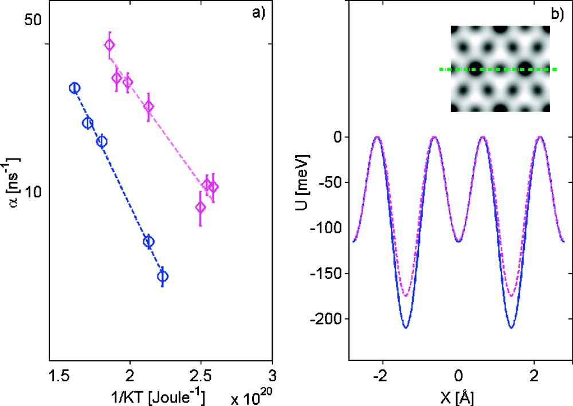
(a) Temperature dependence of α, measured at ΔK = 0.6 Å−1. The blue circles and the magenta diamonds were measured for Θ = 0.065 and 0.3 ML, respectively. The dashed lines (blue and magenta) are the Arrhenius fits to the data mentioned in the text. (b) Coverage-dependent PES used to fit the data. The solid and dashed lines (Θ = 0.065 and 0.3 ML, respectively) are the values of the PES, along the line which connects two top sites, as illustrated on top of the PES by using a green dash-dot line in the inset plot above. To allow a simple comparison, the height of the PES at the maximum is arbitrarily fixed at zero for both coverages. In reality, the changes in the heat of adsorption(5) mean that the two curves will also be shifted apart.
Published in: Gil Alexandrowicz; Pepijn R. Kole; Everett Y. M. Lee; Holly Hedgeland; Riccardo Ferrando; Andrew P. Jardine; William Allison; John Ellis; J. Am. Chem. Soc. 2008, 130, 6789-6794.
DOI: 10.1021/ja800118x
Copyright © 2008 American Chemical Society

