Slide 1

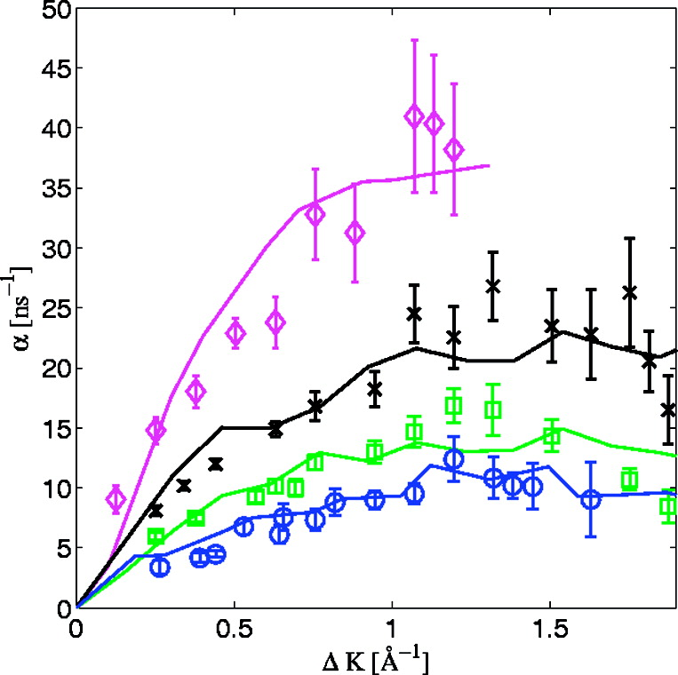
MD simulation results obtained by using a coverage-dependent PES. The markers show the experimental inverse lifetimes shown in Figure 1. The lines show the simulation results obtained by using a coverage-dependent PES. For CO coverages Θ = 0.065, 0.165, 0.22, and 0.3 ML, the barrier to diffusion between top sites, UTT, is 210, 203, 190, and 172 meV, and the energy difference between bridge and top sites, UB − UT, is 95, 80, 70, and 60 meV, respectively. Note that the corrugation values are ∼30% higher than the measured activation, demonstrating the nontrivial relation between the two properties(31) and the importance of using MD simulations to analyze the dynamics.
Published in: Gil Alexandrowicz; Pepijn R. Kole; Everett Y. M. Lee; Holly Hedgeland; Riccardo Ferrando; Andrew P. Jardine; William Allison; John Ellis; J. Am. Chem. Soc. 2008, 130, 6789-6794.
DOI: 10.1021/ja800118x
Copyright © 2008 American Chemical Society

