Slide 1

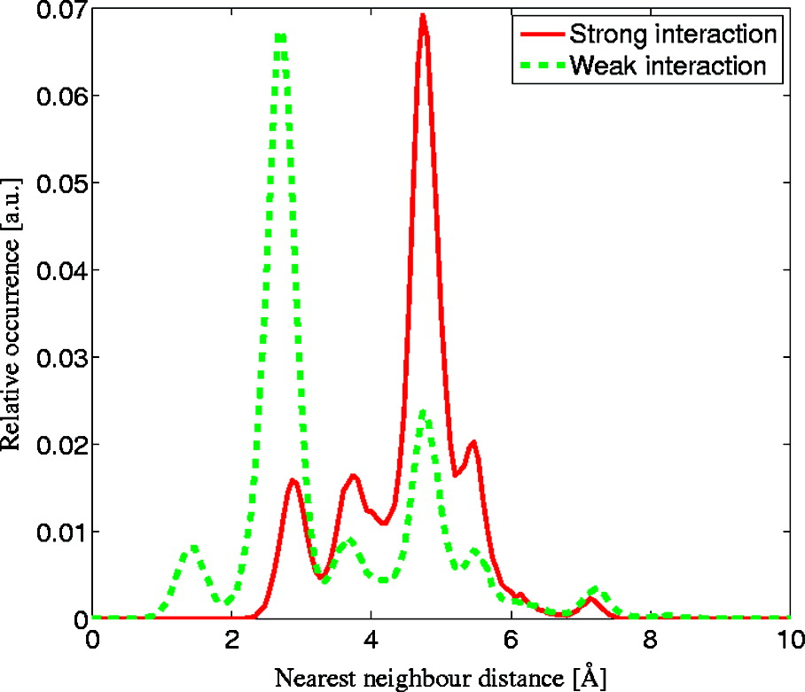
Illustration of the effect of lateral repulsion on the proximity of neighboring adsorbates. The two curves show normalized histograms for the distance to the closest neighbor. The histograms were calculated from simulated MD trajectories at T = 340 K and Θ = 0.17 ML. The red curve was derived from a simulation of the R−3 fit to the McEwen interaction (labeled strong) mentioned in the manuscript, whereas the green curve plots the results for an upper-limit R−3 repulsive interaction, which is still consistent with the uncorrelated dynamics we observe, that is, lies within the shaded region of Figure 2a. As is clearly seen from this comparison, the stronger interaction strongly reduces the occurrence of close proximity between adsorbates and hence will play an important role in processes that are sensitive to this distance.
Published in: Gil Alexandrowicz; Pepijn R. Kole; Everett Y. M. Lee; Holly Hedgeland; Riccardo Ferrando; Andrew P. Jardine; William Allison; John Ellis; J. Am. Chem. Soc. 2008, 130, 6789-6794.
DOI: 10.1021/ja800118x
Copyright © 2008 American Chemical Society

