Slide 1

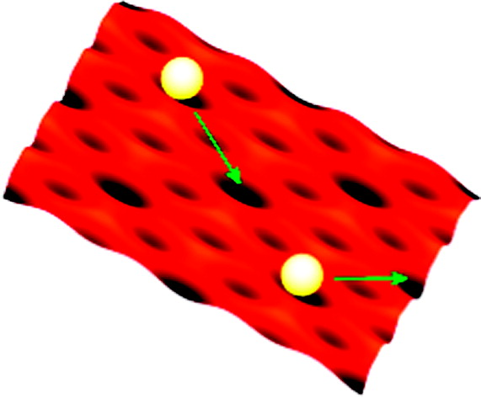
Published in: Gil Alexandrowicz; Pepijn R. Kole; Everett Y. M. Lee; Holly Hedgeland; Riccardo Ferrando; Andrew P. Jardine; William Allison; John Ellis; J. Am. Chem. Soc. 2008, 130, 6789-6794.
DOI: 10.1021/ja800118x
Copyright © 2008 American Chemical Society

