Slide 1
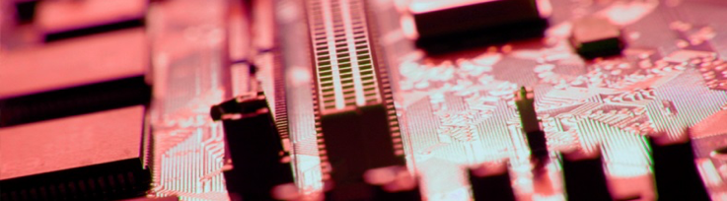

Intro to HPC
Prentice Bisbal
Senior HPC Engineer
Computational Sciences Department
Princeton Plasma Physics Laboratory
pbisbal@pppl.gov

Slide 2
Agenda
What is HPC (discussion)?
Some definitions of HPC
What makes HPC unique?
Why do we need HPC?
Fundamental laws that govern HPC.
Parallelism
Notes:
Note that I’m not going to talk about HPC clusters, programming, or specifics of different hardware, etc. - Instead I want to focus on defining/understanding HPC and the important concepts governing it. - more or less the theory of HPC, rather than any implementation specifics. There will be separate lectures on Cluster architecture, Parallel Programming, and Schedulers, so, I don’t want to repeat what will be said there.
My hope is for this talk to cover all the important, fundamental concepts about HPC, but I doubt I’ll achieve that goal.

Slide 3
What is HPC?
?
Notes:
I’d like for us to try to define HPC ourselves, but before we do, I’d like everyone to get a pen and piece of paper, or open a text editor and come up with your own definition of HPC. (Wait a minute or two, and then ask for volunteers to read their definitions

Slide 4
Synonyms for HPC?
?

Slide 5
Synonyms for HPC?
Scientific Computing
Research Computing
Parallel Computing

Slide 6
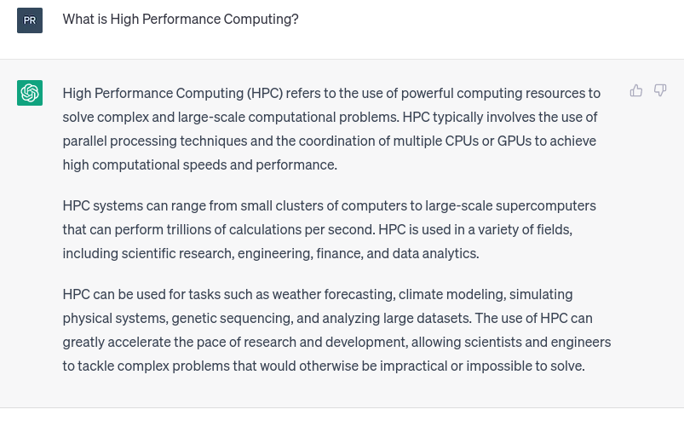
ChatGPT
source: https://chat.openai.com
Notes:
First paragraph, dead-on. Second and third paragraphs are useful information, but go beyond the definition.

Slide 7
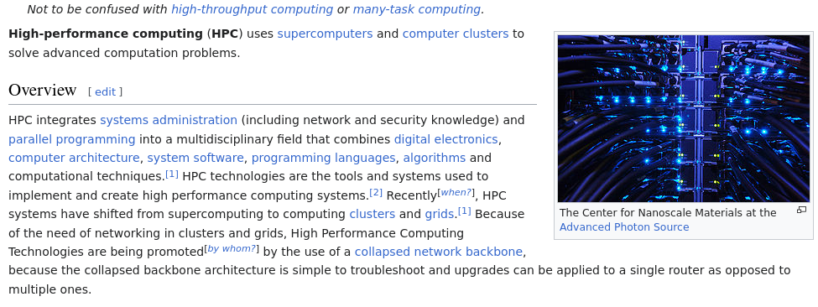
Wikipedia
source: https://en.wikipedia.org/wiki/High-performance_computing
Notes:
Note the “Not to be confused with…” note at the top. First sentence tells us what we do with HPC, but not what HPC is. The “Overview” is trying to be all things to everyone, and totally misses the mark.

Slide 8
My own definition of HPC
High-performance computing (HPC) the study and practice of using of computers to solve computational problems that require sustained computations (processors at or near 100% utilization) for long periods of time. These days this is achieved through the use of parallel programming techniques to allow multiple computers to provide more computational power and RAM than a single computer can provide.
Notes:
Keeping the processors near 100% utliization is important here, and is also a big challenge for HPC programming. Many people forget about RAM, but many jobs just can’t run w/o enough RAM - Swap isn’t acceptable for HPC, and there’s limits to swap size.

Slide 9
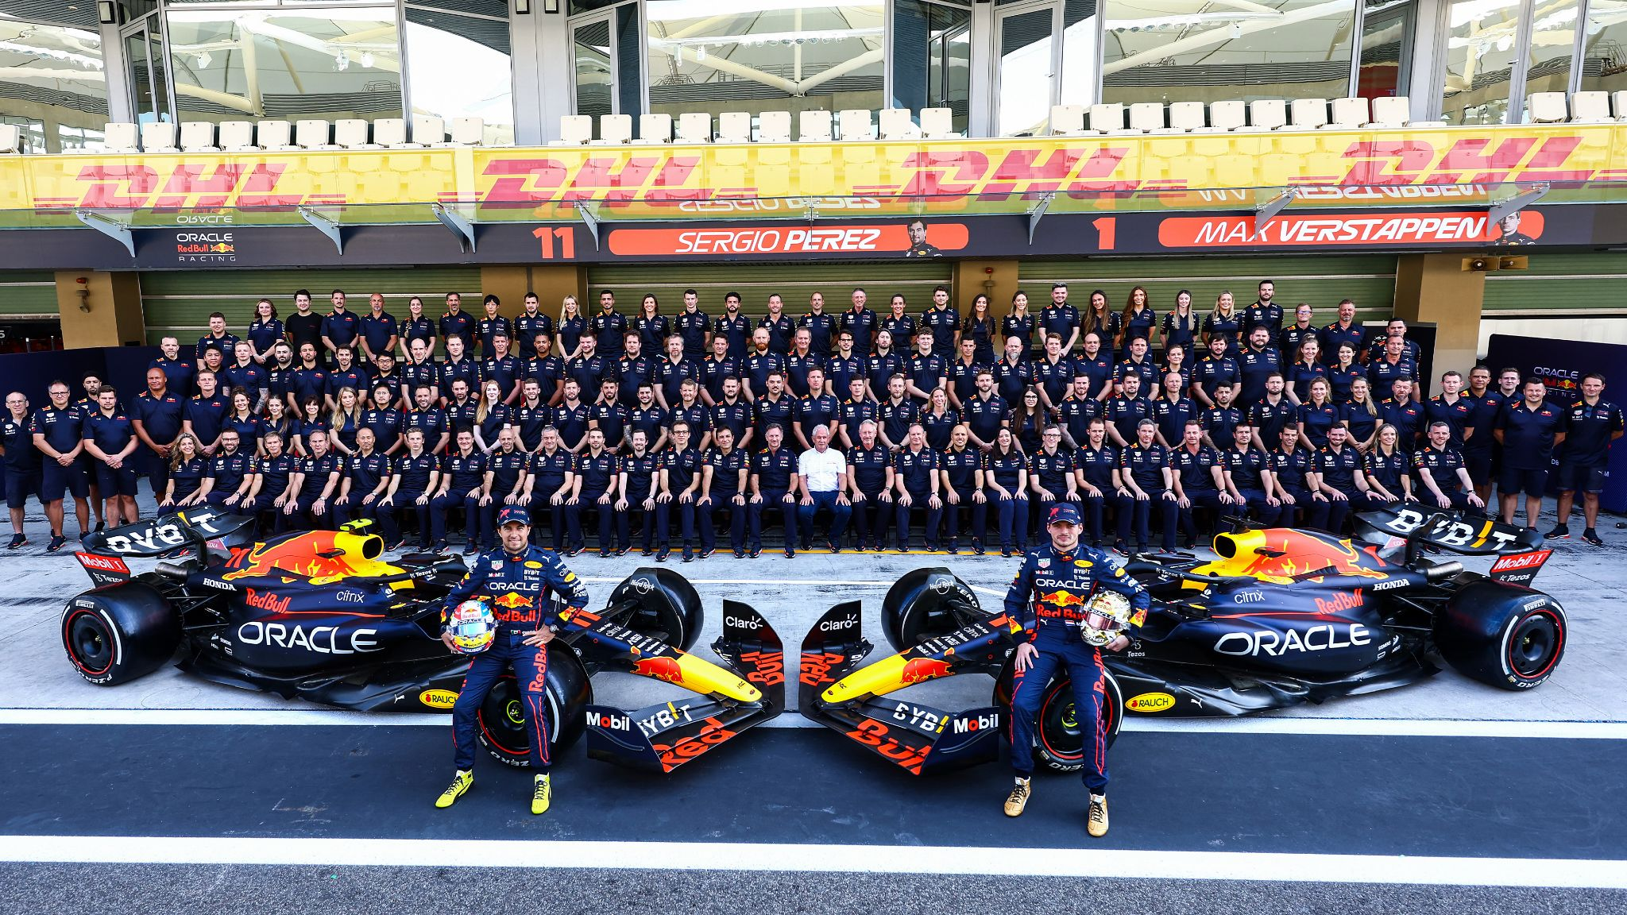
HPC is the Formula 1 of Computing
source: https://twitter.com/redbullracing/status/1593227499588431874/photo/1
Notes:
- All about maximum performance
- Good performance requires both a highly-optimized machine, highly skilled users, and a skilled support team with highly specialized skills
- It takes a large team to build and maintain a large HPC cluster and support the researchers

Slide 10
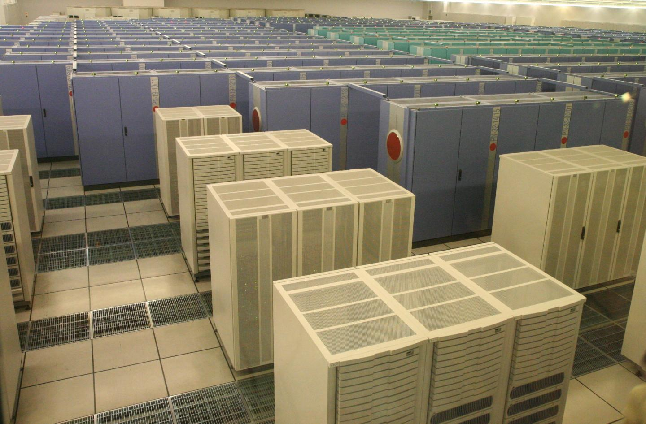
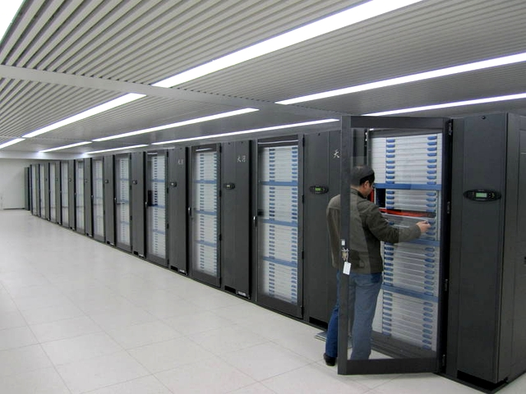
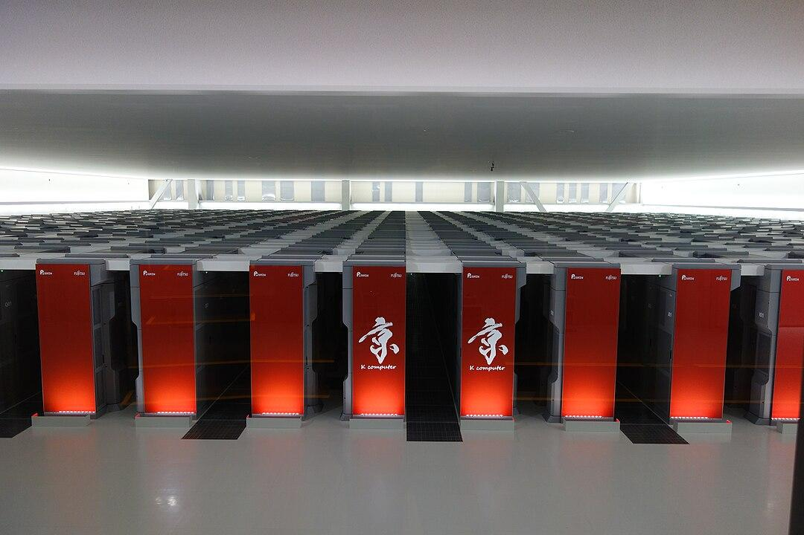
HPC is also the space race of computing
Tianhe-1, China (2009) Source: Nakrut - https://en.wikipedia.org/wiki/Tianhe-1#/media/File:Tianhe-1_supercomputer.jpg
LIcense: CC BY-SA 4.0
K Computer, Japan (2011)
Source: Toshihiro Matsui from Tsukuba and Yokohama, Japan, https://commons.wikimedia.org/wiki/File:%E4%BA%AC%E3%82%B3%E3%83%B3%E3%83%94%E3%83%A5%E3%83%BC%E3%82%BF_(32588659510).jpg License: CC BY 2.0
Earth Simulator, Japan ( 2002)
Source: Manatee_tw - https://www.flickr.com/photos/manatee_tw/3585719603/
License: CC BY-SA 4.0
Notes:
HPC has been dominated by the US, specifically by the DOE since the start of computing, but with the Earth Simulator by Japan in 2002, it has become an international competition used to highlight the technical know-how and scientific superiority of the countries at the top of the list, as serve as a point of nationa pride. Japan has had several systems on the Top500 list in the past 20 years: Earth Simulator, K Computer, and Fugaku. Over the past 10 years or so, China has also made multiple appearances near the top of the list: Tianhe-1, Tiane-1A, Tianhe-2, Sunway TaihuLight. Right now, China is the USA’s biggest rival in this race.

Slide 11
Why do we need HPC?
Compared to physical experiments, simulations using HPC are
Cheaper
Faster
More practical
And allow us to visualize things we can’t normally see:
Molecular dynamics
Fluid flow around an object
Magnetic Fields
Stress in a solid

Slide 12
Applications where HPC is critical
Molecular Dynamics
Fusion Energy
Weather prediction
Studying stress/strain or feasibility of large structures
Nuclear weapons development, testing, and stockpile stewardship
Notes:
Not a conclusive list by any measure. Molecular Dynamics - observing the movement of molecules in motion is very difficult, and happens very quickly. Fusion Energy - designing and building a Fusion reactor can take many years and an enormous amount of labor, and the energy needed to perform a single experiment is enormous
Weather prediction - just not possible without HPC - we can’t build a duplicate earth a couple days ahead of us, and even with HPC, it’s still a challenge since we need to get predictions several times a day, and they have to be far enough into the future to be useful to us!
Large structures - bridges, skyscrapers, dam, etc. - Failure of any of these would be catastrophic, and scale models can be costly or not accurate enough

Slide 13
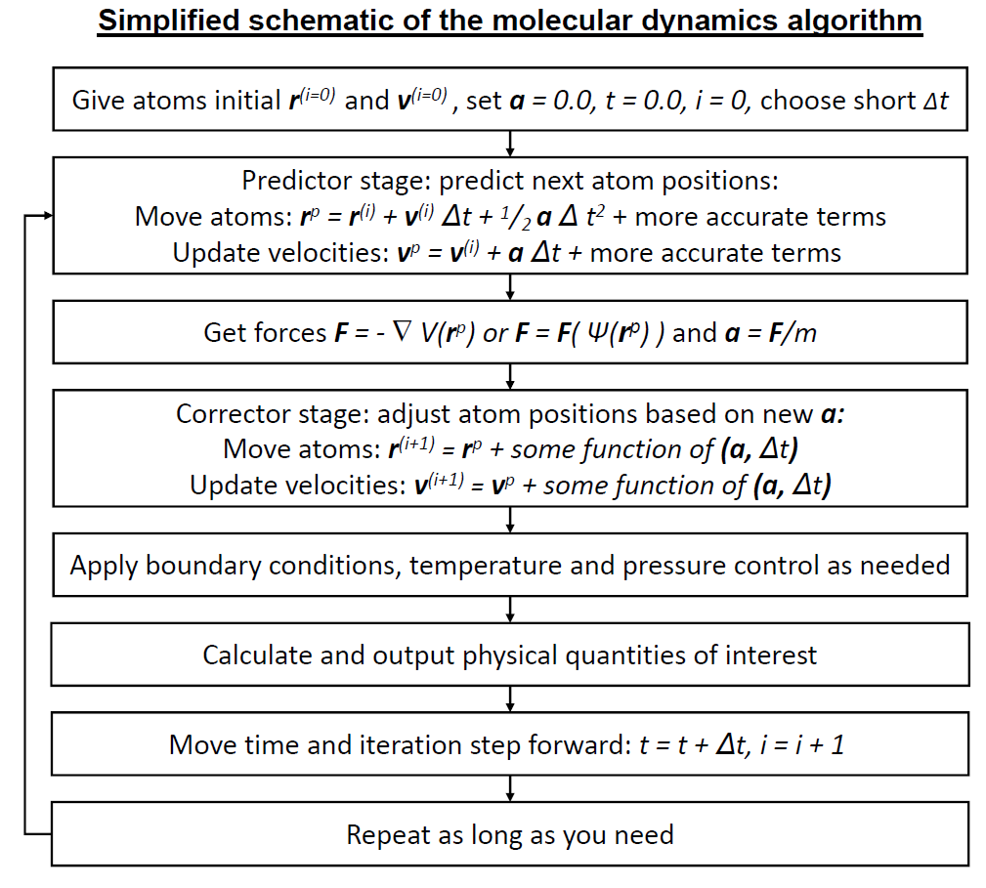
Example: Molecular dynamics
Need a simulation time of at least 1 ms (10⁻³ s)
Time step size is 1 femtosecond (10⁻¹⁵ s)
Pairwise interactions of atoms - nbody problem of O(n²)
A large protein can have 100,000 or more atoms
(10⁵)²(10⁻³/10⁻¹⁵) ≈ 10²² distances to calculate
source: https://en.wikipedia.org/wiki/File:Molecular_dynamics_algorithm.png License: CC-BY-SA-3.0
Notes:
That number is just the start. You have to calculate that number of distances, and then once you know the distances between the atoms, you then need to calculate the different forces each atom exerts on every other atom (gravitational, electrostatic), sum up those forces, and then integrate to get the new position of each atom. In reality, there’s a lot of approximations/simplifications that can be done: cut off distances for different forces, etc. Exascale may change this, but prior to exascale, the only system that has been able to do MD simulations at that 1 ms of simulation time has been the D.E. Shaw Research Anton systems, which are hardware implementations of the DESMOND MD algorithm - not a general purpose - or even programmable - computer!

Slide 14
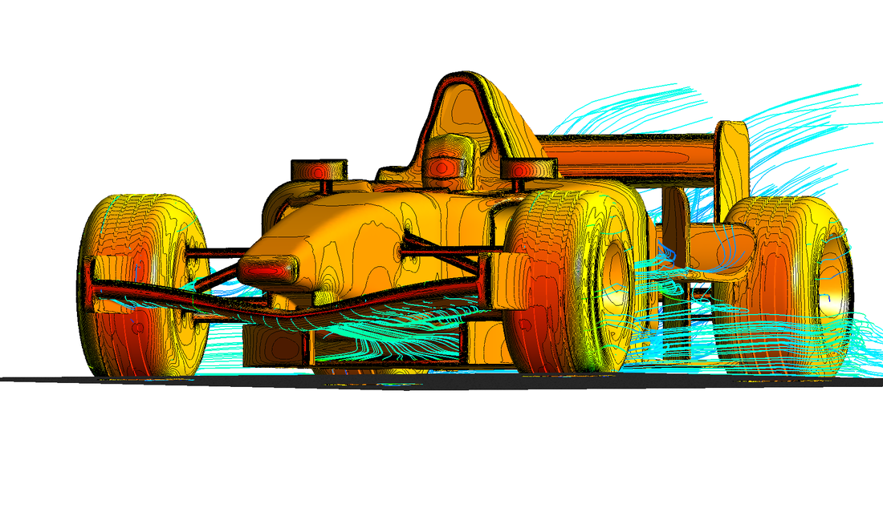
Example: F1 CFD
F1 is the largest user of HPC for CFD in world
Used to optimize car aerodynamics for each track, and for weather conditions
F1 limits how much compute time each team could use for CFG
image source: https://commons.wikimedia.org/wiki/File:F1_CFD_Simulation.png, CC-BY-SA-4.0
Notes:
F1 teams utilize CFD to optimize the aerodynamic tuning of their car to match the characteristics of the track and and take into account the weather conditions (humidity, barometric pressure, etc.). Increasing downforce can increase drag, but it also increases traction, so on courses with long straights, less downforce is better, since you can hit higher top speeds on the straights at the cost of reduced cornering speeds. On tracks with a lot of tight turns, more downforce increases your cornering speed, but decreases your top speed. By running simulations in the days leading up the race, each team hopes to find the perfect balance of downforce and top speed.

Slide 15
How HPC differs from “regular computing”
The processor (FPUs in particular) are at or near 100% utilization for extended periods of time (hours, days, weeks, months..)
Caches and “latency hiding” aren’t as important
There’s less context switching, since only one application should be running at a time
Not as much branching as non-scientific codes
Much more sensitive to memory and networking bandwidths and latencies.
Often calculation need to be double-precision or even greater, so even individual calculations themselves take more work.
Notes:
- In most other computing use cases, processors are sitting idle and waiting for some kind of input to act on.
- Since loop iterations need to be “data-independent of each other” and datasets are much larger than caches, the cache is seldom used, compared to general computing. Even prefetching is probably of limited use, since the calculations should be running through the processor faster than new data can be fed from main memory to cache.
- Since features like branch-prediction and caches aren’t as critical, those features can be eliminated or reduced on a chip to provide more space on the die for arithmetic units - this is one of the features of the GPU architectures. They have less branching hardware and more math hardware. Taking the wrong branch is every expensive on a GPU

Slide 16
“HPC-adjacent” technologies
High-throughput computing
Data analytics (“big data”)
Artificial Intelligence
Notes:
This technologies use similar hardware, and similar practices, but there are fundamental differences that set them apart from what I consider HPC.

Slide 17
High-throughput Computing (HTC)
High-throughput computing (HTC) is the practice of running many serial jobs at once on a collection of computer resources, usually HPC clusters. This type of computing is not considered HPC, but is often done on HPC clusters. This is not the same as embarrassingly parallel.
Often used for “parameter sweeps”, which is where you run the same program with many different combinations of input parameters to see how they impact the output of the simulation
Most schedulers provide a “job array” feature to simplify submitting a large number of similar jobs at once.
Job performance doesn’t scale to more processors
Notes:
This is a pet-peeve of mine. Others may consider HTC a type of HPC, but I don’t!

Slide 18
Data Analytics
Similarities:
Uses a collection of computers and storage to achieve a goal
Uses storage in a parallel manner
Differences
Not mathematically complex
Largely serial - each process is sifting through it’s own chunk of data
I/O bound

Slide 19
Artificial Intelligence
Similarities:
Uses a lot of computer resources
Uses GPUs
Differences
Not based on mathematical models pf physical processes

Slide 20
4 laws of HPC
Moore’s Law
Dennard’s Law
Amdahl’s Law
Gustafson’s Law
Notes:
- Notice I didn’t title this slide “THE 4 laws” of HPC. I’m not saying this is a definitive list of the laws governing HPC, but they are important laws.
- Ask for a show of hands for each law, who has heard of the law and who knows what it means?
- Ask for a show of hands - who thinks Moore’s law has ended?

Slide 21
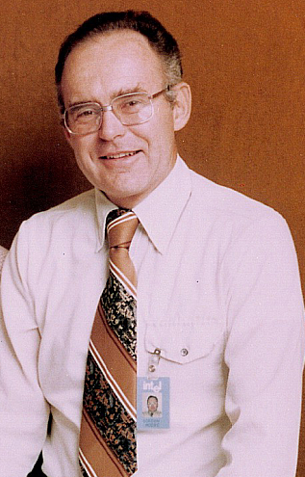
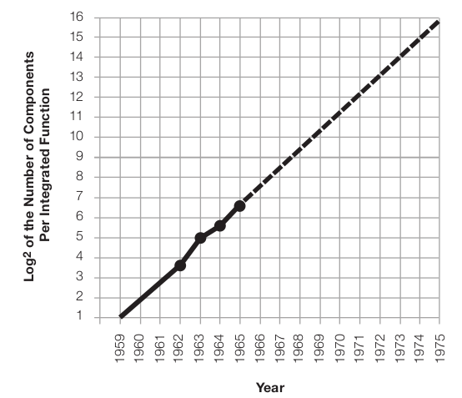
Moore’s Law (1965)
“The complexity for minimum component costs has increased at a rate of roughly a factor of two per year. Certainly over the short term this rate can be expected to continue, if not to increase. Over the longer term, the rate of increase is a bit more uncertain, although there is no reason to believe it will not remain nearly constant for at least 10 years.”
Gordon Moore in 1976
image source: https://www.flickr.com/photos/intelfreepress/8267616249/in/photostream/ Copyright Intel. Used with permission.
Moore, Gordon E., “Cramming more components onto integrated circuits” Electronics, Volume 38, Number 8, April 19, 1965
Notes:
Observation - NOT A LAW

Slide 22
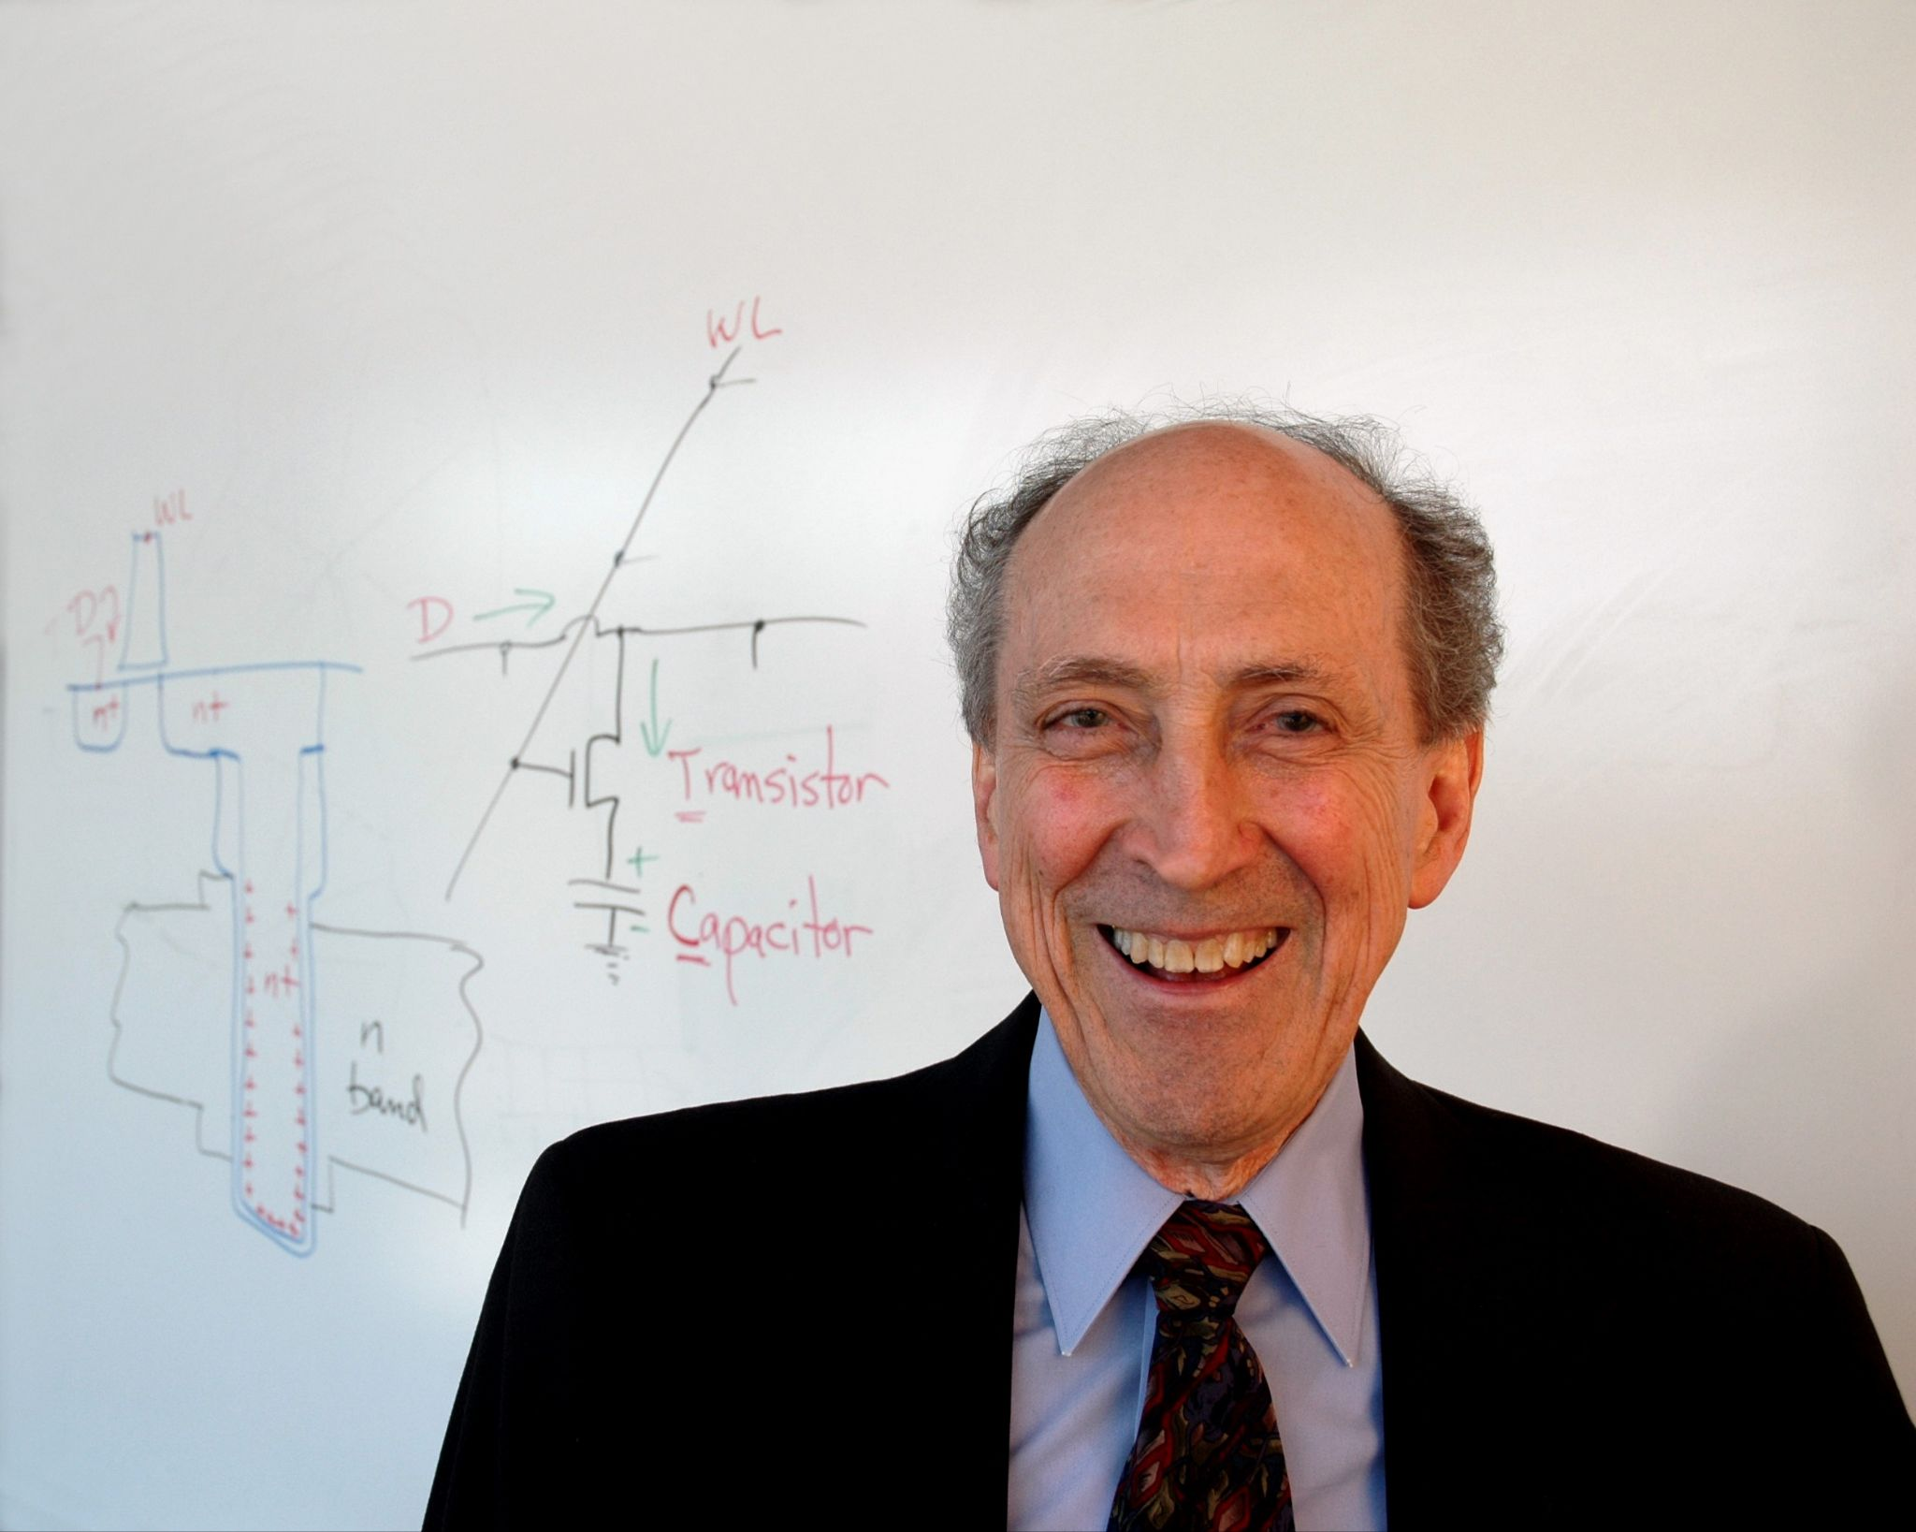
Dennard Scaling (1974)
As transistor size goes down, operating frequency goes up
As transistor size decreases, energy density remains constant
Dennard Scaling stopped in 2005 - 2006
Dennard, Robert H., et al., “Design of Ion-Implanted MOSFET’s with Very Small Physical Dimensions”, IEEE Journal of Solid-State Circuits, Vol. 9, Issue 5, pp. 256-268, October, 1974
image source: https://commons.wikimedia.org/wiki/File:Robert_Dennard.jpg License: CC BY-SA 3.0
Notes:
- Dennard Scaling broke down in 2005 - 2006 when the physical and thermal limitations made it impractical to run processors at higher frequencies, even Moore’s Law is still holding. This is one of the reasons multi-core processors started coming on the market around that time - You still get the energy efficiency of reducing transistor size, and with smaller transistors, you can fit more cores on same space to provide more computing power that way. It’s unclear if “energy density remains the same” applies as the frequency increases, or assumes the features stay at the same frequency (I need to read the original paper to figure it out!)
- Robert Dennard also invented Dynamic Ram, which is pretty big achievement, too!

Slide 23
Moore’s Law, Dennard Scaling and Mark Twain
“I can understand perfectly how the report of my illness got about, I have even heard on good authority that I was dead. James Ross Clemens, a cousin of mine, was seriously ill two or three weeks ago in London, but is well now. The report of my illness grew out of his illness. The report of my death was an exaggeration”
– Mark Twain

Slide 24
Moore’s Law, Dennard Scaling and Mark Twain
“I can understand perfectly how the report of my illness got about, I have even heard on good authority that I was dead. James Ross Clemens Dennard Scaling, a cousin of mine, was seriously ill died two or three weeks ago in London, but is well now back in 2005 or 2006. The report of my illness grew out of his illness its death. The report of my death was an exaggeration”
– Moore’s Law

Slide 25
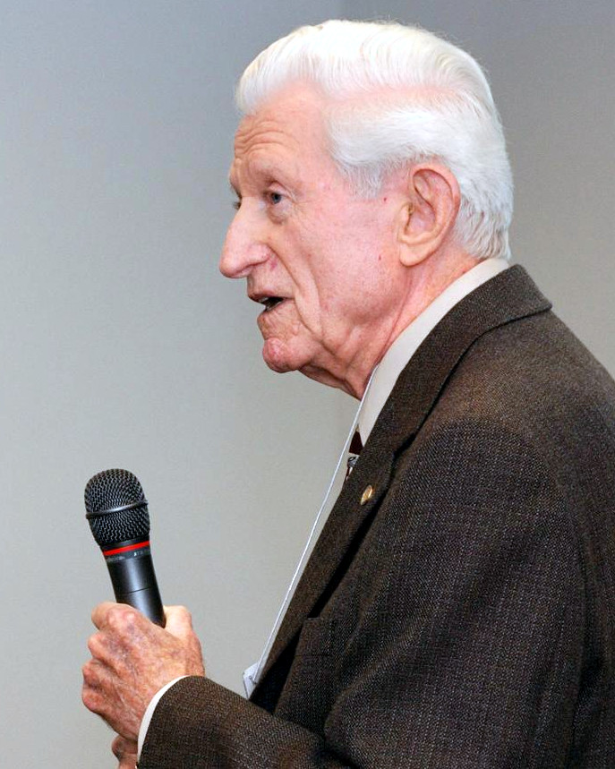
Amdahl’s Law (1967)
The maximum speedup you can achieve is limited by the time spent in the serial portion of a code
Amdahl, Gene M., “Validity of the Single Processor Approach to Achieving Large Scale Computing Capabilities”, AFIPS ‘67 (Spring): Proceedings of the April 18-20, 1967, Spring Joint Coomputer Conference, April 1967, pp. 483-485
Gene Amdahl, 2008 Source: https://commons.wikimedia.org/wiki/File:Amdahl_march_13_2008.jpg
License: CC BY 3.0

Slide 26
Amdahl’s Law (1967)
Serial
Parallel
Increasing parallelization
Serial
Parallel
Serial
Parallel
Serial
Serial
Serial
Execution time

Slide 27
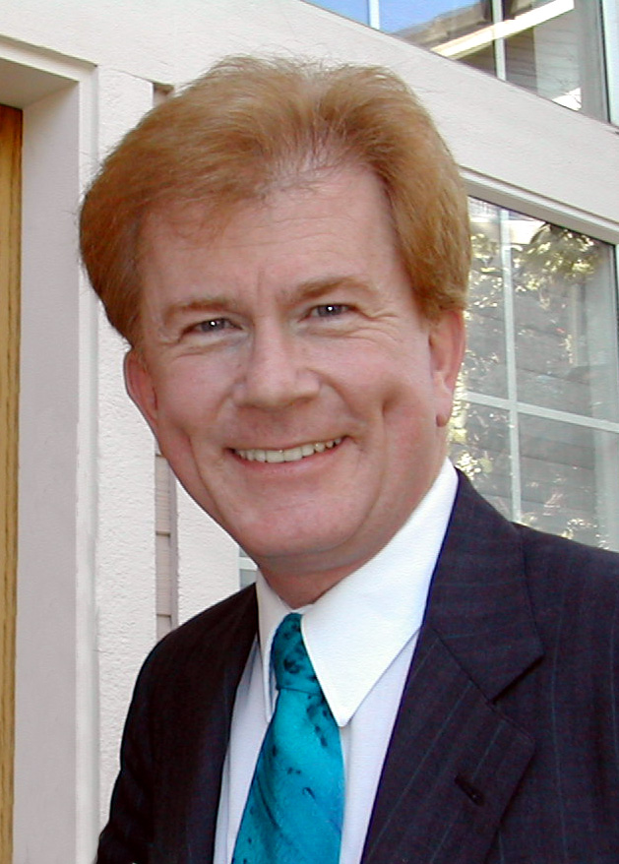
Gustafson’s Law (1988)
Amdahl’s Law applies to problems of a fixed size, using fixed resources. If you increase the job size and the resources,the serial portion tends to stay the same size so you get better overall scale-up than Amdahl’s Law predicts
Gustafson, John L., “Reevaluating Amdal’s Law”, Communications of the ACM, Vol. 31, Issue 5, May, 1998, pp. 532-533
source: https://commons.wikimedia.org/wiki/File:John_L_Gustafson_CEO.jpg
License: CC-BY-SA 3.0
Notes:
My paraphrasing of the law, so inaccuracies of the paraphrasing are all mine.

Slide 28
4 Laws of HPC Conclusion
The “free ride” to better performance that Moore’s Law & Dennard scaling proved from the 1960s to 2005/2006 is now over. Moore’s Law is still applicable, so processors are still adding more performance and getting more efficient. That increased performance is now coming from adding more cores to a single processor (and larger vector registers), requiring parallel computing to take advantage of the power provided by newer processors.

Slide 29
Memory Architectures
Symmetric multiprocessing (SMP)*
Non-Uniform Memory Access (NUMA) *
Distributed memory
* Both symmetric multiprocessing and non-uniform memory access are types of “shared memory processing,” which is also known as “SMP”, which leads confusion and nonsensical, but true statements like “ All SMP is SMP, but not all SMP is SMP!”
Notes:
Understanding memory architectures is important because the different parallelization techniques and overall performance of a processor are largely dictated by the memory architecture: Threads can only be used on shared-memory systems, and since internal processor speeds are so much faster than memory access speeds, anything you can do to speed up memory performance will have a noticeable impact on performance

Slide 30
Memory architectures
Single-processor w/ off-board memory controller
Pros:
Simplest possible design
No competition for memory bandwidth
No scaling, no problems!
RAM
Memory Controller
CPU

Slide 31
Memory architectures
CPU
Symmetric Multiprocessing
Pros:
Still a relatively simple design
Cheap
Cons:
Multiple processors competing for the same memory controller bandwidth
Performance doesn’t scale well - as more processors are added, the effective bandwidth to each one decreases
RAM
Memory Controller
CPU
CPU
CPU

Slide 32
Memory architectures
CPU
Non-Uniform Memory Access (NUMA)
Pros:
Less competition for memory bandwidth
Scales better
Cons:
More complicated design
More components = more expensive
Accessing the RAM on another processor is considerably slower than accessing the local RAM
Care must be taken to minimize how often processor needs to access the RAM of another CPU to take advantage of the architecture
RAM
RAM
RAM
Memory Controller
Memory Controller
Memory Controller
CPU
CPU
CPU
Notes:
Don’t worry too much about whether or not the processors talked to each other, or the memory controllers talked to each other - I’m not a hardware expert, and different vendors probably tried different designs over the years. The important thing to remember is that the memory access was non-uniform

Slide 33
Memory architectures
CPU
Cache-coherent Non-Uniform Memory Access (ccNUMA or cc-NUMA)
Pros:
Scales even better by using local caches to reduce the frequency of accessing distant RAM
Cons:
Even more complicated
Even more complexity means even more expensive
Limited scalability
RAM
RAM
RAM
Memory Controller
Memory Controller
Memory Controller
CPU
CPU
CPU
Notes:
Don’t worry too much about exactly whether the cache was located on the CPU or the memory controller - I’m not a hardware expert, and different vendors probably tried different designs over the years. The important thing to remember is that coherent caches were necessary to really take advantage of caching on NUMA processors - you really can’t have caches on NUMA systems without it.

Slide 34
Modern processors memory architecture
RAM
RAM
Core
Core
Core
Core
Core
Core
Core
Core
Core
Core
MC
Core
MC
Core
MC
MC
Core
MC
Core
Core
Core
Core
Core
Core
Core
Core
Core
Core
MC
Core
MC
Core
MC
Core
MC
Core
Notes:
This is a simplified illustration of a modern processor, and may not be the best! It’s meant to show the memory layers of memory architectures. At the lowest level, you have several cores that may share a memory controller and a level-2 cache. Since all the cores access RAM through the same memory controller, this would be symmetric multiprocessing at this level. As you Zoom out, there’s additional levels of ccNUMA.

Slide 35
Memory Architectures
Distributed Memory Architecture
“Shared nothing” architecture
Processes on different nodes share their work with each other my message passing
Pros:
Cheap and simple compared to the exotic architectures of previous supercomputer designs
Takes advantage of the economies of scale provided by using commodity hardware
Scales out relatively easily and cheaply
Scales much larger than shared-memory systems (2048 cores vs. millins of cores)
Cons:
Message-passing less efficient than using shared-memory
Programming is more complicated than for shared-memory architectures
Compute node
RAM
Compute node
RAM
Compute node
Network
RAM
Compute node
RAM
Compute node
RAM

Slide 36
The largest SMP systems
Hecate
Princeton University
SGI Altix UV 1000
256 8-core processors (1536 cores)
12.1 TB RAM
Blacklight
Pittsburgh Supercomputing Center
SGI Altix UV 1000
512 8-core processors (4096 cores)
32 TB RAM
Office of Information Technology, Princeton University, Office of Information Technology, 2011-12 Annual Report, p. 35, https://oit.princeton.edu/document/8
Chiachia, Ken, “Blacklight Goes to Work at PSC”, November 10, 2010, https://www.psc.edu/blacklight-goes-to-work-at-the-pittsburgh-supercomputing-center/

Slide 37
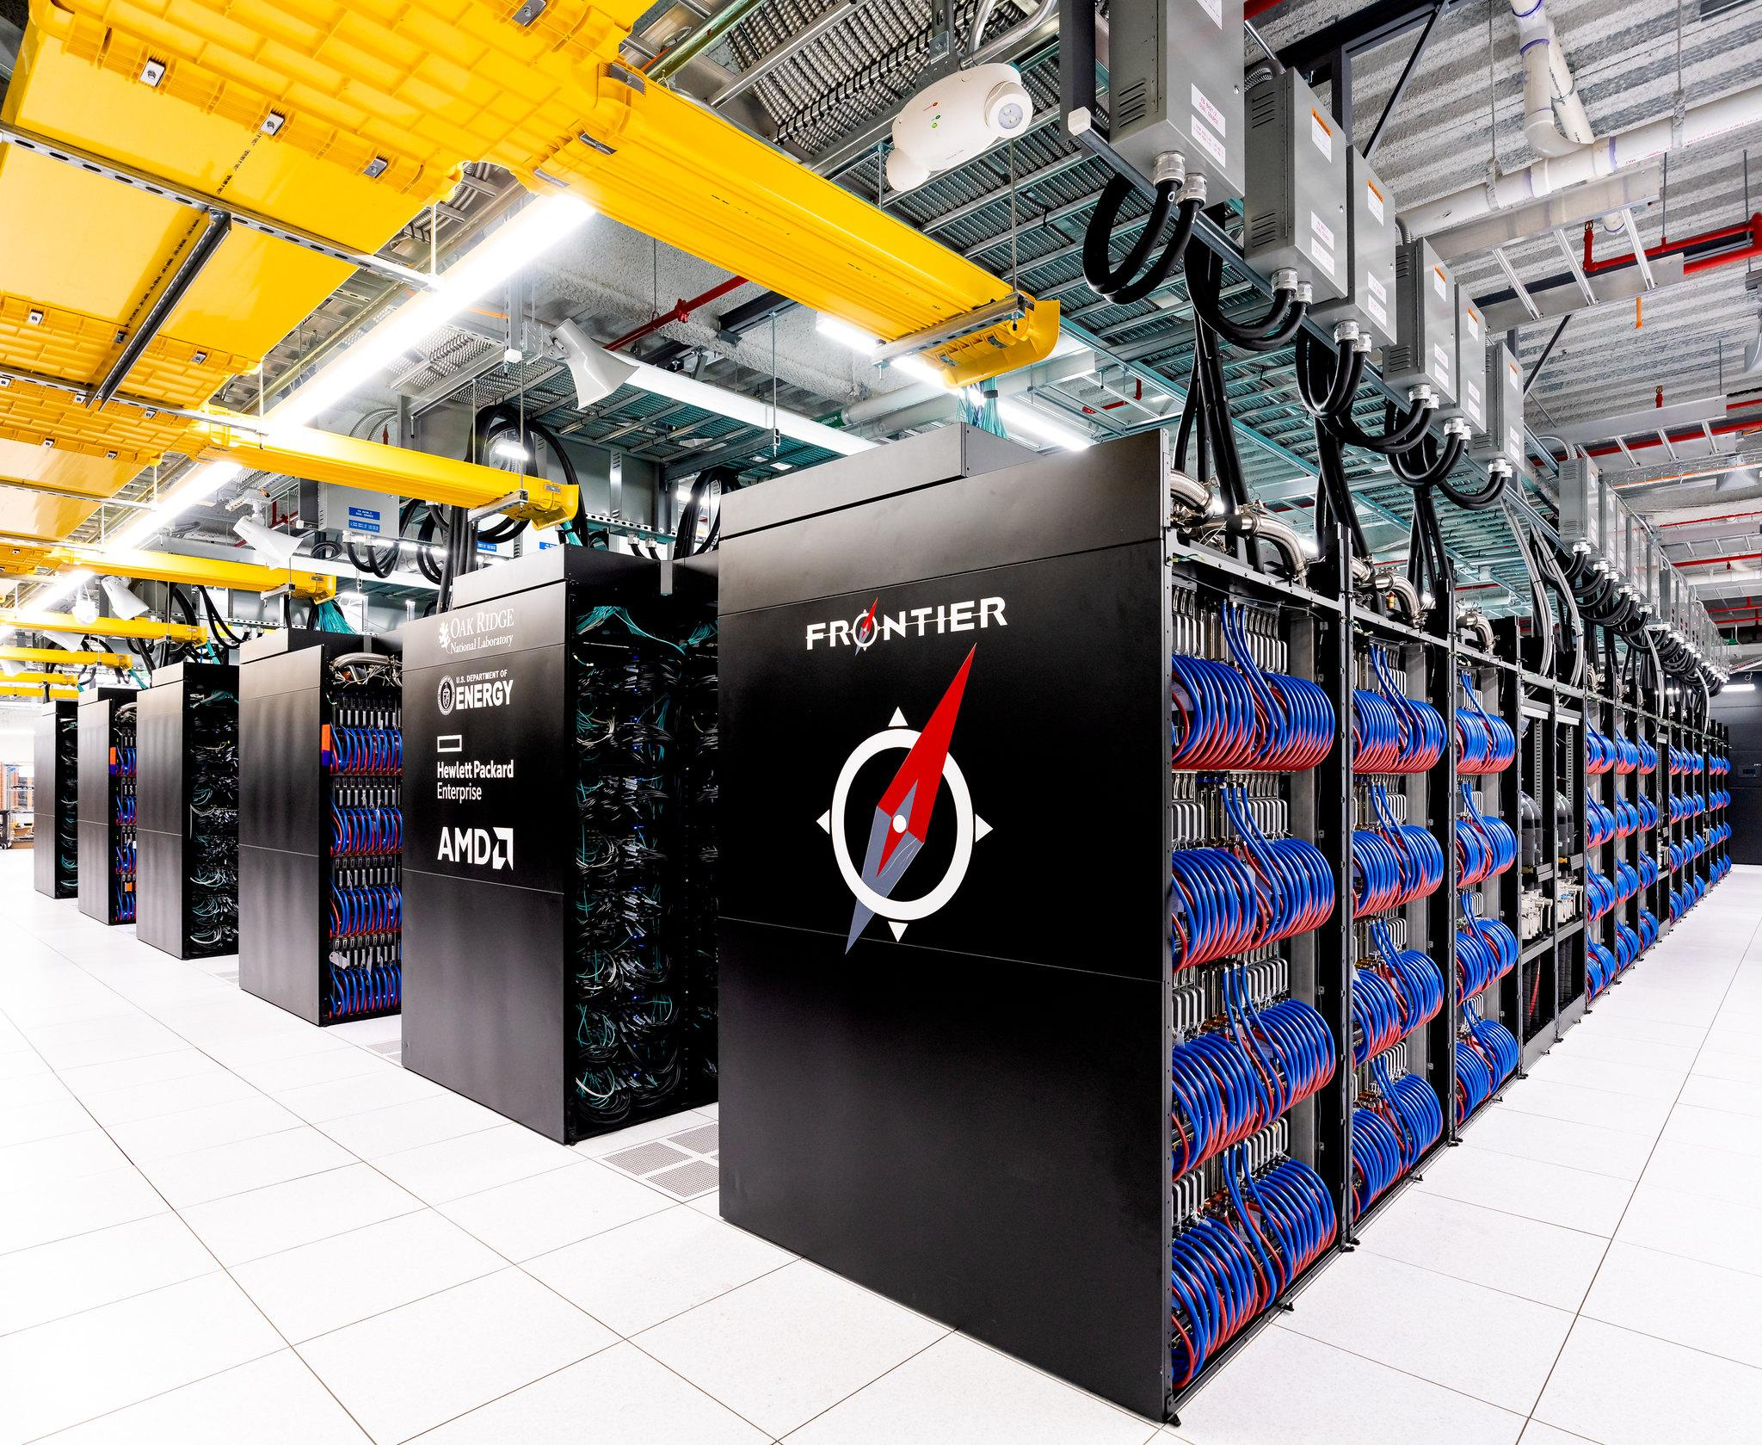
Largest distributed memory system
Frontier
Oak Ridge Leadership Computing Facility (OLCF)
HPE Cray EX
9,402 nodes
601,728 AMD EPYC CPU cores
37,608 AMD Instinct MI250 GPUs
Scaling limited by power consumption
source: https://www.flickr.com/photos/olcf/52117623843/in/album-72177720299483343/
License: CC-BY-2.0
Notes:
For scaling this scaling discussion, the important number is the 601,728 CPU cores, since each one of those can be a single MPI rank or thread, which is what we are currently talking about for scaling. Those threads or MPI ranks would then orchestrate the work performed on the GPUs, which are essentially very large vector processors. Those 601,728 cores is much greater than the 4000 cores of the Blacklight system, which to my knowledge is the largest shared memory system ever. As far as I know, the only limitation to Frontier’s scaling is power consumption. When we broke the petascale barrier in 2008 with Roadrunner, it was stated that it was impractical to go beyond 20 MW of power consumption for a cluster. Frontier’s power consumption was estimated to be around 34 MW, and actual measured runs used about 28 MW.

Slide 38
Why is memory architecture important?
Dictates what programming methodology that will be used (threads vs. message-passing)
May be an important factor in hardware purchasing
How you optimize your programs may vary depending on the memory architecture of the target system

Slide 39
Processes vs. Threads
Processes:
“Heavyweight”
Each process has its own resources and memory address space that are not shared with other processes
Can be used with shared- memory or distributed-memory architectures
More work for parallel programming
Threads:
“Lightweight”
A thread exists within a process
All the threads within a process share the same resources and memory address space.
Can only be used with shared-memory architectures
Simplifies parallel programming
Notes:
Threads are considered lightweight because once the parent process is started, creating a new thread takes less effort than creating another process, since there’s no need to allocate the thread its own memory space, and other resources.

Slide 40
Processes vs. Threads
Processes
Process
Threads
Allocated
Memory
Allocated
Memory
Allocated
Memory
Allocated
Memory
Other resources
Other resources
Other resources
Other resources

Slide 41
Scalar processing
Vector Processing
1
5
18
6
6
2
4
11
7
4
3
9
29
13
10
1 + 1 = 2
Notes:
Scalar processing - applying a single instruction to a single set of data
Vector processing - applying the same instructions to multiple sets of data
Vector processing can provide enormous speed up, but is not suited to sections of code where there is any kind of branching, since the condition checking slows down the performance. GPU accelerators are essentially just massive vector processors, and most of the FLOPS performance in newer cores has come from increasing the size of the vector registers so that more numbers can be operated on in a single vector instruction.
In the early days of supercomputing (crays and such) the exotic processors often were vector processors. Then the performance of general-purpose processors improved to the point that the cost and limited applications of vector processors was no longer practical, they died our. With the end of Dennard Scaling in the early mid-2000s, vector processing is making a comeback, both in the form of GPUs and general-purpose cores like Intel Xeon and AMD EPYC processors which have Vector processing units that implement the AVX instruction sets. The Fugaku supercomputer uses 64-bit Arm-based Fujitsu processors with vector extensions.

Slide 42
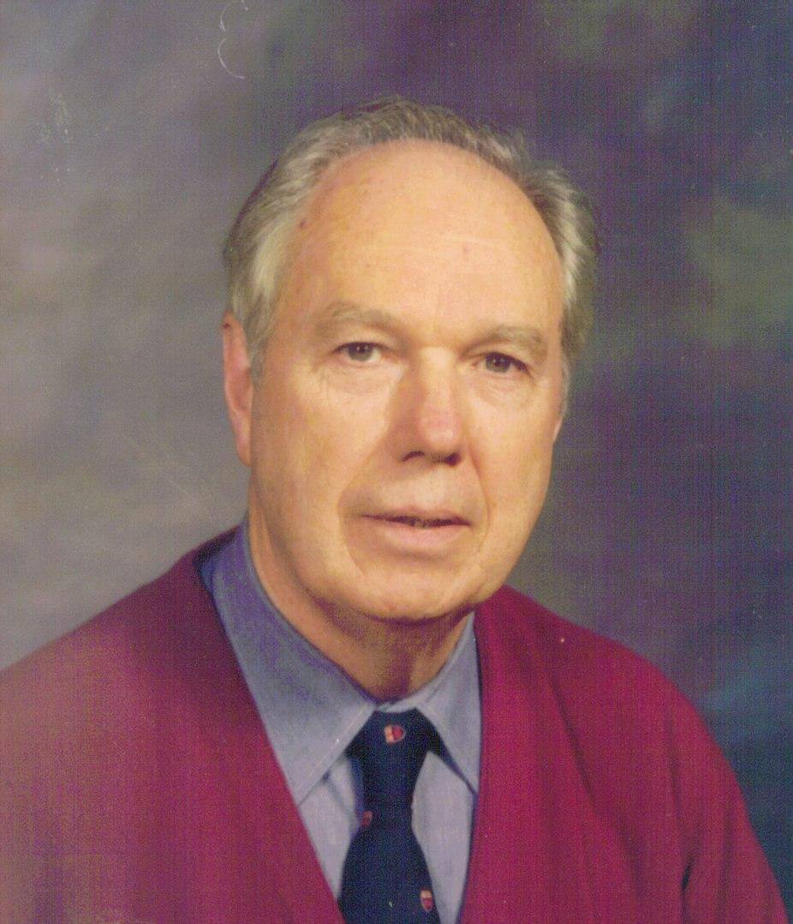
Flynn’s Taxonomy (1966)
Single Instruction, Single Data (SISD) | Multiple Instruction, Single Data (MISD)
Single Instruction,Multiple Data (SIMD) | Multiple Instruction, Multiple Data (MIMD)
Michael J Flynn By Michael Flynn - http://arith.stanford.edu/~flynn/jpeg/flynn600.JPG, CC BY-SA 3.0, https://commons.wikimedia.org/w/index.php?curid=4198900
Notes:
SISD - Scalar processors - traditional computer processing SIMD - Vector processors - specialized vector processors of old supercomputers, and even some modern ones (K computer), GPUs, AVX
instructions in modern processors
MIMD - Rare - only used in fault-tolerant systems: Examples: redundant computer systems used in space missions, etc.
MIMD - Modern parallel computing. Each MPI process (rank) is a separate process (multiple instructions) operating on it’s own set of data.

Slide 43

Tightly-coupled vs. embarrassingly parallel
Tightly-coupled:
Frequent communication between processes throughout the calculations
Harder to decompose and program
Very sensitive to network bandwidth and latency
Embarrassingly parallel:
Limited communications throughout calculations
“Embarrassingly” easy to decompose and program
Not as sensitive to network bandwidth and latency

Slide 44
Suitability for parallelization
In order for something to be parallelizable, each iteration of a calculation must be “data-independent” of the other iterations. This means that the data used in the calculation of one iteration cannot be the result of another iteration.
A(i) = B(i) + C(i)
A(i) = A(i-1) + 1
✔
✘

Slide 45
Programming Techniques for Parallelization
Shared Memory:
Techniques
Threads
Message-Passing
Thread Examples
OpenMP
Distributed Memory:
Techniques:
Message-Passing
Message-passing examples:
Message-Passing Interface (MPI)
Parallel Virtual Machine (PVM)
In reality, multiple parallelization techniques are used together for maximum performance: OpenMP within a node, MPI for internode communications, and CUDA or similar for using GPUs for vector processing.
Notes:
MPI is an open-standard that has been around since the 1990s to standardize the API to the MPI libraries that different Unix vendors had created over the years. It simplifies the programming necessary for HPC applications to coordinate and communicate with each other.
PVM is largely a dead technology, but I include it here for educational purposes. It’s purpose is similar to MPI, but it relied on sending packed buffers between processes, which required extra programming steps to pack the buffers on the sender, and then unpack the buffers on the receiver - not very programmer friendly!
MPI and PVM are implemented as libraries. MPI implementations are available for many different languages: C, C++, Fortran, Python, etc. Any compiler that understands those languages can use use MPI.
OpenMP is the most common threading technique for HPC. It is implemented as an extension of the languages, so the compilers must understand OpenMP is the most common threading model used for HPC. It is implemented as “pragmas” that extend a language, so the compiler used to compile OpenMP programs must support OpenMP.
In reality, most MPI implementations can detect when communication is going on between processes on the same node and use shared-memory in those situations, so there’s only a small performance penalty, if any, for using MPI within a node. To maximize performance, it’s not uncommon to use “hybrid” programming where OpenMP is used within a node, and MPI is used internode communication.
While there are a number of ways for different programs or threads to communicate, both MPI and OpenMP act as abstractions layers that handle the details of these communications to make it easier for the scientific programmer to do their job, and they are also optimized for the work/communications patterns used by these jobs.

Slide 46
Communications: scatter/gather example
Sum the numbers 1 - 10, using 5 processes
Process 1: 1 + 6 = 7
Process 1: Sum = 55
Process 1: 2 + 7 = 9
Process 1: Sum = 55
Process 1: 3 + 8 = 11
Sum = 55
Process 1: Sum = 55
Process 1: 4 + 9 = 13
Process 1: Sum = 55
Process 1: 5 + 10 = 15
Process 1: Sum = 55
Gather Operation
Scatter Operation
Notes:
I think this simple example is a great example of how HPC works. It demonstrates decomposing a task into smaller subtasks, and using collective operations (scatter and gather in this case) to work as a group to sum up all the subtotals, and then redistribute that answer to all the other nodes. Unfortunately, this example leaves out a lot of important details…

Slide 47
Communications: scatter/gather example
Sum the numbers 1 - 10, using 5 processes
Process 1: 1 + 6 = 7
Process 1
Process 2: 7 + 9 = 16
Process 2: 2 + 7 = 9
Process 2
Process 3: 16 + 24 = 40
Process 3: 40 + 15 = 55
Process 3: 3 + 8 = 11
Process 3: 11 + 13 = 24
Process 4: 4 + 9 = 13
process 4
Process 5: 5 + 10 = 15
Process 5
Gather Operation
Scatter Operation
Notes:
This slide provides a better illustration of how communications for scatter and gather operations work. It shows the “fan-in” pattern used in the gather operation, and the “fan-out” operation used in the scatter operation. However, even this is simplified so I can fit it on one slide legibly (and because my slide animation skills stink!) - In the gather operation, I’m overlapping communication and adding in a single step. In reality, process one would communicate with Process 2, and then process 2 would do the addition, etc. In the scatter operation, Process 3 would communicate with only Process 2, and then in the next step, as process 2 is communication with process 1, it would communicate with Process 4. For the final step, either Process 2,3, or 1 would communicate with Process 5? Does everyone understand that? Even with threads, a similar pattern would be used for the gather operation, since only one thread can write to a memory address at time, but for read operations, multiple threads can read the same address at the same time.

Slide 48
Communications: Diminishing returns
linear, non-ideal scaling
Ideal, linear scaling
negative scaling
Performance
(FLOPS)
diminishing returns region
inflection point
linear region
Number of cores
Notes:
Ideally we want our job to scale perfectly linearly - that is if we double the number of cores being used, our job should take exactly half the time to run. In reality, that’s rarely, if ever, going to happen. Once different processes have to communicate with each other, there’s always going to be a performance cost for that. Ideally, that will be minimal, and the job will still scale largely linearly, if not at a perfect 1:1, as shown by the green line in this graph. The red line, which I’ve hand-drawn in (obviously) show what you may get with some codes: It scales line linearly up to a point. Then you hit an inflection point where communications starts to hinder performance and you enter a regions of diminishing returns as you scale to more and cores. You may eventually reach a point where the performance curve flattens out and or even go negative. Before doing production runs on a new code, scaling studies should be done by varying the number of cores for a fixed problem size and graphing the results. It’s okay to run in a region of diminishing returns, but you don’t want to go too far into that region or hit a point of no scaling or negative scaling. All jobs should eventually hit an inflection point where scaling starts to diminish, but better networking and algorithm design can work to push that point further down the horizontal axis.

Slide 49
Communications: Diminishing returns
linear region
inflection point
diminishing returns region
negative scaling
Execution Time
linear, non-ideal scaling
Ideal, linear scaling
Number of cores
Notes:
In practice, when doing a scaling study, you probably won’t know exactly how many FLOPS it takes to complete your task, so you’ll most likely be measuring execution time. Since execution time is inversely proportional to performance, the resulting graph for a scaling study using execution time would be inverted compared to the previous graph, as this one shows. You can see, the trends of linear scaling, inflection point, diminishing returns and negative scaling would still be evident.

Slide 50
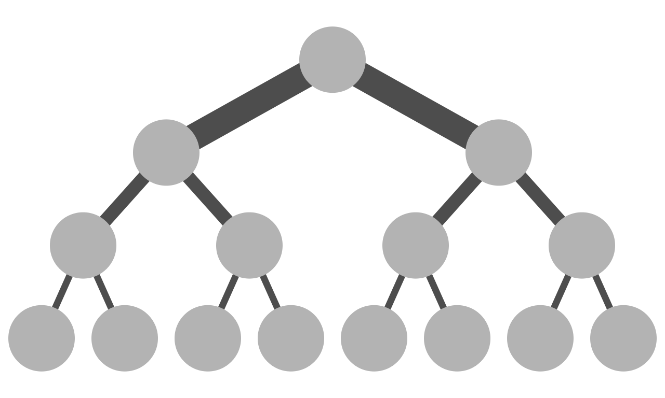
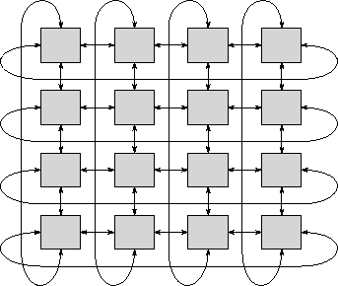
Network topologies
Fat-tree network
Source: https://en.wikipedia.org/wiki/Fat_tree#/media/File:Fat_tree_network.svg
License: public domain
2-D torus network
source: Foster, Ian, “Designing and Building Parallel Programs, https://www.mcs.anl.gov/~itf/dbpp/
Notes:
There is a separate lecture on networking, so I don’t want to discuss networking too much here. Suffice it to say that with the level of communication that goes in a parallel job, and the sensitivity to latency and bandwidth of these jobs, the star topology of your typical datacenter network doesn’t scale to HPC. Various network topologies have been used over the years, with these two being the most common. A 2-d torus network is shown here because it’s much easier to visualize and understand than a torus network with higher dimensions. This network is called a torus because if you were to draw it with the ends wrapped around each other differently, you’d get a donut-shape, which is also known as a torus. If the ends didn’t wrap around like that, you’d have a “mesh” network. The IBM Blue Genes had a flexible mesh network that could be used as a mesh or torus, with the Blue Gene /Q having a 5-D torus. The K-Computer in Japan used a 6-D torus known as the “tofu” network. Mesh networks are best where most of the communications are limited to “nearest neighbors” such as particle-in-cell applications. Mesh networks are typically included in the design of more exotic system. The Fat-tree topology is typically used for Infiniband networks, and is more general purpose, and simpler to set up. It’s common in the Top500 systems as well as smaller , general purpose clusters.

Slide 51
Summary
Defined what HPC is and why we need it
The 4 laws of HPC
Processor and cluster memory architecture
Vector processors
Code suitability parallelizing techniques
Communications/scalability

Slide 52
Questions?

