Slide 1


Designing an HPC Cluster
Prentice Bisbal
Senior HPC Engineer
Computational Sciences Department
Princeton Plasma Physics Laboratory
This document is a result of work by volunteer LCI instructors and is licensed under CC BY-NC 4.0 (https://creativecommons.org/licenses/by-nc/4.0/).
Notes:
‹#›

Slide 2
Cluster design guidelines
An HPC cluster is a system, and must be designed using a holistic approach that takes this into account
The goal is to get as much performance as your budget will allow, not the most hardware
The cluster should be as balanced as possible - fast processors with slow networking or storage are not useful!

Slide 3
Linux Cluster Architecture
External
IMPI network
Master Node
RAID
LAN
Data Transfer Node (DTN)
Private
IPMI Network
Login Node
GPU
GPU
Compute Node
GPU
GPU
Compute Node
Private
Ethernet Network
GPU
GPU
Compute Node
Compute Node
cluster
security
boundary
Compute Node
Private Infiniband Network
Parallel Storage
(scratch)
Central shared parallel storage
Notes:
The architecture shown has been the standard for HPC clusters for about 20 years now - rackmount x86 servers based on COTS hardware connected with Infiniband, and a high-performance parallel filesystem.
The 3 networks shows are not either/or - each serves a separate purpose on a cluster.
The IB network provides the high-bandwidth, low-latency communications needed for parallel processes on different nodes
The private Ethernet network is sometimes referred to as the “management” network, since basic network services like DHCP/PXE/TFTP for provisioning, and Slurm, SSH, NTP, and mail during cluster operation. On more recent systems with newer IB cards that I’ve bought, those IB cards can do DHCP, etc., and IB speeds have gotten ridiculously high lately, so this network may not be needed much anymore.
The private IPMI network is for dedicated IPMI interfaces, like the higher-end iDRAC interfaces on Dell servers. Those interfaces are more reliable than shared ones, and allow you to watch the cluster boot, which shared IPMI interfaces cannot do. IPMI is needed for remote management, and to allow the scheduler to power-off/power-on nodes if you choose to use that feature. It’s also much easier and quicker to start a cluster after a shutdown with a some simple IPMI commands and shell scripting.
Notice that the master rnode’s own IPMI interface is accessible outside the cluster. This allows you to restart and access the master node, ad therefore the rest of the cluster, remotely after some kind of shutdown event.
The dotted line indicates the cluster’s security boundary. Nodes with network connections that cross that line need to have all the usual security measures you’d implement on non-compute nodes: iptables, SElinux, etc. On the nodes entirely within that boundary (the compute nodes), you don’t want to have those services enables, as they create overhead which can hurt performance.
‹#›

Slide 4
Head node
Hardware:
Redundant power supplies for availability
Redundant (RAID-1) system disks
RAID-5 or -6 array for home directories and /usr/local
InfiniBand Host Channel Adapter (HCA)
Dedicated IPMI Interface
Ethernet NIC for cluster private Ethernet network
Ethernet NIC for public Ethernet network
Processor(s) not important and need not match the rest of the cluster
Software/Services
DHCP server
TFTP server
HTTP server (for Kickstart)
NTP server for cluster
LDAP replica for cluster
Mail relay host for cluster
Scheduler (slurmctld for Slurm, etc.)
IB Subnet Manager (opensm)
Other IB services
NFS server for /home and /usr/local
Parallel filesystem client
log server/relay for cluster
IPtables
SELinux
SSSD
sshd

Slide 5
Login node
Hardware:
Redundant power supplies for availability
May need uultiple power supplies to support GPUs
Redundant (RAID-1) system disks
Same processors as compute nodes
Same GPUs as compute nodes, if applicable
InfiniBand HCA
Ethernet NIC for cluster private network
Ethernet NIC for public network
Dedicated IPMI interface
Software/Services
NFS Client for /home and /usr/local
IB services
sshd
Parallel filesystem client
NTP client
Arbiter or similar to prevent users from overusing resources/running jobs on login node
Iptables
SELinux
NTP client
SSSD
Notes:
Your login node hardware should be pretty robust to maximize uptime: redundant system disks, redundant power supplies, etc. It should also have the same processors and GPUs so that users can compile and test/debug code without having to wait for access to a compute node (within reason).

Slide 6
Data Transfer node
Hardware:
Redundant power supplies
RAID-1 system disks
IB HCA
Ethernet NIC for cluster private network
High-bandwidth Ethernet NIC for public network
Dedicated IPMI interface
Processors not important, and do not need to match the rest of cluster
Software:
Globus or other high-speed transfer tool
IB services
IPtables
SELinux
Note: be careful IPtables and SELinux rules don’t impact transfer speed!
sshd
SSSD
Notes:
A data transfer node is needed for 2 reasons:
You don’t want users to do large file transfers to the login node, as it will impact responsiveness for other users
Globus is a much faster way to move data than SSH/SCP

Slide 7
Compute nodes
Hardware:
No redundant power supplies
No redundant disks
Even the smallest hard drives are more than big enough for a compute node
May need multiple power supplies to support GPUs
IB HCA
Ethernet NIC for cluster private Ethernet network
Dedicated IPMI interface
Software:
Cluster “client” daemon (slurmd)
NFS client for /home, /usr/local, etc.
Parallel filesystem client
NTP
SSSD
SSHD
disable swap

Slide 8
Why Infiniband?
Short Answer:
Higher bandwidth and lower latency
Longer answer:
Kernel bypass - no context switching
Crossbar switching (circuit-based networking)
Better bisectional bandwidth
Lower overhead protocol

Slide 9
Infiniband: Crossbar switches
Host 1
Host 2
Host 3
Host 4
Host 5
Host 6
Host 1
Host 2
Host 3
Host 4
Host 5
Host 6
Notes:
In this simple diagram, every node can connect to every other node, but none of them are connected right now.

Slide 10
Infiniband: Crossbar switches
Host 1
Host 2
Host 3
Host 4
Host 5
Host 6
Host 1
Host 2
Host 3
Host 4
Host 5
Host 6
Notes:
We now have 3 communication pairs all talking to each other with no competition for bandwidth with the other pairs

Slide 11
Infiniband
For the jobs that aren’t sensitive to network bandwidth and latency, having IB won’t hurt them, but for the jobs that are, not having IB will hurt their performance.
Therefore, it’s better to have Infiniband and not need it, than to need Infiniband and not have it

Slide 12
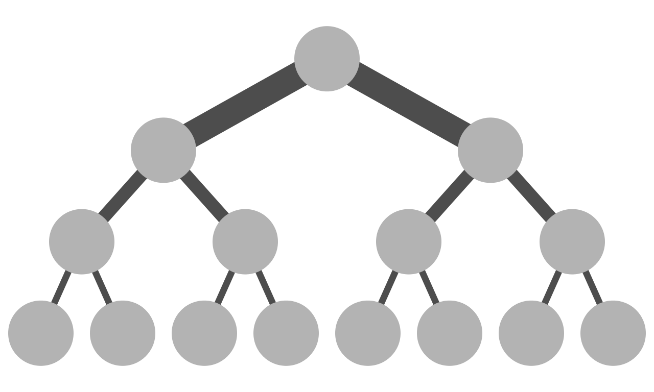
Infiniband: Fat-trees and oversubscription
Fat-tree
practice:
(8-port switches)
2:1 oversubscription
(6-port switches)
Fat-treetheory:
Core
Core
Core
Core
2x links
Leaf
Leaf
Leaf
Leaf
Leaf
Leaf
Leaf
Notes:
Please excuse the different port counts on the switches. I was trying to keep the switches as small as possible while illustrating these concepts, and that’s how the math worked out.
A full fat-tree is also known as “non-blocking”. Whereas if you don’t have a full fat-tree layout, that’s known as oversubscription.

Slide 13
Infiniband hardware
Fixed configuration switches - 40 ports (HDR) or 64 ports (NDR), managed and unmanaged
Modular “director” switches - 512, 1024, and 2048 port capacities, managed
Direct attached copper (DAC) cables - up to 2M in length
Active copper cables (ACC) cables - up to 4M in length
Active Optical Cables (AOC) - 3 - 100 meter lengths
Fibre optic cables - much longer lengths
Infiniband Host Channel Adapters
Splitter cables:
2-way splitters for HDR convert 1 200 Gb/s port into 2x 100 Gb/s ports
2-way splitters for NDR convert 1 400 Gb/s port into 2x 200 Gb/s ports.
4-way splitters for NDR convert 1 400 Gb/s port into 4x 100 Gb/s ports
Copper cables ($100 - $200) are much cheaper than fiber optic (> $1000)
Notes:
Fixed configuration switch are 1U top-of-rack style switches
Managed mean the subnet manager runs on the switch
Since IB switch bandwidth has far outpaced the speed of the PCIe bus. For example, HDR does 200 Gb/s and NDR does 400 Gb/s, but PCIe 3.0 only does about 100 gb/s. and PCIe 4 does only about 200 Gb/s, So you can now get splitter cables that split a single 200 Gb/s HDR port into 2x 100 Gb/s HDR ports referred to as HDR100, and for NDR there are 4-way splitter cables to turn a single 400 Gb/s NDR port into 4 100 Gb/s NDR100 ports.
To save money, copper can be used within a rack, and use AOC cables from the leaf switches to the core switches

Slide 14
InfiniBand design decisions/specifications
Use fixed configuration switches for the core, or use a modular “director” switch(es)?
Copper or Fibre cables between the leaf switches and racks?
Switch ports facing front or back of rack - depends on node design
Airflow in switches - depends on whether ports face front or back - make sure this is correct!
Full non-blocking or oversubscription?
Notes:
Modular director switches are expensive, but so are IB cables, so at a certain cluster size, it may be cheaper to go with a modular director switch than a bunch of core switches.
Fiber cables are great because they take up a lot less space in a the rack, and are more flexible and easier to run, but copper cables are much cheaper.
Non-blocking is desirable, but it can be expensive. Going with 2:1 oversubscription can provide significant savings with only a modest performance hit. Going to from 2:1 to 3:1 doesn’t provide much hardware savings, based on my experience.

Slide 15
Selecting processors
More cores != better performance
Higher base frequency != better performance
Hyperthreading shouldn’t provide any benefit for HPC workloads
Use objective metrics to measure performance:
High Performance LINPACK (HPL, https://netlib.org/benchmark/hpl/)
High-Performance Conjugate Gradient (HPCG, https://www.hpcg-benchmark.org/)
STREAM (https://www.cs.virginia.edu/stream)
Several actual applications that you expect to run on your cluster
Criteria should be performance/dollar or performance/W
Measure sustained performance

Slide 16
Selecting Processors
Go with x86_64 processors (Intel or AMD)
POWER and ARM are interesting, but…
Limited support for precompiled binaries
Limited user community which means…
Less probability that someone else encounters a bug before you do
Smaller communities to ask for help
Processor specs are always changing as new chips come on the market.

Slide 17
Processor selection criteria
Get the most performance, not the most hardware
More cores != more performance
Most of the performance comes from Advanced Vector Extensions (AVX):
AVX
AVX2
AVX512 therefore, larger AVX registers -> better performance

Slide 18
HPL Benchmark
Can give reliable measure of actual sustained GFLOPS of performance
Can tackle some time and practice to learn how to compile optimally and tune for best performance
Can take some time to run with different parameters to get the best possible results
Great for measuring FLOPS/W

Slide 19
How to evaluate processor performance
Calculate theoretical max FLOPS
Use well-known benchmarks
High-Performance LINPACK (HPL)
High-performance Conjugate Gradient (HPCG)
STREAM benchmark
Use applications that will be used on your cluster that represent typical jobs.

Slide 20
Calculating theoretical max flops
Seldom reflects actual performance
Requires research - AVX512 frequency isn’t the same as the base frequency of the processor, and is often hard to find
Need to know how many AVX-512 units per core.
Fused Multiply-Add (FMA) instruction counts as 2 FLOPS
Calculate for double-precision FLOPS
Example: Cascade Lake AP processor:
Theoretical FLOPS:
(512/64) * 2 FLOPS/Hz * 2.3 GHz * 2 * 48 Cores/socket * 2 sockets = 7065 GFLOPS
Measured FLOPS (HPL): 4711.20 GFLOPS

Slide 21
Using your own applications as benchmarks
Must be an application that represents the characteristics of average jobs on your cluster
Must have good, well-known scaling characteristics
Shouldn’t be I/O-bound
Job size should be large enough that runtime is an hour or more on your largest test system

Slide 22
Evaluation systems
Pros:
Allows you to test real hardware
Can access hardware that’s not available for sale yet.
May be sent to your site
Cons:
Usually a single, stand-alone unit
May be only accessible from the Internet
Can’t test scalability across multiple nodes
Can’t test different networking options
Can’t test different storage solutions
May not be able to test large jobs due the difficulty of transferring large datasets to test unit
Limited time to test
May not be the exact processor model(s) you will end up buying

Slide 23
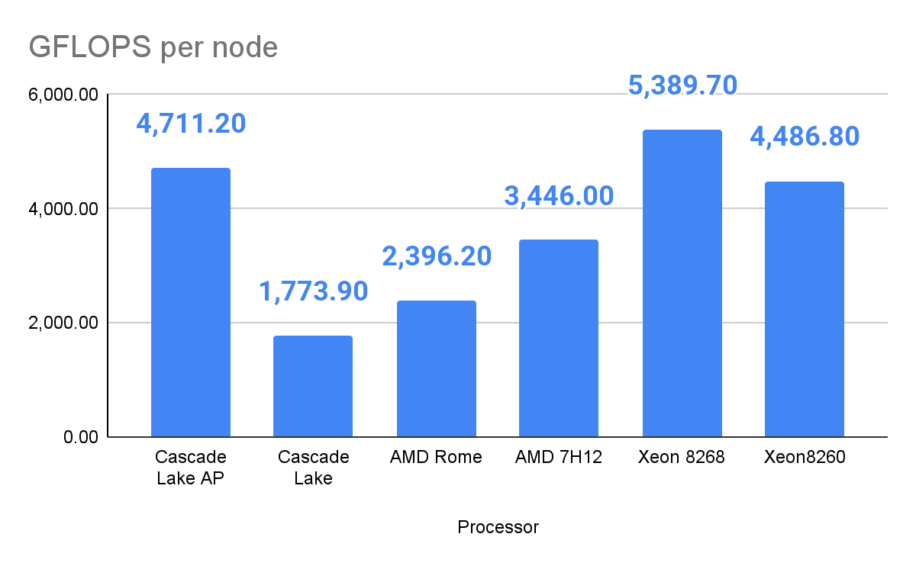
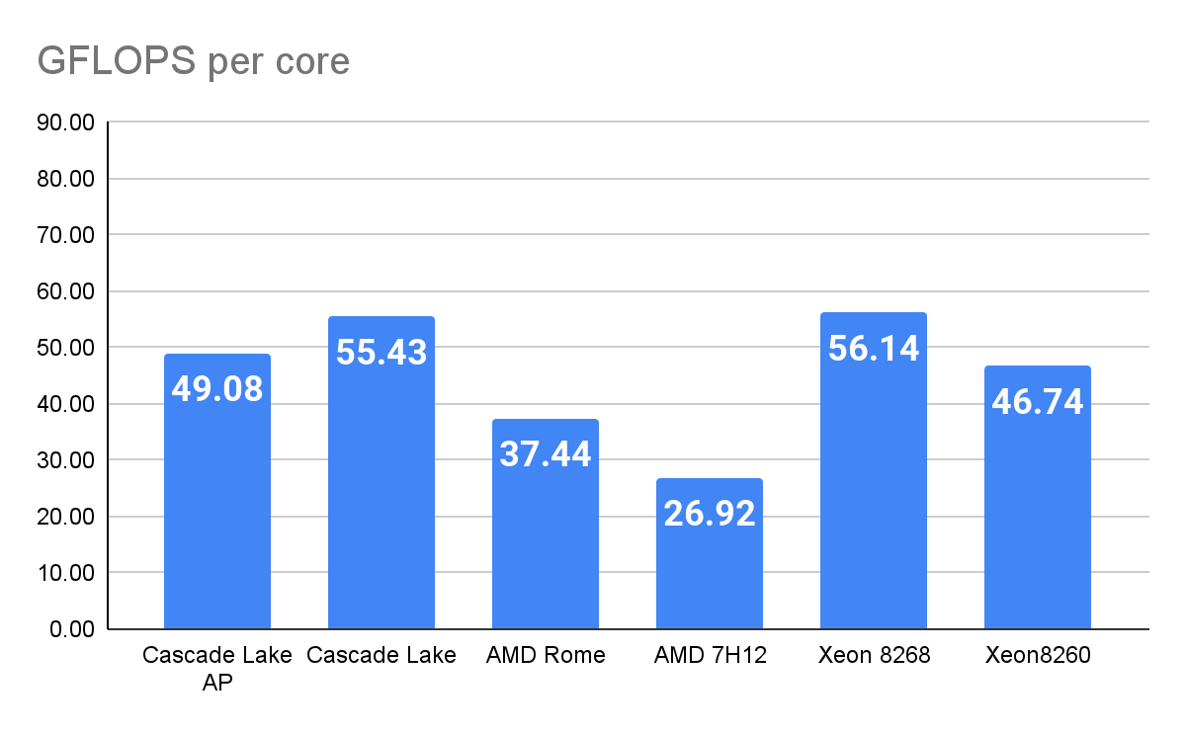
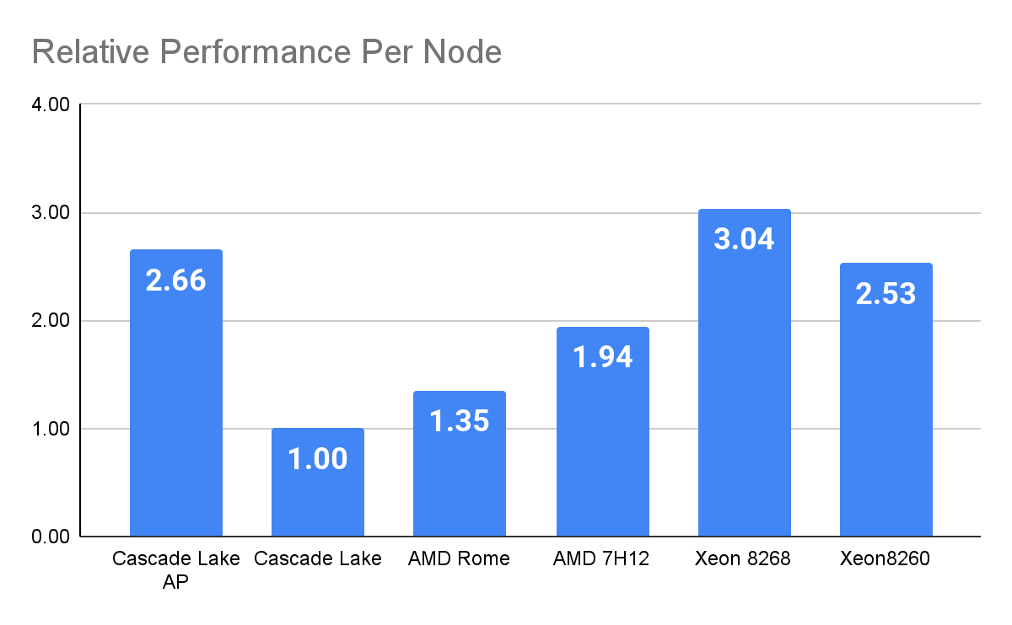
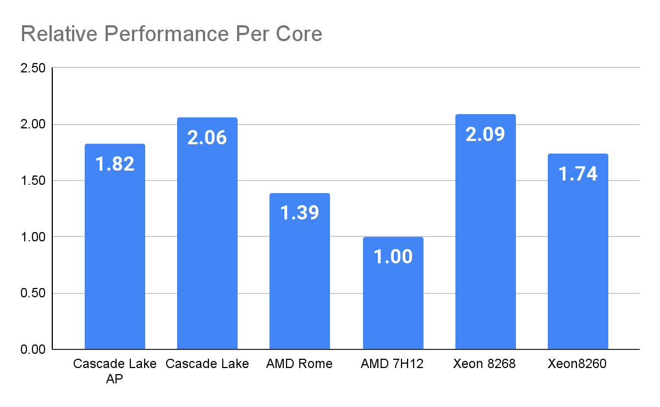
Stellar cluster - HPL results from evaluation systems
Notes:
- Actual data from evaluation of different processors for the Stellar cluster at Princeton University, which was bought to serve 3 different user groups: PU, PPPL, and CIMES.
- PU and PPPL chose the Intel Cascade Lake AP processors, CIMES chose the AMD 7H12 processors
- The AMD 7H12 system had 2 64-core processors for a total of 128 cores.
- The Cascade Lake AP system had 4 24-core processors for a total of 96 cores
- Despite having 25% less cores than the 7H12 processors, the Cascade Lake AP system had 37% more FLOPS.

Slide 24
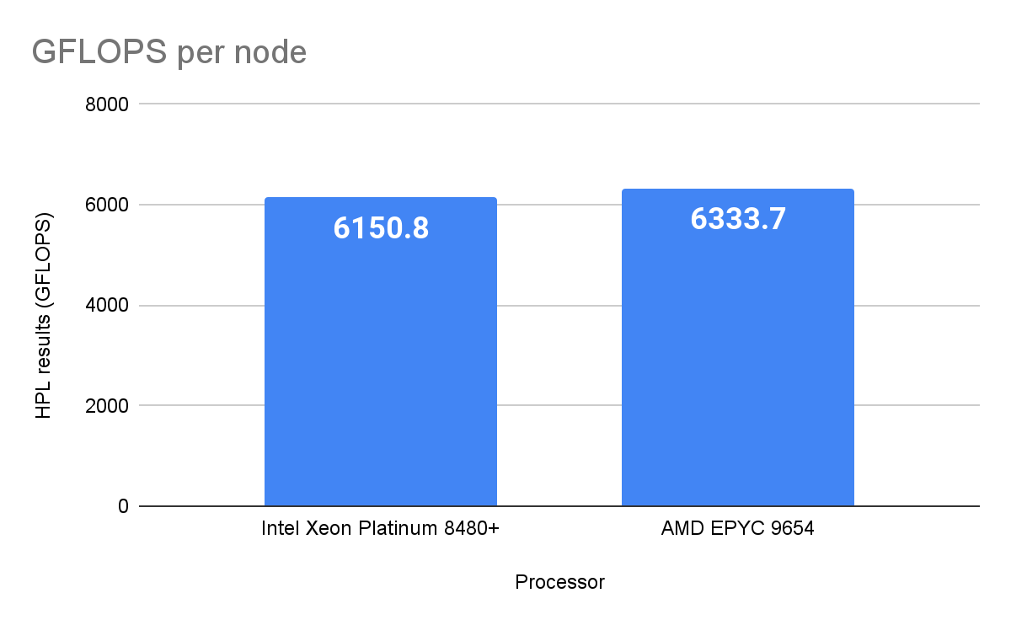
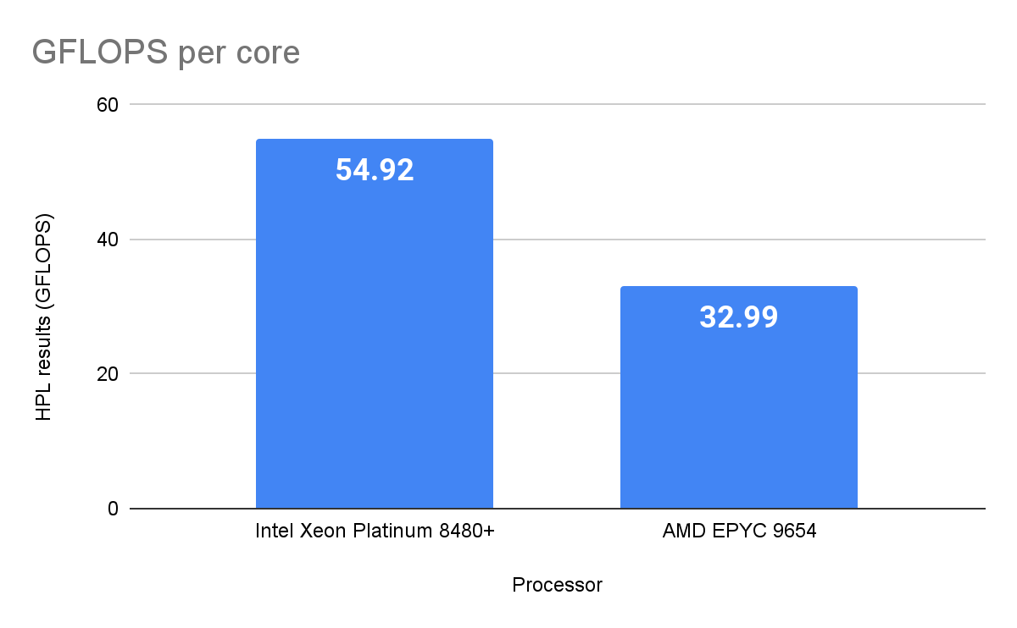
Tiger cluster replacement - HPL on eval. systems
Processor | Cores per socket | Sockets | Total cores | Measured GFLOPS | GFLOPS/Core
Intel Xeon Platinum 8480+ | 56 | 2 | 112 | 6,150.80 | 54.92
AMD EPYC 9654 | 96 | 2 | 192 | 6,333.70 | 32.99

Slide 25
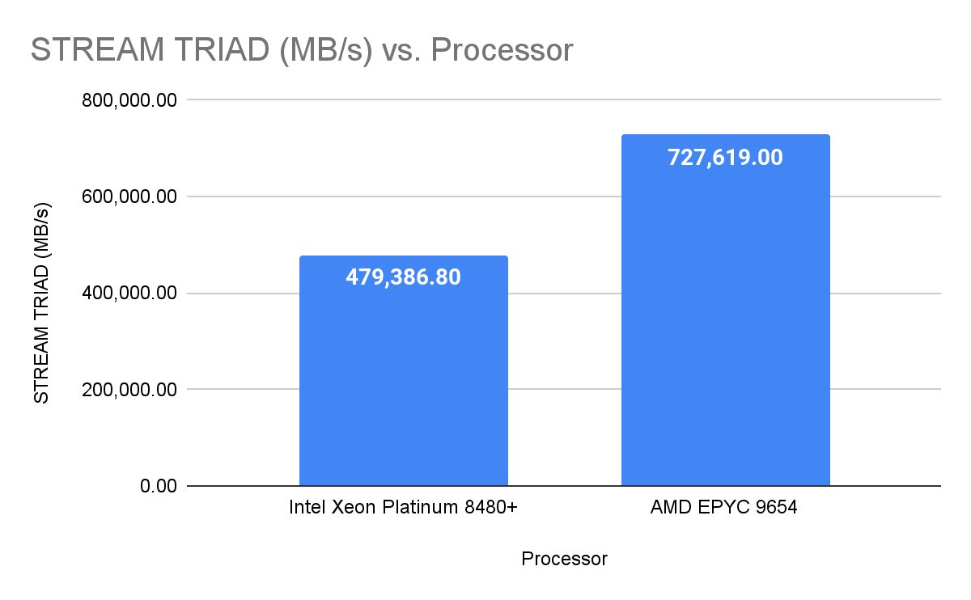
Tiger replacement - STREAM on eval. systems
Processor | STREAM TRIAD (MB/s)
Intel Xeon Platinum 8480+ | 479,386.80
AMD EPYC 9654 | 727,619.00

Slide 26
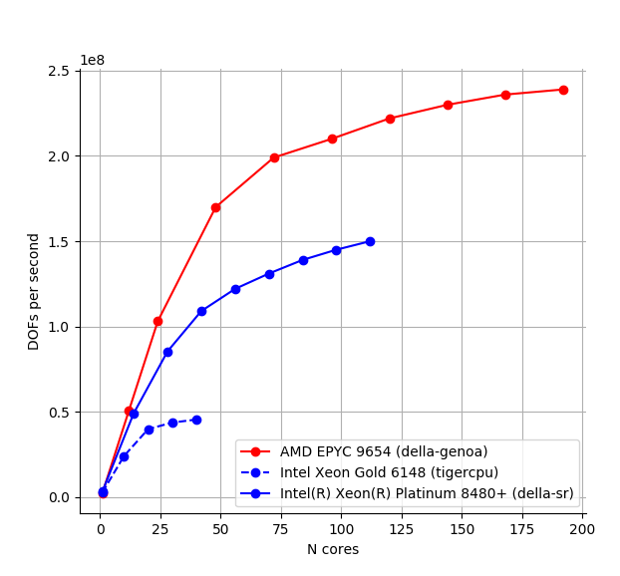
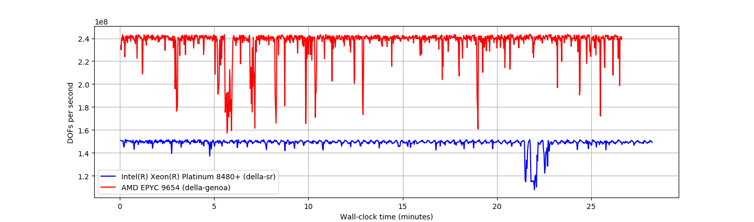
Tiger cluster - User feedback on eval. systems:
“Ran the same benchmark on the Intel Sapphire Rapids chip. On a full node, I'm getting ~1.6x faster performance on the EPYC. I think this makes sense -- 12 memory channels vs 8 and ~3x more cache.
In typical CFD applications I see the memory bandwidth get saturated at lower core counts; are you looking at lower core count / higher frequency chips?”

Slide 27
GPUs
No longer the future of HPC - they are the present
Been around for ~20 years now.
Dominate the Top500 and Green500
Most leadership-class systems are GPU-based
Unfortunately
Many commercial applications still don’t support GPUs or have limited support
Still a lot of laggards who are reluctant to port their codes to GPUs
Still dominated by one vendor - NVIDIA
Less competition -> higher prices and less innovation
What is NVIDIA goes out of business?
GPUs are expensive, but
More powerful than CPUs for many HPC workloads
More energy efficient than CPUs (in most cases)
Notes:
When I say more energy efficient than CPUs (in most cases), I’m acknowledging the fact that some CPU-only systems have beaten GPU-based systems on the Green500 systems a few times. In those cases, those CPUs were specialied processors designed to be extremely energy efficient. Those would be the POWERPC A-series chips used in the IBM Blue Genes, and the 64-bit ARM processors used in Fugaku

Slide 28
Selecting GPUs
Go with NVIDIA GPUs
AMD GPUs aren’t nearly as widely used as NVIDIA (but that may change soon)
Intel has had lots of issues getting GPUs to market
NVIDIA GPUs have been around for 20 years and NVIDIA dominates the field so…
If an application or library is going to support GPUs, it’s most likely going to support NVIDIA GPUS
Lots of existing expertise out there for programming CUDA
Large community of NVIDIA GPU users.

Slide 29
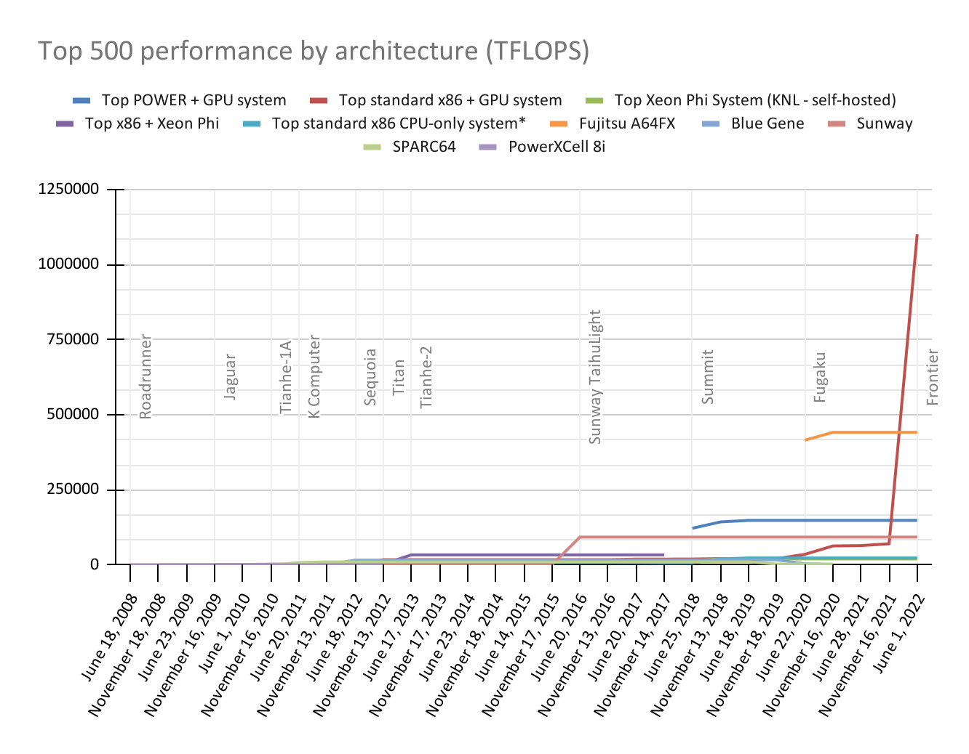
Design

Slide 30
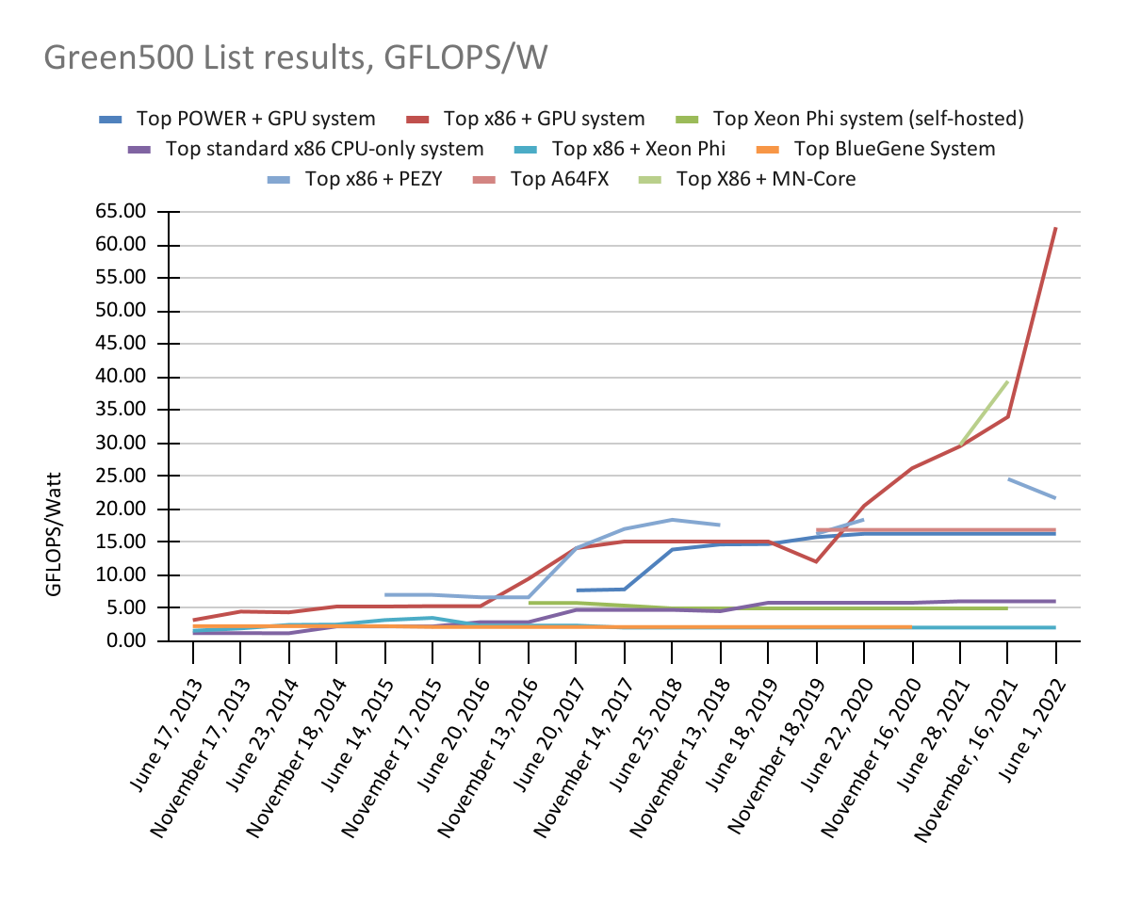

Slide 31
Design Decisions for GPUs
What percentage of your nodes should have GPUs?
Should your GPU nodes have a lot of GPUs, or only 1 or 2?
Do you need the high-memory GPU models?

Slide 32
High-Performance Parallel Storage
You need it, but I’ll leave the details to its own lecture
3 main options:
GPFS (IBM)
Lustre (Open-source / who even knows anymore?)
BeeGFS(Open-source/Fraunhofer Center/ThinkParQ)
More disks, more servers -> more performance

Slide 33
Other considerations
Power
Cooling
Physical space
Notes:
HPC clusters consume a lot more power than the non-HPC systems in a data center, so you need to consider the environment the cluster is going into, and may need to include these factors in your design:

Slide 34
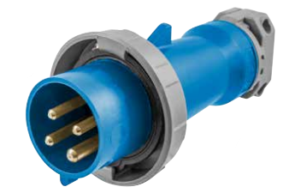
Power
A full rack of compute nodes under load can draw ~35 KW of power, or even more.
May require multiple PDUs in the rack
May require higher current PDUs
May require higher voltage to the rack (208 V or higher)
Notes:
Image - IEC-60309 “Hubbell” Connector for 60-amp, 3-phase, 208V power.

Slide 35
Cooling
All that electricity is converted to heat, and that heat has to go somewhere! You may need to consider:
Rear door heat exchangers
Hot-aisle or cold-aisle containment
Other datacenter improvements (larger/more cracs)

Slide 36
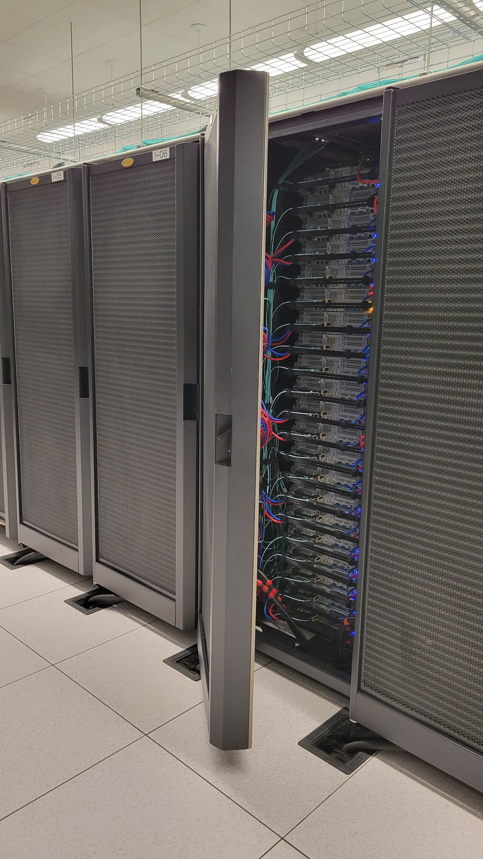
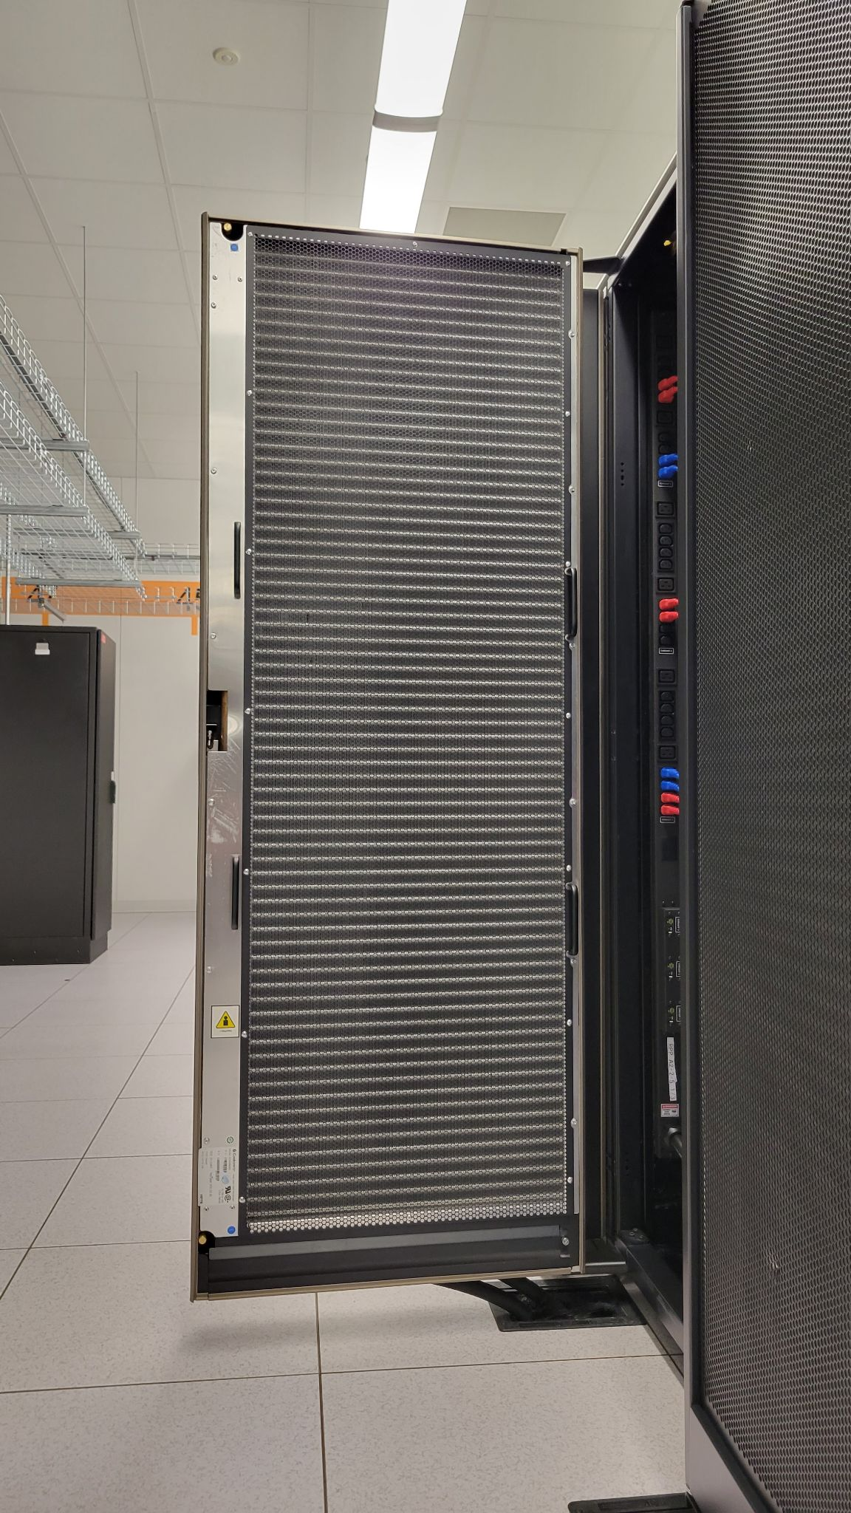
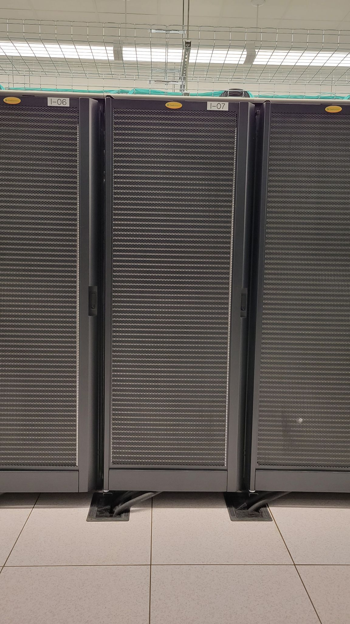
Rear-door heat exchangers
Not water-cooling
Air-to-water heat exchangers that remove heat from air before it leaves the rack
Active and passive models
Require chilled water or glycol in the data center

Slide 37
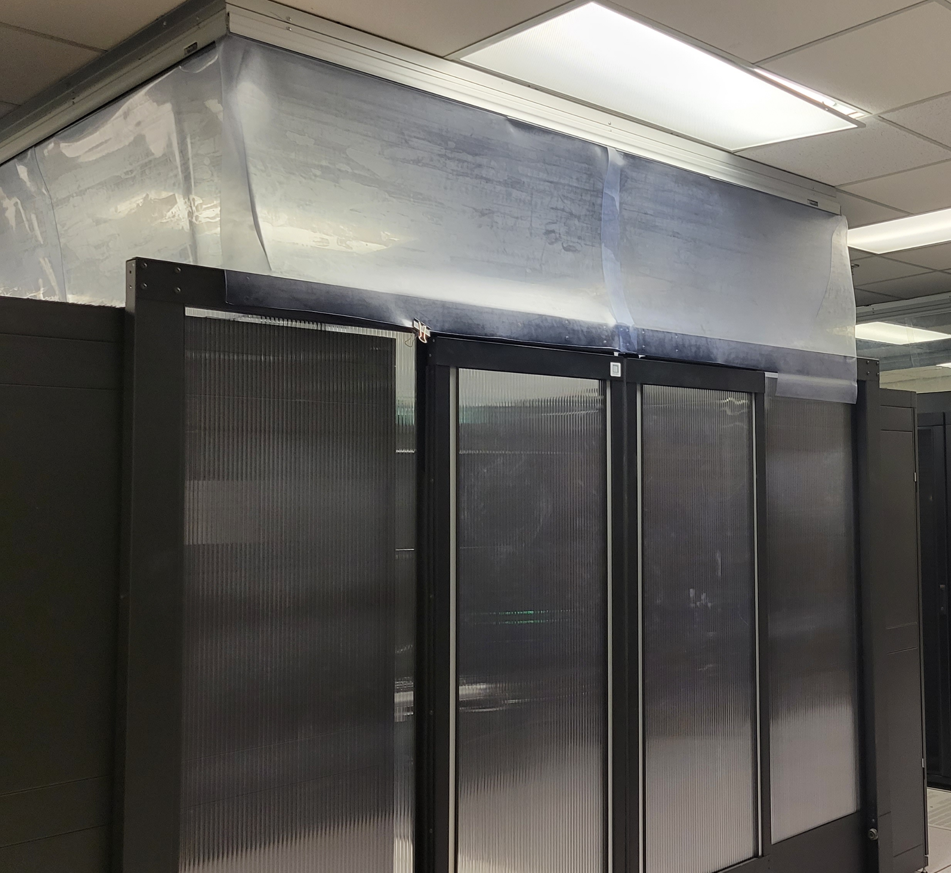
Hot-aisle/cold-aisle containment
Physical barriers to prevent the air from the hot aisles and cold aisles from mixing
More control over airflow
Improves the efficiency of the datacenter air-conditioning
Usually don’t know you need it until a few months after the cluster is up and running.

Slide 38
Space
Go with extra-deep racks:
More processors, GPUs, power supplies, etc. -> larger, deeper chassis
Additional networking requires more space in back of rack
Larger/more PDUs require more space.
It’s better to have the space and not need it, than…
Rear-door heat exchangers add even more to a racks’ footprint
Racks full of dense servers weigh more - make sure the floor can support the weight of your HPC racks
Notes:
It’s better to think about these issues before you buy your cluster - having to get bigger racks after your cluster is delivered and then moving all the nodes is a lot of work and hassle. It’s also embarrassing.
If your datacenter isn’t already using extra deep racks or rear-door heat exchangers, you may find yourself where putting these racks in place makes an aisle too narrow, which could become a safety/code issue.
Think about these issues and talk to your datacenter manager before ordering your cluster!

