Slide 1

Linux Clusters Institute: Intro to Networking
Kyle Hutson
(former) HPC System Administrator / Kansas State University
Systems Engineer / KanREN
This document is a result of work by volunteer LCI instructors and is licensed under CC BY-NC 4.0 (https://creativecommons.org/licenses/by-nc/4.0/).
Notes:
‹#›

Slide 2
Background Survey
Familiarity with…
Infiniband/OmniPath
Ethernet
TCP/IP
Switches and routers
Firewalls
VLANs

Slide 3
Agenda
Network technologies
OSI model
How does data get forwarded in a network
Considerations for HPC

Slide 4
Infiniband / OmniPath
Common for interconnects of nodes
IB more popular than OPA
Switched fabrics
Direct memory access on remote hosts
Built on concept of subnets connected by routers, just like Ethernet

Slide 5
Ethernet and TCP/IP
Node management (PXE, IPMI, etc)
Connection to external world
File share access
User access
Admin access
Some filesystems

Slide 6
Snow White and the 7 Layers
Physical: cables, connectors
Data: local network (Ethernet: switches)
Network: between networks (IP: routers)
Transport: end-to-end connection (TCP, UDP)
Session
Presentation
Application

Slide 7
Anatomy of a packet
Layer 2 |  | Layer 3 |  |  | Layer 4 |  |  | Payload
Src MAC | Dst MAC | Prot | Src IP | Dst IP | Prot | Src Port | Dst Port | Data
Packets in a network have headers for each layer, followed by a payload
Each layer consists of its own headers, and the rest of the packet

Slide 8
Switches vs routers
Bridges forward at layer 2
Based on MAC addresses
Data units are called “frames”
Modern bridges are called switches
Routers forward at layer 3
Based on IP addresses
Data units are called “packets”
When in doubt, route

Slide 9
Forwarding at layer 2
Src MAC | Dst MAC | Src IP | Dst IP | Payload
Within a local network, layer 2 forwarding is used
At this layer, MAC addresses are used to address devices
Source MAC is the address of the sender
Destination MAC is either the true destination, or next hop
ARP (or IPv6 ND) resolves IPs to MAC addresses
Switches build tables that let them map MAC addresses to ports

Slide 10
Forwarding at layer 3
Src MAC | Dst MAC | Src IP | Dst IP | Payload
Between networks, layer 3 forwarding is used
At this layer, IP addresses are used to address devices
Source and destination IPs remain unchanged over lifetime of packet (unless NAT is in play)
Routers build tables that let them map IP prefixes to next hops
Source and destination MAC addresses get rewritten all the time as a packet makes its way through networks

Slide 11
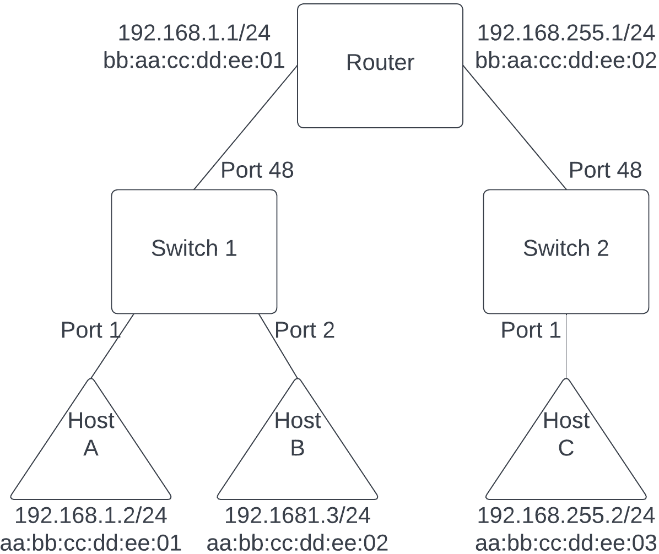
Examples

Slide 12

How about DNS
DNS resolves human readable names to IP addresses
That step happens before an endpoint puts together a packet
That’s it, really

Slide 13
Firewalls
Most firewalls are routers
Switches and routers are made to never drop frames/packets
Firewalls usually have rule sets that tell them when to not drop packets with a default deny
Varying features on how to make drop decisions
”Packet filter”
“Layer 7” / ”Application firewall”
Firewalls are slow, comparatively

Slide 14
HPC network considerations
Speed
Latency
Bandwidth
Reliable delivery
Having to resend things is slow
Secure access to data as needed
Network zones, with firewalls between them

