Slide 1
Chapter 6
Cost-Volume-Profit Analysis
Copyright ©2020 McGraw-Hill Education. All rights reserved. No reproduction or distribution without the prior written consent of McGraw-Hill Education.
6-1
Notes:
Chapter 6: Cost-Volume-Profit Analysis
Cost-volume-profit (CVP) analysis is a decision-making tool that focuses on the relationship among the volume and mix of units sold, prices, variable costs, fixed costs, and profit. The CVP framework allows managers to evaluate how changing one or more of these key variables will impact profitability, while holding everything else constant.

Slide 2
Assumptions of CVP
Assumption | Explanation
Linear cost and revenue functions | We will use a straight line to approximate the relationship between total cost and sales volume, as well as total revenue and sales volume.
All costs can be classified as either fixed or variable | For mixed costs, we must determine the total fixed cost and variable cost per unit.(Refer to Chapter 5 for a review of the methods used to estimate cost behavior.) We assume step costs will remain fixed within the relevant range
Only volume affects total cost and total revenue | We ignore other factors that can affect costs and revenue, such as employee learning curves, productivity gains, and volume discounts for buying in bulk.
Production volume is equal to sales volume | This simplifies the analysis because some costs vary with production while others vary with sales volume. Holding inventory constant also eliminates any differences in operating profit that are due to the costing method used to value inventory for external reporting.(See the supplement to Chapter 5 for further discussion of the effect of changing inventory levels on profit.)
Constant product mix | For companies that sell multiple products and services, we assume that the relative proportion of units sold or sales revenue generated by each product or service line remains constant. (to analyze changes in volume, we can analyze changes in mix separately).
Notes:
Cost-volume-profit analysis is based on the following assumptions, most of which were introduced in Chapter 5 when we analyzed cost behavior patterns.
Linear cost and revenue functions. We will use a straight line to approximate the relationship between total cost and sales volume, as well as total revenue and sales volume.
All costs can be classified as either fixed or variable. For mixed costs, we must determine the total fixed cost and variable cost per unit. We assume step-fixed costs will remain fixed within the relevant range, though we need to pay attention to the magnitude of our volume adjustment.
Only volume affects total cost and total revenue. We ignore other factors that can affect costs and revenue, such as employee learning curves, productivity gains, and volume discounts for buying in bulk.
Production volume is equal to sales volume. This simplifies the analysis because some costs vary with production while others vary with sales volume. Holding inventory constant also eliminates any differences in operating profit that are due to the costing method used to value inventory for external reporting. This is for convenience more than anything else.
Constant product mix. For companies that sell multiple products and services, we assume that the relative proportion of units sold or sales revenue generated by each product or service line remains constant. This is an assumption we can relax and analyze later.

Slide 3
Cost-Volume-Profit Graph
A Simplified Example
Only one type and one size of coffee
Price is $2.50 per unit
Variable costs are $1.00 per unit
Fixed costs are $12,000 per month
Notes:
To illustrate, let’s start with a simple but unrealistic scenario in which Starbucks sells only one type and size of coffee. Assume the price is $2.50 per unit and variable costs are $1.00 per unit. Recall from Chapter 5 that variable costs, such as the cost of coffee beans and supplies, increase in direct proportion to the number of units produced or customers served. Fixed costs are $12,000 per month, including rent, insurance, equipment depreciation, salaries, and other costs that must be paid each month regardless of the number of customers served.
This data implies a series of curves. Lets plot them.

Slide 4
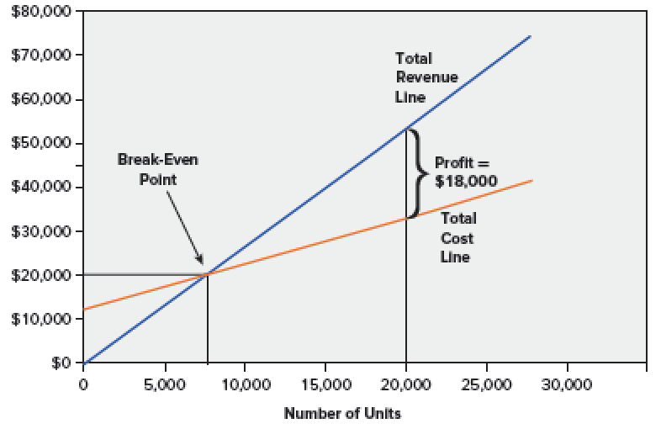
Cost-Volume-Profit Graph
Notes:
A cost-volume-profit graph, or CVP graph, provides a visual representation of the relationship between total revenue, total costs, volume, and profit. In this graph we have plotted total revenue on the vertical axis and volume in units on the horizontal axis.
The total revenue (blue) line is based on the number of units sold multiplied by the unit sales price ($2.50). A higher unit sales price will result in a steeper total revenue line.
The total cost (red) line is the sum of the total fixed and total variable costs. Notice that the total cost line intercepts the y-axis at $12,000. This is the total fixed costs, or the total cost that will be incurred regardless of volume. The variable cost per unit ($1) is represented by the slope of the total cost line, which increases by $1 with each additional unit sold.
The break-even point is the point at which the total revenue and total cost lines cross (leaving zero profit). In this example, the break-even point corresponds to 8,000 units, or $20,000 in total sales revenue (8,000 units × $2.50).
The difference between the total revenue line and the total cost line is profit (loss), reported as net operating income on the income statement. Anything below 8,000 units results in a loss because total cost is higher than total revenue. Anything above 8,000 units results in a profit.

Slide 5
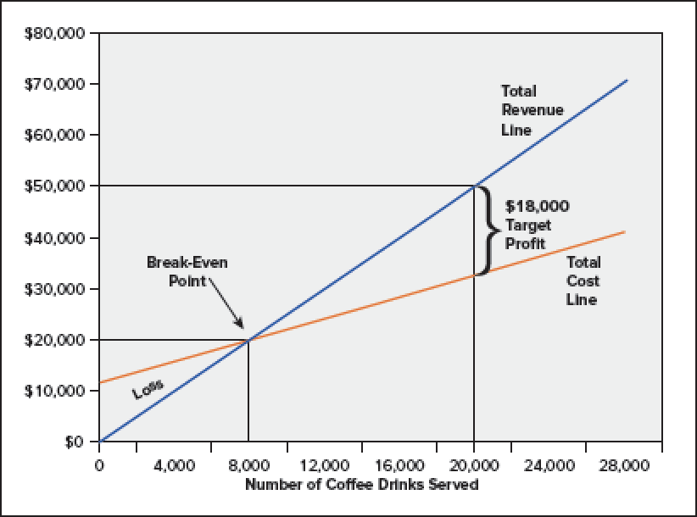
Cost-Volume-Profit in Graph
Copyright ©2020 McGraw-Hill Education. All rights reserved. No reproduction or distribution without the prior written consent of McGraw-Hill Education.
Notes:
Below the break-even point, we see losses, and above the break-even point, we see profits.
If Starbucks sells 20,000 cups of coffee, it will earn a target profit of $18,000. Total revenue will be $50,000 (20,000 cups times $2.50 per cup), total variable costs will be $20,000 (20,000 cups times $1.00 per cup), and fixed costs will be $12,000. So total revenue will be $50,000 and total costs will be $32,000 ($20,000 plus $12,000) resulting in a target profit of $18,000.

Slide 6

Learning Objective 6-1
Use cost-volume-profit analysis to find the break-even point.
Notes:
Learning objective 6-1 is to use cost-volume-profit analysis to find the break-even point.

Slide 7

Basic CVP Analysis
Break-even analysis is a special case of the simplest form of cost-volume-profit analysis. The goal of break-even analysis is to determine the level of sales (in either units or total sales dollars) needed to break even, or earn zero profit.
Methods
Profit Equation Method
Unit Contribution Margin Method
Contribution Margin Ratio Method
Notes:
The cost-volume-profit framework can be used to analyze many different managerial decisions. Two of the simplest types of CVP analysis are break-even analysis and target profit analysis. As you will see shortly, break-even analysis is a special case of target profit analysis, where the target profit is set equal to zero. Once you understand the break-even model, it is very easy to extend it to a target profit other than zero. There are several different approaches or methods we can use to model the relationship between revenues, costs, profit, and volume, including the following:
• Profit Equation Method
• Unit Contribution Margin Method
• Contribution Margin Ratio Method

Slide 8
Profit Equation Method
Sales revenue – Variable cost – Fixed costs = Profit
(Unit price × Q) - (Unit VC× Q) - FC = Profit
Q = Quantity of unit sold
To find the break-even point, we simply set the profit equation equal to zero, and solve for the quantity of units (Q).
Break–Even Analysis
(Unit price × Q) - (Unit VC× Q) – FC = Profit
($2.50× Q) - ($1.00 × Q) - $12,000 = 0
$1.50Q = $12,000
Q = $12,000 ÷ $1.50
Q = 8,000
Notes:
The profit equation defines profit as the difference between total sales revenue and total fixed and variable costs.
Total sales revenue and variable costs are a function of the number of units sold (Q), while total fixed costs are independent of the number of units sold. In CVP analysis, we allow any single factor in the equation to vary, while holding everything else constant, to determine the ultimate effect on profit. We have restated the basic equation at the top of your screen to include the components of total sales revenue (unit price x quantity sold) and total variable costs (unit variable costs x quantity sold). To find the break-even point, we simply set the profit equation equal to zero, and solve for the quantity of units (Q).
Using the information from our prior example, we know that the sales price is $2.50 per unit, the unit variable costs are $1 and the total fixed costs are $12,000. When we use these numbers in the profit equation, we get that $1.50Q = $12,000. We then solve for Q of 8,000 units.

Slide 9
Profit Equation Method (2 of 2)
Let’s verify our break-even analysis.
Break–Even Analysis
(Unit price × Q) - (Unit VC× Q) – FC = Profit
($2.20 × 8,000) - ($100 × 8,000) - $12,000 = 0
$20,000 - $8,000 - $12,000 = 0
Notes:
Here is the verification of the break-even analysis we just finished. Notice that when we substitute 8,000 cups for Q in the equation, profit is equal to zero.

Slide 10
Learning Objective 6-2
Use cost-volume-profit analysis to determine the sales needed to achieve a target profit.
Notes:
Learning objective 6-2 is to use cost-volume-profit analysis to determine the sales needed to achieve a target profit.

Slide 11
Profit Equation Method
Assume that the target profit was $18,000.
Target Profit Analysis
(Unit price × Q) - (Unit VC × Q) – FC = Profit
($2.50 × Q) - ($1.00 × Q) - $12,000 = $18,000
$1.50 Q = $30,000
Q = 20,000 units

Slide 12

Unit Contribution Margin Method
 | Per Unit | Number Of Units | Total
Sales revenue | $2.50
Less: Variable costs | 1.00
Contribution margin | $1.50 | × Q = | $12,000
Less: Fixed costs |  |  | 12,000
Net operating income |  |  | 0
Notes:
An alternative tool that can be used to answer most cost-volume-profit questions is the contribution margin income statement. This income statement makes a distinction between variable costs and fixed costs. Recall that contribution margin is the difference between sales revenue and variable costs, or the amount of profit available to cover fixed costs and profit.
The unit contribution margin tells us how much each unit sold contributes toward fixed costs and profit. In our Starbucks example, the unit selling price was $2.50 and the unit variable cost was $1.00, which gives us a unit contribution margin of $1.50. This amount is used first to cover total fixed costs, with the remainder as profit. As with the profit equation approach, we can use the unit contribution margin method for both break-even and target profit analysis.
Should be 8,000

Slide 13

Unit Contribution Margin Method
Compute the break-even point in units for Starbucks. Recall that Starbucks’ total fixed costs are $12,000 and the unit contribution margin is $1.50 per cup.
$Break−Even Units (Q) = \frac{Total Fixed Costs}{Unit Contribution Margin}$
$Break−Even Units (Q) =\$12,000 ÷\$1.50 per cup$
$Break−Even Units (Q) =8,000 cups$
Notes:
Compute the breakeven point in units for Starbucks. Recall that Starbucks’ total fixed costs are $12,000 and the unit contribution margin is $1.50 per cup. We determine the break-even units by dividing total fixed costs by the unit contribution margin.
The break-even units are 8,000 ($12,000/$1.50) cups of coffee served.

Slide 14
Unit Contribution Margin Method
To translate break-even units into sales revenue, we can multiply by the unit sales prices.
Break-Even Sales ($) = Break-Even Units × Unit Sales Price
Break-Even Sales = 8,000 cups × $2.50 = $20,000
Notes:
To translate break-even units into sales revenue, we can multiply by the unit sales prices.
In our example, we multiple the break-even number of cups of coffee, 8,000, times the selling price per cup of $2.50, to arrive at the break-even sales of $20,000. It might be a good idea to check back to our graph of the break-even point and see the 8,000 cups and $20,000.

Slide 15
Unit Contribution Margin Method
Assume that the target profit was $18,000.
 | Per Unit | Number of Units (Q) | Total
Sales revenue | $2.50
Less: Variable costs | 1.00
Contribution margin | $1.50 | × Q = | $ ?
Less: Fixed costs |  |  | 12,000
Net operating income |  |  | $18,000
Copyright ©2020 McGraw-Hill Education. All rights reserved. No reproduction or distribution without the prior written consent of McGraw-Hill Education.
Notes:
The unit contribution margin can also be used for target profit analysis. For example, how many units must be sold to earn $18,000 in profit? In this case, the total contribution margin must be enough to cover $12,000 in total fixed costs, with enough left over to provide $18,000 in target profit.
We need to generate $30,000 ($12,000 + $18,000) in total contribution margin to reach the target profit. We then divide by the unit contribution margin to determine how many units must be sold to reach this target. We determine that 20,000 units ($30,000/$1.50) are needed to achieve the target profit.

Slide 16
Contribution Margin Ratio Method
 | Per Unit | Percent of Sales
Sales price | $2.50 | 100%
Less: Variable costs | 1.00 | 40%
Contribution margin | $1.50 | 60% ($1.50 ÷ $2.50)
Notes:
The third way to approach cost-volume-profit problems is based on the contribution margin ratio, or the contribution margin stated as a percentage of sales dollars.
The contribution margin ratio tells us how much contribution margin is generated per dollar of sales revenue. In this example, variable costs make up 40 percent of sales revenue ($1.00/$2.50), which leaves 60 percent of every sales dollar as contribution margin ($1.50/$2.50). Because fixed costs do not change with sales volume, each additional $1.00 in sales revenue will add $0.60 to profit.
We can use the contribution margin ratio to determine the total sales revenue needed to earn a target profit, including a break-even profit of zero.

Slide 17
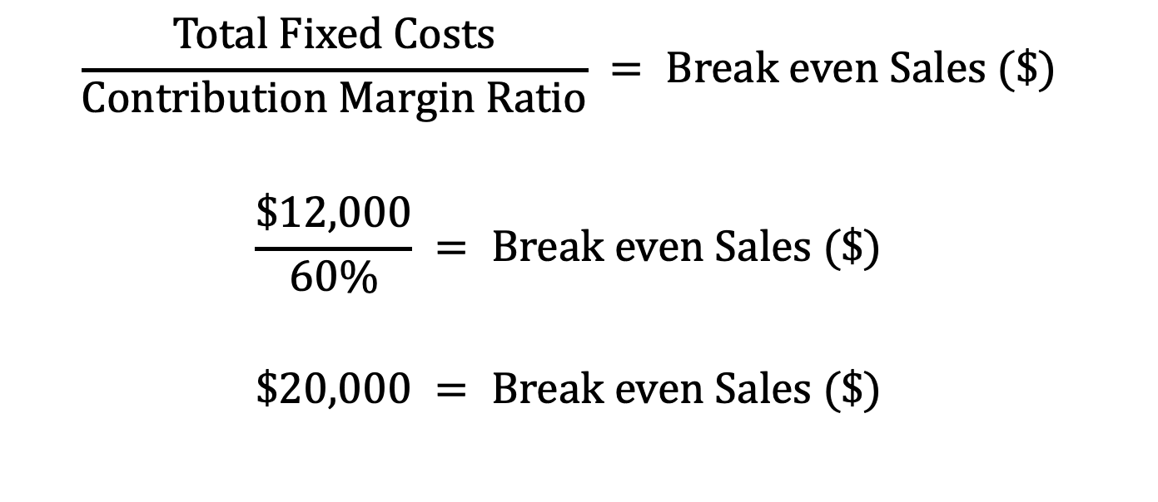
Contribution Margin Ratio Method (2 of 3)
At break-even, the total contribution margin must equal total fixed costs, with nothing left over as profit.
$$\frac{Total Fixed Costs}{Contribution Margin Ratio} = Break even Sales (\$)$$
$$\frac{\$12,000}{60\%} = Break even Sales (\$)$$
$$\$20,000 = Break even Sales (\$)$$
Copyright ©2020 McGraw-Hill Education. All rights reserved. No reproduction or distribution without the prior written consent of McGraw-Hill Education.
Notes:
At break-even, the total contribution margin must equal total fixed costs, with nothing left over as profit. To solve for the break-even point in sales revenue, we simply divide total fixed costs of $12,000 by the 60 percent contribution margin ratio. So, break-even sales is $20,000. The contribution margin ratio simply provides a direct way to calculate the sales revenue needed to break-even.
Notice that this formula is almost identical to the formula for break-even units, except the denominator is the contribution margin ratio rather than the unit contribution margin. The contribution margin ratio allows us to solve for total sales revenue in one step rather than first solving for units and then multiplying by the unit sales price. The end result is the same.

Slide 18
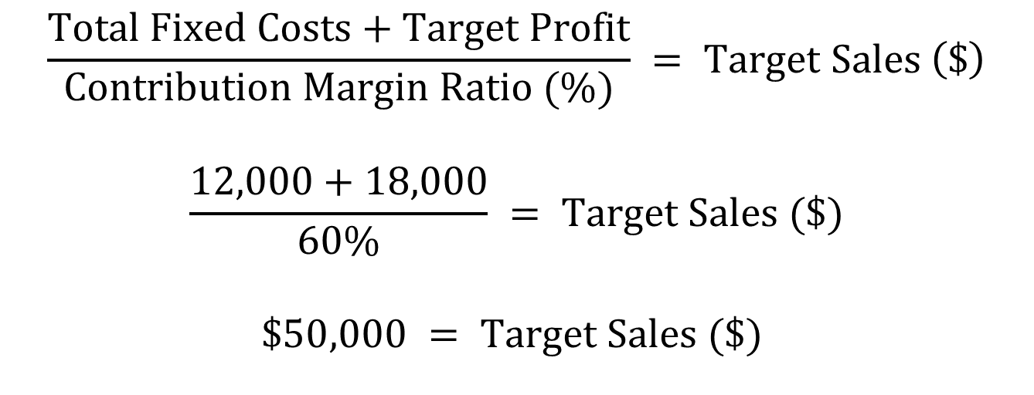
Contribution Margin Ratio Method (3 of 3)
Assume that the target profit was $18,000.
$$\frac{Total Fixed Costs+Target Profit}{Contribution Margin Ratio (\%)} = Target Sales \left(\$\right)$$
$$\frac{12,000+18,000}{60\%} = Target Sales (\$)$$
$$\$50,000 = Target Sales (\$)$$
Copyright ©2020 McGraw-Hill Education. All rights reserved. No reproduction or distribution without the prior written consent of McGraw-Hill Education.
Notes:
We can also use the contribution margin ratio approach for target profit analysis. Assume the target profit is $18,000, the total contribution margin must be enough to cover $12,000 in total fixed costs, with enough left over to provide $18,000 in target profit.
We need to generate $30,000 ($12,000 + $18,000) in total contribution margin to reach the target profit. To determine the target sales needed, we divide by the contribution margin ratio of 60% to determine how much sales revenue is needed to reach this target. We determine that $50,000 of sales revenue is needed to achieve the target profit.

Slide 19

Learning Objective 6-3
Compute the margin of safety.
Notes:
Learning objective 6-3 is to compute the margin of safety.

Slide 20
Margin of Safety
Margin of safety is the difference between actual or budgeted sales and the break-even point.
Actual or Budgeted Sales
– Break even Sales
= Margin of Safety
Notes:
The margin of safety is the difference between actual or budgeted sales and the breakeven point. Think of the margin of safety as a buffer zone that identifies how much sales can drop before the business will suffer a loss. This application of CVP analysis is most relevant to companies that face a significant risk of not making a profit, such as start-up businesses or companies that face extreme competition or abrupt changes in demand.

Slide 21
Margin of Safety
Copyright ©2020 McGraw-Hill Education. All rights reserved. No reproduction or distribution without the prior written consent of McGraw-Hill Education.
Notes:
Let’s assume that our hypothetical Starbucks coffee location operated above the break-even point during February with sales of $37,500. During the month, the company reported a profit of $10,500. Let’s calculate Starbucks’ margin of safety.
Recall that the break-even point was 8,000 units, or $20,000 in total sales. Subtracting $20,000 from Starbucks’ actual sales of $37,500, we find that Starbucks’ margin of safety in dollars is $17,500.

Slide 22
Learning Objective 6-4
Analyze how changes in prices and cost structure affect cost-volume-profit relationships.
Notes:
Now that we’ve used CVP to characterize costs at a given point. Lets look at costs at
Learning objective 6-4 is to analyze how changes in prices and cost structure affect cost-volume-profit relationships.

Slide 23
Changing Prices
Assume Starbucks’ manager is considering increasing the price of coffee to $4.00, with no effect on unit variable cost or total fixed costs.
 | Current Price Per Unit | Current Price Percent | Proposed Price Per Unit | Proposed Percent
Sales price | $2.50 | 100% | $4.00 | 100%
Less: Variable costs | 1.00 | 40% | 1.00 | 25%
Contribution margin | $1.50 | 60% | $3.00 | 75%
Notice that both the unit contribution margin and the contribution margin ratio increased as a result of the price increase.
Copyright ©2020 McGraw-Hill Education. All rights reserved. No reproduction or distribution without the prior written consent of McGraw-Hill Education.
Notes:
Managers can use CVP to analyze many different decisions, such as whether to change the price of the product, buy materials from a different supplier, pay employees a salary instead of commission, spend more on advertising, or invest in automated equipment. The CVP model allows managers to perform “what if” analysis to see how changing one or more variables will affect the others.
Assume Starbucks’ manager is considering increasing the price of coffee to $4.00, with no effect on unit variable cost or total fixed costs.
click to show table
Notice that both the unit contribution margin and the contribution margin ratio increased to $3.00 and 75%, respectively, as a result of the price increase.
This makes sense - we are charging a higer price for the same thing, so we get to keep the difference
click again to leave

Slide 24
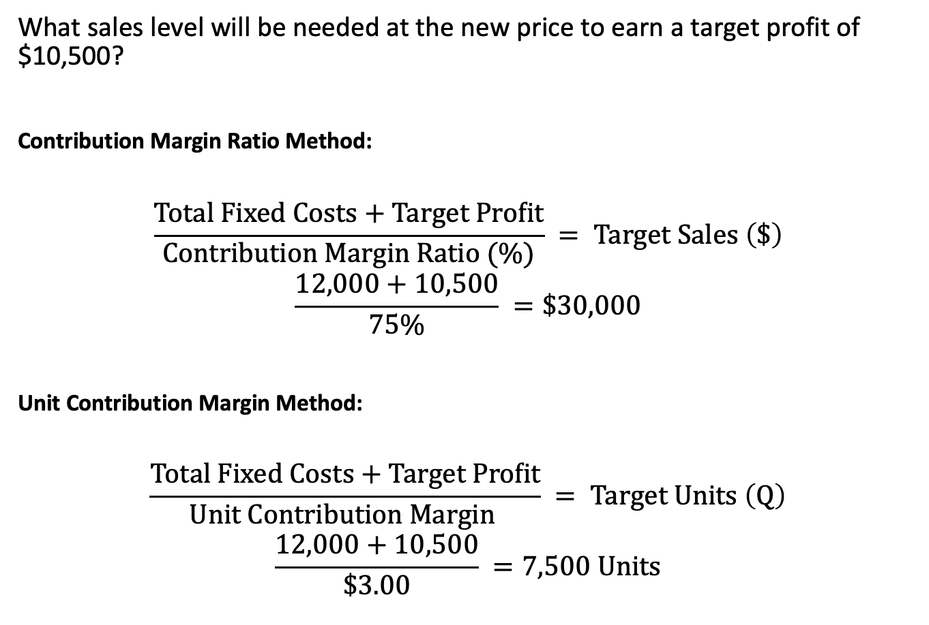
Changing Prices
What sales level will be needed at the new price to earn a target profit of $10,500?
Contribution Margin Ratio Method:
$$\frac{Total Fixed Costs+Target Profit}{Contribution Margin Ratio (\%)} = Target Sales \left(\$\right)$$
$$\frac{12,000+10,500}{75\%} =\$30,000$$
Unit Contribution Margin Method:
$$\frac{Total Fixed Costs+Target Profit}{Unit Contribution Margin } = Target Units \left(Q\right)$$
$$\frac{12,000+10,500}{\$3.00} =7,500 Units$$
Notes:
To determine the sales level needed to earn a target profit of at least $10,500 at the new price, we can use the contribution margin ratio formula.
2 clicks
This analysis shows that the company needs to earn $30,000 in total sales revenue ($22,500/75%, the $22,500 is the $12,000 fixed costs plus the target profit of $10,500) to earn $10,500 in profit.
Now lets do this in units:
Because the proposed sales price is $4, this translates into 7,500 units ($30,000 ÷ $4). As we discovered earlier in the chapter, you could get this same number by dividing the total fixed costs plus the target profit by the new unit contribution margin of $3.00.
Now click through the rest of the slide
22500/1.50=15000

Slide 25
Changing Variable Costs and Volume
Assume Starbucks’ manager is trying to increase profit to $16,800 per month. He plans to purchase higher quality coffee beans which will raise variable costs by $0.25 per unit and is expected to increase sales volume by 20%.
What unit sales price would be needed to earn the target profit of $16,800?
New Unit Variable Cost: $1.25 ($1.00 + $0.25)
New Sales Volume: 18,000 units (15,000 × 120%)
Notes:
Assume Starbucks’ manager is trying to find a way to increase profit to $16,800 per month. To achieve this goal, he plans to purchase higher quality coffee beans to improve the taste of the product. This will raise variable costs by $0.25 per unit and is expected to increase sales volume by 20 percent. The manager believes that consumers will be willing to pay a higher price for better tasting coffee, but is not sure what price to charge. What unit sales price would be needed to earn a target profit of $16,800?
In this example, two components in the model are changing at the same time: (CLICK)
• Unit variable costs will increase from $1.00 to $1.25. (CLICK)
• Volume will increase from 15,000 units to 18,000 units (15,000 times 120%). (CLICK)

Slide 26
Changing Variable Costs and Volume
Profit Equation Method
(Unit Price × Q) – (Unit VC × Q) – Total FC = Profit
(Unit Price × 18,000)
– ($1.25 × 18,000)
– $12,000
= $16,800
(Unit Price × 18,000) – $22,500 – $12,000 = $16,800
(Unit Price × 18,000) = $16,800 + $22,500 + $12,000
(Unit Price × 18,000) = $51,300
Unit Price = $51,300 ÷ 18,000
Unit Price = $2.85
Notes:
In this example we are solving for unit price.
Total fixed costs are assumed to remain unchanged at $12,000, and the target profit is $16,800. In this case, we cannot use the contribution margin to solve the problem because we don’t know the unit sales price. However, we can set up a profit equation with the unit sales price as the unknown variable. The Starbucks manager would need cover $51,300 in costs and target profit (variable costs of $1.25 x 18,000 units + $12,000 fixed costs + $16,800 target profit). The manager would need to raise the unit price to $2.85 ($51,300/18,000) to meet the target profit of $16,800, assuming all of the other variables in the CVP model remain the same.

Slide 27
Changing Fixed Costs and Prices
Assume the Starbucks manager is considering starting a customer appreciation program that would reward customers by giving them their tenth cup of coffee for free. The company would spend an additional $3,000 per month to advertise the rewards program.
How much sales volume is needed to earn a target profit of $16,800?
New Average Price: $2.25
((9 units at $2.50) / 10)
New Fixed Costs: $15,000
($12,000 + $3,000)
Notes:
Assume the Starbucks manager is considering starting a customer appreciation program that would reward customers by giving them their tenth cup of coffee for free. If all customers participated in this program, the average unit selling price would drop from $2.50 to $2.25 per unit [(9 units × $2.50) / 10 ]. In addition, the company would spend an additional $3,000 per month to advertise the rewards program. The manager wants to know how much sales volume is needed to earn a target profit of $16,800.
In this example, two components in the model are changing at the same time:
• Price will drop from $2.50 to $2.25 per unit.
• Fixed costs will increase from $12,000 to $15,000.
Unit variable costs are assumed to remain the same at $1.00, and the target profit is $16,800. Because the price decreased to $2.25 and variable costs remained at $1.00, the new unit contribution margin is $1.25. We can use the target profit formula from earlier in the chapter to determine the number of units (Q) that must be sold to reach the $16,800 target profit.

Slide 28
Changing Fixed Costs and Prices
Unit Contribution Margin Method
Copyright ©2020 McGraw-Hill Education. All rights reserved. No reproduction or distribution without the prior written consent of McGraw-Hill Education.
Notes:
We can use the target profit formula from earlier in the chapter to determine the number of units (Q) that must be sold to reach the $16,800 target profit.
As noted on the previous slide, fixed costs will increase to $15,000 and the target profit is $16,800. The average price will drop to $2.25 per unit, but variable costs remain the same at $1.00, so the new unit contribution margin is $1.25.
In this case, the Starbucks manager would need to sell 25,440 units ($31,800/$1.25) at an average sales price of $2.25 in order meet the target profit of $16,800, assuming all of the other variables in the model remain the same.

Slide 29
Changes in Cost Structure
Cost structure refers to how a company uses variable costs versus fixed costs to perform its operations.
Starbucks Example:
  Investing in touch screens to allow customers to place their own order.
  Increase fixed costs by $14,000 per month.
  Decrease variable costs per unit by $0.70.
  Unit sales price will be unchanged at $2.50.
What level of volume would be needed to justify this expenditure?
Notes:
Next we analyze how a change in cost structure affects the cost-volume-profit relationship. Cost structure refers to how a company uses variable costs versus fixed costs to perform its operations. Some companies have a relatively high proportion of variable costs such as direct materials and direct labor while others have relatively high fixed costs such as facilities, equipment, and salaries. Managers face many decisions that can affect their relative cost structure and have implications for cost-volume-profit analysis.
A common example is the decision to automate a process that is currently done manually. Automation typically reduces variable costs (by reducing direct labor) while increasing fixed costs (by increasing equipment depreciation, maintenance, and supervision).
Assume that the Starbucks manager is considering investing in equipment that would allow customers to place their own order using a touch screen at the counter. The store could lease the machine for $14,000 per month (increasing monthly fixed costs from $12,000 to $26,000). The automation would save $0.70 in variable costs per unit (from $1.00 to $0.30). The unit sales price will be $2.50 under either alternative. What level of volume would be needed to justify this expenditure?

Slide 30

Changes in Cost Structure
Instead of setting a single profit equation equal to zero (to find break-even), we set two profit equations equal to one another, so that each alternative yields the same profit. Then we solve for the number of units that will give an equal profit under either alternative.
Notes:
One way to solve this problem is to use the profit equation method. Instead of setting a single profit equation equal to zero (to find the break-even point), we set two profit equations equal to each other so that they yield the same profit. Doing so allows us to find the indifference point, or the point at which managers should be indifferent about which alternative to choose because they yield the same profit.

Slide 31
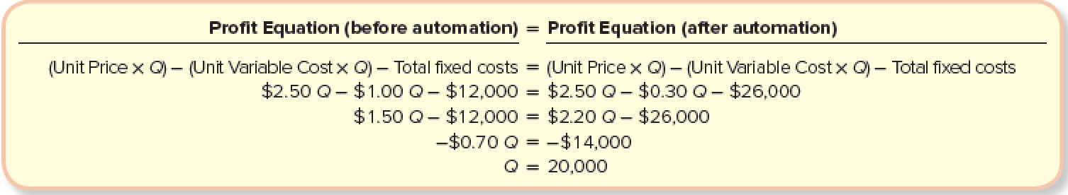
Changes in Cost Structure (3 of 3)
Notes:
So, the profit equation before automation must equal the profit equation after automation.
$2.50Q -$1.00Q - $12,000 = $2.50Q - $0.30Q - $26,000, when we solve for Q we determine that at a sales volume of 20,000 units, the company will make the same profit with or without automation. If volume is more than 20,000 units, the company will make a higher profit with the automated ordering system. But if volume is less than 20,000 units per month, profit will be higher without automation.
The difference in these two curves is driven by the difference in operating leverage.

Slide 32
Learning Objective 6-5
Calculate the degree of operating leverage and use it to predict the effect a change in sales will have on profit.
Notes:
Learning objective 6-5 is to calculate the degree of operating leverage and use it to predict the effect a change in sales will have on profit.

Slide 33
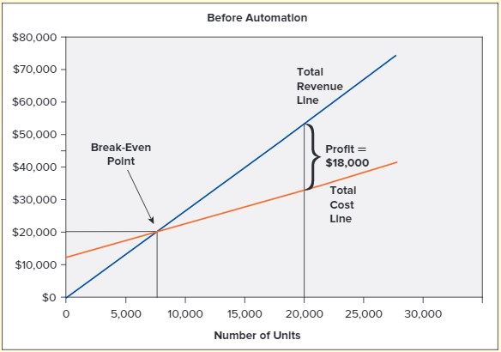
Changes in Cost Structure (1 of 2)
Automation increases the break-even point because fixed costs are higher. But each unit adds more profit because of the lower variable cost per unit.
Copyright ©2020 McGraw-Hill Education. All rights reserved. No reproduction or distribution without the prior written consent of McGraw-Hill Education.
Notes:
At less than 20,000 units, profit is higher before automation.

Slide 34
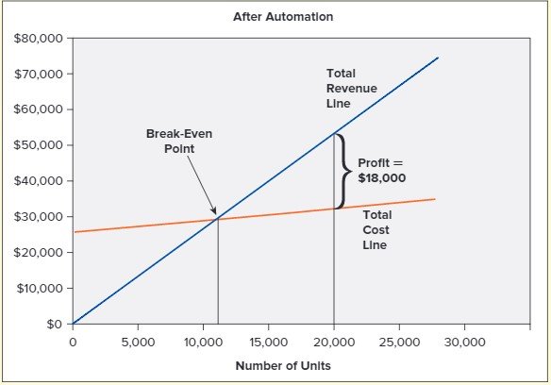
Changes in Cost Structure
Notes:
Automation increases the break-even point because fixed costs are higher. But each unit adds more profit because of the lower variable cost per unit. Profit is the same at 20,000 units. As long as the manager expects demand to exceed 20,000 units per month, the investment in automation should result in increased profit. However, there is a greater risk with automation in the event that demand is not as large as expected. This risk is reflected in a measure called degree of operating leverage.

Slide 35
Degree of Operating Leverage
Degree of operating leverage measures the extent to which fixed costs are used to operate the business. In general, high fixed costs indicate that a company has high operating leverage.
- This is not the same as having high financial leverage.
Notes:
Degree of operating leverage measures the extent to which fixed costs are used to operate the business. In general, high fixed costs indicate that a company is highly leveraged.
Recall that fixed costs are subtracted from contribution margin to calculate net operating income (profit). If fixed costs are zero, contribution margin (numerator) and net operating income (denominator) are equal, resulting in a degree of operating leverage of one. A degree of operating leverage greater than one means that managers are using fixed costs for some operations. Fixed costs do not change with volume; as a result, a degree of operating leverage greater than one means that a given change in sales volume will impact profit to a larger degree.

Slide 36
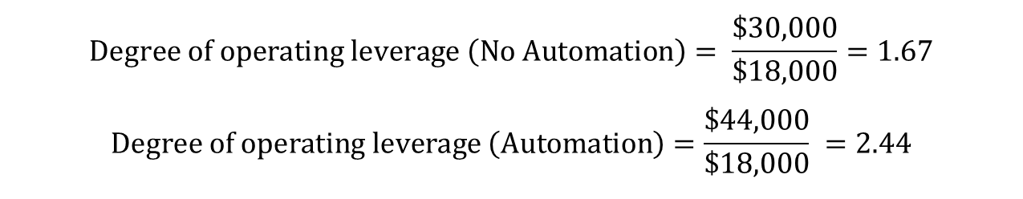
Degree of Operating Leverage
Let's see how the trade-off of fixed and variable costs (through automation) affected Starbucks’ degree of operating leverage. We will use the indifference point of 20,000 cups sold.
 | 20,000 Units sold (No Automation) Per Unit | 20,000 Units sold (No Automation) Total | 20,000 Units sold (Automation) Per Unit | 20,000 Units sold (Automation) Total
Sales revenue | $2.50 | $50,000 | $2.50 | $50,000
Less: Variable costs | 1.00 | 20,000 | 0.30 | 6,000
Contribution margin | $1.50 | $30,000 | $2.20 | $44,000
Less fixed costs |  | 12,000 |  | 26,000
Net operating income |  | $18,000 |  | $18,000
$$Degree of operating leverage \left(No Automation\right)= \frac{\$30,000}{\$18,000}=1.67$$
$$Degree of operating leverage \left(Automation\right)=\frac{\$44,000}{\$18,000} =2.44$$
Copyright ©2020 McGraw-Hill Education. All rights reserved. No reproduction or distribution without the prior written consent of McGraw-Hill Education.
Notes:
Let’s see how the trade-off of fixed and variable costs (through automation) affects Starbucks’ degree of operating leverage. As a starting point, we use the indifference point of 20,000 units so that sales revenue and profit will be the same in both scenarios.
Although profit is the same at 20,000 units, the degree of operating leverage is higher with automation 2.44 ($44,000/$18,000) than without it, 1.67($30,000/$18,000). The reason is that automation requires an investment in fixed costs.

Slide 37
Degree of Operating Leverage (3 of 3)
The degree of operating leverage is a multiplier we can use to predict how a percentage change in sales revenue will translate into a percentage change in profit. In this example, if sales revenue increases by 10%, profit will increase by 16.7% without automation or 24.4% with automation.
 | (No Automation) Base Case | (No Automation) 10 Percent Increase | (Automation) Base Case | (Automation) 10 Percent Increase
Sales revenue | $50,000 | $55,000 | $50,000 | $55,000
Less: Variable costs | 20,000 | 22,000 | 6,000 | 6,600
Contribution margin | $30,000 | $33,000 | $44,000 | $48,400
Less: Fixed costs | 12,000 | 12,000 | 26,000 | 26,000
Net operating income | $18,000 | $21,000 | $18,000 | $22,400
Copyright ©2020 McGraw-Hill Education. All rights reserved. No reproduction or distribution without the prior written consent of McGraw-Hill Education.
Notes:
The degree of operating leverage is a multiplier that we can use to predict how a percentage change in sales revenue will translate into a percentage change in profit. In this example, if sales revenue increases by 10 percent, profit will increase by 16.7 percent (10% × 1.67) without automation or 24.4 percent (10% × 2.44) with automation.
Keep in mind that operating leverage works in both directions. It magnifies the effect of both increases and decreases in sales revenue. If sales decrease by 10 percent, the company will experience a more dramatic decline in profit with automation than without it. In general, a company with a high degree of operating leverage (high fixed costs) will experience greater swings in profit as a result of changes in sales revenue and is therefore considered riskier than a comparable company with a smaller degree of operating leverage. In making choices about cost structure, managers must consider both the rewards (potential for increased profit) and amount of risk (upside and downside) they are willing to bear.

Slide 38
Learning Objective 6-6
Perform multiproduct cost-volume-profit analysis and explain how the product or sales mix affects the analysis.
Notes:
Learning objective 6-6 is to perform multiproduct cost-volume-profit analysis and explain how the product or sales mix affects the analysis.

Slide 39

Multi-Product Cost-Volume-Profit Analysis
Product mix is the relative mix of products or services stated in terms of the number of units sold.
The product mix is used to compute the weighted-average contribution margin per unit.
Sales mix is the relative mix of products or services as a percentage of total sales revenue.
The sales mix is used to compute the weighted-average contribution margin ratio, or contribution margin as a percentage of sales.
Notes:
In the previous examples, we simplified the CVP analysis by assuming that Starbucks sells only one type and size of coffee drink. But we all know that Starbucks, and most other businesses, offer more than one product or service. For example, Starbucks sells coffee, tea, pastries, sandwiches, salads, mugs, T-shirts, and other novelty items. Each of these items is likely to have a different price and unit cost, which makes the CVP analysis more complex.
The key to performing CVP analysis in a multiproduct setting is to make an assumption about the relative mix of products or services sold. The mix can be stated in terms of the number of units sold (called the product mix) or as a percentage of total sales revenue (called the sales mix). The product mix is used to compute the weighted-average contribution margin per unit, while the sales mix is used to compute the weighted-average contribution margin ratio, or contribution margin as a percentage of sales. Either of these numbers can be used for multiproduct cost-volume-profit analysis, including break-even or target profit analysis. Which method you use depends on how the information is presented and whether you are trying to solve for the number of units or total sales revenue. As with the single-product scenarios, both methods will yield the same answer as long as you have complete information about unit sales prices. The only caveat is that the analysis will be valid only for the assumed product or sales mix.

Slide 40
Weighted-Average Contribution Margin
Let’s extend our example by assuming that Starbucks sells two products: coffee and pastries.
 | Coffee | Pastries
Sales price | $2.50 | $4.00
Less: Variable costs | 1.00 | 1.25
Unit contribution margin | $1.50 | $2.75
Notice a lower unit contribution margin for coffee, $1.50, than pastries, $2.75.
Copyright ©2020 McGraw-Hill Education. All rights reserved. No reproduction or distribution without the prior written consent of McGraw-Hill Education.
Notes:
Let’s start by stating the product mix in units, which will be used to calculate a weighted-average unit contribution margin. The weighted-average unit contribution margin is then used in place of the single product unit contribution margin in the cost-volume-profit analysis. The weighted-average unit contribution margin is the average unit contribution margin of multiple products weighted according to the percentage of units sold.
To illustrate, let’s extend our Starbucks example to incorporate two product offerings: coffee and pastries. While unrealistic, this simple example illustrates the concepts and techniques needed to apply CVP to even more product and service offerings.
Notice that pastries have a higher unit contribution margin ($2.75) than coffee ($1.50). We can calculate a weighted-average of these two numbers, with the weight based on the relative proportion (mix) of units sold.

Slide 41
Weighted-Average Contribution Margin
The management at Starbucks estimates that 60% of units sold are coffee and 40% pastries. Based on this product mix, we can calculate the weighted-average unit contribution margin.
 | Coffee | Pastries
Unit contribution margin | $1.50 | $2.75
Unit mix (weight) | × 60% | × 40%
 | $0.90 | $1.10
Weighted–average unit contribution margin = $0.90 + $1.10 = $2.00
Copyright ©2020 McGraw-Hill Education. All rights reserved. No reproduction or distribution without the prior written consent of McGraw-Hill Education.
Notes:
The management at Starbucks estimates that 60% of units sold are coffee and 40% are pastries.
We can calculate a weighted-average of these two numbers, with the weight based on the relative proportion (mix) of units sold. The coffee unit contribution margin of $1.50 x 60% plus the pastries unit contribution margin of $2.75 x 40% gives a weighted-average unit contribution margin of $2.00 ($0.90 + $1.10)
The $2 weighted-average unit contribution margin means that Starbucks will make an average of $2 in contribution margin for each unit sold, but only if 60 percent of the units are coffee and 40 percent are pastries. This weighted-average contribution margin can be used in place of the single product unit contribution margin to complete CVP analysis using the unit contribution margin method.

Slide 42
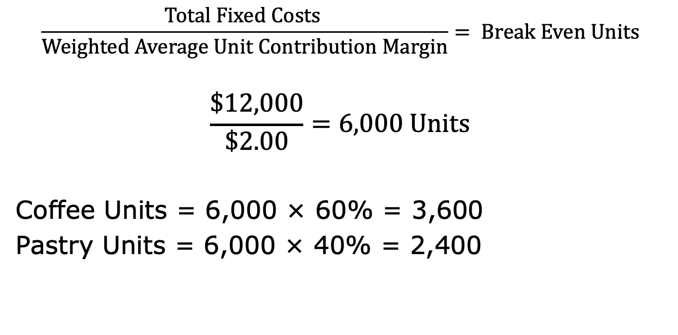
Break-Even Analysis
$$\frac{Total Fixed Costs }{Weighted Average Unit Contribution Margin}= Break Even Units$$
$$\frac{\$12,000}{\$2.00}=6,000 Units$$
Coffee Units = 6,000 × 60% = 3,600
Pastry Units = 6,000 × 40% = 2,400
Notes:
At the break-even point, fixed costs must be exactly equal to contribution margin. If we divided the total fixed costs by the weighted-average unit contribution margin, the result tells us how many total units must be sold to break even. We then use the assumed product mix to determine how many units of each product type must be sold.
Starbucks' monthly fixed costs are still $12,000, and with the weighted-average unit contribution margin of $2.00, the break-even units are 6,000. Since the $2.00 weighted-average contribution margin was based on a 60%/40% percent product mix, we must use the same mix to determine the units of each individual product. The company should break-even if it sells 3,600 units of coffee (6,000 x 60%) and 2,400 units of pastries (6,000 x 40%).

Slide 43
Target Profit Analysis
Let’s assume that four coffee drinks are served for every one pastry (or a 4 to 1 ratio). The new product mix is 80% coffee units and 20% pastry units. Based on this product mix, we can calculate the weighted-average unit contribution margin.
 | Coffee | Pastries
Unit contribution margin | $1.50 | $2.75
Unit mix (weight) | × 80% | × 20%
 | $1.20 | $0.55
Weighted–average unit contribution margin = $1.20 + $0.55 = $1.75
Copyright ©2020 McGraw-Hill Education. All rights reserved. No reproduction or distribution without the prior written consent of McGraw-Hill Education.
Notes:
Next, we extend the cost-volume-profit analysis to include a target profit. Assume that Starbucks serves four coffee drinks for every pastry (or a 4:1 ratio). The new product mix is 80 percent coffee units and 20 percent pastry units. The weighted-average unit contribution margin based on this product mix is $1.75 ($1.50 x 80% + 2.75 x 20%). Because the coffee product is weighted more heavily, it will lower the weighted-average contribution margin.

Slide 44
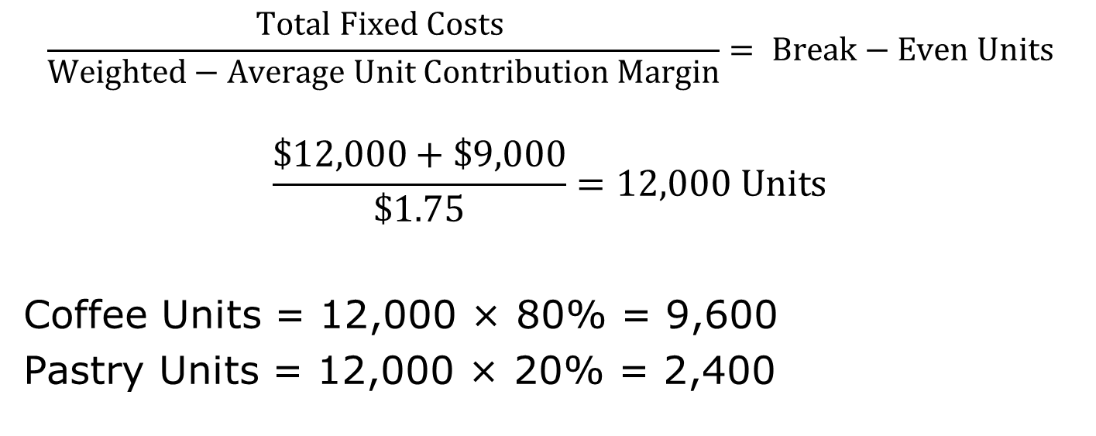
Target Profit Analysis
If the Starbucks manager wants to earn a monthly profit of $9,000 and monthly fixed costs remain at $12,000, how many coffee and pastry units must be sold?
$$\frac{Total Fixed Costs }{Weighted−Average Unit Contribution Margin}= Break−Even Units$$
$$\frac{\$12,000+\$9,000}{\$1.75}=12,000 Units$$
Coffee Units = 12,000 × 80% = 9,600
Pastry Units = 12,000 × 20% = 2,400
Notes:
If the Starbucks manager wants to earn a monthly profit of $9,000 and monthly fixed costs remain at $12,000, using the new weighted-average contribution margin of $1.75, how many coffee and pastry units must be sold? The break-even is 12,000 units (($12,000 + $9,000)/$1.75)
The company will earn $9,000 profit if it sells 9,600 coffee drinks (12,000 x 80%) and 2,400 pastries (12,000 x 20%).

Slide 45
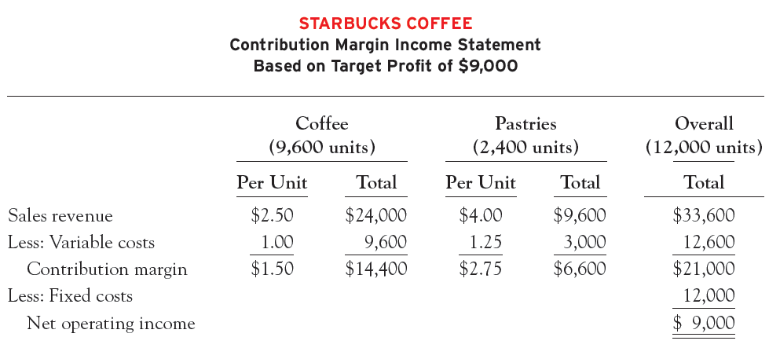
Target Profit Analysis
Copyright ©2020 McGraw-Hill Education. All rights reserved. No reproduction or distribution without the prior written consent of McGraw-Hill Education.
Notes:
We can confirm this result by preparing a contribution margin income statement. This statement confirms the results of our target profit analysis. Profit will be $9,000 if the company sells 12,000 units, with 9,600 units of coffee (80 percent) and 2,400 units of pastries (20 percent).

Slide 46
Weighted-Average Contribution Margin Ratio
We can also do multiproduct CVP analysis by using the sales mix (stated in terms of total sales dollars) to compute the weighted-average contribution margin ratio.
This approach is commonly used in business because managers often have aggregated information about revenue and costs by product line.
Notes:
We can also do multiproduct CVP analysis by using the sales mix (stated in terms of total sales dollars) to compute the weighted-average contribution margin ratio. This approach is commonly used in business because managers often have aggregated information about revenue and costs by product line (as opposed to the detailed information about prices, quantities, etc.)

Slide 47
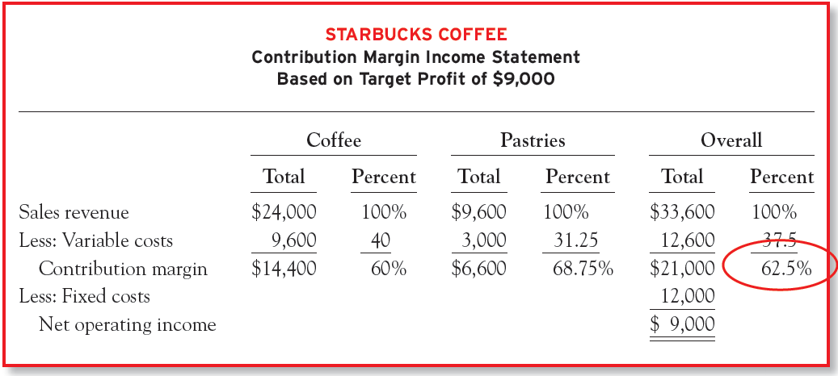
Weighted-Average Contribution Margin Ratio
Sales Mix:
Pastries: $9,600/$33,600=28.57%
Coffee: $24,000/$33,600=71.43%
Copyright ©2020 McGraw-Hill Education. All rights reserved. No reproduction or distribution without the prior written consent of McGraw-Hill Education.
Notes:
Consider the following contribution margin statement for Starbucks. This is the same income statement we just prepared for a target profit of $9,000, but the numbers have been restated as a percentage of total sales revenue. The weighted-average contribution margin ratio reflects the contribution margin ratios of the two products weighted according to the relative percentage of total sales revenue.
In this example, the sales mix is 71.43 percent ($24,000 ÷ $33,600) from coffee and 28.57 percent ($9,600 ÷ $33,600) from pastries. The sales mix is based on total sales revenue (dollars) not units. The 62.5 percent ($21,000/$33,600) means overall or weighted-average contribution margin ratio that every dollar of sales revenue will generate an average of $0.625 in contribution margin. But this number only holds if the sales mix is 71.43 percent coffee and 28.57 percent pastries.
Managers can use the 62.5 percent weighted-average contribution margin ratio to determine how much total sales revenue is needed to break even or earn a target profit.

Slide 48
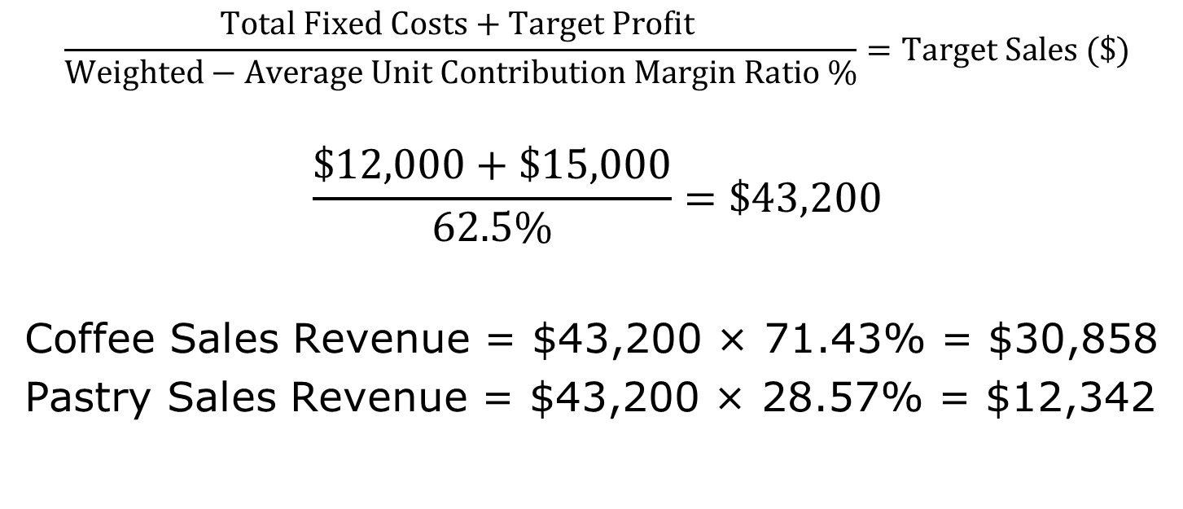
Weighted-Average Contribution Margin Ratio
Assume that the Starbucks’ manager wants to earn a target profit of $15,000
$$\frac{Total Fixed Costs+Target Profit }{Weighted−Average Unit Contribution Margin Ratio \%}=Target Sales (\$)$$
$$\frac{\$12,000+\$15,000}{62.5\%}=\$43,200$$
Coffee Sales Revenue = $43,200 × 71.43% = $30,858
Pastry Sales Revenue = $43,200 × 28.57% = $12,342
6-48
Notes:
Assume that the Starbucks’ manager wants to earn a target profit of $15,000. Given the assumed sales mix, what is the total sales revenue needed to achieve this target profit?
To answer this question, we can use the target sales formula, with the weighted-average contribution margin ratio as the denominator. To determine how much of the $43,200 ($12,000 + $15,000)/62.5%) in target sales revenue must come from each product line, we multiply by the assumed sales mix. Notice that we used the total sales mix (not the unit sales mix) to determine how much of the total sales revenue must come from coffee and pastries. Remember that the 62.5% weighted-average contribution margin ratio was weighted according to the sales mix, not the product mix. Coffee sales would need to be $30,858 ($43,200 x 71.43%) and pastry sales would need to be $12,342 ($43,200 x 28.57%)
The most important thing to remember when performing cost-volume-profit analysis in a multiproduct setting is to assume and maintain a constant product or sales mix. The mix can be stated in terms of the number of units sold or as a percentage of total sales revenue. The only difference between the two is the unit sales price (which is excluded from the product mix but included in the sales mix). Either approach provides the same end result.

