Slide 1
Lab I
Mar. 05, 2018

Slide 2
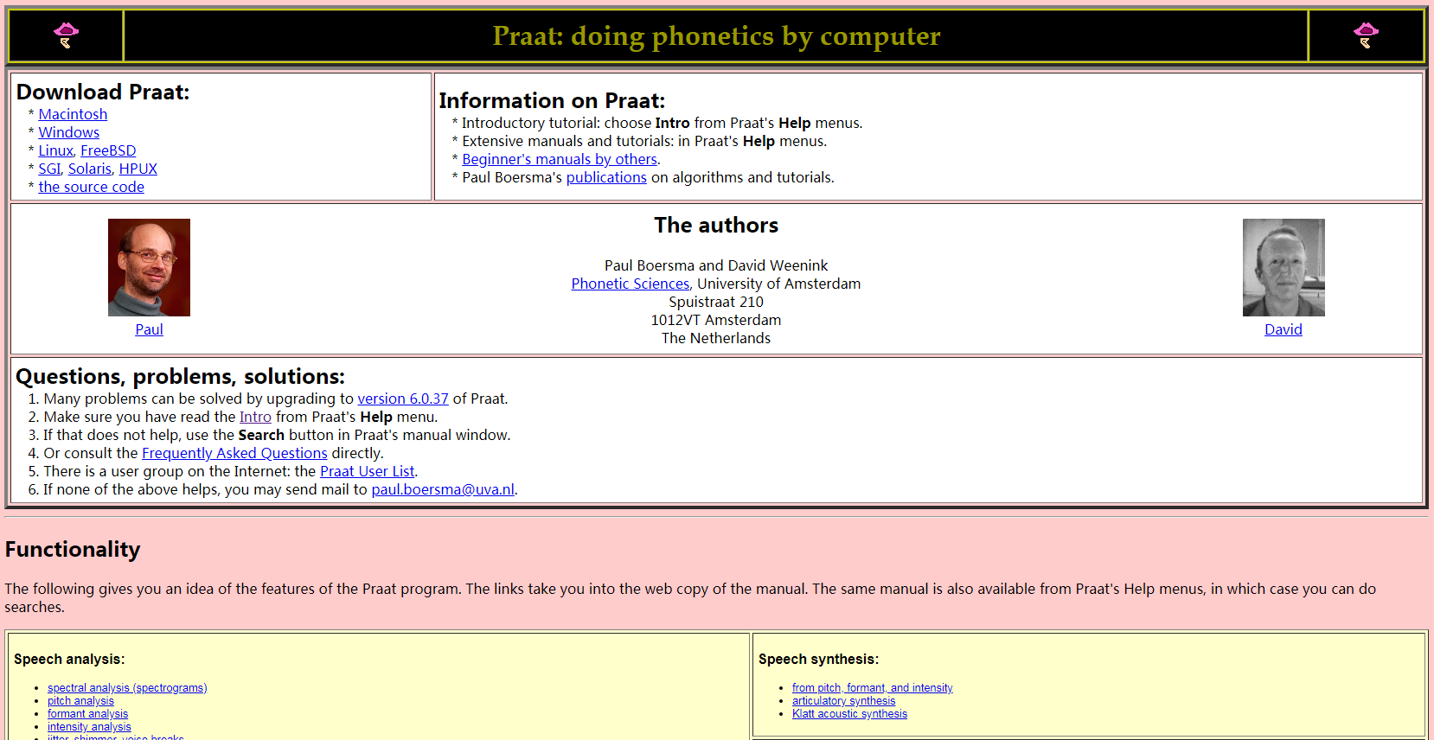
Tool introduction
http://www.fon.hum.uva.nl/praat/

Slide 3
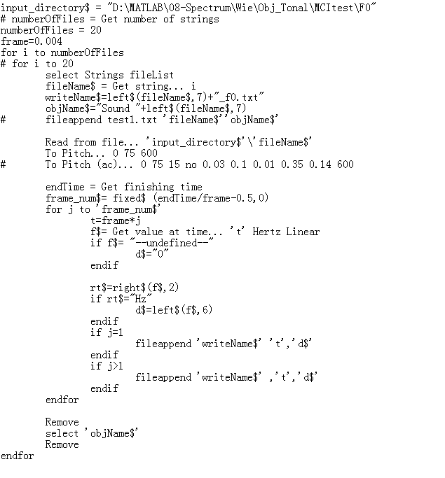

Slide 4
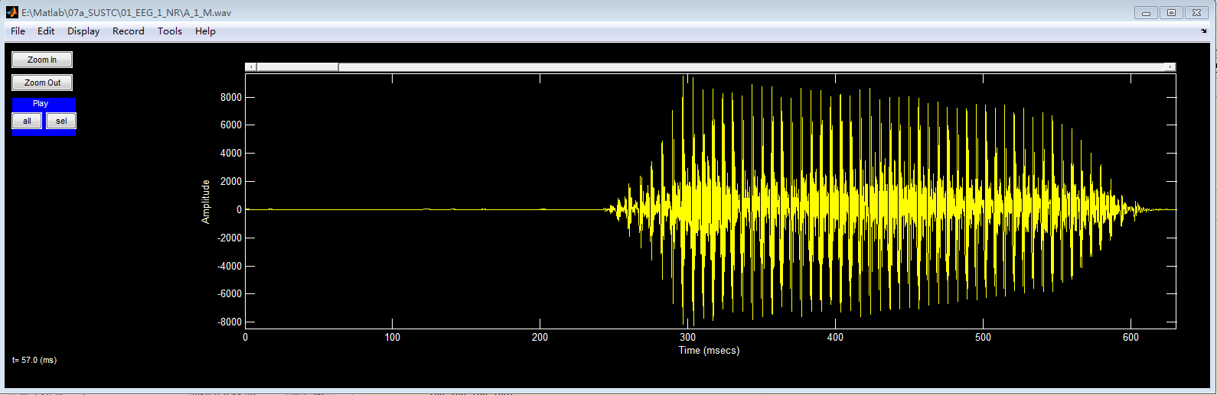
Colea

Slide 5
1) Speech recording
Under Matlab environment, learn to use Matlab codes wavrecord, wavwrite, wavread, wavplay to record vowel /a:/ /i/ /u/.
Use FFT to analyse the spectrum of the recorded vowels.
Plot the spectra, and find the frequencies for peaks of spectral envelope
Mark the positions of F1, F2, F3 in spectra.

Slide 6
Cont.
Download Praat, and learn to use Praat to analyse recorded vowels.
Learn to use Praat to record speech
Extract the spectra from Praat, and find the frequencies for peaks of spectral envelope
Compare with those computed with FFT in Matlab

Slide 7
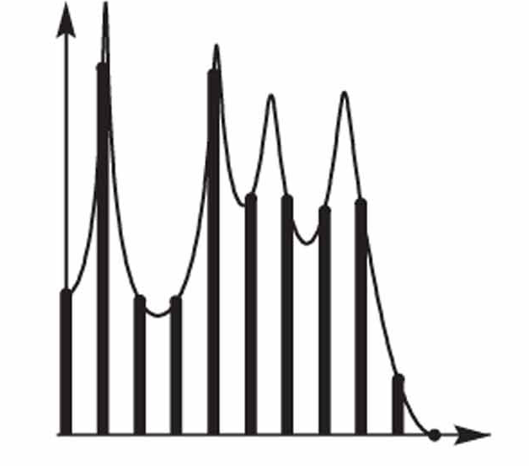
2) Synthesize vowels using pure tones
Sample the spectral envelopes in task 1)
Use pure tones to synthesize vowels /a:/ /i/ /u/
Plot the waveforms of the three synthesized vowels.
Attached the three vowels with lab report.

