Slide 1
Brian Davis¹, Song Guo¹, Kelcy Smith¹
^{January 5, 2017}
¹ SGT, Inc., Contractor to the USGS EROS Center. 47914 252nd Street, Sioux Falls, SD 57198. Work performed under USGS contract G15PC00012.
U.S. Department of the Interior
U.S. Geological Survey
Notes:
Though this is pyccd walkthrough, it needs to be synced with: pyccd ADD (including work flow diagram) and pyccd pseudo-code for pseudo-code review and documentation, before public release.
Target audience is science evaluation team:
George Xian
Quiang Zhou
Alisa Gallant
Daryn Dockter
Ryan Recker
James Vogelman

Slide 2
Agenda
Background
ARD
Basic Terminology
Standard Modeling Components
Variogram (Madogram)
LASSO Regression
Robust Regression
Tmask
Walk Through Change Detection Processing Steps
Describe Output Results
Notes:
Attempt to Introduce clarity, understanding of algorithm, NOT software implementation/version details

Slide 3
Background, Context
Provide understanding of Continuous Change Detection (CCD) algorithm as implemented to aid evaluation, analysis, recommendations for future updates
Corresponds to Matlab Version 12.30 used for processing Chesapeake Bay
Implemented in python
Open source, eliminating licensing restrictions and cost
Platform-independent
Information Warehouse + Data Store (IW + DS) interaction
Science Execution Environment (SEE) processing
python and associated tools, modules, common to HPC Systems
Increase modularity, decrease complexity
Enable sending results to Information Warehouse for subsequent interaction
Future ARD access through API, eliminating file-system data management:
“Answers, Not Data”
Notes:
Python is interpreted, modular, standard mathematics modules, performs operations on entire arrays/data-sets, mature GUI tools, github repository, automated generation of performance analysis and accompanying documentation; - pyccd has drastically reduced LOC, is vastly less complex
Provide understanding of Continuous Change Detection (CCD) algorithm as implemented to aid evaluation, analysis, and recommendations for updates
Originally developed in Matlab
Ported to open source (C), eliminating licensing restrictions and cost, enabling port to any HPC system
Implemented in python for lcmap Information Warehouse + Data Store interaction and SEE processing
python and associated tools common to HPC systems
Python is interpreted, not compiled language, open-source, modular, standard mathematics modules, performs operations on entire arrays/data-sets, mature GUI tools, github repository, generation of accompanying documentation
Efficiently communications with API - Interactive – no longer requires creating/downloading/managing/pre-processing data – ARD taken care of, focus on science, not data management!
Results (coefficients, etc.) stored back to the IW for subsequent on-demand retrieval, but only when ccd is requested to be run. We are not operational yet.

Slide 4
ARD
Pixel Alignment
Consistent Projection
Standardized Extents (tiles)
Standard Level 2 Products Suite
Eliminates Swath Overlap
Adds Side-lap, (Temporal Density)
User-defined Area of Interest (AOI)
ARD Named Future Standard Landsat Product
Notes:
if desired, able to include < 20% clear “scenes”, though those 20% of pixels have some chance of being contaminated by clouds/shadows. What a great idea for the topic of a future research project using API/IW+DS!

Slide 5
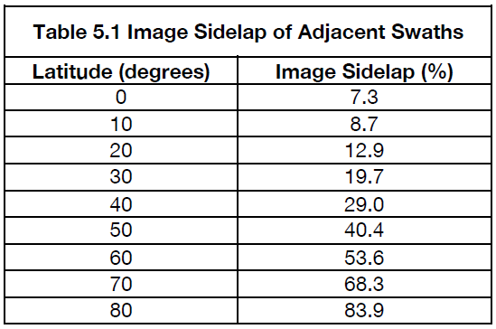
Landsat WRS-2 Side-lap*
* From the Landsat 7 Data Users Handbook
CONUS:
TX/FL ≈ 24º N ≈ 15.62%
WA/ME ≈ 36º N ≈ 20.28%
Avg. ≈ 30º N ≈ 19.70%
Notes:
19.70 * 2 = potentially 39.40% more coverage.

Slide 6
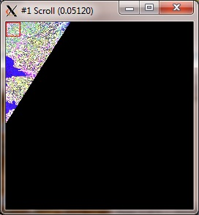
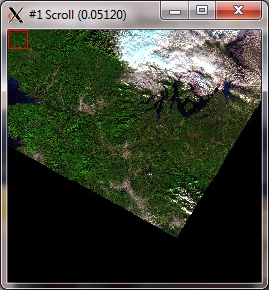
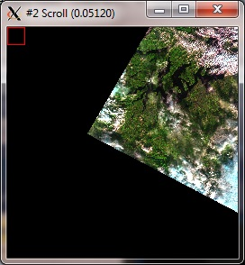
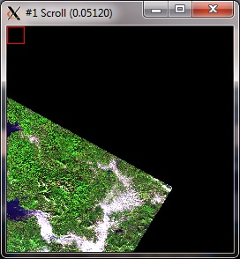
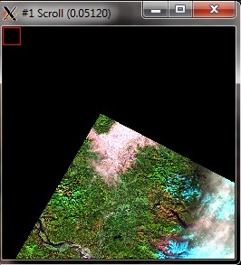
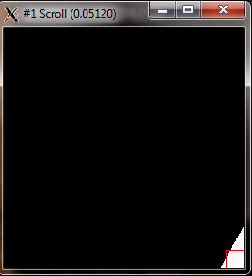
Input – Analysis Ready Data (ARD) WA grid07 Example, 1982 – 2015 TM, ETM+, OLI/TIRS
Path 48
Path 47
Path 46
Path 45
Row 27
Row 28
Notes:
temporal layers, not spatial mosaic
Spatially more dense, AND temporally more dense
This is done For you, no data management required by user to obtain temporal stacks of pixels/data.

Slide 7
Terminology
Model regression fit of points to a curve
Variogram Variogram is a description of the spatial continuity of the data, usually the squares of the differences.
Madogram is instead the abs of the diffs, and the “distance” between points is ignored.
MEOW Minimum Expected Observation Window ( number of coefficients * 3 )
Tmask time-series mask, outliers determined by regression fit using green ( SWIR1) band
Window current sliding array of X # number of observations (model window, peek window, fit window)
Fit Window observations that are used to fit a regression model to, subset of the model window
Model Window observations that are currently represented by a fitted regression model
Peek Window observations that are currently being analyzed / under statistical scrutiny
Stable Model generalized fit 4 coefs (min) from LASSO Regression
Detection Bands subset of spectral bands used to determine outliers and detect change: red, green, NIR, SWIR1, SWIR2
LASSO Regression Initial first attempt at fitting points to curve, and subsequent start detection, change detection
Robust Regression more general purpose curve fitting for identifying outliers
Residual predicted value from a curve fit - actual value, used as a measure of error
Persistent Processing Mask Application of Tmask, cfmask, etc.., to maks, not eliminate data from input arrays
Notes:
Current “best guess”, will update code/pseudo-code upon suggestion and approval. However, keep in mind this will be open source, released to the public, not just a few internal users. Goal is to encourage collaborative efforts. Terminology is hopefully near the middle of a continuum with software engineers at one end and science algorithm experts at the other.

Slide 8


Current CCD Operational Parameters
Change Probability Threshold
Inverse of chi² ( 0.99, number of detection bands )
Outlier Threshold
inverse of chi² ( 1-1e-6, number of detection bands )
Minimum Number of Consecutive Observations required to identify a change
6
Maximum Number of Model Coefficients Produced
8 (insert FFT graphic)
Clear count threshold percent = 0.25
Snow count threshold percent = 0.75
LASSO Regression lambda value = 20 (limiting cross-validation saves processing time)
Notes:
Parameters may be a mis-nomer. In practice, these values are in a .yaml file, which is read, and can be adjusted, but these are not actual “command line arguments”.

Slide 9
pyccd Input Landsat Data
Spectral Band | LT4, LT5, LE7 | LC8
 | Surface Reflectance (SR) Band #
Red | 1 | 2
Green | 2 | 3
Blue | 3 | 4
Visible Near InfraRed (NIR) | 4 | 5
Short Wave InfraRed (SWIR) 1 | 5 | 6
Short Wave InfraRed (SWIR) 2 | 7 | 7
 | Brightness Temperature Band # (Top Of Atmosphere (TOA) Band)
Thermal | 6 | 10
 | CFMASK Band
MASK | cfmask | cfmask
Notes:
Brief Refresher.

Slide 10
Variogram (Median Madogram) Example
Example Red Band DN Values
Absolute value of differences of consecutive pixels
Median of differences: 676
note: Individual Variograms calculated independently for each band
Time
418 | 449 | 1125 | 1069 | 340 | 422 | 1304 | 1585 | 5035 | 498 | ……
31 | 676 | 56 | 729 | 82 | 882 | 281 | 3450 | 4357 | ……
Notes:
Variogram is a description of the spatial continuity of the data, usually the squares of the differences. Madogram is instead the abs of the diffs, and the distance between points is constant, so irrelevant, and not included in calculations.
http://www.gammadesign.com/gswinhelp/other_autocorrelation_measures/madograms.htm

Slide 11

LASSO Regression
C constant or intercept
C₁ slope or trend line
C₂ thru C₇ sinusoid amplitudes
4 Coefficients defined as (referred to as a generalized fit):
C + C₁ + C₂ + C₃
6 Coefficients adds:
C₄ + C₅
8 further adds:
C₆ + C₇
Minimum number of observations required for a fit is defined as:
number of coefficients (4,6,8) * NUM_OBS_FACTOR (3)
Notes:
Lasso regression is mathematical model to do curve fitting of points
Why lasso? Python module call is a standard all python apps/modules adhere to. Calculations are documented and consistent across platforms and applications.
https://www.analyticsvidhya.com/blog/2016/01/complete-tutorial-ridge-lasso-regression-python/
“gives much better output than traditional step-wise regression, requiring fewer parameters and can be automated to a large extent”
Least Absolute Shrinkage and Selection Operator
“Regression with regularization”
size of coefficients is penalized, we don’t want to underfit or overfit

Slide 12
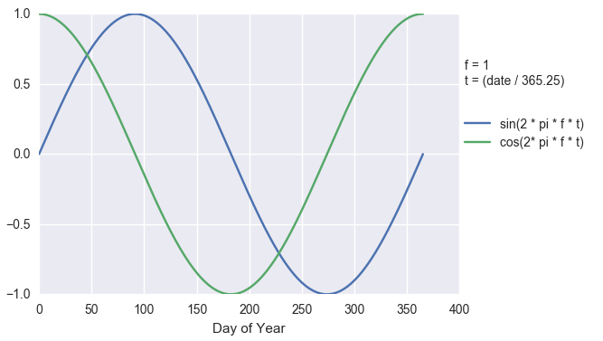
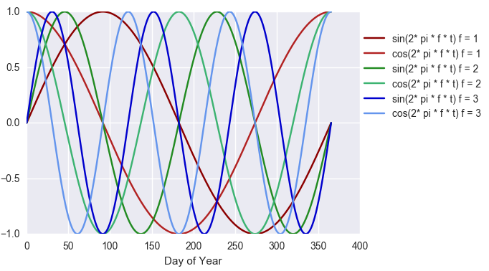
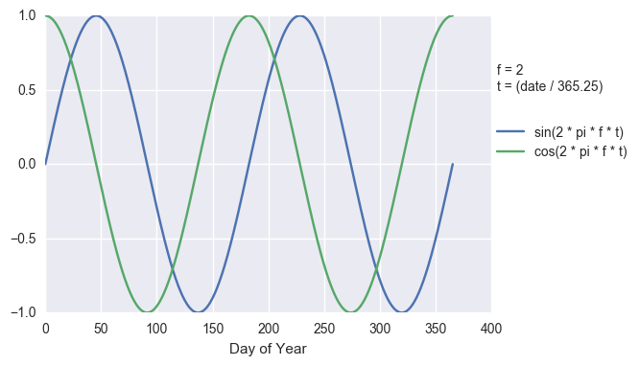
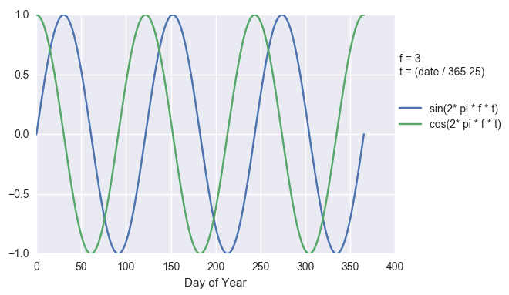
Sine Wave Visualization
Notes:
Some example visualizations to help understand each sinusoid component that comprise a full 8 coefficient fit.

Slide 13
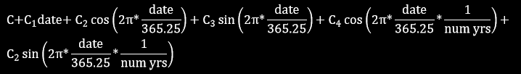
Robust Regression (Ordinary Least Squares)
Number of years refers to the span of years represented by the model window, rounded up
Notes:
OLS should be fairly straightforward for everyone. Chris Holden (BU) is investigating perhaps more accurate solution - “Robust Linear Models”.

Slide 14
Tmask
Use the Robust Regression method to fit curves for the green and SWIR1 bands, for a given observation window.
If any residual is > the Tmask Threshold
( 4.89 * variogram value),
mark the observation as an outlier and update the Persistent Processing Mask
Notes:
“Time-series mask”

Slide 15
main
if the percentage of clear pixels < clear threshold:
if the percentage of snow > snow threshold:
Persistent Snow Procedure
else:
Insufficient Clear Procedure
else:
Standard Procedure
Notes:
pseudo-code, not actual code, but exposure to the former will occur occasionally, so introduce here.

Slide 16
Persistent Snow Procedure
Include observations flagged as snow by the QA
Total observations = snow observations + clear observations
Use only acceptable values (unsaturated)
if num (observations ) > meow size threshold ( default = 12 ):
for band in bands:
if thermal band:
do a generalized curve fit for entire thermal set
else:
if number of observations < meow size threshold (default=12)
set intercept value to constant value
set coefficients to zero
else:
do a generalized curve fit for observation set
Notes:
Get the first 2 simple scenarios out of the way.

Slide 17
Insufficient Clear Procedure
Use the insufficient clear observations
Using the green band, update Persistent Processing Mask to exclude observations exceeding:
green_band_median + 400
Do a generalized curve fit for observation set
Notes:
“generalized curve fit” is lasso regression, described in more detail later
Query Zhe for explanation of why 400 above, why that value (400), and why not below?

Slide 18
Initial Change Detection Setup
Mask out duplicate observations using first of two swath overlap observations
Sort temporally
Convert thermal values from degrees Kelvin to Celsius:
value = value * 10 – 27315
Create mask(s) of values that fall outside of acceptable ranges, considered saturated if > acceptable maximum:
Reflectance acceptable range: 0 -> 10,000
Thermal acceptable range: -9,320 -> 7,070
Create Variogram (madogram) for each band
Notes:
so you can’t shoot yourself in the foot. Can be requested from the API with all these filters already enacted, but users may get data from who knows where. This is incorporated for safety’s sake, but should never have to be used in “operational/production” processing.
*Input observations are inferred to be in temporal order
Code is currently inefficient in filtering at start and in procedure, but we are not talking about implementation details here, we are describing functionality.

Slide 19
Standard Procedure Flow Chart
Initialize Model Window
> 12 obs, > 1 yr
Increment:
start, end
Build Initial Curve Fit
Yes
Stable?
No
Continuous Monitoring
Update Fit Window,
Include Observation
Build New Curve Fit
Yes
Look Back
New Curve?
No
Look Forward
Include
Observation
Adjust Model
Window Start
Detect Change
Detect Start
Yes
Change Magnitude less
than Change Threshold
No
Yes
No
Record Change Model
Change Magnitude less
than Change Threshold
Observations Exhausted
Finish
Notes:
Animation

Slide 20
Standard Procedure Flow Chart
Initialize Model Window
> 12 obs, > 1 yr
Increment:
start, end
Build Initial Curve Fit
Yes
Stable?
No
Continuous Monitoring
Update Fit Window,
Include Observation
Build New Curve Fit
Yes
Look Back
New Curve?
No
Look Forward
Include
Observation
Adjust Model
Window Start
Detect Change
Detect Start
Yes
Change Magnitude less
than Change Threshold
No
Yes
No
Record Change Model
Change Magnitude less
than Change Threshold
Observations Exhausted
Finish
Notes:
Changed “Update stop, break, Include Observation” changed to “Update Fit Window, Include Observation”. Kelcy?
Flow Chart to be incorporated into ADD.

Slide 21
Standard Procedure Flow Chart
Initialize Model Window
> 12 obs, > 1 yr
Increment:
start, end
Build Initial Curve Fit
Yes
Stable?
No
Continuous Monitoring
Update stop, break
Include Observation
Build New Curve Fit
Yes
Look Back
New Curve?
No
Look Forward
Include
Observation
Adjust Model
Window Start
Detect Change
Detect Start
Yes
Change Magnitude less
than Change Threshold
No
Yes
No
Record Change Model
Change Magnitude less
than Change Threshold
Observations Exhausted
Finish
Notes:
Init: Assess Observation Window Data, establish stable time frame for calculating a model

Slide 22
Standard Procedure Flow Chart
Initialize Model Window
Initialize Model Window
> 12 obs, > 1 yr
Increment:
start, end
Build Initial Curve Fit
Yes
Stable?
No
initialize first model window
(start is set to previous break point; window size set to contain 12 observations)
while there are clear observations:
mask outliers in current window as defined by tmask
if not enough observations (12) and minimum temporal span (1 year) in the window:
increase window size by 1 continue to the next observation
Continuous Monitoring
Update stop, break
Include Observation
Build New Curve Fit
Yes
Look Back
New Curve?
No
Look Forward
Include
Observation
Adjust Model
Window Start
Detect Change
Detect Start
Yes
Change Magnitude less
than Change Threshold
No
Yes
No
Record Change Model
Change Magnitude less
than Change Threshold
Observations Exhausted
Finish

Slide 23
Standard Procedure Flow Chart
Initialize Model Window
> 12 obs, > 1 yr
Increment:
start, end
Build Initial Curve Fit
Yes
Stable?
No
Continuous Monitoring
Update stop, break
Include Observation
Build New Curve Fit
Yes
Look Back
New Curve?
No
Look Forward
Include
Observation
Adjust Model
Window Start
Detect Change
Detect Start
Yes
Change Magnitude less
than Change Threshold
No
Yes
No
Record Change Model
Change Magnitude less
than Change Threshold
Observations Exhausted
Finish
Notes:
Build Initial Curve Fit: data has been filtered by Tmask

Slide 24
Standard Procedure Flow Chart
Build Initial Curve Fit
Initialize Model Window
> 12 obs, > 1 yr
Increment:
start, end
Build Initial Curve Fit
Yes
Stable?
No
perform LASSO Regression using 4-coefficient model
Continuous Monitoring
Update stop, break
Include Observation
Build New Curve Fit
Yes
Look Back
New Curve?
No
Look Forward
Include
Observation
Adjust Model
Window Start
Detect Change
Detect Start
Yes
Change Magnitude less
than Change Threshold
No
Yes
No
Record Change Model
Change Magnitude less
than Change Threshold
Observations Exhausted
Finish

Slide 25
Standard Procedure Flow Chart
Initialize Model Window
> 12 obs, > 1 yr
Increment:
start, end
Build Initial Curve Fit
Yes
Stable?
No
Continuous Monitoring
Update stop, break
Include Observation
Build New Curve Fit
Yes
Look Back
New Curve?
No
Look Forward
Include
Observation
Adjust Model
Window Start
Detect Change
Detect Start
Yes
Change Magnitude less
than Change Threshold
No
Yes
No
Record Change Model
Change Magnitude less
than Change Threshold
Observations Exhausted
Finish
Notes:
Stable?: Predicted Values within Threshold?

Slide 26
Stable?
Standard Procedure Flow Chart
Initialize Model Window
> 12 obs, > 1 yr
Increment:
start, end
Build Initial Curve Fit
Yes
Stable?
No
for each of the detection bands ( r, g, n, s1, s2)
model slope coef * diff ( end – start dates )
check_vals = ( |slope| + |first model residual| + |last model residual| ) / MAX
(where MAX = max (variogram, model RMSE) )
if summation of ( check_vals )² < change threshold:
stable
else:
increment model window start and end by 1
Continuous Monitoring
Update stop, break
Include Observation
Build New Curve Fit
Yes
Look Back
New Curve?
No
Look Forward
Include
Observation
Adjust Model
Window Start
Detect Change
Detect Start
Yes
Change Magnitude less
than Change Threshold
No
Yes
No
Record Change Model
Change Magnitude less
than Change Threshold
Observations Exhausted
Finish

Slide 27
Standard Procedure Flow Chart
Stable? (example)
Initialize Model Window
> 12 obs, > 1 yr
Increment:
start, end
Build Initial Curve Fit
Yes
Stable?
No
Observations (Green Band)
Fitted Model (Green Band)
C = -44782.78
C₁ = 0.062 (slope coefficient)
C₂ = 194.19
C₃ = 0
Model Window = start: 724785 end: 725777
First Residual = 200 Last Residual = -56
Green check value = (|0.062 * (725777 - 724785)| + |200| + |-56|) / 32.56 = 9.751351351351351
Red = 10.56 NIR = 15.23 SWIR1 = 18.78 SWIR2 = 37.96
Check Value = 9.75² + 10.56² + 15.23² + 18.78² + 37.96² = 1440.96
Continuous Monitoring
4614 | 514 | 602 | 484 | 549 | 2673 | 731 | 2662 | 954 | 1329 | 1827 | 5102
Update stop, break
Include Observation
Build New Curve Fit
Yes
Look Back
New Curve?
No
Look Forward
Include
Observation
Adjust Model
Window Start
Detect Change
Detect Start
Yes
Change Magnitude less
than Change Threshold
No
Yes
No
Record Change Model
Change Magnitude less
than Change Threshold
Observations Exhausted
Finish

Slide 28
Standard Procedure Flow Chart
Initialize Model Window
> 12 obs, > 1 yr
Increment:
start, end
Build Initial Curve Fit
Yes
Stable?
No
Continuous Monitoring
Update stop, break
Include Observation
Build New Curve Fit
Yes
Look Back
New Curve?
No
Look Forward
Include
Observation
Adjust Model
Window Start
Detect Change
Detect Start
Yes
Change Magnitude less
than Change Threshold
No
Yes
No
Record Change Model
Change Magnitude less
than Change Threshold
Observations Exhausted
Finish
Notes:
Lookback: look bacwkard in time at previous values (Left of break)

Slide 29
Standard Procedure Flow Chart
Look Back
Initialize Model Window
> 12 obs, > 1 yr
Increment:
start, end
Build Initial Curve Fit
Yes
Stable?
No
for each observation preceding current model window start and end of previous model window:
If change magnitude < change threshold:
add observation to current model window
else:
proceed with continuous monitoring
note: when look-back is complete, if this is the very first model window, and there 6 or more unused observations, do a general curve fit on them
Continuous Monitoring
Update stop, break
Include Observation
Build New Curve Fit
Yes
Look Back
New Curve?
No
Look Forward
Include
Observation
Adjust Model
Window Start
Detect Change
Detect Start
Yes
Change Magnitude less
than Change Threshold
No
Yes
No
Record Change Model
Change Magnitude less
than Change Threshold
Observations Exhausted
Finish

Slide 30
Standard Procedure Flow Chart
Look Back ( adjusting the model start )
Initialize Model Window
> 12 obs, > 1 yr
Increment:
start, end
Build Initial Curve Fit
Yes
Stable?
No
Time (Julian days)
Continuous Monitoring
day ( i_start )
day ( j )
day ( j + T )
Update stop, break
Include Observation
Build New Curve Fit
Yes
Peek Window
Model Window
Peek Window
Peek Window
Peek Window
Look Back
New Curve?
No
Look Forward
Include
Observation
Adjust Model
Window Start
Detect Change
Detect Start
Yes
Change Magnitude less
than Change Threshold
No
Yes
No
Record Change Model
Change Magnitude less
than Change Threshold
clear_x ( i_start )
clear_x ( i )
clear_x ( i + N )
Observations Exhausted
Observations
Finish
Notes:
This contains amination objects.
Encountering a break/change (an observation that does NOT fit model/curve of the current Model Window) causes the peek window to stop.

Slide 31
Standard Procedure Flow Chart
Initialize Model Window
> 12 obs, > 1 yr
Increment:
start, end
Build Initial Curve Fit
Yes
Stable?
No
Continuous Monitoring
Update stop, break
Include Observation
Build New Curve Fit
Yes
Look Back
New Curve?
No
Look Forward
Include
Observation
Adjust Model
Window Start
Detect Change
Detect Start
Yes
Change Magnitude less
than Change Threshold
No
Yes
No
Record Change Model
Change Magnitude less
than Change Threshold
Observations Exhausted
Finish
Notes:
Detect Start: “Detect Start of current model window” (matlab version has one more initial model fit before passing to Continuous Monitoring, if none of the look-back observations fit, and the number greater than six, see if they can be their own model)

Slide 32
Standard Procedure Flow Chart
Detect Start
Initialize Model Window
> 12 obs, > 1 yr
Increment:
start, end
Build Initial Curve Fit
Yes
Stable?
No
using the observations in the Peek Window, calculate a change magnitude per observation:
for each of the detection bands ( r, g, n, s1, s2):
difference magnitude = residuals / MAX
(where MAX = max ( variogram, model RMSE ) )
change magnitude = sum ( difference magnitude ^2 )
if the minimum ( change magnitude ) > change threshold:
change detected
if the first change magnitude > outlier threshold:
update Persistent Processing Mask
else:
include the observation in the Model Window
Continuous Monitoring
Update stop, break
Include Observation
Build New Curve Fit
Yes
Look Back
New Curve?
No
Look Forward
Include
Observation
Adjust Model
Window Start
Detect Change
Detect Start
Yes
Change Magnitude less
than Change Threshold
No
Yes
No
Record Change Model
Change Magnitude less
than Change Threshold
Observations Exhausted
Finish

Slide 33
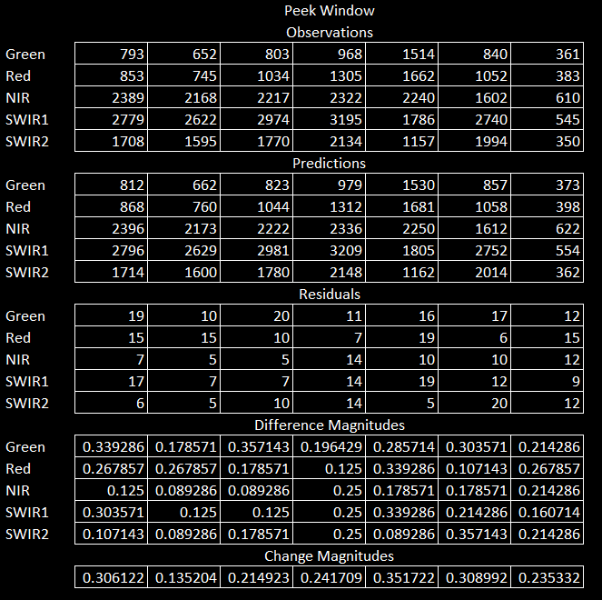
Standard Procedure Flow Chart
Detect Start
(Calculate Change Magnitudes example)
Initialize Model Window
> 12 obs, > 1 yr
Increment:
start, end
Build Initial Curve Fit
Yes
Stable?
No
Continuous Monitoring
Update stop, break
Include Observation
Build New Curve Fit
Yes
Look Back
New Curve?
No
Look Forward
Include
Observation
Adjust Model
Window Start
Detect Change
Detect Start
Yes
Change Magnitude less
than Change Threshold
No
Yes
No
Record Change Model
Change Magnitude less
than Change Threshold
Observations Exhausted
Finish
Notes:
Example values for descriptive purposes only.

Slide 34
Standard Procedure Flow Chart
Initialize Model Window
> 12 obs, > 1 yr
Increment:
start, end
Build Initial Curve Fit
Yes
Stable?
No
Continuous Monitoring
Update stop, break
Include Observation
Build New Curve Fit
Yes
Look Back
New Curve?
No
Look Forward
Include
Observation
Adjust Model
Window Start
Detect Change
Detect Start
Yes
Change Magnitude less
than Change Threshold
No
Yes
No
Record Change Model
Change Magnitude less
than Change Threshold
Observations Exhausted
Finish

Slide 35
Standard Procedure Flow Chart
Initialize Model Window
> 12 obs, > 1 yr
Increment:
start, end
Build Initial Curve Fit
Yes
Stable?
No
Continuous Monitoring
Update stop, break
Include Observation
Build New Curve Fit
Yes
Look Back
New Curve?
No
Look Forward
Include
Observation
Adjust Model
Window Start
Detect Change
Detect Start
Yes
Change Magnitude less
than Change Threshold
No
Yes
No
Record Change Model
Change Magnitude less
than Change Threshold
Observations Exhausted
Finish
Notes:
Continuous Monitoring: process subsequent observations, no tmask filtering in place

Slide 36
Standard Procedure Flow Chart
Continuous Monitoring
Initialize Model Window
> 12 obs, > 1 yr
Increment:
start, end
Build Initial Curve Fit
Yes
Stable?
No
loop through remaining observations until change is detected or observations are exhausted
Continuous Monitoring
Update stop, break
Include Observation
Build New Curve Fit
Yes
Look Back
New Curve?
No
Look Forward
Include
Observation
Adjust Model
Window Start
Detect Change
Detect Start
Yes
Change Magnitude less
than Change Threshold
No
Yes
No
Record Change Model
Change Magnitude less
than Change Threshold
Observations Exhausted
Finish

Slide 37
Standard Procedure Flow Chart
Initialize Model Window
> 12 obs, > 1 yr
Increment:
start, end
Build Initial Curve Fit
Yes
Stable?
No
Continuous Monitoring
Update stop, break
Include Observation
Build New Curve Fit
Yes
Look Back
New Curve?
No
Look Forward
Include
Observation
Adjust Model
Window Start
Detect Change
Detect Start
Yes
Change Magnitude less
than Change Threshold
No
Yes
No
Record Change Model
Change Magnitude less
than Change Threshold
Observations Exhausted
Finish

Slide 38
Standard Procedure Flow Chart
Build New Curve Fit
Initialize Model Window
> 12 obs, > 1 yr
Increment:
start, end
Build Initial Curve Fit
Yes
Stable?
No
utilize LASSO Regression with a set number of coefficients based on the number of observations encompassed by the model window
Number of Coefficents per Model Window size:
# coefficents observation count*
4 12
6 18
8 24
*number of coefficient times the NUM_OBS_FACTOR (3)
Continuous Monitoring
Update stop, break
Include Observation
Build New Curve Fit
Yes
Look Back
New Curve?
No
Look Forward
Include
Observation
Adjust Model
Window Start
Detect Change
Detect Start
Yes
Change Magnitude less
than Change Threshold
No
Yes
No
Record Change Model
Change Magnitude less
than Change Threshold
Observations Exhausted
Finish

Slide 39
Standard Procedure Flow Chart
Look Forward ( extending the model in time )
Initialize Model Window
> 12 obs, > 1 yr
Increment:
start, end
Build Initial Curve Fit
Yes
Stable?
No
Time (Julian days)
day ( 0 )
day ( i )
Continuous Monitoring
day ( i * 1.33 )
Fit Window
Build New Curve Fit
Fit Window
Update stop, break
Include Observation
Yes
Peek Window
Peek Window
Peek Window
Peek Window
Model Window
No
Look Back
New Curve?
Look Forward
Include
Observation
Adjust Model
Window Start
Detect Change
Detect Start
Yes
Change Magnitude less
than Change Threshold
No
Yes
No
Record Change Model
Change Magnitude less
than Change Threshold
clear_x ( 0 )
clear_x ( 24 )
clear_x ( i_start )
Observations Exhausted
Observations
Finish
Notes:
Contains animation objects
The peek window stop if a) an observation is encountered that does not fit the model/curve of the current Model Window, or b) elapsed time of 1.33 times that of the Model Window. Hence, 2 different X axes and labels.

Slide 40
Standard Procedure Flow Chart
Initialize Model Window
> 12 obs, > 1 yr
Increment:
start, end
Build Initial Curve Fit
Yes
Stable?
No
Continuous Monitoring
Update stop, break
Include Observation
Build New Curve Fit
Yes
Look Back
New Curve?
No
Look Forward
Include
Observation
Adjust Model
Window Start
Detect Change
Detect Start
Yes
Change Magnitude less
than Change Threshold
No
Yes
No
Record Change Model
Change Magnitude less
than Change Threshold
Observations Exhausted
Finish

Slide 41
Detect Change
Standard Procedure Flow Chart
Initialize Model Window
> 12 obs, > 1 yr
Increment:
start, end
Build Initial Curve Fit
Yes
Stable?
No
using the observations in the Peek Window
if the Model Window > 24 observations:
model RMSE used is recalculated using the closest 24 observations temporally to the Peek Window
calculate a change magnitude per observation
for each of the detection bands ( r ,g, n, s1, s2):
difference magnitude = residuals / MAX
( where MAX = max ( variogram, model RMSE) )
change magnitude = sum ( difference magnitude ^2 )
if the minimum ( change magnitude ) > change threshold:
change detected
if the first change magnitude > outlier threshold:
update persistent processing mask
else:
include the observation in the model window
Continuous Monitoring
Update stop, break
Include Observation
Build New Curve Fit
Yes
Look Back
New Curve?
No
Look Forward
Include
Observation
Adjust Model
Window Start
Detect Change
Detect Start
Yes
Change Magnitude less
than Change Threshold
No
Yes
No
Record Change Model
Change Magnitude less
than Change Threshold
Observations Exhausted
Finish

Slide 42
Standard Procedure Flow Chart
Initialize Model Window
> 12 obs, > 1 yr
Increment:
start, end
Build Initial Curve Fit
Yes
Stable?
No
Continuous Monitoring
Update stop, break
Include Observation
Build New Curve Fit
Yes
Look Back
New Curve?
No
Look Forward
Include
Observation
Adjust Model
Window Start
Detect Change
Detect Start
Yes
Change Magnitude less
than Change Threshold
No
Yes
No
Record Change Model
Change Magnitude less
than Change Threshold
Observations Exhausted
Finish

Slide 43
Standard Procedure Flow Chart
New Curve?
Initialize Model Window
> 12 obs, > 1 yr
Increment:
start, end
Build Initial Curve Fit
Yes
Stable?
No
If < 24 observations:
model new curve with LASSO Regression
if > 24 observations and the time span of observations has increased by a factor of 1.33 since the last curve fit:
model new curve LASSO Regression
else:
continue to use existing model curve
Continuous Monitoring
Update stop, break
Include Observation
Build New Curve Fit
Yes
Look Back
New Curve?
No
Look Forward
Include
Observation
Adjust Model
Window Start
Detect Change
Detect Start
Yes
Change Magnitude less
than Change Threshold
No
Yes
No
Record Change Model
Change Magnitude less
than Change Threshold
Observations Exhausted
Finish

Slide 44
Standard Procedure Flow Chart
Initialize Model Window
> 12 obs, > 1 yr
Increment:
start, end
Build Initial Curve Fit
Yes
Stable?
No
Continuous Monitoring
Update stop, break
Include Observation
Build New Curve Fit
Yes
Look Back
New Curve?
No
Look Forward
Include
Observation
Adjust Model
Window Start
Detect Change
Detect Start
Yes
Change Magnitude less
than Change Threshold
No
Yes
No
Record Change Model
Change Magnitude less
than Change Threshold
Observations Exhausted
Finish

Slide 45
Standard Procedure Flow Chart
Initialize Model Window
> 12 obs, > 1 yr
Increment:
start, end
Build Initial Curve Fit
Yes
Stable?
No
Continuous Monitoring
Update stop, break
Include Observation
Build New Curve Fit
Yes
Look Back
New Curve?
No
Look Forward
Include
Observation
Adjust Model
Window Start
Detect Change
Detect Start
Yes
Change Magnitude less
than Change Threshold
No
Yes
No
Record Change Model
Change Magnitude less
than Change Threshold
Observations Exhausted
Finish

Slide 46
Standard Procedure Flow Chart
Initialize Model Window
> 12 obs, > 1 yr
Increment:
start, end
Build Initial Curve Fit
Yes
Stable?
No
Continuous Monitoring
Update stop, break
Include Observation
Build New Curve Fit
Yes
Look Back
New Curve?
No
Look Forward
Include
Observation
Adjust Model
Window Start
Detect Change
Detect Start
Yes
Change Magnitude less
than Change Threshold
No
Yes
No
Record Change Model
Change Magnitude less
than Change Threshold
Observations Exhausted
Finish

Slide 47
Standard Procedure Flow Chart
Record Change Model
Initialize Model Window
> 12 obs, > 1 yr
Increment:
start, end
Build Initial Curve Fit
Yes
Stable?
No
start
end
break
per band coefficients
per band RMSE’s
per band median of the last used Peek Window residuals
number of observations
number of fitted coefficients
change probability
Continuous Monitoring
Update stop, break
Include Observation
Build New Curve Fit
Yes
Look Back
New Curve?
No
Look Forward
Include
Observation
Adjust Model
Window Start
Detect Change
Detect Start
Yes
Change Magnitude less
than Change Threshold
No
Yes
No
Record Change Model
Change Magnitude less
than Change Threshold
Observations Exhausted
Finish

Slide 48
Standard Procedure Flow Chart
Initialize Model Window
> 12 obs, > 1 yr
Increment:
start, end
Build Initial Curve Fit
Yes
Stable?
No
Continuous Monitoring
Update stop, break
Include Observation
Build New Curve Fit
Yes
Look Back
New Curve?
No
Look Forward
Include
Observation
Adjust Model
Window Start
Detect Change
Detect Start
Yes
Change Magnitude less
than Change Threshold
No
Yes
No
Record Change Model
Change Magnitude less
than Change Threshold
Observations Exhausted
Finish

Slide 49
Standard Procedure Flow Chart
Finish
Initialize Model Window
> 12 obs, > 1 yr
Increment:
start, end
Build Initial Curve Fit
Yes
Stable?
No
if the number of remaining observations is < MEOW size but >= Peek Size:
fit a generalized model is for remaining observations
send/save output results
exit
Continuous Monitoring
Update stop, break
Include Observation
Build New Curve Fit
Yes
Look Back
New Curve?
No
Look Forward
Include
Observation
Adjust Model
Window Start
Detect Change
Detect Start
Yes
Change Magnitude less
than Change Threshold
No
Yes
No
Record Change Model
Change Magnitude less
than Change Threshold
Observations Exhausted
Finish

Slide 50
Standard Procedure Flow Chart
Initialize Model Window
> 12 obs, > 1 yr
Increment:
start, end
Build Initial Curve Fit
Yes
Stable?
No
Continuous Monitoring
Update stop, break
Include Observation
Build New Curve Fit
Yes
Look Back
New Curve?
No
Look Forward
Include
Observation
Adjust Model
Window Start
Detect Change
Detect Start
Yes
Change Magnitude less
than Change Threshold
No
Yes
No
Record Change Model
Change Magnitude less
than Change Threshold
Observations Exhausted
Finish

Slide 51
Standard Procedure Flow Chart
Results Output
Initialize Model Window
> 12 obs, > 1 yr
Increment:
start, end
Build Initial Curve Fit
Yes
Stable?
No
start
end
break
per band coefficients
per band RMSE’s
per band median of the last used Peek Window residuals
number of observations
number of fitted coefficients
change probability
list of recorded change models
procedure used
Persistent Processing Mask
algorithm version
Continuous Monitoring
Update stop, break
Include Observation
Build New Curve Fit
Yes
Look Back
New Curve?
No
Look Forward
Include
Observation
Adjust Model
Window Start
Detect Change
Detect Start
Yes
Change Magnitude less
than Change Threshold
No
Yes
No
Record Change Model
Change Magnitude less
than Change Threshold
Observations Exhausted
Finish
Notes:
x/y location will be handled by the API/invocation capability.

Slide 52
Questions / Discussion

Slide 53
Acronym List
AOI Area Of Interest
API Application Programming Interface
ARD Analysis Ready Data
CCD Continuous Change Detection
CFMASK C version of Function of MASK
DN Digital Number
EROS Earth Resources Observation and Science
IW+DS Information Warehouse + Data Store
LASSO Least Absolute Shrinkage and Selection Operator
LCMAP Land Change Monitoring and Projection
MEOW Minimum Expected Observation Window
NIR Near InfraRed
SR Surface Reflectance
SWIR Short Wave InfraRed
TOA Top Of Atmosphere

Slide 54
Bibliography
CCD:
http://www.sciencedirect.com/science/article/pii/S0034425714000248
http://www.sciencedirect.com/science/article/pii/S0034425715000590
http://www.sciencedirect.com/science/article/pii/S0034425712000387
ARD:
https://drive.google.com/drive/folders/0B5wwu78kdogOfmZIWGI1S2dNRE5LeDVNeGxDU1phUndyTHpMbUVuNFdFNTZBV2RsbVhqMjQ
https://drive.google.com/a/doi.gov/file/d/0B5wwu78kdogONnN5N1BGTjFvdGM/view?usp=sharing
ADD, these slides:
https://drive.google.com/drive/folders/0BzELHvbrg1pDREJlTF8xOHBZbEU?usp=sharing
git Repository:
https://github.com/USGS-EROS/lcmap-pyccd/tree/develop
https://drive.google.com/drive/folders/0B5wwu78kdogOfmZIWGI1S2dNRE5LeDVNeGxDU1phUndyTHpMbUVuNFdFNTZBV2RsbVhqMjQ
https://drive.google.com/drive/folders/0B5wwu78kdogOfmZIWGI1S2dNRE5LeDVNeGxDU1phUndyTHpMbUVuNFdFNTZBV2RsbVhqMjQ

