Slide 1
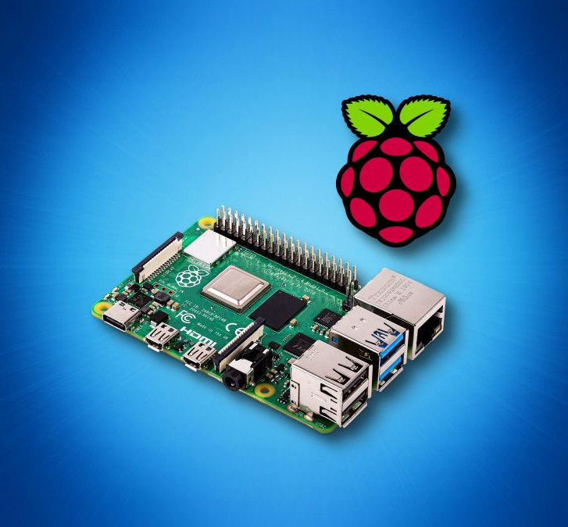
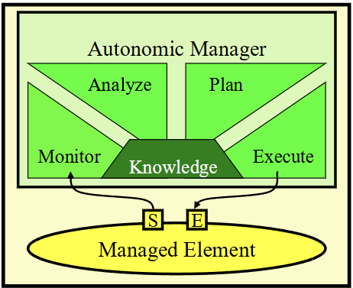
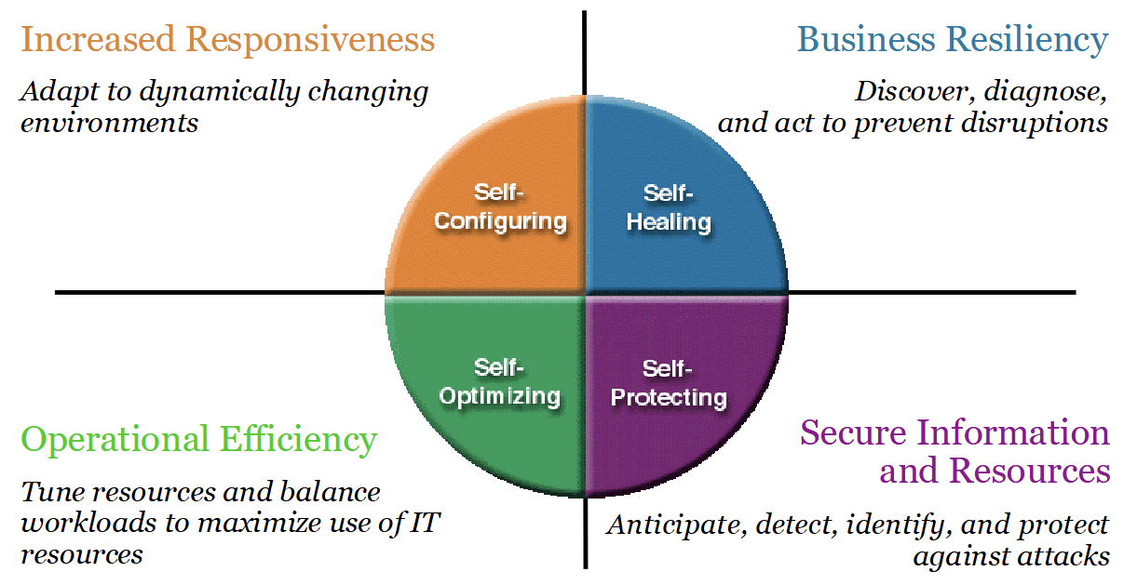
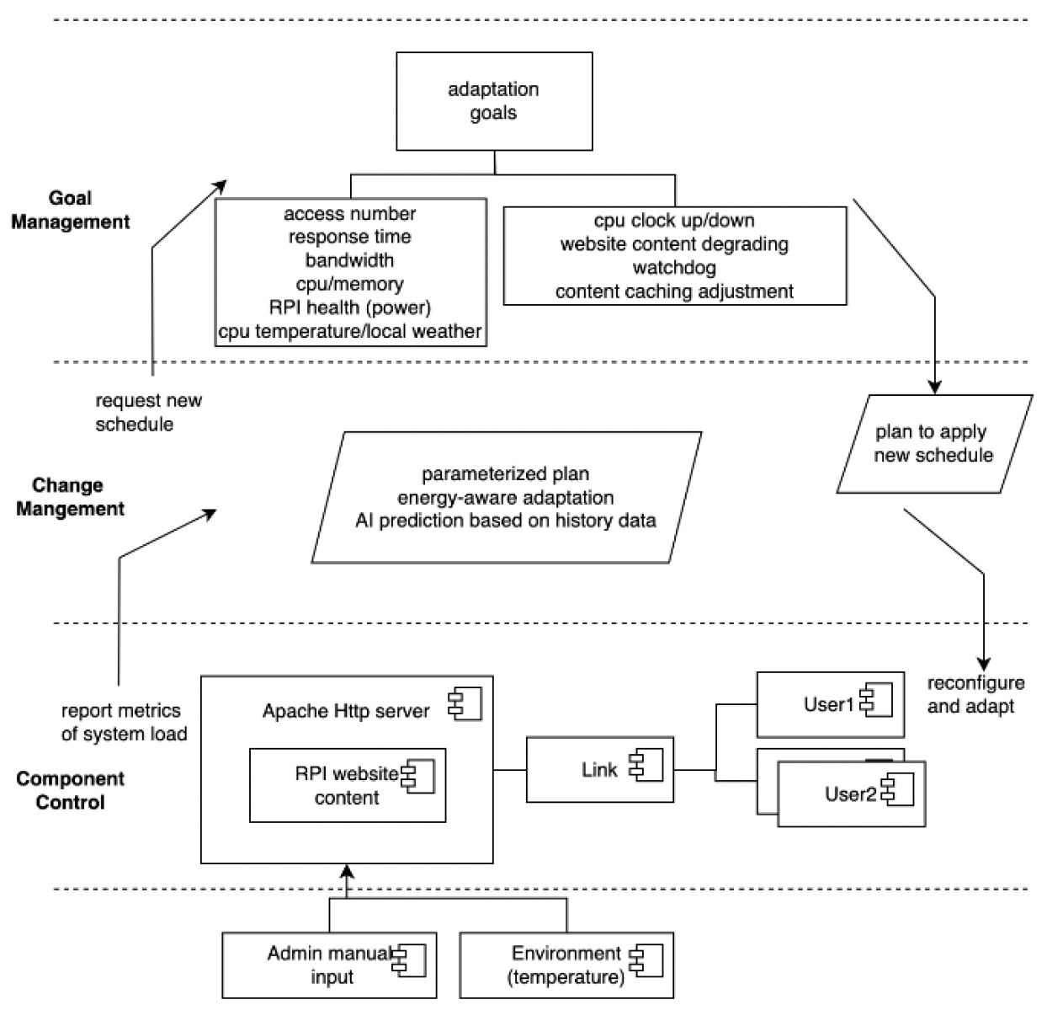
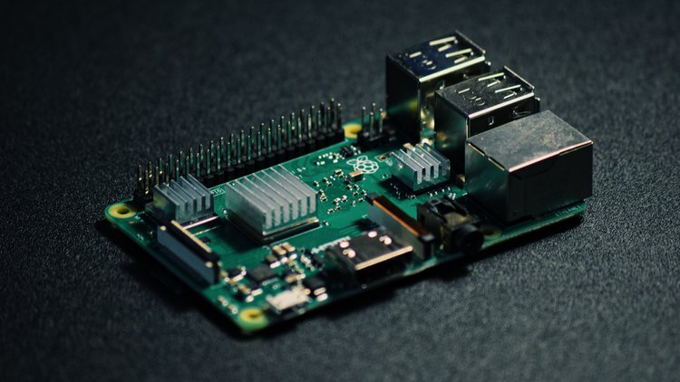
Unbeatable Website on a Pi: A Self-Adaptive Approach
ESASS 2024 Project Poster by Arthur Li & Daniel Almeida (Professor: Dr. Ladan Tahvildari) – Department of Electrical and Computer Engineering
Problem Statement
Motivation
MAKE-K
Reliability of Raspberry Pi Website (RPiWeb)
Remote location, unreliable environments, resource-constrained
Downtime, manual restarts, wasted resources/overprovisioning
Ensure consistent uptime and user confidence
Raspberry Pi Utility
Introduce dependable Raspberry Pi platform for personal web hosting
Monitoring
Python monitoring daemon tracking system metrics
Enable external weather metric monitoring
Analysis and Planning
Optimal metric thresholds
Content degradation from dynamic to static
CPU clock speed & voltage
Execution and Knowledge
Watchdog timer reboots
Historical data for adaptive threshold refinement
HTML adaptation templates
Self-CHOP
Proposed Framework
Project Goal
Conclusions
Self-Configuration
Adjust CPU clock speeds dynamically
Self-Optimizing
Content degradation
Self-Healing
Crash recovery via watchdog mechanism
Self-Protection
Priority-based fallback pages
1-No additional expense except a single RPi board
2-Deploy it and Forget it !
Case Study
Conclusions & Future Work
References
[1] J. O. Kephart and D. M. Chess, "The Vision of Autonomic Computing," IEEE Computer Magazine, pp. 41-50, Jan. 2003
[2] L. Tahvildari, ECE750-T37: Engineering Self-Adaptive Software Systems, Lecture 1, Dept. of Elect. and Comp. Eng., University of Waterloo, 2024

Slide 2
