Slide 1
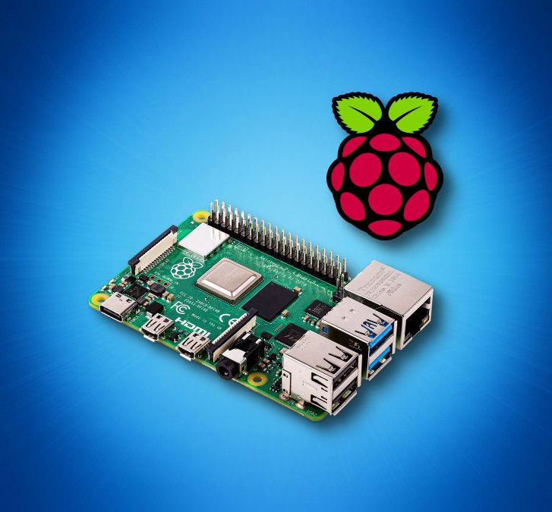
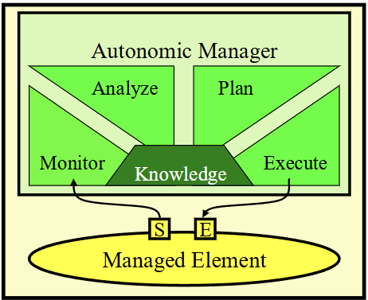
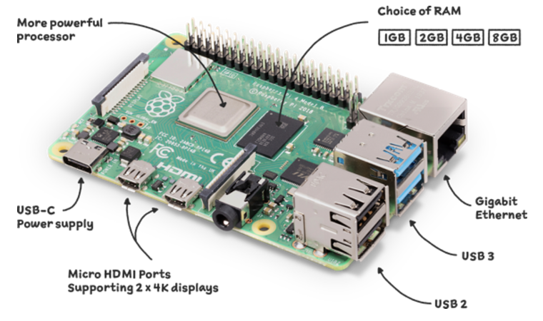
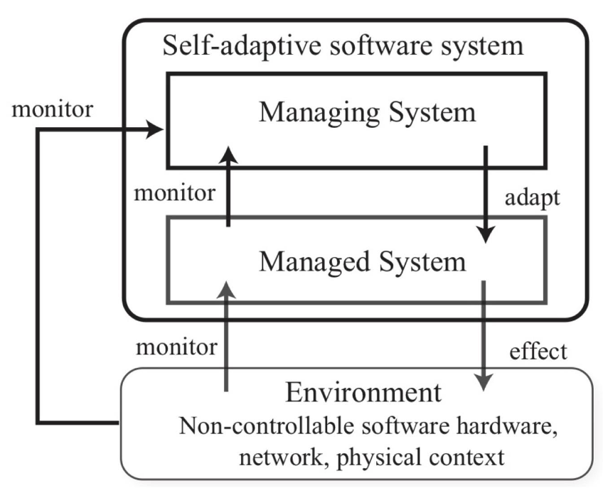
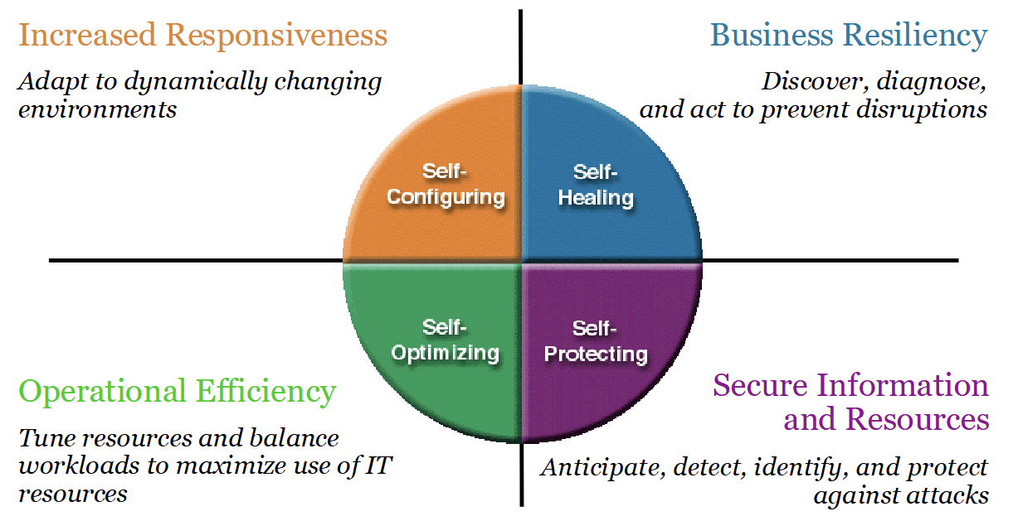
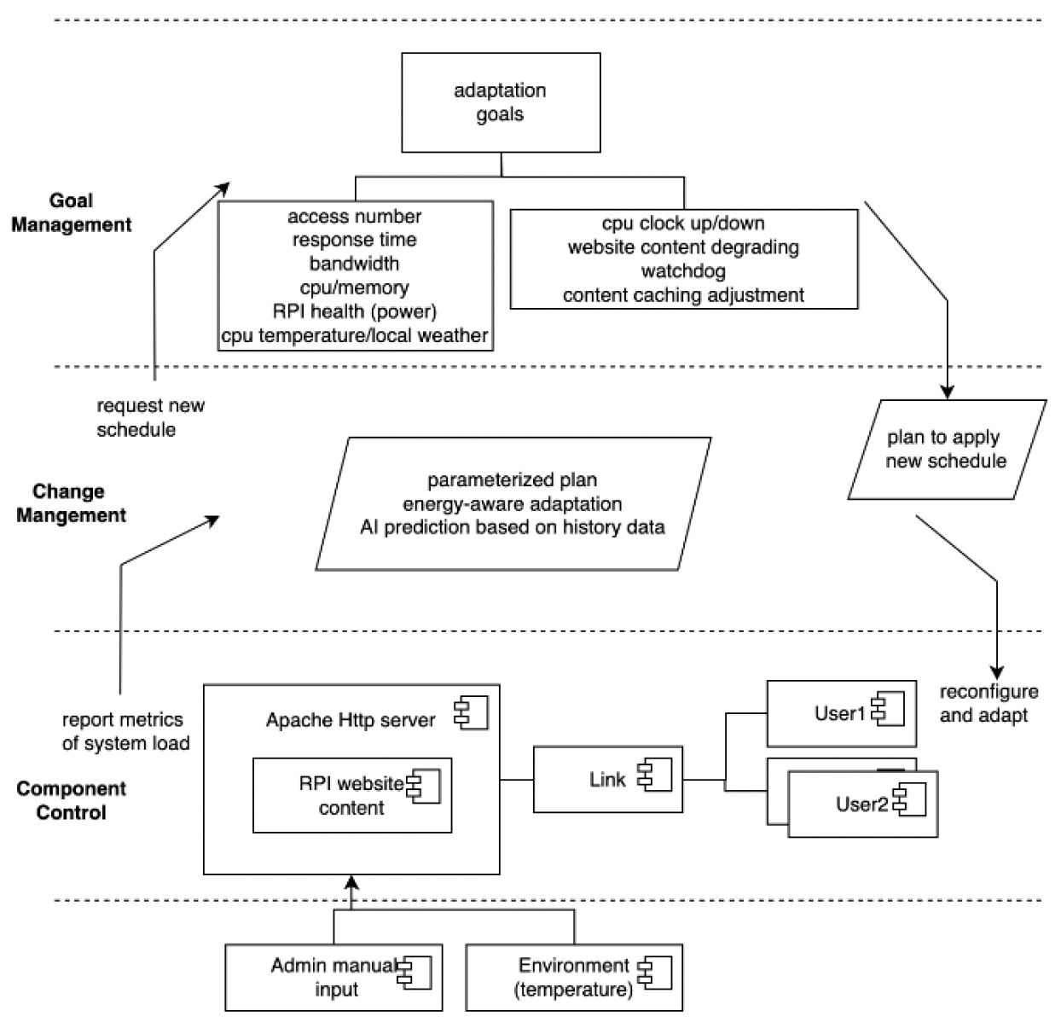
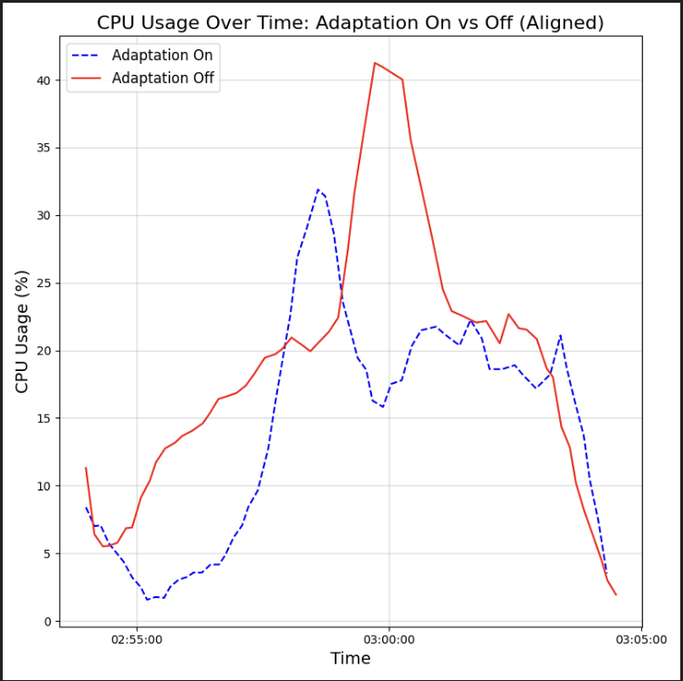
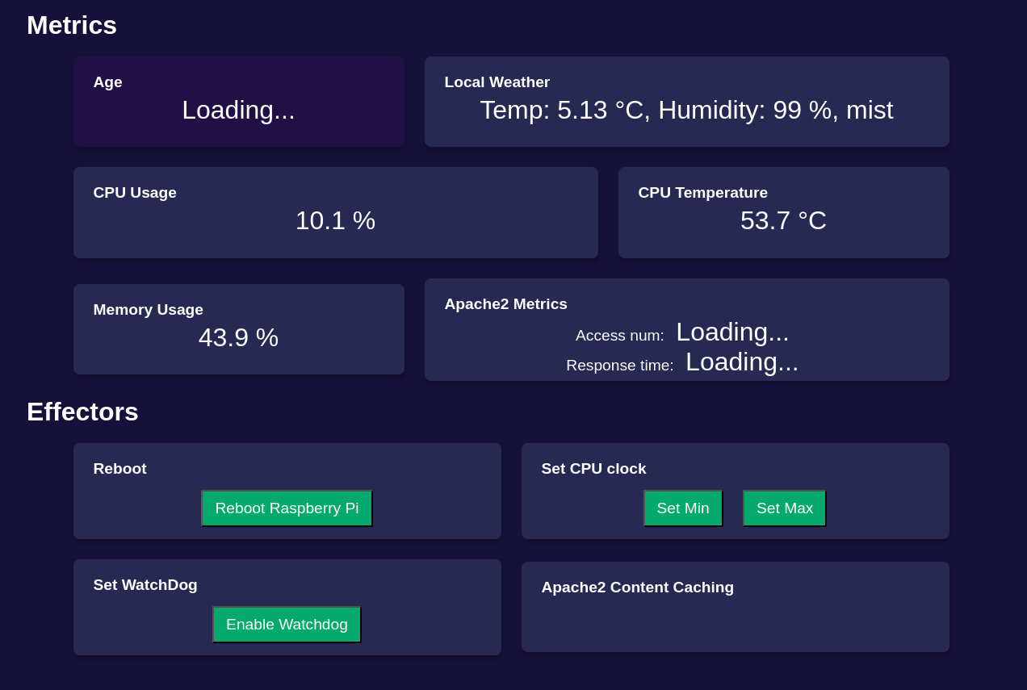
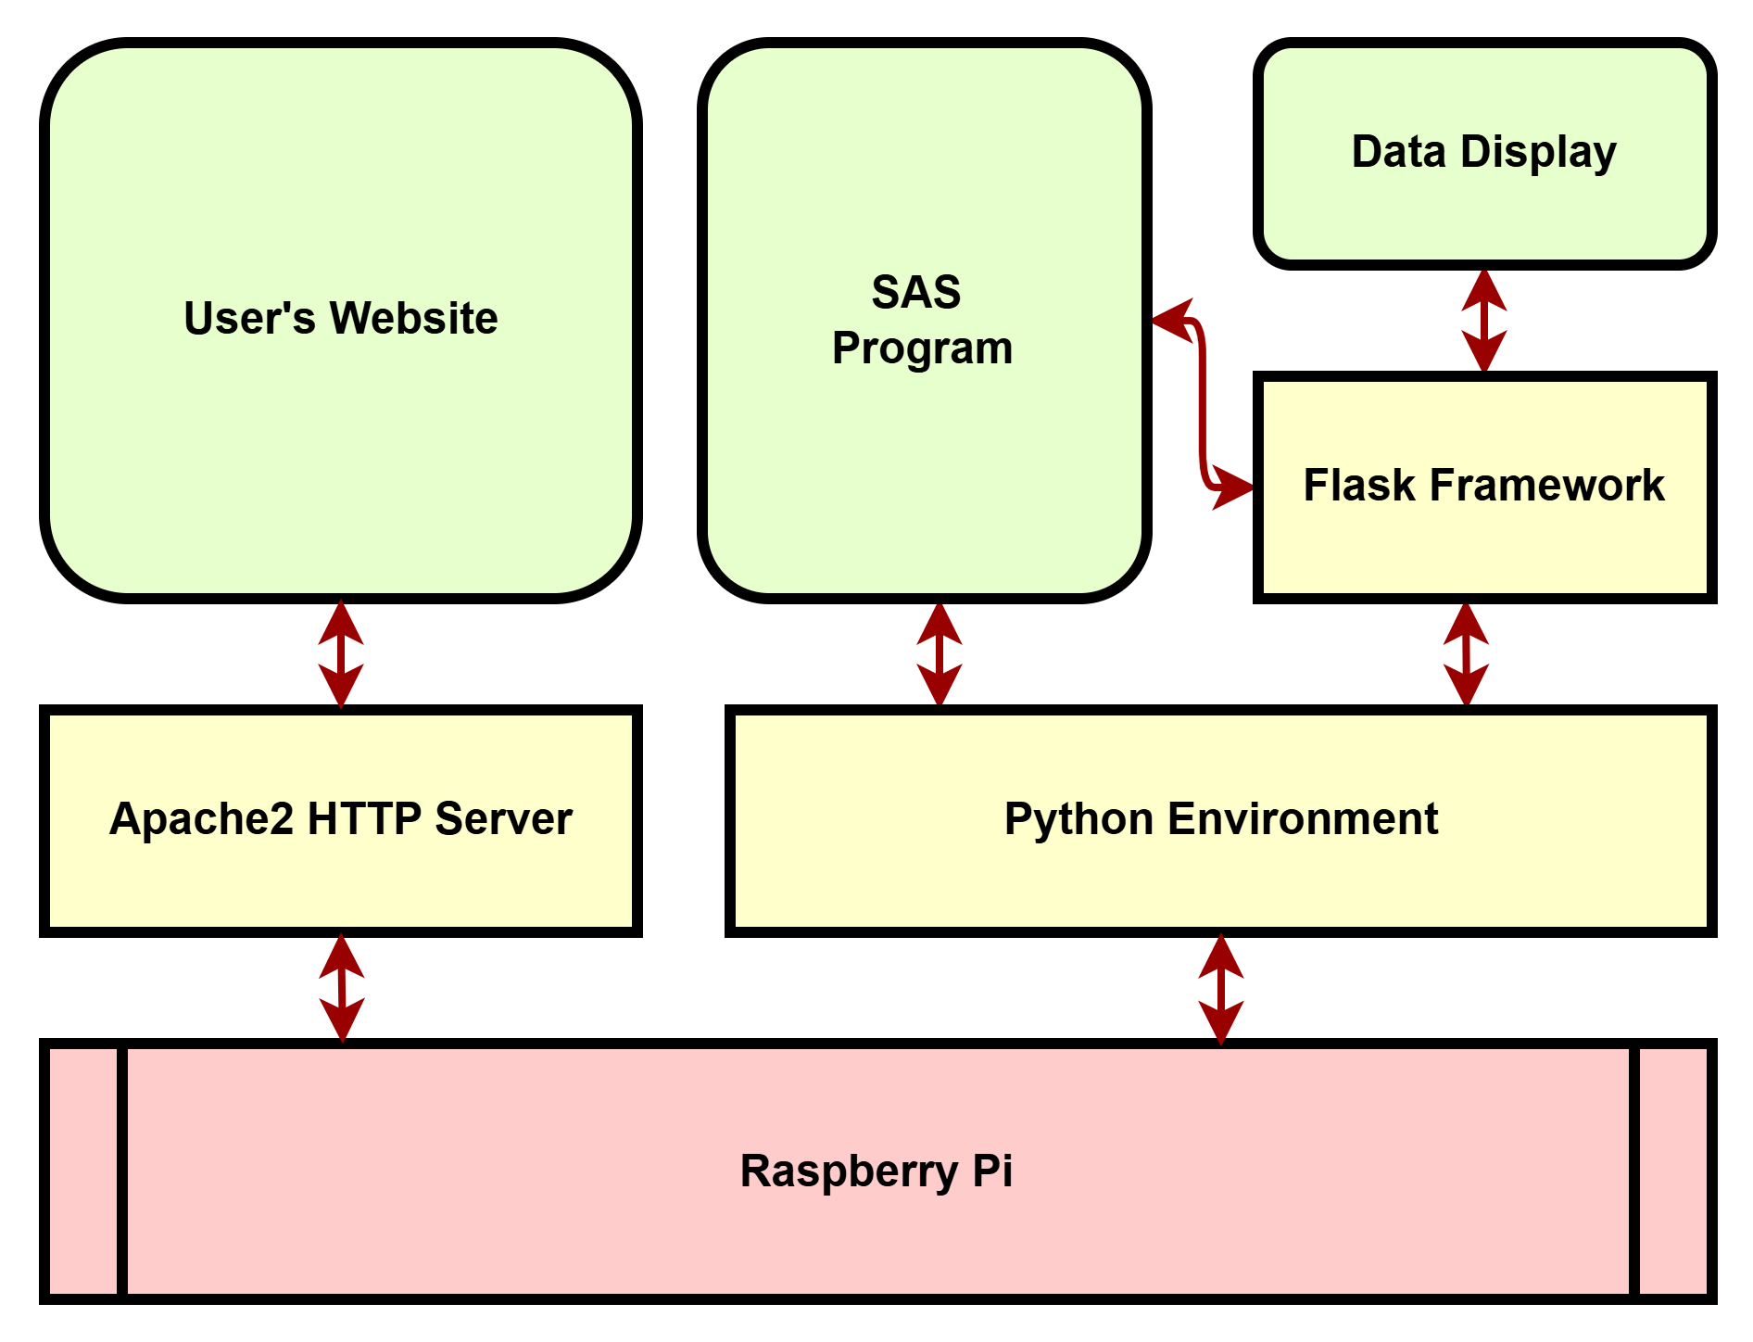
Unbeatable Website on a Pi: A Self-Adaptive Approach
ESASS 2024 Project Poster by Arthur Li & Daniel Almeida (Professor: Dr. Ladan Tahvildari) – Department of Electrical and Computer Engineering
Problem Statement
Motivation
MAKE-K
Reliability of Raspberry Pi Website (RPiWeb)
Introduce dependable Raspberry Pi platform for personal web hosting
Mitigate crashes, overheating, memory exhaustion
Eliminate manual labour
Raspberry Pi Utility
Remote location, unreliable environments, resource-constrained
Downtime, manual restarts, wasted resources/overprovisioning
Ensure consistent uptime and user confidence
No additional expenses
Deploy-and-forget
Monitoring
Python monitoring daemon tracking system metrics
Enable external weather metric monitoring
Analysis and Planning
Optimal metric thresholds
Content degradation from dynamic to static
CPU clock speed & voltage
Execution and Knowledge
Watchdog timer reboots
Historical data for adaptive threshold refinement
HTML adaptation templates
Self-CHOP
Proposed Framework
Approach
Conclusions
Monitoring
Leverage watchdog timers; system hang detection and recovery
Voltage, CPU Temp, CPU Clock, Latency, CPU Usage, Memory Usage
Implementation
Apache HTTP Server: Web content hosting and caching tools
JMeter: User traffic simulation; varying traffic and bandwidth conditions
Python: Daemon for resource monitoring and adaptation execution
Testing and Validation
Traffic stress testing; simulating real-world scenarios
Historical data collection
Anomaly detection model training
Self-Configuration
Adjust CPU clock speeds dynamically
Self-Optimizing
Content degradation
Self-Healing
Crash recovery via watchdog mechanism
Self-Protection
Priority-based fallback pages
Case Study
Conclusions & Future Work
Outcome
Adaptive framework improves RPiWeb hosting
Dynamic adaptation optimizes performance under fluctuating traffic loads
Automatic reboot mechanisms ensure minimal downtime and uninterrupted hosting
Optimal thresholds reduce content oscillation and enable efficient resource allocation
Considerations
ML improvements with richer historical data for model training
Framework scalability to even more resource constrained environments

Slide 2
References
[1] J. O. Kephart and D. M. Chess, "The Vision of Autonomic Computing," IEEE Computer Magazine, pp. 41-50, Jan. 2003
[2] L. Tahvildari, ECE750-T37: Engineering Self-Adaptive Software Systems, Lecture 1, Dept. of Elect. and Comp. Eng., University of Waterloo, 2024
[3] D. Weyns, An Introduction to Self-Adaptive Systems: A Contemporary Software Engineering Perspective, Wiley-IEEE CS Press, Oct. 2020
[4] "Raspberry Pi 4 Model B," Raspberry Pi, https://www.raspberrypi.com/products/raspberry-pi-4-model-b/

