Slide 1
LINUX TASKS AND SCHEDULER
ARTHUR SAMUELYAN

Slide 2
AGENDA
Task - process/thread from the perspective of kernel.
Task states.
Trivial task manipulations (creation/deletion).
Non-trival task manipulations (scheduling).

Slide 3

BASIC CONCEPTS
single-threaded process
multi-threaded process
code
data
files
code
data
files
registers
stack
stack
stack
stack
registers
registers
registers

Slide 4
BASIC CONCEPTS
Create new process:
fork();
Create new thread:
pthread_create();

Slide 5

TASK
Create new process task:
fork();
clone(..., SIGCHLD, ...);
Create new thread task:
pthread_create();
clone(..., CLONE_VM | CLONE_FS | CLONE_FILES | CLONE_SIGHAND | CLONE_THREAD, ...);

Slide 6
TASK STRUCT
aka “Task descriptor”
defined in linux/sched.h
[Example 01-TaskStruct]
Stack
struct thread_info
current
.task
struct task_struct

Slide 7
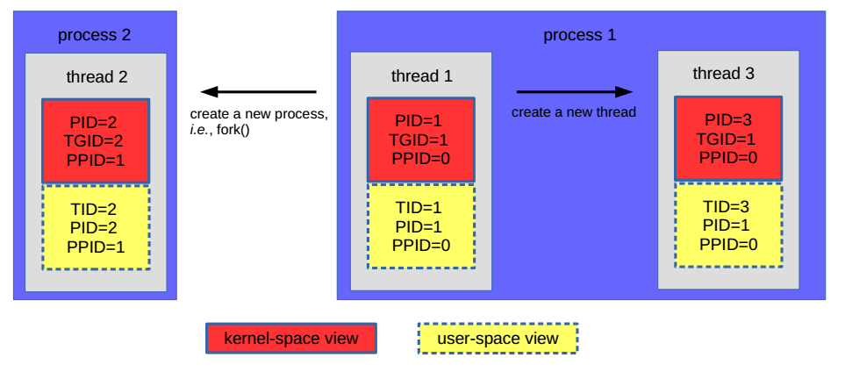
TASK STRUCT
Task from a perspective of user and kernel:

Slide 8
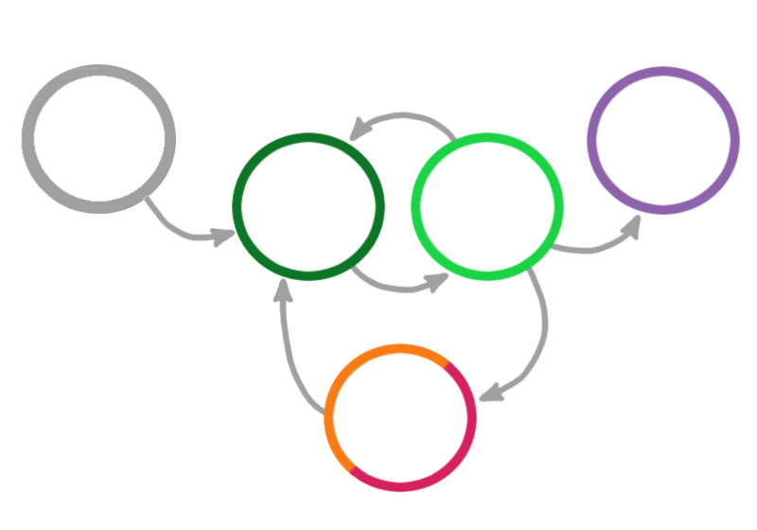
TASK LIFECYCLE
.state
Preempted by higher priority task
Parent task running
TASK_ZOMBIE (terminated, but not reaped by parent)
TASK_RUNNING (waits in sceduler’s queue)
TASK_RUNNING (actually running)
fork( )
do_exit( )
Sheduler calls context_switch( )
event occurs, task is woken up and placed back to the run queue
sleeps on wait queue for a certain event
TASK_
INTERRUPTIBLE / TASK_
UNINTERRUPTIBLE (waiting)

Slide 9
TASK LIFECYCLE
.state
Preempted by higher priority task
Z
Parent task running
TASK_ZOMBIE (terminated, but not reaped by parent)
R
R
TASK_RUNNING (waits in sceduler’s queue)
TASK_RUNNING (actually running)
fork( )
do_exit( )
Sheduler calls context_switch( )
event occurs, task is woken up and placed back to the run queue
sleeps on wait queue for a certain event
S/D
TASK_
INTERRUPTIBLE / TASK_
UNINTERRUPTIBLE (waiting)
S - interruptible sleep (wait for event to complete)
D - uninterruptible, ignores signals (usually IO)

Slide 10

TASK LIFECYCLE
.state
Preempted by higher priority task
Z
Parent task running
TASK_ZOMBIE (terminated, but not reaped by parent)
R
R
TASK_RUNNING (waits in sceduler’s queue)
TASK_RUNNING (actually running)
fork( )
do_exit( )
T
TASK_STOPPED (does not have right to run)
Sheduler calls context_switch( )
event occurs, task is woken up and placed back to the run queue
sleeps on wait queue for a certain event
S/D
After
SIGSTOP
SIGTSTP
SIGTTIN
SIGTTOU
or under strace
TASK_
INTERRUPTIBLE / TASK_
UNINTERRUPTIBLE (waiting)
S - interruptible sleep (wait for event to complete)
D - uninterruptible, ignores signals (usually IO)

Slide 11

REAPING TASK
After do_exit( ) call task_struct is still present in memory. Someone has to clean it. The zombie task needs reaper.
Find task with same TGID and make reaper (thread case).
Parent task becomes reaper (process case).

Slide 12
REPARENTING
init
PID 1
...
...
PID 101
TGID 101
PID 201
PID 102
TGID 101
PID 202
PID 103

Slide 13
REPARENTING
init
PID 1
...
...
PID 101
TGID 101
PID 201
PID 102
TGID 101
PID 202
PID 103

Slide 14
REPARENTING
init
PID 1
...
...
PID 101
TGID 101
PID 201
PID 202
PID 103

Slide 15
REPARENTING
init
PID 1
...
...
PID 101
TGID 101
PID 201
PID 202
PID 103

Slide 16
REPARENTING
init
PID 1
PID 202
...
...
PID 101
TGID 101
PID 103

Slide 17
SCHEDULER PARADIGM
Auxiliary definitions:
Tasks can be IO-bound and CPU-bound.
IO-bound: long wait for IO and low average calculation time.
They can eventually take a lot of processor time (e.g. load a texture in a game), but in 99% of times, they’ve happen to be runned by scheduler, they do a small calculation (e.g. check, whether the mouse button pressed) and continue waiting.
CPU-bound: always require a lot of processor time (and use up all given).
(e.g. encrypting/decrypting, high-precision physics simulation)

Slide 18
SCHEDULER PARADIGM
Regularly give every task a guaranteed slice of procesors time to use.
(guranteed, means cannot be taken away forcefully since given,
yet can be voluntary yielded by task itself)
Keep the maximum number of tasks being run per second with the minimum of processor load.
(hence, give higher priority and a greater time slice to IO-bound tasks)

Slide 19
O(N) SCHEDULER
Runqueue is a single round Robin (list of tasks).
After all the tasks have used their time slices up, rescheduling happens
(time slices recalculated, task order is preserved)
If task yields it’s time slice, it is given a greater one next ”epoch”
(epoch - time between rescheduling)

Slide 20
O(N) SCHEDULER
Runqueue is a single round Robin (list of tasks).
- Multiple cores, single lock
After all the tasks have used their time slices up, rescheduling happens
(time slices recalculated, task order is preserved)
- O(N)
If task yields it’s time slice, it is given a greater one next ”epoch”
(epoch - time between rescheduling)

Slide 21
O(1) SCHEDULER
Runqueue is now a fixed-size array of round Robins
When the task has used it up - it gets moved to expired runqueue.
When active runqueue gets empty - runqueues are swapped.
expired runqueue
active runqueue
Priority 0
Priority 0
runtime task priorities
Priority 1
Priority 1
...
...
Priority 99
Priority 99
user task priorities
Priority 100
Priority 100
...
...
Priority 139
Priority 139

Slide 22
O(1) SCHEDULER
Preemption improvement:
If a task appeared in higher priority round Robin of the runnable queue, the lesser priority round Robin stops
Multiprocessor load balancing:
Each 200ms scheduler checks load on each processor and moves tasks from higher loaded to lesser loaded
Dynamic priorities (user tasks only):
IO-bound tasks get higher priority, CPU-bound tasks get lower priority
Definition above is done by heuristics (calculate average wait time)

Slide 23
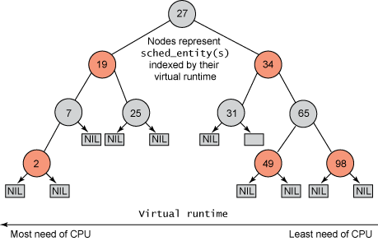
COMPLETELY FAIR SCHEDULER
Runqueue is a red-black tree, ordered by processor time neediness, instead of round Robin
Scheduler takes most time-needed task (left side of tree). Since the task has executed, it’s time slice and time neediness are recalculated and it is inserted back in the tree (acc. neediness).

Slide 24
COMPLETELY FAIR SCHEDULER
Runqueue is a red-black tree, ordered by processor time neediness, instead of round Robin
- Multiple cores, single lock
Scheduler takes most time-needed task (left side of tree). Since the task has executed, it’s time slice and time neediness are recalculated and it is inserted back in the tree (acc. neediness).
+ acquiring O(log n) + insertation O(log n)

Slide 25

KERNEL NEEDS YOU

Slide 26
SOURCES
Robert Love “Linux kernel development”
Chapter 3
Chapter 4
Anatoly Stupak’s lectures from “Linux kernel development” course, MIPT
Jinkyu Koo “Linux kernel scheduler”
Github.io

