Slide 1
CONVOLUTIONAL NEURAL NETWORKS:
AN INTRODUCTION
Option Ingénierie digitale des systèmes complexes
Mines ParisTech, 14/02/2019
Lorenzo Battarra lorenzo.battarra@safrangroup.com
Luca Boldrin luca.boldrin@safrangroup.com
Data Scientists @ Safran Analytics
1

Slide 2


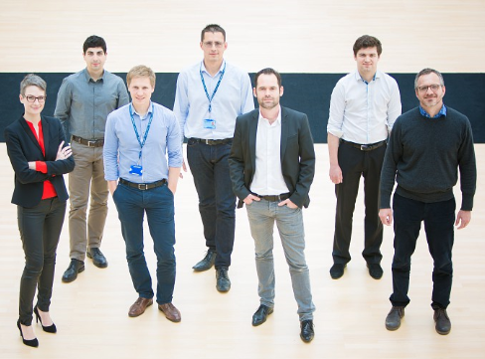

SAFRAN ANALYTICS EN CHIFFRES
55 COLLABORATEURS
CRÉATION EN
JANVIER
2015
4
DIRECTIONS
(STRATÉGIE , TECHNIQUE, PROGRAMMES, DONNÉES)
POSTES
OUVERTS

Slide 3




SAFRAN ANALYTICS - NOTRE RÔLE
Appréhender la problématique Data dans sa globalité
Développer nos propres compétences et outils internes Safran
Faire monter en compétence les individus et les organisations
Résoudre des problèmes complexes par des approches Data Driven

Slide 4
SAFRAN ANALYTICS LES MÉTIERS
DIRECTION TECHNIQUE
DIRECTION PROGRAMMES
DIRECTION
DES DONNÉES
DIRECTION STRATÉGIE ET DÉVELOPPEMENT
Mettre en œuvre Safran Analytics et créer les conditions favorables au sein de Safran pour faire de la donnée un levier de création de valeur
Délivrer l’expertise technique et s'assurer de la faisabilité des besoins : plateformes, analyses prédictive, prototypes, …
Piloter et s’assurer de la réussite des projets en mettant en place les moyens nécessaires
Etablir des règles de gouvernance
Les faire adopter
Faire du système de contrainte (sécurité/propriété) des données un levier de création de valeur
Valoriser les Données
Directeur D&S
Adjoint
Maitrise d’Ouvrage Technique
Chef de Projet Plateformes
Responsable Transformation
Community Manager
CTO
Data Engineers
Data Scientists
Software Engineer
Directeur des Programmes
Référents société
Directeur de programme SGDS
Protection des Données
Gouvernance des Données

Slide 5
Outline
Introduction to Neural Networks
Neural Network architecture
Training
Overfitting and regularization
Convolutional Neural Networks
Why convolutions?
Convolutions practicalities
Example: CNN for classification
Historical architectures and performance

Slide 6
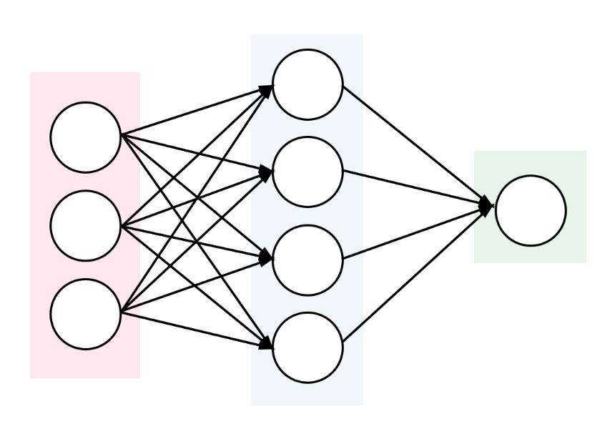
1
Introduction to Neural Networks

Slide 7
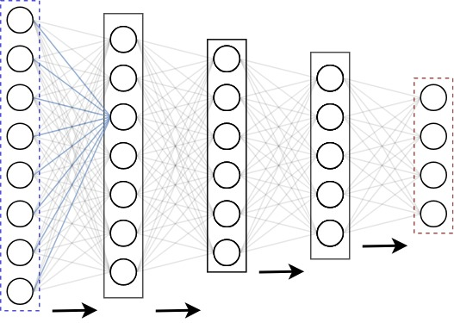

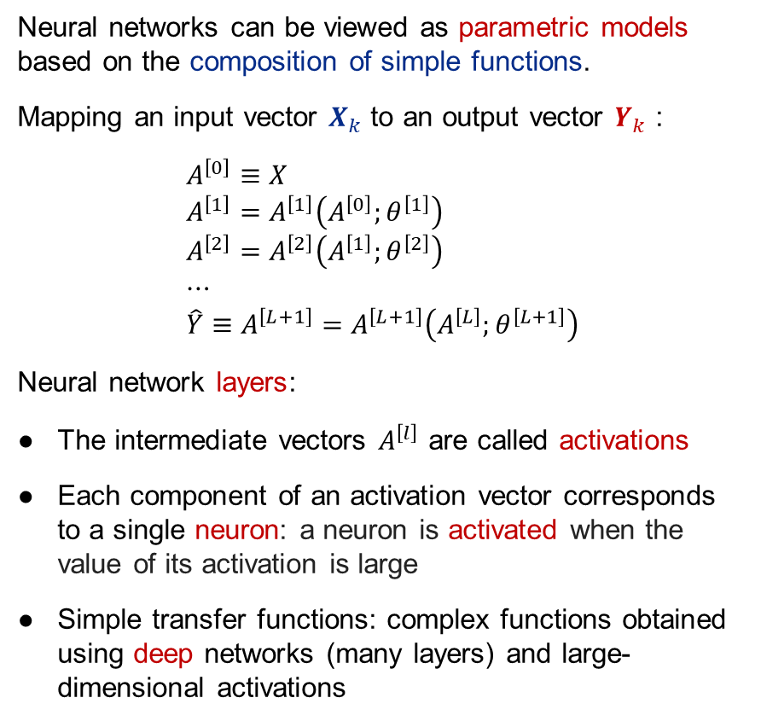




Neural Network architecture: composition of simple functions
Neural networks can be viewed as parametric models based on the composition of simple functions.
Mapping an input vector $X_{k}$ to an output vector $Y_{k}$ :
$$A^{\left[0\right]}≡X \\ A^{\left[1\right]}=A^{\left[1\right]}\left(A^{\left[0\right]};θ^{\left[1\right]}\right) \\ A^{\left[2\right]}=A^{\left[2\right]}\left(A^{\left[1\right]};θ^{\left[2\right]}\right) \\ ⋯ \\ \hat{Y}≡A^{\left[L+1\right]}=A^{\left[L+1\right]}\left(A^{\left[L\right]};θ^{\left[L+1\right]}\right)$$
Neural network layers:
● The intermediate vectors $A^{\left[l\right]}$ are called activations
● Each component of an activation vector corresponds to a single neuron: a neuron is activated when the value of its activation is large
● Simple transfer functions: complex functions obtained using deep networks (many layers) and large-dimensional activations
$$X≡A^{\left[0\right]}$$
$$A^{\left[1\right]}\left(A^{\left[0\right]}\right)$$
$$A^{\left[2\right]}\left(A^{\left[1\right]}\right)$$
$$A^{\left[3\right]}\left(A^{\left[2\right]}\right)$$
$${\hat{Y}=A}^{\left[4\right]}\left(A^{\left[3\right]}\right)$$
outputs
inputs
hidden layers

Slide 8
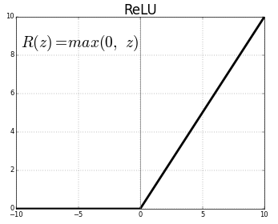

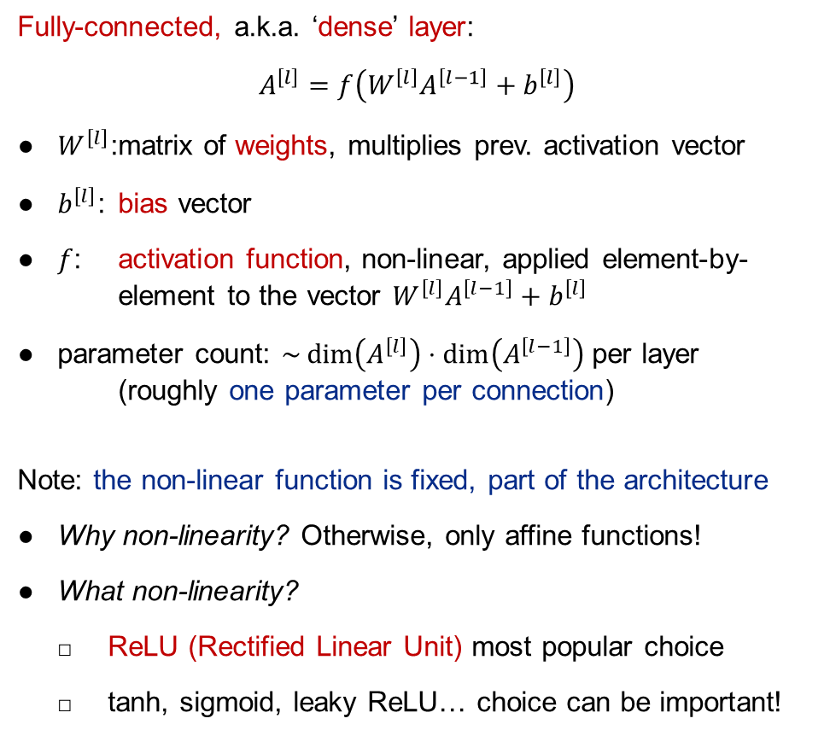




Neural Network architecture: multi-layer perceptron
$$X≡A^{\left[0\right]}$$
$$A^{\left[1\right]}$$
Fully-connected, a.k.a. ‘dense’ layer:
$$A^{\left[l\right]}=f\left(W^{\left[l\right]}A^{\left[l−1\right]}+b^{\left[l\right]}\right)$$
● $W^{\left[l\right]}$: matrix of weights, multiplies prev. activation vector
● $b^{\left[l\right]}$: bias vector
● $f$: activation function, non-linear, applied element-by-element to the vector $W^{\left[l\right]}A^{\left[l−1\right]}+b^{\left[l\right]}$
● parameter count: $\sim \dim\left(A^{\left[l\right]}\right)⋅\dim\left(A^{\left[l−1\right]}\right)$ per layer (roughly one parameter per connection)
Note: the non-linear function is fixed, part of the architecture
● Why non-linearity? Otherwise, only affine functions!
● What non-linearity?
□ ReLU (Rectified Linear Unit) most popular choice
□ tanh, sigmoid, leaky ReLU… choice can be important!
$$A^{\left[2\right]}$$
$$A^{\left[3\right]}$$
$${\hat{Y}=A}^{\left[4\right]}$$
Notes:
* Parameters can be shared… RNNs

Slide 9
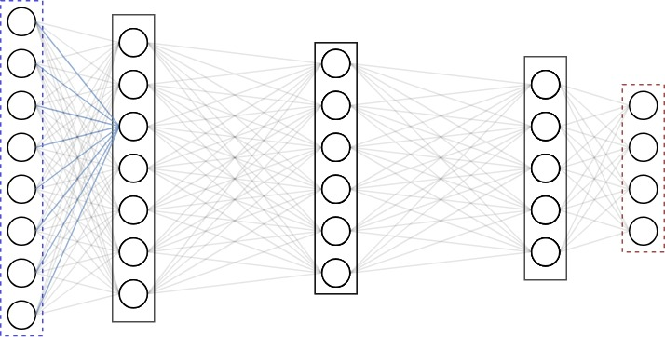
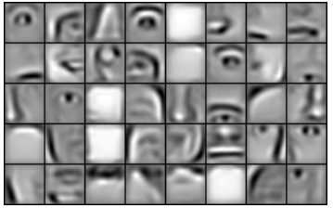
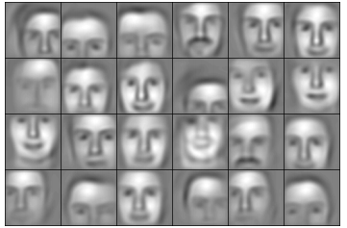
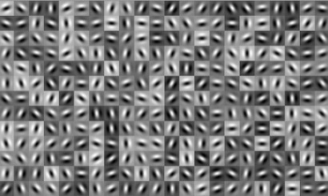

Neural Network architecture: why do NNs work?
Universal approximation property:
$$\left(p_{Alice}, p_{Bob}\right)$$
Any continuous function can be approximated (with arbitrarily small error) using a feed-forward network with a single hidden layer.
However, might need an exponentially large number of neurons!
NNs are good at tasks that can be decomposed as sequence of:
● combining some of previous features
● creating new higher-level feature from this combination
To be compared to: writing a single function that computes the output directly from the input.
Picture = input that gives maximum activation for a given neuron
Neurons in first layers: low-level features
Neurons in last layers: high-level features
Notes:
* Parameters can be shared… RNNs

Slide 10

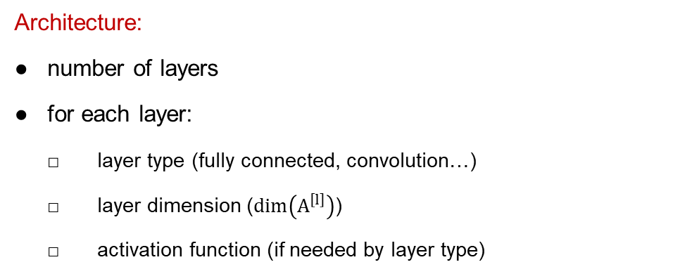
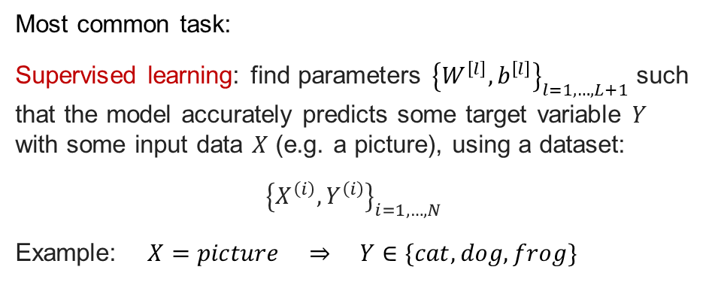
Training – supervised learning
Architecture:
● number of layers
● for each layer:
□ layer type (fully connected, convolution…)
□ layer dimension ($\dim\left(A^{\left[l\right]}\right)$)
□ activation function (if needed by layer type)
$$X≡A^{\left[0\right]}$$
$$A^{\left[1\right]}\left(A^{\left[0\right]}\right)$$
$$A^{\left[2\right]}\left(A^{\left[1\right]}\right)$$
$$A^{\left[3\right]}\left(A^{\left[2\right]}\right)$$
$${\hat{Y}=A}^{\left[4\right]}\left(A^{\left[3\right]}\right)$$
Most common task:
Supervised learning: find parameters ${\left\{W^{\left[l\right]}, b^{\left[l\right]}\right\}}_{l=1, …, L+1}$ such that the model accurately predicts some target variable $Y$ with some input data $X$ (e.g. a picture), using a dataset:
$${\left\{X^{\left(i\right)}, Y^{\left(i\right)}\right\}}_{i=1, …, N}$$
Example: $X=picture ⇒ Y∈\{cat, dog,frog\}$
outputs
inputs
hidden layers
$$A^{\left[l\right]}=f\left(W^{\left[l\right]}A^{\left[l−1\right]}+b^{\left[l\right]}\right)$$
Notes:
* Parameters can be shared… RNNs

Slide 11
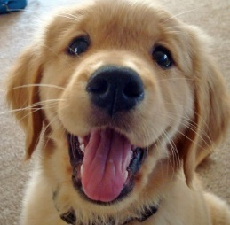
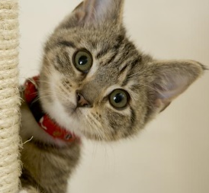
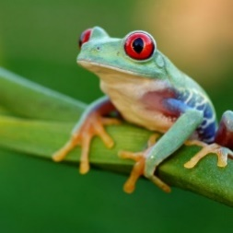
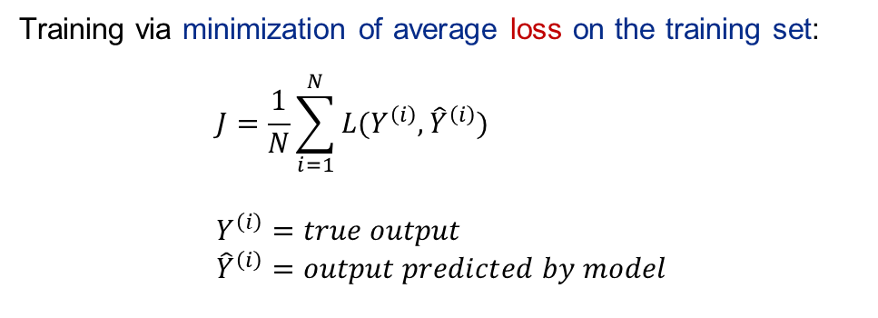
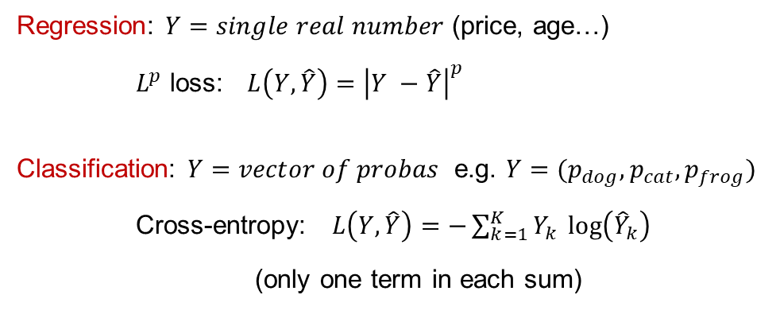
Training – loss functions
Training via minimization of average loss on the training set:
$$J=\frac{1}{N}\sum_{i=1}^{N}{L(Y^{\left(i\right)}, {\hat{Y}}^{\left(i\right)}}) \\ Y^{\left(i\right)}=true output \\ {\hat{Y}}^{\left(i\right)}=output predicted by model$$
Regression: $Y=single real number$ (price, age…)
$L^{p}$ loss: $L\left(Y, \hat{Y}\right)={\left|Y −\hat{Y}\right|}^{p}$
Classification: $Y=vector of probas$ e.g. $Y=(p_{dog}, p_{cat}, p_{frog})$
Cross-entropy: $L\left(Y, \hat{Y}\right)=−\sum_{k=1}^{K}{Y_{k}} \log\left({\hat{Y}}_{k}\right)$
(only one term in each sum)
DOG | 0.8 | 0.3 | 0.7
CAT | 0.1 | 0.6 | 0.2
FROG | 0.1 | 0.1 | 0.1
loss | 0.09 | 0.22 | 1.00
Average loss = 0.44
Notes:
* Parameters can be shared… RNNs

Slide 12
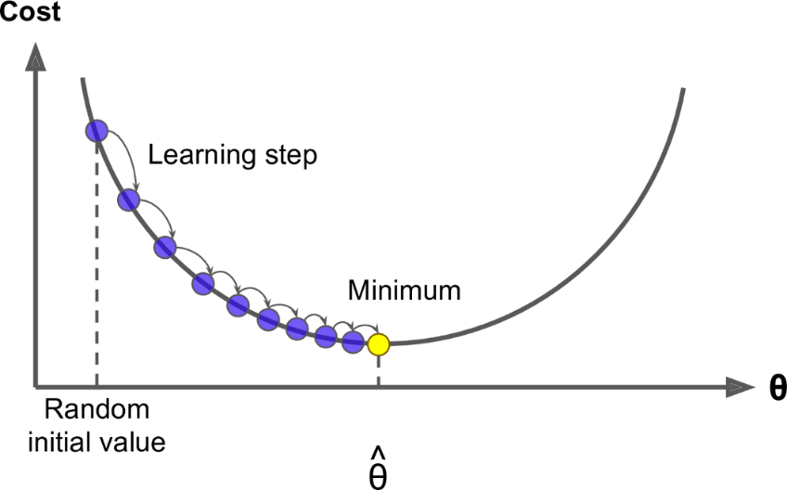
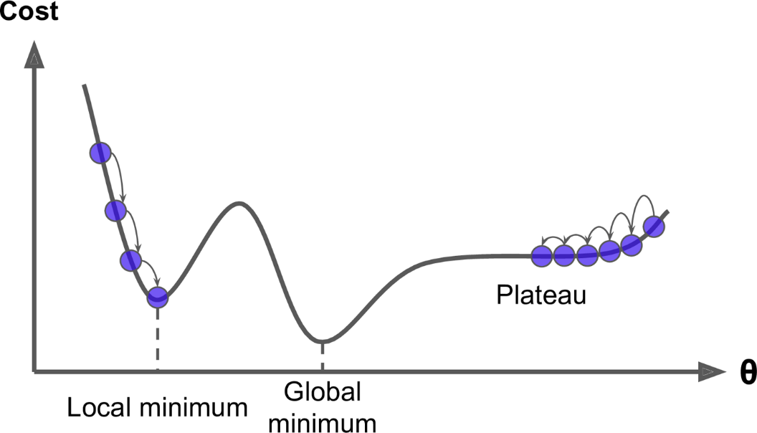

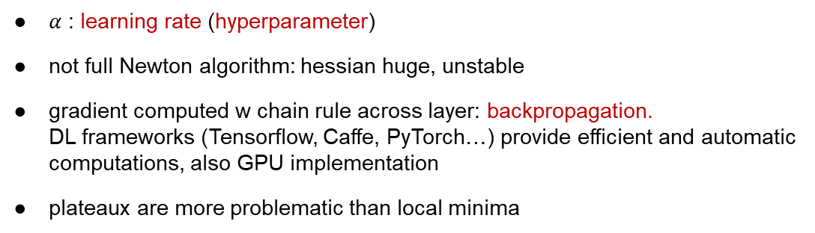


Training – gradient descent (1)
$$J\left(θ\right)$$
Gradient descent to train parameters:
$$J\left(θ\right)=\frac{1}{N}\sum_{i=1}^{N}{L(Y^{\left(i\right)}, {\hat{Y}}^{\left(i\right)}}) \\ {\hat{Y}}^{\left(i\right)}={\hat{Y}}^{\left(i\right)}\left(X^{\left(i\right)};θ\right) \\ θ→θ−α \frac{∂J}{∂θ}$$
$$J\left(θ\right)$$
● $α$ : learning rate (hyperparameter)
● not full Newton algorithm: hessian huge, unstable
● gradient computed w chain rule across layer: backpropagation. DL frameworks (Tensorflow, Caffe, PyTorch…) provide efficient and automatic computations, also GPU implementation
● plateaux are more problematic than local minima
Notes:
* Parameters can be shared… RNNs

Slide 13
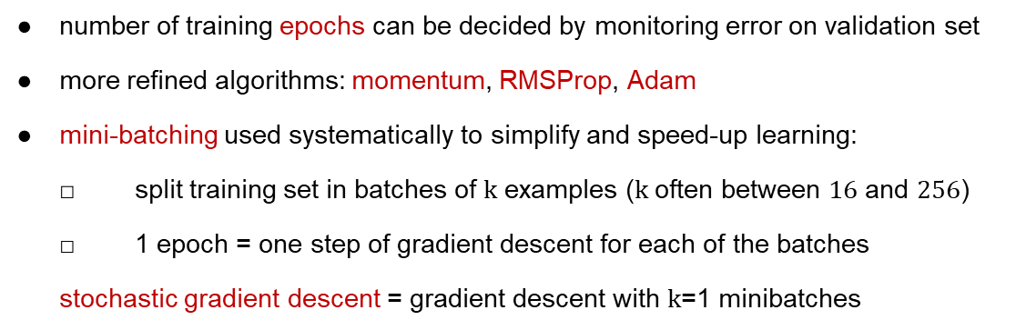

Training – gradient descent (2)
$$J\left(θ\right)$$
$$J\left(θ\right)=\frac{1}{N}\sum_{i=1}^{N}{L(Y^{\left(i\right)}, {\hat{Y}}^{\left(i\right)}}) \\ {\hat{Y}}^{\left(i\right)}={\hat{Y}}^{\left(i\right)}\left(X^{\left(i\right)};θ\right) \\ θ→θ−α \frac{∂J}{∂θ}$$
$$J\left(θ\right)$$
● number of training epochs can be decided by monitoring error on validation set
● more refined algorithms: momentum, RMSProp, Adam
● mini-batching used systematically to simplify and speed-up learning:
□ split training set in batches of $k$ examples ($k$ often between $16$ and $256$)
□ 1 epoch = one step of gradient descent for each of the batches
stochastic gradient descent = gradient descent with $k$=1 minibatches
Notes:
* Parameters can be shared… RNNs

Slide 14
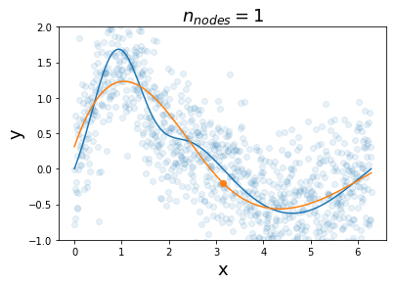
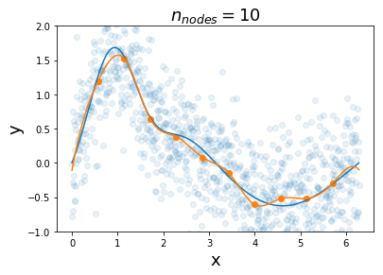
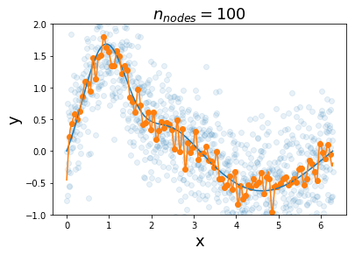
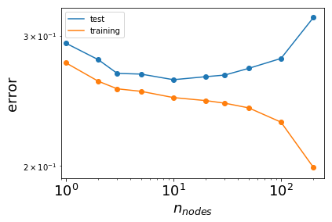
Training – overfitting and regularization
Overfitting occurs in supervised learning when the model fits the noise in the training data. Happens when the model:
● is too rich (too many parameters) compared to the amount of training data / noise level
● is trained for too long
NNs are prone to overfitting: many parameters!
Regularization is the general task or reducing/preventing overfitting – several techniques:
● early stopping: monitor loss on validation set and stop training at minimum
● add penalty on weights in loss function
● data augmentation when available: for images, generate new ones by rotation/translation/zoom
● Dropout
Notes:
* Parameters can be shared… RNNs

Slide 15
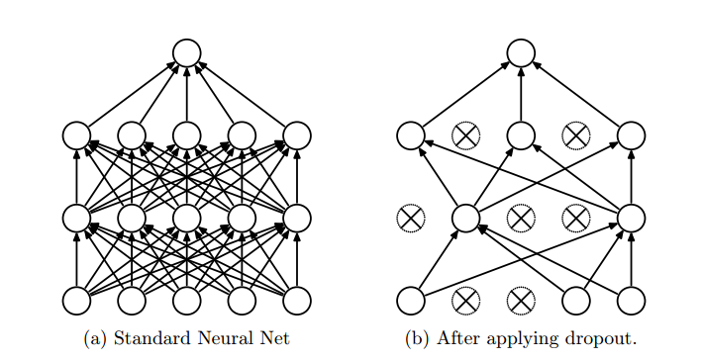
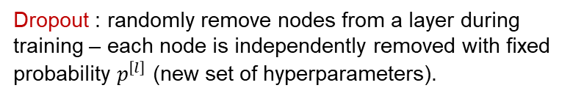
Training – Dropout
Dropout : randomly remove nodes from a layer during training – each node is independently removed with fixed probability $p^{\left[l\right]}$ (new set of hyperparameters).
Intuition: the network is pushed to learn ways to predict the output that do not depend crucially on the values of single activations (overfitting).
https://www.cs.toronto.edu/~hinton/absps/JMLRdropout.pdf
Notes:
* Parameters can be shared… RNNs

Slide 16
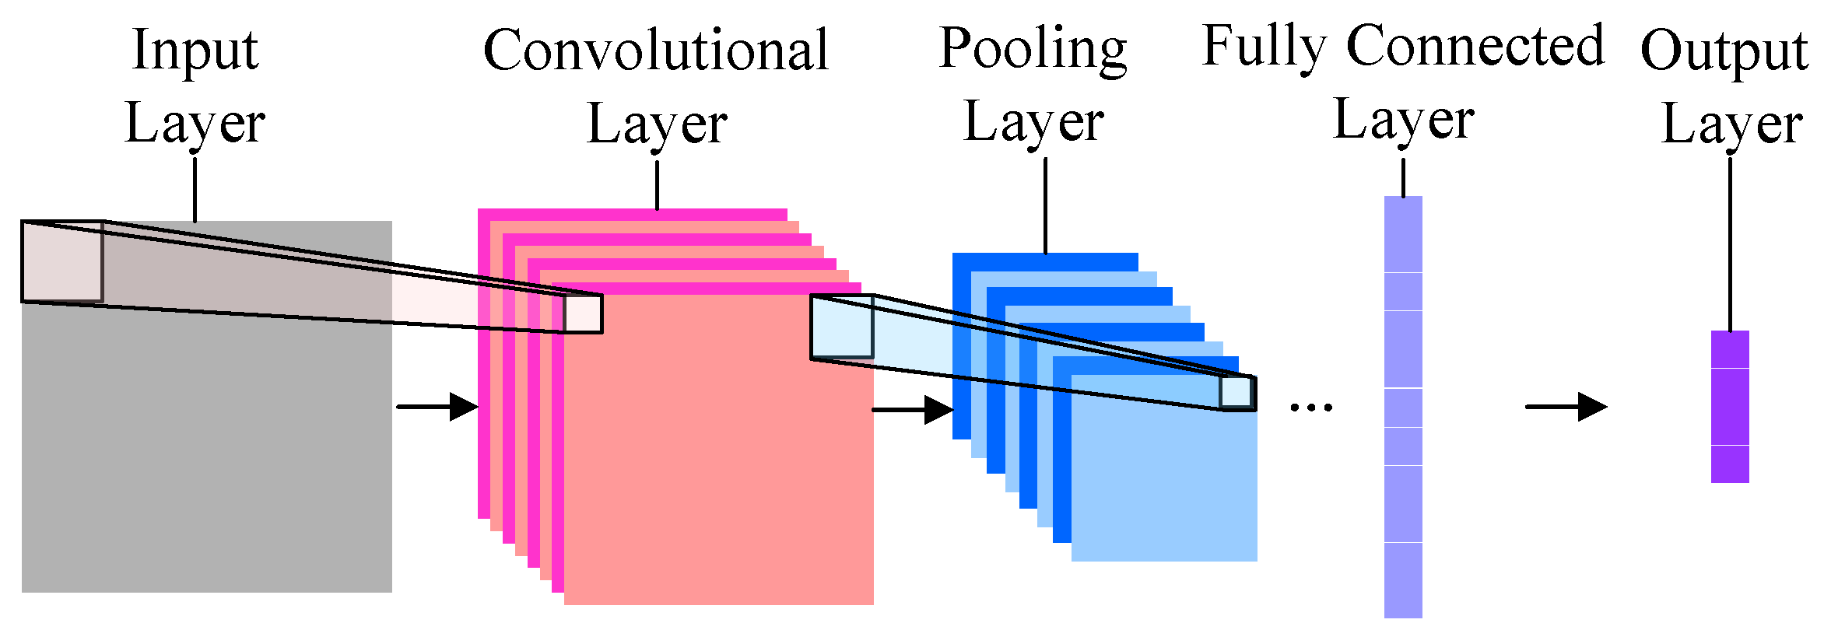
2
Convolutional Neural Networks

Slide 17
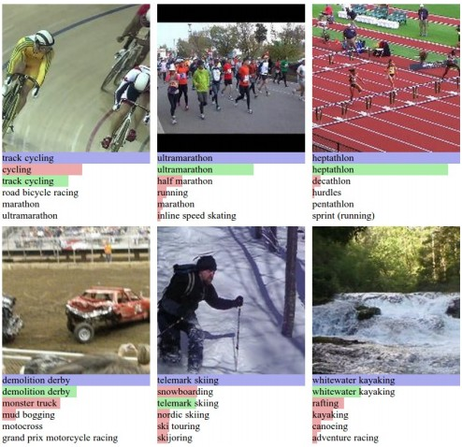
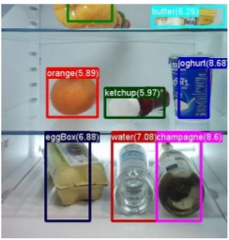
Computer vision tasks
Incomplete list of others:
Face verification/recognition
Image segmentation
Medical image analysis
Semantic understanding
classification
detection

Slide 18

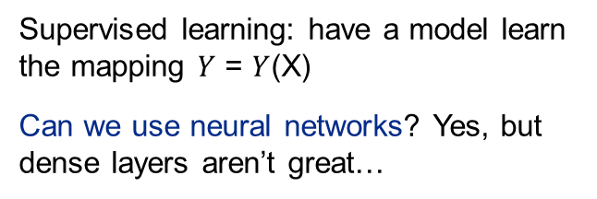
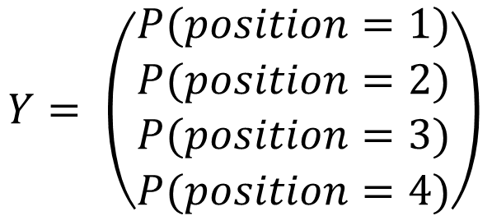

Example: image classification
$$Y= \left(\begin{matrix}\begin{matrix}P(position=1) \\ P(position=2)\end{matrix} \\ \begin{matrix}P(position=3) \\ P(position=4)\end{matrix}\end{matrix}\right)$$
$$X=$$
Supervised learning: have a model learn the mapping $Y$ = $Y$(X)
Can we use neural networks? Yes, but dense layers aren’t great…

Slide 19

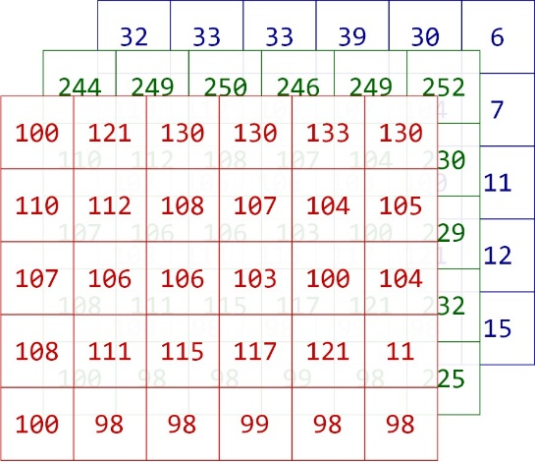



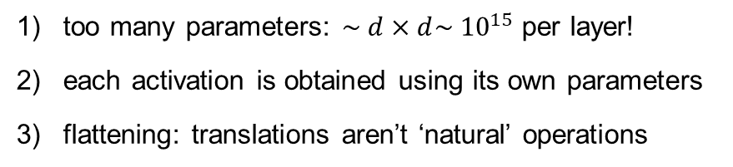
Why convolutions: dense layers and images
$$d$$
$$=$$
too many parameters: $\sim d×d\sim {10}^{15}$ per layer!
each activation is obtained using its own parameters
flattening: translations aren’t ‘natural’ operations
$$d=width×height×n_{channels}=3.5⋅{10}^{7}$$

Slide 20
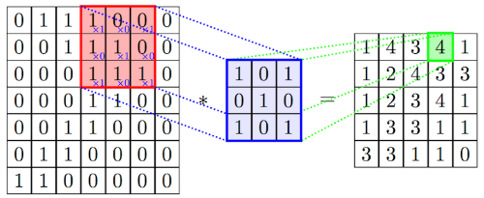
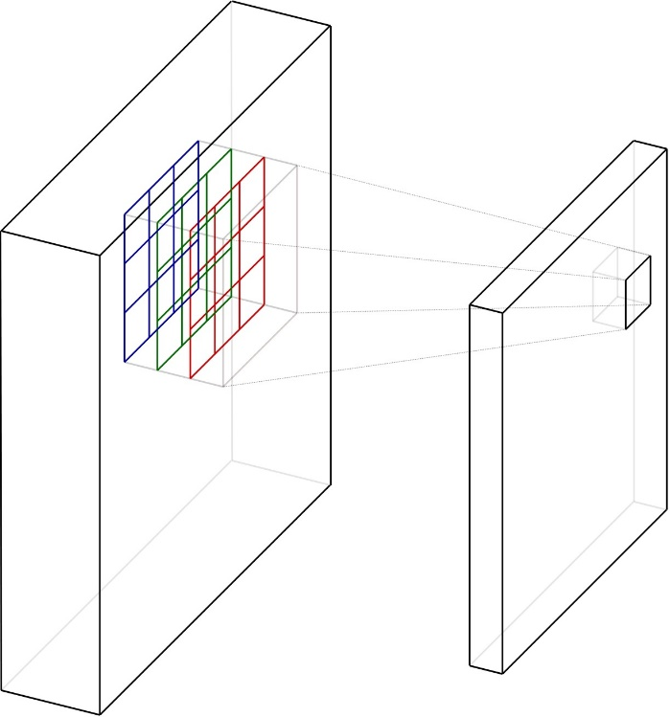

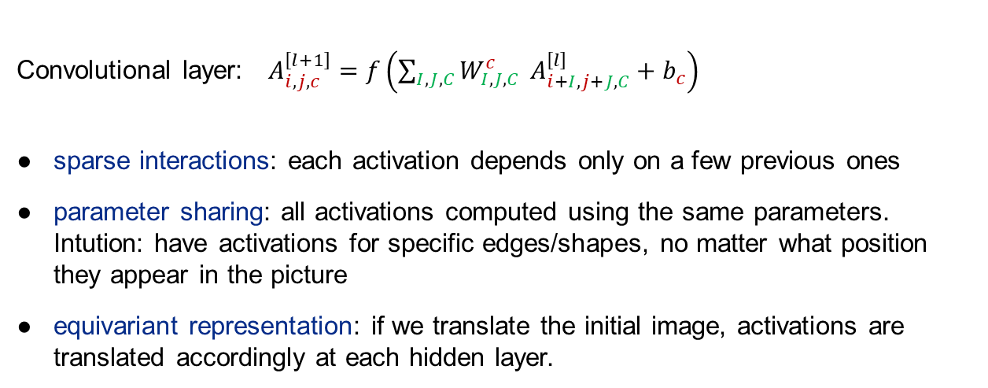

Convolutions
+ add bias (same for all elements)
+ apply non-linear activation, element by element
$$A^{\left[l+1\right]}$$
1d case
filter
$$A^{\left[l\right]}$$
Convolutional layer: $A_{i, j, c}^{\left[l+1\right]}=f\left(\sum_{I, J, C}{W_{I, J, C}^{c}} A_{i+I, j+J, C}^{\left[l\right]}+b_{c}\right)$
● sparse interactions: each activation depends only on a few previous ones
● parameter sharing: all activations computed using the same parameters. Intution: have activations for specific edges/shapes, no matter what position they appear in the picture
● equivariant representation: if we translate the initial image, activations are translated accordingly at each hidden layer.
general d

Slide 21
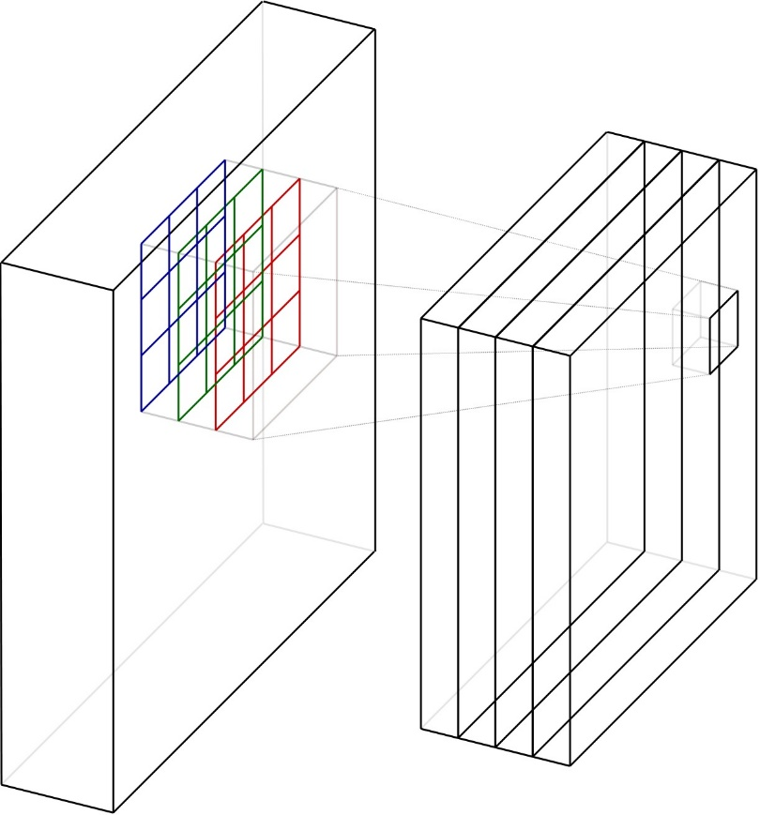


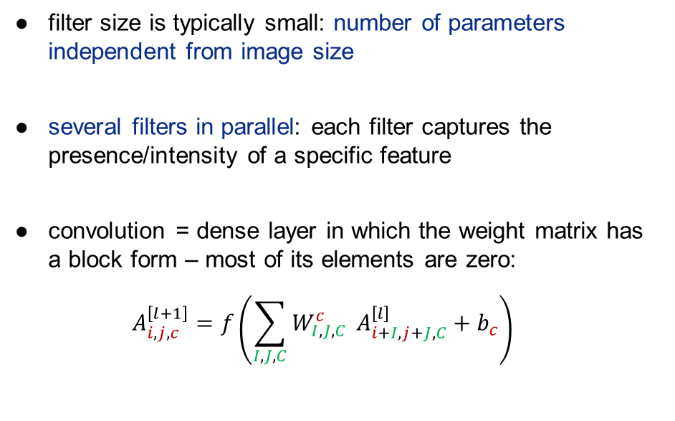


Convolutions (2)
$$A^{\left[l\right]}$$
● filter size is typically small: number of parameters independent from image size
● several filters in parallel: each filter captures the presence/intensity of a specific feature
● convolution = dense layer in which the weight matrix has a block form – most of its elements are zero:
$$A_{i, j, c}^{\left[l+1\right]}=f\left(\sum_{I, J, C}{W_{I, J, C}^{c}} A_{i+I, j+J, C}^{\left[l\right]}+b_{c}\right)$$
$$A^{\left[l+1\right]}$$
$$n_{c}^{\left[l+1\right]}=n_{filters}$$
$$n_{c}^{\left[l\right]}$$

Slide 22


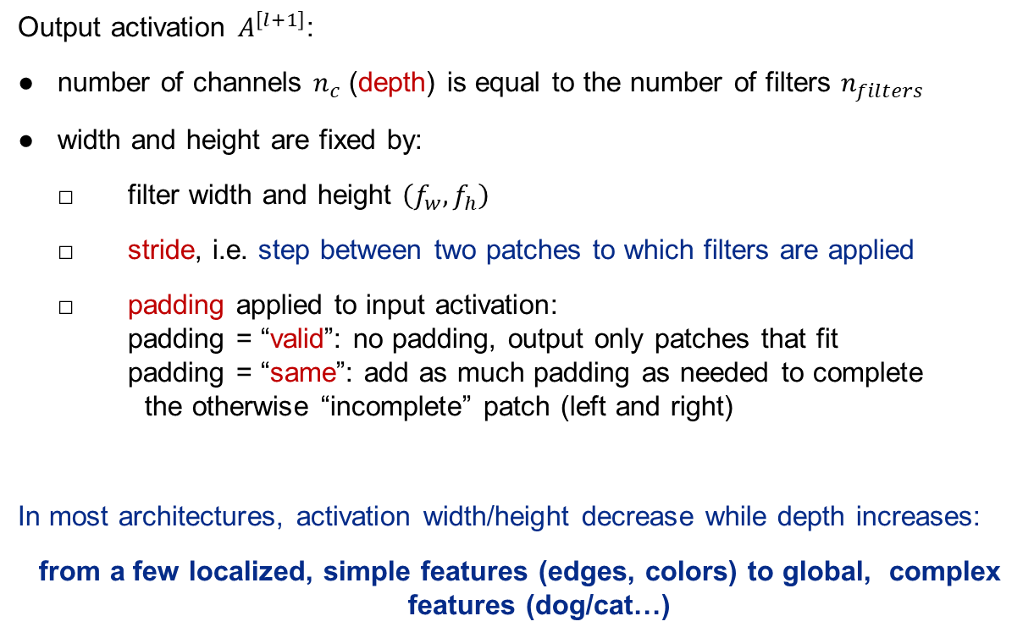


Convolution practicalities
$$A^{\left[l\right]}$$
$$A^{\left[l+1\right]}$$
Output activation $A^{\left[l+1\right]}$:
● number of channels $n_{c}$ (depth) is equal to the number of filters $n_{filters}$
● width and height are fixed by:
□ filter width and height $\left(f_{w},f_{h}\right)$
□ stride, i.e. step between two patches to which filters are applied
□ padding applied to input activation: padding = “valid”: no padding, output only patches that fit padding = “same”: add as much padding as needed to complete the otherwise “incomplete” patch (left and right)
In most architectures, activation width/height decrease while depth increases:
from a few localized, simple features (edges, colors) to global, complex features (dog/cat…)
$$n_{c}^{\left[l+1\right]}=n_{filters}$$
$$n_{c}^{\left[l\right]}$$

Slide 23
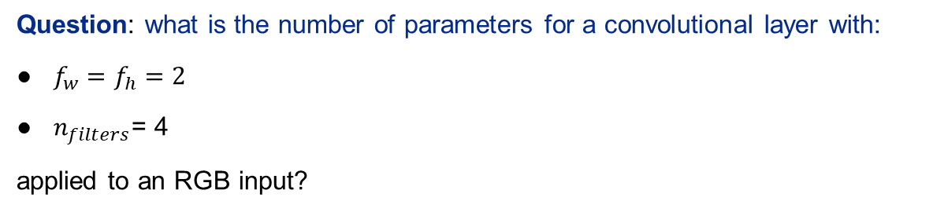
Convolution practicalities: quiz (1)
$$A^{\left[l\right]}$$
$$A^{\left[l+1\right]}$$
Question: what is the number of parameters for a convolutional layer with:
● $f_{w}=f_{h}=2$
● $n_{filters}$= 4
applied to an RGB input?
$$n_{c}^{\left[l+1\right]}=n_{filters}$$
$$n_{c}^{\left[l\right]}$$

Slide 24

Convolution practicalities: quiz (1)
$$A^{\left[l\right]}$$
$$A^{\left[l+1\right]}$$
Question: what is the number of parameters for a convolutional layer with:
● $f_{w}=f_{h}=2$
● $n_{filters}$= 4
applied to an RGB input?
$$n_{pars}=f_{w}⋅f_{h}⋅3⋅n_{filters}=48$$
$$n_{c}^{\left[l+1\right]}=n_{filters}$$
$$n_{c}^{\left[l\right]}$$

Slide 25
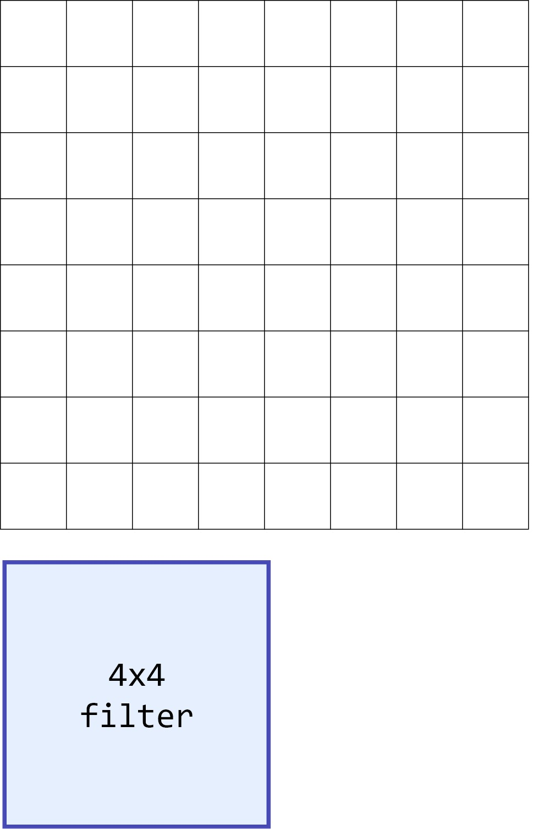
Convolution practicalities: quiz (2)
Question: what is the output size (width, height) of the convolution:
● input size = 8x8
● filter size = 4x4
● stride = 3
with padding = “valid”? What about padding = “same”?
Reminder: □ stride, i.e. step between two patches to which filters are applied
□ padding applied to input activation: padding = “valid”: no padding, output only patches that fit padding = “same”: add as much padding as needed to complete the otherwise “incomplete” patch (left and right)

Slide 26
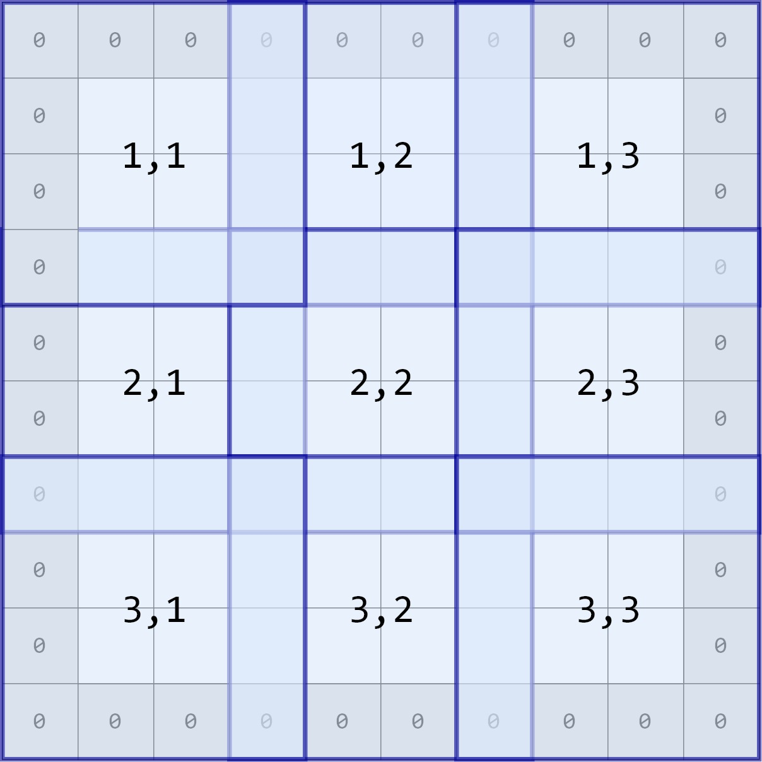
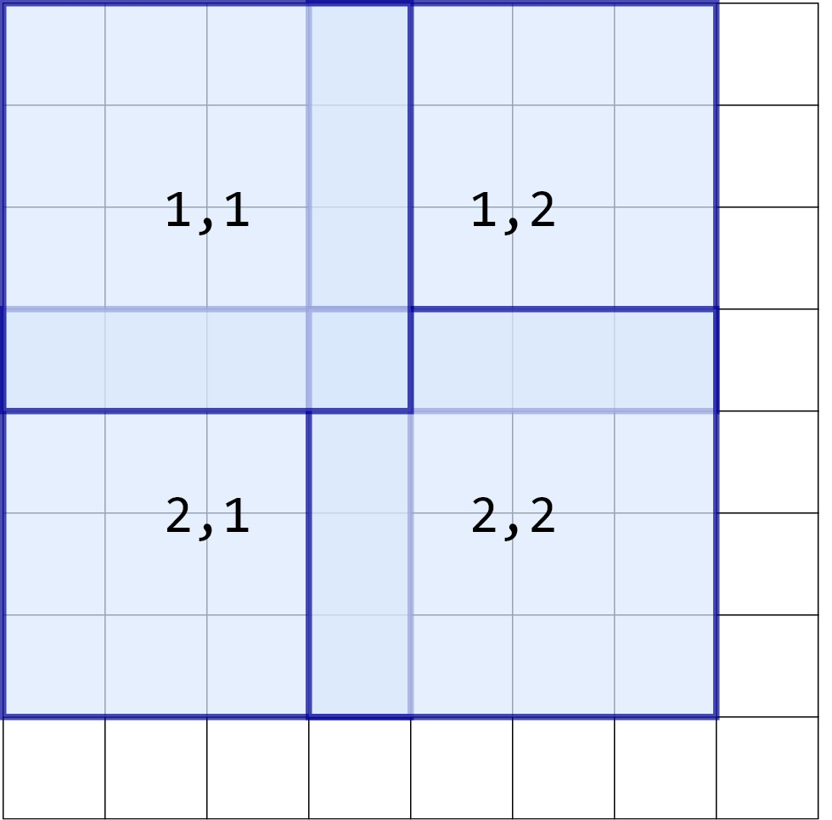
Convolution practicalities: quiz (2)
● input size = 8x8
● filter size = 4x4
● stride = 3
“valid” = no padding, output only patches that fit output = 2x2
“same” = add as much padding as needed to complete the otherwise “incomplete” patch output = 3x3

Slide 27
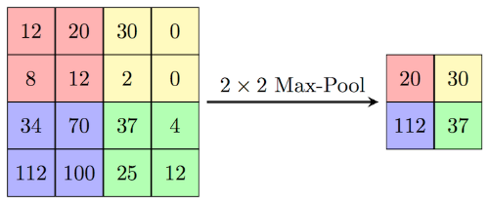
Convolutional networks - pooling
Convolutional neural networks (CNNs) are neural networks that include convolutional layers.
Convolutional layers most often followed by pooling layers:
● goal: reduce dimensionality
● min, max, average pooling
● transformation is applied channel-by-channel: depth is unchanged
● stride and padding need to be chosen – works exactly like for convolution
● no trainable parameters
Image: CS231n course

Slide 28
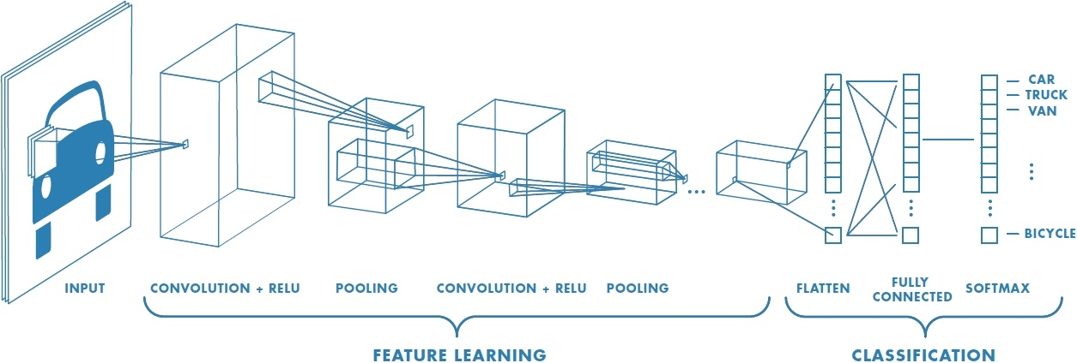
Convolutional networks – architecture view
size decreases, depth increases
Image: mathworks.com

Slide 29
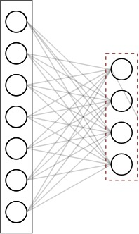
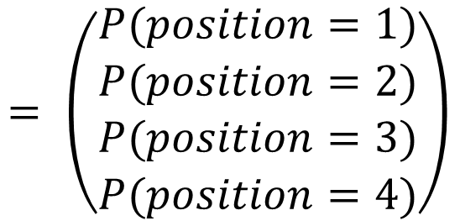


Convolutional networks - softmax
Last layer in classification network must produce class probabilities: cannot use usual activation functions
$${\hat{Y}≡A}^{\left[L+1\right]}=softmax\left(W^{\left[L+1\right]}A^{\left[L\right]}\right) \\ softmax{\left(z\right)}_{j}=\frac{e^{z_{j}}}{\sum_{k=1}^{K}{e^{z_{k}}}} j=1, …, K$$
$$= \left(\begin{matrix}\begin{matrix}P(position=1) \\ P(position=2)\end{matrix} \\ \begin{matrix}P(position=3) \\ P(position=4)\end{matrix}\end{matrix}\right)$$
…
Proper probabilities:
● all positive
● sum up to one
● soft max: when one of the $z_{j}$ is much larger than the others, the corresponding probability is $≃1$

Slide 30








Convolutional networks – test poses full example
CONV $$n_{f}=32 \\ f=5x5 \\ s=1 \\ "valid"$$
max pool $$f=3x3 \\ s=3 \\ "valid"$$
CONV $$n_{f}=32 \\ f=5x5 \\ s=1 \\ "valid"$$
max pool $$f=3x3 \\ s=3 \\ "valid"$$
resampling
31x31x32
98x98x32
94x94x32
300x300x3
296x296x32
3968x2976x3
CONV $$n_{f}=64 \\ f=5x5 \\ s=1 \\ "valid"$$
max pool $$f=3x3 \\ s=3 \\ "valid"$$
Dense 64 ReLU
Dense 4 Softmax
flatten
27x27x64
9x9x64
4
64
5184

Slide 31


