Slide 1
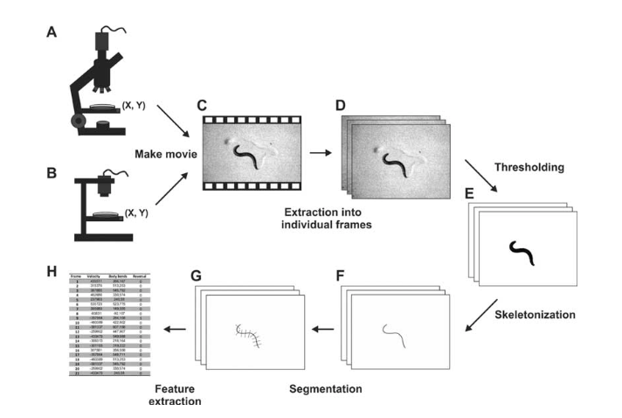
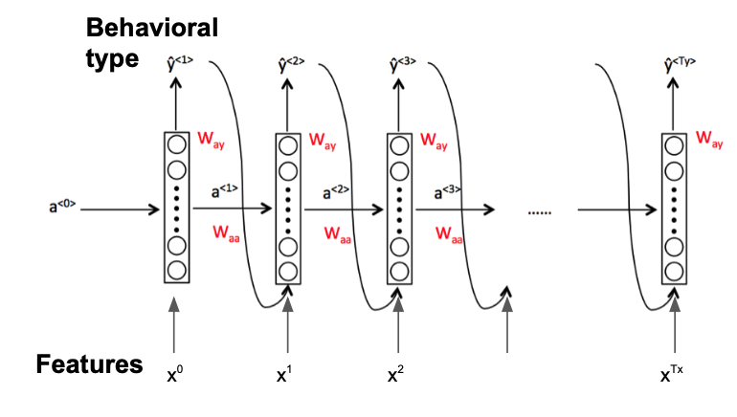
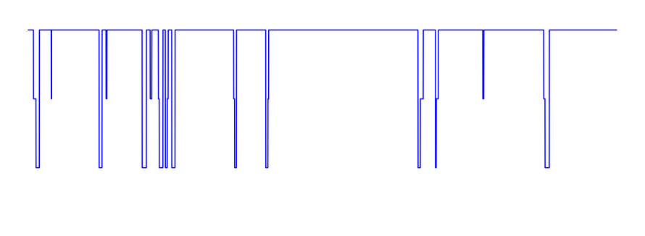
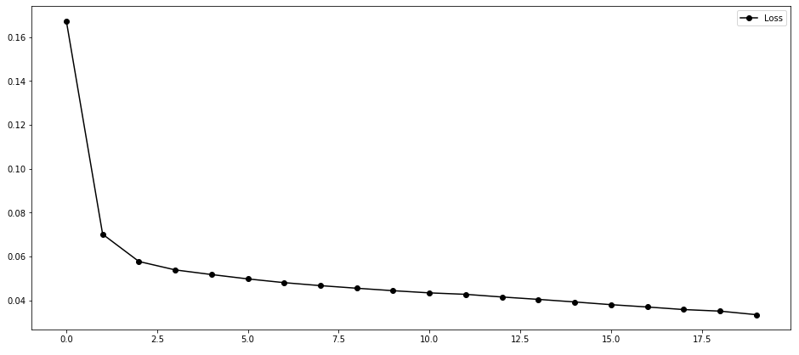
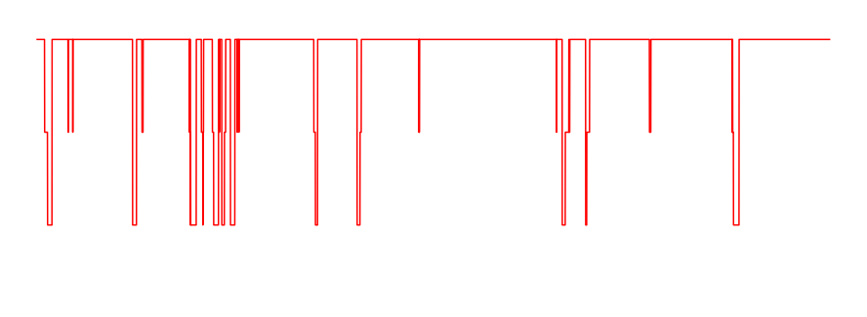
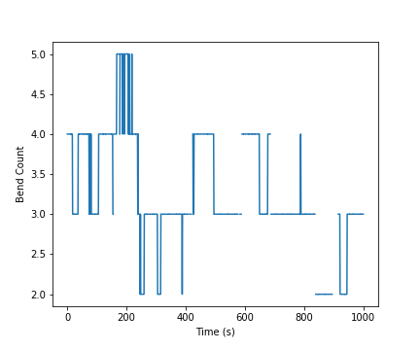
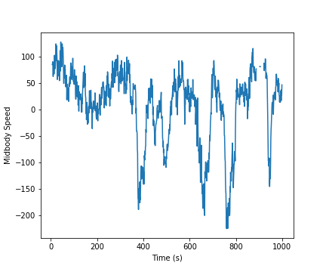
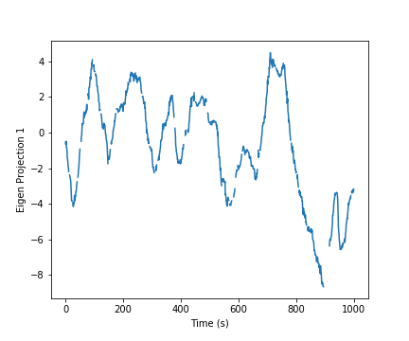
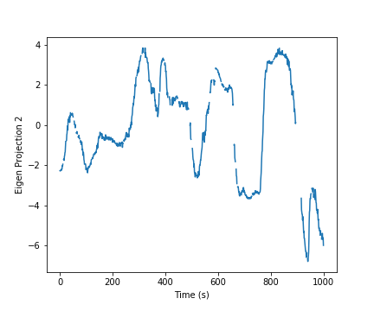
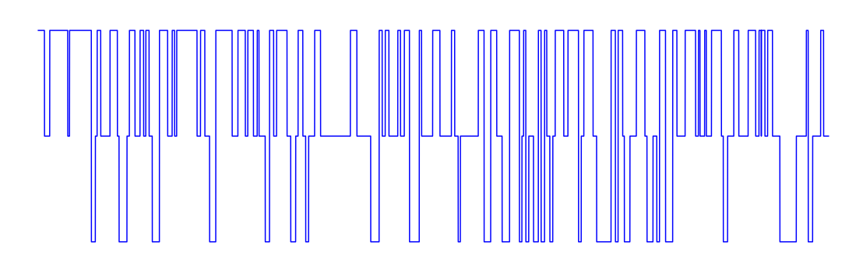
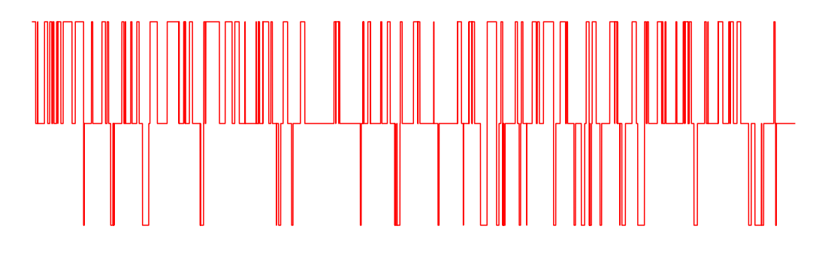
Classification of Behaviors using Posture Features in C.elegans Behavioral Database Jimin Kim², Rahul Biswas¹
¹ Department of Statistics, University of Washington, ² Department of Electrical and Computer Engineering, University of Washington
Introduction
ANN Architecture
Nematode C. elegans is a popular model organism for neurobiological and behavioral aspects.
We use many to many LSTM to take time sequence of posture features as inputs and outputs behavioral types (Forward, Backward, Pause).
We collect behavioral data of C. elegans compiled by automatic imaging techniques during experiments which constitute various posture features.
We construct and train ANN model to take posture features as inputs and outputs behavioral types (e.g. forward, backward, pause).
Through this study, we aim to show how predictive posture features are for classifying behavior types, with possible application in experiments to assist in auto-labeling of behaviors.
For the results below we use data window size of 50 (2s), batch size of 10 and hidden layer size of 512
Results
Prediction on Testing Sample
(150 Experiment sets, Lr = 0.0001, 20 Epochs)
(9 Features used: Eigenprojection 1 – 6, head, mid-body, tail absolute speed)
Ground Truth
FWD
Loss Curve
C.elegans Behavioral Database
PAUSE
Predicted
BWD
We use data from OpenWorm behavioral database: 13,339 experiments with time series of features. Each experiment consists of ~25,000 video frames (~1000s) and 44 posture features. .
FWD
PAUSE
BWD
0s
99.1% accuracy
400s
Epochs
Prediction on Random Experiment Sets
Ground Truth
FWD
Bend Count
Midbody Speed
Eigenprojection 1
Eigenprojection 2
…
PAUSE
Data Preprocessing and Feature Extraction
BWD
features
features
features
Predicted
EXP_1
EXP_2
EXP_n
EXP_1 to
EXP_n
LABELS
EXP_1 to
EXP_n
LABELS
FWD
time
…
Stacked time
Stacked time
…
PAUSE
Convert original data format (hdf) into Numpy objects
Discard time indices with NaN entries for both labels and feature time series.
Scale and partition the data with appropriate window size.
0s
80 - 90% accuracy for each experiment (~1000s)
300s
BWD
Stack multiple experiments data into single matrix.
Extract labels from features
References
[1] Yemini, E., Jucikas, T., Grundy, L. J., Brown, A. E., & Schafer, W. R. (2013). A database of Caenorhabditis elegans behavioral phenotypes. Nature methods, 10(9), 877.

