Slide 1

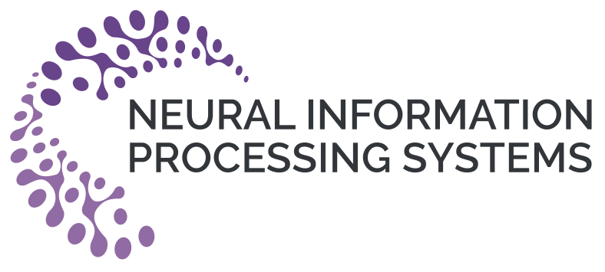


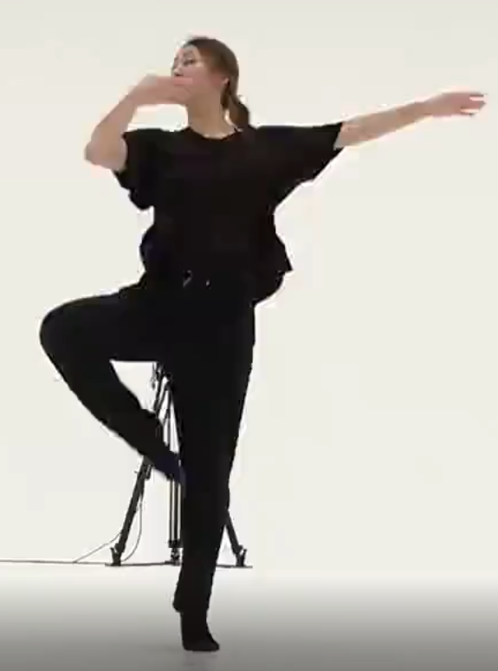
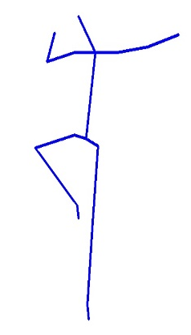
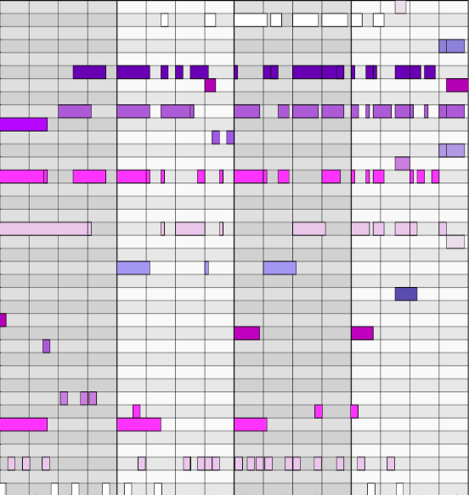
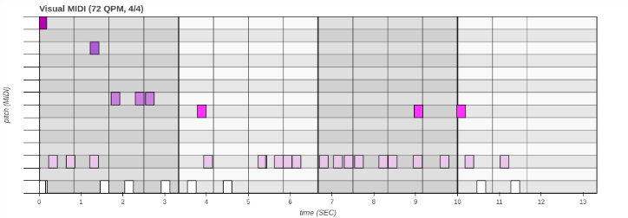


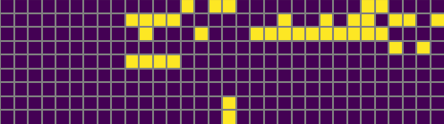

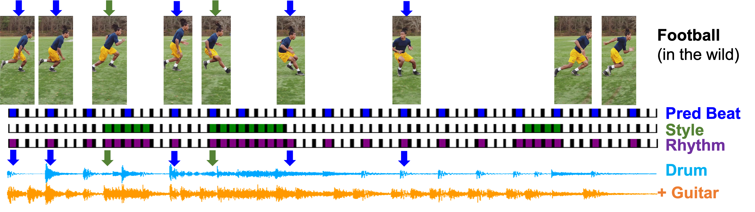
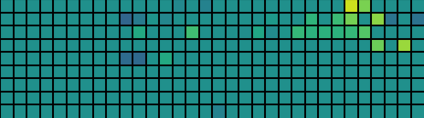
How Does it Sound? Generation of Rhythmic Soundtrack for Human Movements
Kun Su^{1*}, Xiulong Liu^{1*}, Eli Shlizerman^{1,2} *Equal Contribution
¹ Electrical & Computer Engineering, ² Applied Mathematics, University of Washington, Seattle, USA
Drum2Music
RhythmicNet
Drum2Music completes the drum music by adopting an Encoder-Decoder architecture using transformer-XL to generate a music track of either piano or guitar conditioning on the generated drum performance.
Video2Rhythm
Rhythm2Drum
Drum2Music
Human Activity Video
Soundtrack
Drum Midi
Multi Instrumental Midi
RhythmicNet pipeline takes as an input video with human movements and generates a soundtrack for it.
Style: To capture various rapid movements and motion characteristics that are not reflected by the beat, we propose an additional stream, called the style. The combination of the two streams constitutes the rhythm of the dynamics.
Drum Track Encoder
Target Track Decoder
RhythmicNet Components:
Evaluations & Results
Video2Rhythm: Inferring rhythm from human activity
Rhythm2Drum: Translating rhythm to drum music
Drum2Music: Adding piano/guitar track
We evaluate each component of RhythmicNet quantitively using available dataset (see paper for more details). We also perform a qualitative human perceptual evaluation of soundtracks of ‘in the wild’ videos.
Rhythm2Drum
Rhythm2Drum transforms the rhythm into drum sounds. It implements an Encoder-Decoder Transformer that given the rhythm generates the drums performance Hits (onsets). The Transformer generates natural and diverse drum onsets by autoregressively learning the hits as a word sequence conditioned on the rhythm.
Video2Rhythm
Preference
We decompose the rhythm into two streams: Beat and Style.
 | No Soundtrack | Drums Only | Drums + Piano | Drums + Guitar
Votes | 7.3% | 31.2% | 32.1% | 29.4%
ST-GCN + Transformer
Soundtrack match to video |  |  | Soundtrack match to video (Ablation)
Random | Shuffle | RhythmicNet | Random+GrooveVAE | Video2Rhythm+GrooVAE | Video2Rhythm+Rhythm2Drum
30.8% | 27.8% | 41.4% | 23.3% | 33.3% | 43.4%
Beat Prediction
Rhythm
Keypoints
Kinematic
Analysis
Encoder-Decoder Transformer
Style Extraction
Soundtracks match to movements in the video
U-Net
Hits
Velocities
Rhythm
Beat: Body keypoints from the video are transformed to a beat signal with a novel SpatioTemporal Graph Convolutional network in conjunction with Transformer Encoder. These network models capture motion features and translate them to musical beat estimation.
Offsets
Subsequently, a U-net type model generates the drum Velocities and Offsets. The U-Net learns them conditioned on the Hits matrix.
Visit our poster to see and listen to examples!
Also at: https://github.com/shlizee/RhythmicNet

