Slide 1
Lecture 13: Manycore GPU Architectures and Programming, Part 3 -- Streaming, Library and Tuning
CSCE 790: Parallel Programming Models for Multicore and Manycore Processors
Department of Computer Science and Engineering
Yonghong Yan
yanyh@cse.sc.edu
http://cse.sc.edu/~yanyh

Slide 2
Overlapping Communication and Computation
Three sequential steps for a single kernel execution
Multiple kernels
Asynchrony is a first-class citizen of most GPU programming frameworks
Computation-communication overlap is a common technique in GPU programming
GPU
Compute
Compute
Compute
Compute
PCIe Bus
Copy
Copy
Copy
Copy
Copy

Slide 3
Abstract Concurrency
Different kinds of action overlap are possible in CUDA?
Overlapped host computation and device computation
Overlapped host computation and host-device data transfer
Overlapped host-device data transfer and device computation
Concurrent device computation
CUDA Streams to achieve each of these types of overlap

Slide 4
CUDA Streams
CUDA Streams: a FIFO queue of CUDA actions to be performed
Placing a new action at the head of a stream is asynchronous
Executing actions from the tail as CUDA resources allow
Every action (kernel launch, cudaMemcpy, etc) runs in an implicit or explicit stream
head
CUDA Stream
tail
CUDA Application
Kernel
cudaMemcpy
cudaMemcpy
CUDA Runtime & GPU

Slide 5
CUDA Streams
Two types of streams in a CUDA program
The implicitly declared stream (NULL stream)
Explicitly declared streams (non-NULL streams)
Up until now, all code has been using the NULL stream by default
cudaMemcpy(...);
kernel<<<...>>>(...);
cudaMemcpy(...);
Non-NULL streams require manual allocation and management by the CUDA programmer

Slide 6
CUDA Streams
To create a CUDA stream:
cudaError_t cudaStreamCreate(cudaStream_t *stream);
To destroy a CUDA stream:
cudaError_t cudaStreamDestroy(cudaStream_t stream);
To wait for all actions in a CUDA stream to finish:
cudaError_t cudaStreamSynchronize(cudaStream_t stream);
To check if all actions in a CUDA stream have finished:
cudaError_t cudaStreamQuery(cudaStream_t stream);

Slide 7
CUDA Streams
cudaMemcpyAsync: Asynchronous memcpy
cudaError_t cudaMemcpyAsync(void *dst, const void *src,
size_t count, cudaMemcpyKind kind, cudaStream_t stream = 0);
cudaMemcpyAsync does the same as cudaMemcpy, but may return before the transfer is actually complete
Pinned host memory is a requirement for cudaMemcpyAsync
Memory that is resident in physical memory pages, and cannot be swapped out, also referred as page-locked
Recall malloc normally reserve virtual address space first and then actually physical pages are allocated

Slide 8
CUDA Streams
Performing a cudaMemcpyAsync:
int *h_arr, *d_arr;
cudaStream_t stream;
cudaMalloc((void **)&d_arr, nbytes);
cudaMallocHost((void **)&h_arr, nbytes);
cudaStreamCreate(&stream);
cudaMemcpyAsync(d_arr, h_arr, nbytes, cudaMemcpyHostToDevice, stream);
...
cudaStreamSynchronize(stream);
cudaFree(d_arr); cudaFreeHost(h_arr); cudaStreamDestroy(stream);
page-locked memory allocation
Call return before transfer complete
Do something while data is being moved
Sync to make sure operations complete

Slide 9
CUDA Streams
Associate kernel launches with a non-NULL stream
Note that kernels are always asynchronous
kernel<<<nblocks, threads_per_block, smem_size, stream>>>(...);
The effects of cudaMemcpyAsync and kernel launching
Operations are put in the stream queue for execution
Actually operations may not happen yet
Host-side timer to time those operations
Not the actual time of the operations

Slide 10
CUDA Streams
Vector sum example, A + B = C
Partition the vectors and use CUDA streams to overlap copy and compute
NULL stream
Copy A
Copy B
vector_sum<<<...>>>
Copy C
Stream A
A
B
v_s
C
Stream B
A
B
v_s
C
Stream C
A
B
v_s
C
Stream D
A
B
v_s
C

Slide 11
CUDA Streams
How can this be implemented in code?
for (int i = 0; i < nstreams; i++) {
int offset = i * eles_per_stream;
cudaMemcpyAsync(&d_A[offset], &h_A[offset], eles_per_stream *
sizeof(int), cudaMemcpyHostToDevice, streams[i]);
cudaMemcpyAsync(&d_B[offset], &h_B[offset], eles_per_stream *
sizeof(int), cudaMemcpyHostToDevice, streams[i]);
……
vector_sum<<<..., streams[i]>>>(d_A + offset,
d_B + offset, d_C + offset);
cudaMemcpyAsync(&h_C[offset], &d_C[offset], eles_per_stream *
sizeof(int), cudaMemcpyDeviceToHost, streams[i]);
}
for (int i = 0; i < nstreams; i++)
cudaStreamSynchronize(streams[i]);

Slide 12
CUDA Events
Timing asynchronous operations
Host-side timer: only measure the time for the call, not the actual time for the data movement or kernel execution
Events to streams, which mark specific points in stream execution
Events are manually created and destroyed:
cudaError_t cudaEventCreate(cudaEvent_t *event);
cudaError_t cudaEventDestroy(cudaEvent_t *event);
Copy A
Copy B
vector_sum<<<...>>>
Copy C
Event

Slide 13
CUDA Events
To add an event to a CUDA stream:
cudaError_t cudaEventRecord(cudaEvent_t event, cudaStream_t stream);
Event marks the point-in-time after all preceding actions in stream complete, and before any actions added after cudaEventRecord run
Host to wait for some CUDA actions to finish
cudaError_t cudaEventSynchronize(cudaEvent_t event);
Wait for all the operations before this events to complete, but not those after
Copy A
Copy B
vector_sum<<<...>>>
Copy C
Event

Slide 14
CUDA Events
Check if an event has been reached without waiting for it:
cudaError_t cudaEventQuery(cudaEvent_t event);
Get the elapsed milliseconds between two events:
cudaError_t cudaEventElapsedTime(float *ms, cudaEvent_t start, cudaEvent_t stop);
Copy A
Copy B
vector_sum<<<...>>>
Copy C
start
stop

Slide 15
CUDA Events
In codes:
float time;
cudaEvent_t start, stop;
cudaEventCreate(&start); cudaEventCreate(&stop);
cudaEventRecord(start);
kernel<<<grid, block>>>(arguments);
cudaEventRecord(stop);
cudaEventSynchronize(stop);
cudaEventElapsedTime(&time, start, stop);
cudaEventDestroy(start);
cudaEventDestroy(stop);

Slide 16
Implicit and Explicit Synchronization
Two types of host-device synchronization:
Implicit synchronization causes the host to wait on the GPU, but as a side effect of other CUDA actions
Explicit synchronization causes the host to wait on the GPU because the programmer has asked for that behavior

Slide 17
Implicit and Explicit Synchronization
Five CUDA operations that include implicit synchronization:
A pinned host memory allocation (cudaMallocHost, cudaHostAlloc)
A device memory allocation (cudaMalloc)
A device memset (cudaMemset)
A memory copy between two addresses on the same device (cudaMemcpy(..., cudaMemcpyDeviceToDevice))
A modification to the L1/shared memory configuration (cudaThreadSetCacheConfig, cudaDeviceSetCacheConfig)

Slide 18
Implicit and Explicit Synchronization
Four ways to explicitly synchronize in CUDA:
Synchronize on a device
cudaError_t cudaDeviceSynchronize();
Synchronize on a stream
cudaError_t cudaStreamSynchronize();
Synchronize on an event
cudaError_t cudaEventSynchronize();
Synchronize across streams using an event
cudaError_t cudaStreamWaitEvent(cudaStream_t stream, cudaEvent_t event);

Slide 19
Implicit and Explicit Synchronization
cudaStreamWaitEvent adds inter-stream dependencies
Causes the specified stream to wait on the specified event before executing any further actions
event does not need to be an event recorded in stream
cudaEventRecord(event, stream1);
...
cudaStreamWaitEvent(stream2, event);
...
No actions added to stream2 after the call to cudaStreamWaitEvent will execute until event is satisfied

Slide 20
Suggested Readings
Chapter 6 in Professional CUDA C Programming
Justin Luitjens. CUDA Streams: Best Practices and Common Pitfalls. GTC 2014. http://on-demand.gputechconf.com/gtc/2014/presentations/S4158-cuda-streams-best- practices-common-pitfalls.pdf
Steve Rennich. CUDA C/C++ Streams and Concurrency. 2011. http://on-demand.gputechconf .com/gtc-express/2011/presentations/StreamsAndConcurrencyWebinar.pdf

Slide 21

Manycore GPU Architectures and Programming: Outline
Introduction
GPU architectures, GPGPUs, and CUDA
GPU Execution model
CUDA Programming model
Working with Memory in CUDA
Global memory, shared and constant memory
Streams and concurrency
CUDA instruction intrinsic and library
Performance, profiling, debugging, and error handling
Directive-based high-level programming model
OpenACC and OpenMP
Notes:
GPUs have developed from graphics cards into a platform for high performance computing and perhaps the most important development in HPC for many years.

Slide 22
CUDA Libraries
CUDA Libraries offer pre-packaged and expertly-optimized functions that implement commonly useful operations.
Vector addition, matrix vector, matrix matrix, FFT, etc

Slide 23
CUDA Libraries
What are the advantages of CUDA Libraries?
Support a wide range of application domains
Highly usable, high-level APIs that are familiar to domain experts
Tuned by CUDA experts to perform well across platforms and datasets
Often offer the quickest route for porting, simply swap out API calls
Low maintenance, developer of the library takes on responsibility of bug fixes and feature requests

Slide 24
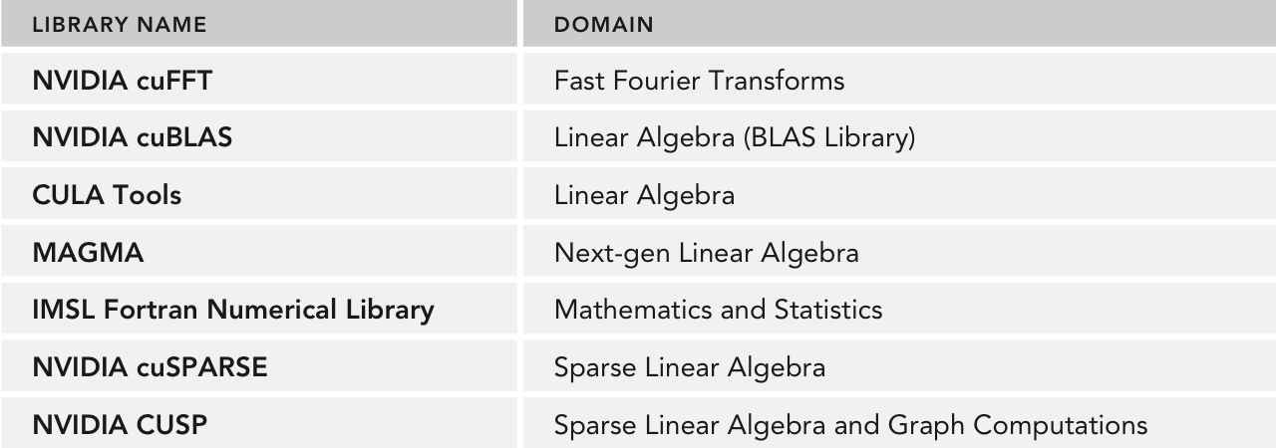
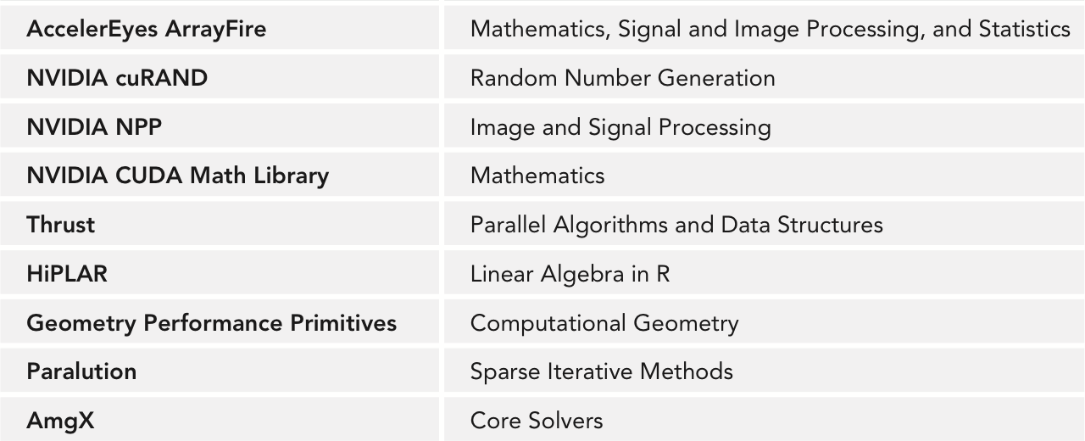
CUDA Libraries

Slide 25
Workflow to Use CUDA Library
Create a library-specific handle that manages contextual information useful for the library’s operation.
Many CUDA Libraries have the concept of a handle which stores opaque library-specific information on the host which many library functions access
Programmer’s responsibility to manage this handle
For example: cublasHandle_t, cufftHandle, cusparseHandle_t, curandGenerator_t
Allocate device memory for inputs and outputs to the library function.
Use cudaMalloc as usual

Slide 26
Common Library Workflow
If inputs are not already in a library-supported format, convert them to be accessible by the library.
Many CUDA Libraries only accept data in a specific format
For example: column-major vs. row-major arrays
Populate the pre-allocated device memory with inputs in a supported format.
In many cases, this step simply implies a cudaMemcpy or one of its variants to make the data accessible on the GPU
Some libraries provide custom transfer functions, for example: cublasSetVector optimizes strided copies for the CUBLAS library

Slide 27
Common Library Workflow
Configure the library computation to be executed.
In some libraries, this is a no-op
Others require additional metadata to execute library computation correctly
In some cases this configuration takes the form of extra parameters passed to library functions, others set fields in the library handle
Execute a library call that offloads the desired computation to the GPU.
No GPU-specific knowledge required

Slide 28
Common Library Workflow
Retrieve the results of that computation from device memory, possibly in a library-determined format.
Again, this may be as simple as a cudaMemcpy or require a library-specific function
If necessary, convert the retrieved data to the application’s native format.
If a conversion to a library-specific format was necessary, this step ensures the application can now use the calculated data
In general, it is best to keep the application format and library format the same, reducing overhead from repeated conversions

Slide 29
Common Library Workflow
Release CUDA resources.
Includes the usual CUDA cleanup (cudaFree, cudaStreamDestroy, etc) plus any library-specific cleanup
Continue with the remainder of the application.

Slide 30
Common Library Workflow
Not all libraries follow this workflow, and not all libraries require every step in this workflow
In fact, for many libraries many steps are skipped
Keeping this workflow in mind will help give you context on what the library might be doing behind the scenes and where you are in the process
Next, we’ll take a look at two commonly useful libraries
Try to keep the common workflow in mind while we work with them

Slide 31
cuBLAS
cuBLAS is a port of a popular linear algebra library, BLAS
cuBLAS (like BLAS) splits its subroutines into multiple levels based on data types processed:
Level 1: vector-only operations (e.g. vector addition)
Level 2: matrix-vector operations (e.g. matrix-vector multiplication)
Level 3: matrix-matrix operations (e.g. matrix multiplication)

Slide 32
cuBLAS Idiosyncracies
For legacy compatibility, cuBLAS operates on column-major matrices
cuBLAS also has a legacy API which was dropped since CUDA 4.0, this lecture will use the new cuBLAS API
If you find cuBLAS code that doesn’t quite match up, you may be looking at the old cuBLAS API
3 0 0
6 0 0
0 2 1
3
6
0
0
0
2
0
0
1

Slide 33
cuBLAS Data Management
Device memory in cuBLAS is allocated as you’re used to: cudaMalloc
Transferring data to/from the device uses cuBLAS-specific functions:
cublasGetVector/cublasSetVector
cublasGetMatrix/cublasSetMatrix

Slide 34
cuBLAS Data Management
Example:
cublasStatus_t cublasSetVector(int n, int elemSize, const void *x, int incx, void *y, int incy);
where:
n is the number of elements to transfer to the GPU
elemSize is the size of each element (e.g. sizeof(int))
x is the vector on the host to copy from
incx is a stride in x of the array cells to transfer to
y is the vector on the GPU to copy to
incy is a stride in y of the array cells to transfer to

Slide 35
cuBLAS Data Management
Example:
cublasSetVector(5, sizeof(int), h_x, 3, d_x, 2);
h_x
d_x

Slide 36
cuBLAS Data Management
Similarly:
cublasStatus_t cublasSetMatrix(int rows, int cols, int elemSize,
const void *A, int lda, void *B, int ldb);
where:
rows is the number of rows in a matrix to copy
cols is the number of cols in a matrix to copy
elemSize is the size of each cell in the matrix (e.g. sizeof(int))
A is the source matrix on the host
lda is the number of rows in the underlying array for A
B is the destination matrix on the GPU
ldb is the number of rows in the underlying array for B

Slide 37
cuBLAS Data Management
Similarly:
cublasSetMatrix(3, 3, sizeof(int), h_A, 4, d_A, 5);
4
5

Slide 38
cuBLAS Example
Matrix-vector multiplication
Uses 6 of the 10 steps in the common library workflow:
Create a cuBLAS handle using cublasCreateHandle
Allocate device memory for inputs and outputs using cudaMalloc
Populate device memory using cublasSetVector, cublasSetMatrix
Call cublasSgemv to run matrix-vector multiplication on the GPU
Retrieve results from the GPU using cublasGetVector
Release CUDA and cuBLAS resources using cudaFree, cublasDestroy

Slide 39
cuBLAS Example
You can build and run the example cublas.cu:
cublasCreate(&handle);
cudaMalloc((void **)&dA, sizeof(float) * M * N);
cudaMalloc((void **)&dX, sizeof(float) * N);
cudaMalloc((void **)&dY, sizeof(float) * M);
cublasSetVector(N, sizeof(float), X, 1, dX, 1);
cublasSetVector(M, sizeof(float), Y, 1, dY, 1);
cublasSetMatrix(M, N, sizeof(float), A, M, dA, M);
cublasSgemv(handle, CUBLAS_OP_N, M, N, &alpha, dA, M, dX, 1, &beta, dY, 1);
cublasGetVector(M, sizeof(float), dY, 1, Y, 1);
/* for sgemm */
cublasSgemm(handle, CUBLAS_OP_N, CUBLAS_OP_N, matrix_size.uiWB, matrix_size.uiHA, matrix_size.uiWA, &alpha, d_B, matrix_size.uiWB, d_A, matrix_size.uiWA, &beta, d_C, matrix_size.uiWA)

Slide 40
cuBLAS Portability
Porting to cuBLAS from BLAS is a straightforward process. In general, it requires:
Adding device memory allocation/freeing (cudaMalloc, cudaFree)
Adding device transfer functions (cublasSetVector, cublasSetMatrix, etc)
Transform library routine calls from BLAS to cuBLAS (e.g. cblas_sgemv ➔ cublasSgemv)

Slide 41
cuBLAS Portability
Some common optimizations following a naive BLAS ➔ cuBLAS port are:
Reusing device memory allocations
Removing redundant data transfers from and to the device
Adding streamed execution using cublasSetStream

Slide 42
cuBLAS Summary
cuBLAS makes accelerating legacy BLAS applications simple and easy
Very little added code
Straightforward mapping from BLAS routines to cuBLAS routines
Flexible API improves portability
For new linear algebra applications, cuBLAS offers a high-performance alternative to BLAS
High-performance kernels with very little programmer time

Slide 43
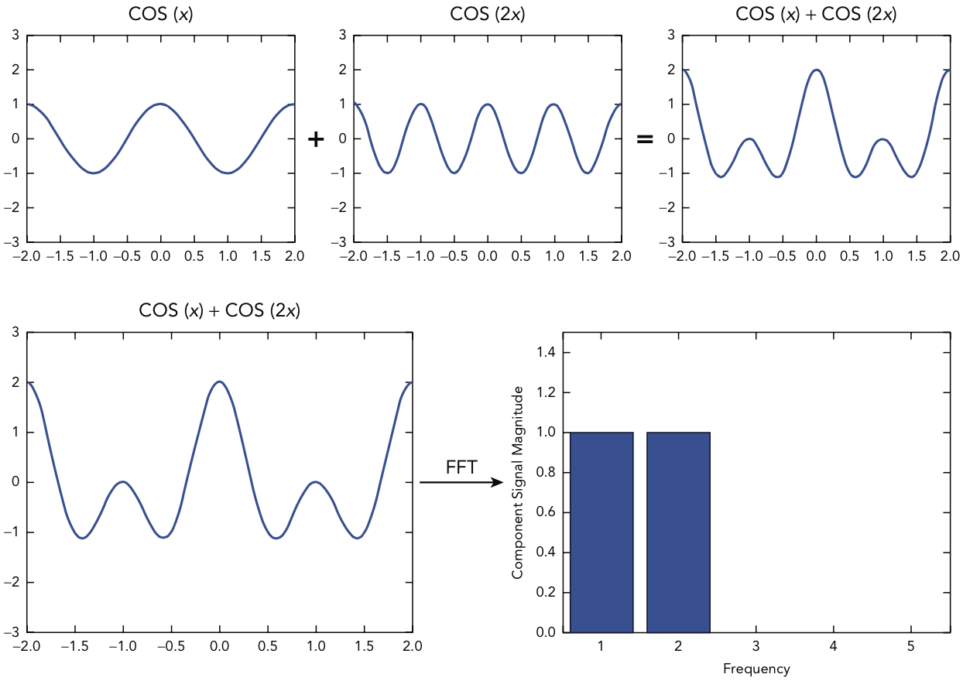
cuFFT
cuFFT offers an optimized implementation of the fast Fourier transform

Slide 44
cuFFT Configuration
In cuFFT terminology, plans == handles
cuFFT plans define a single FFT transformation to be performed
cuFFT uses plans to derive the internal memory allocations, transfers, kernels required to implement the desired transform
Plans are created with:
cufftResult cufftPlan1d(cufftHandle *plan, int nx, cufftType type, int batch);
cufftResult cufftPlan2d(cufftHandle *plan, int nx, int ny, cufftType type);
cufftResult cufftPlan3d(cufftHandle *plan, int nx, int ny, int nz, cufftType type);

Slide 45
cuFFT Configuration
cufftType refers to the data types of a transformation, for example:
Complex-to-complex: CUFFT_C2C
Real-to-complex: CUFFT_R2C
Complex-to-real: CUFFT_C2R

Slide 46
cuFFT Example
A complex-to-complex 1D cuFFT plan and executing it, using 6 of the 10 steps in the common library workflow:
Create and configure a cuFFT plan
Allocate GPU memory for the input samples and output frequencies using cudaMalloc
Populate GPU memory with input samples using cudaMemcpy
Execute the plan using a cufftExec* function
Retrieve the calculated frequencies from GPU memory using cudaMemcpy
Release CUDA and cuFFT resources using cudaFree, cufftDestroy

Slide 47
cuFFT Example
You can build and run an example cufft.cu:
cufftPlan1d(&plan, N, CUFFT_C2C, 1);
cudaMalloc((void **)&dComplexSamples, sizeof(cufftComplex) * N);
cudaMemcpy(dComplexSamples, complexSamples, sizeof(cufftComplex) * N, cudaMemcpyHostToDevice);
cufftExecC2C(plan, dComplexSamples, dComplexSamples, CUFFT_FORWARD);
cudaMemcpy(complexFreq, dComplexSamples, sizeof(cufftComplex) * N, cudaMemcpyDeviceToHost);

Slide 48
cuFFT Summary
Like cuBLAS, cuFFT offers a high-level and usable API for porting legacy FFT applications or writing new ones
cuFFT’s API is deliberately similar to industry-standard library FFTW to improve programmability
Offers higher performance for little developer effort

Slide 49
Drop-In CUDA Libraries
Drop-In CUDA Libraries allow seamless integration of CUDA performance with existing code bases
Full compatibility with industry-standard libraries, expose the same external APIs
BLAS ➔ NVBLAS
FFTW ➔ cuFFTW
Two ways to use Drop-In Libraries:
Re-link to CUDA Libraries
LD_PRELOAD CUDA Libraries before their host equivalents

Slide 50
Drop-In CUDA Libraries
Re-linking legacy applications to CUDA Libraries:
Suppose you have a legacy application that relies on BLAS:
$ gcc app.c –lblas –o app
Recompiling with NVBLAS linked will automatically accelerate all BLAS calls
$ gcc app.c –lnvblas –o app
Alternatively, simply set LD_PRELOAD when executing the application:
$ env LD_PRELOAD=libnvblas.so ./app
Notes:
Instructor note: If you think this topic is worth going into further detail on, there is an example available with Chapter 8 called drop-in.c that can be used to demonstrate Drop-In Libraries using the C BLAS library and NVBLAS.

Slide 51
Survey of CUDA Library Performance
We’ve seen that cuBLAS and cuFFT are high-level, programmable libraries (like their host counterparts)
No CUDA-specific concepts (e.g. thread blocks, pinned memory, etc)
Let’s do a brief survey of CUDA Library performance to see the performance improvements possible
Focus on the same libraries (cuBLAS and cuFFT) but similar data on other libraries is available in the book and online

Slide 52
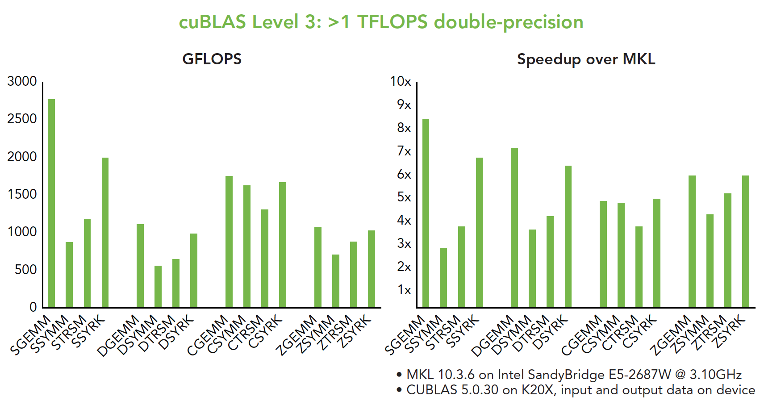
Survey of CUDA Library Performance

Slide 53
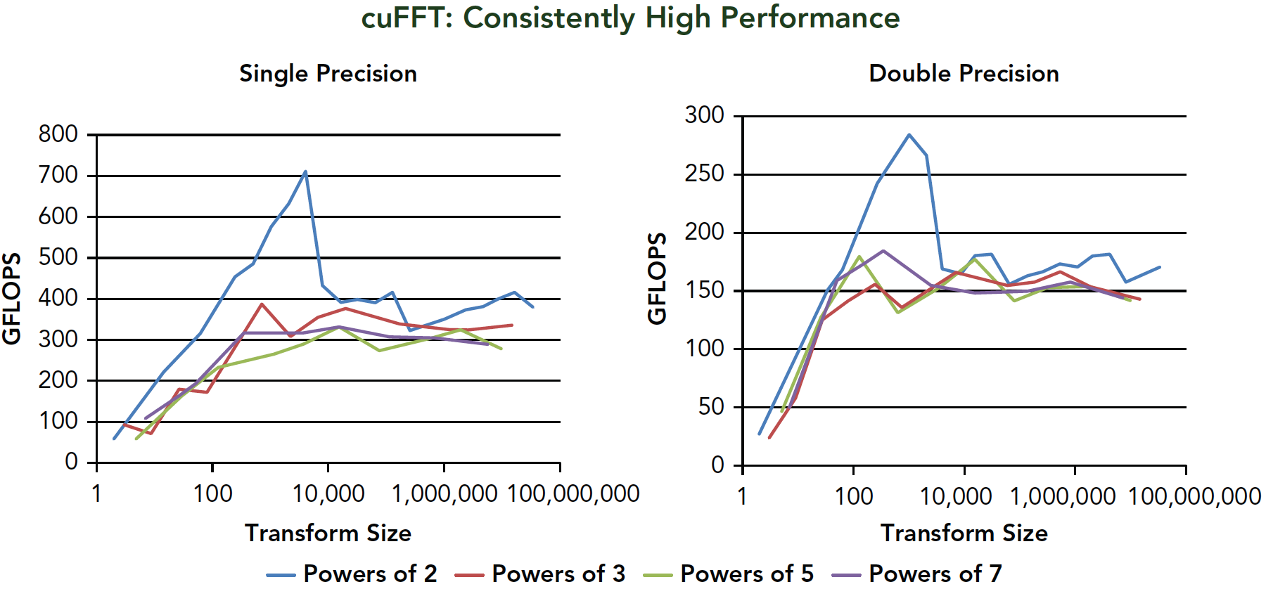
Survey of CUDA Library Performance

Slide 54
Suggested Readings
All sections in Chapter 8 of Professional CUDA C Programming except Using OpenACC
cuSPARSE User Guide. 2014. http://docs.nvidia.com/cuda/cusparse/
cuBLAS User Guide. 2014. http://docs.nvidia.com/cuda/cublas/
cuRAND User Guide. 2014. http://docs.nvidia.com/cuda/curand/
cuFFT User Guide. 2014. http://docs.nvidia.com/cuda/cufft/
CUDA Toolkit 5.0 Performance Report. 2013. http://on-demand.gputechconf.com/ gtc-express/2013/presentations/cuda--5.0-math-libraries-performance.pdf

Slide 55
Manycore GPU Architectures and Programming: Outline
Introduction
GPU architectures, GPGPUs, and CUDA
GPU Execution model
CUDA Programming model
Working with Memory in CUDA
Global memory, shared and constant memory
Streams and concurrency
CUDA instruction intrinsic and library
Performance, profiling, debugging, and error handling
Directive-based high-level programming model
OpenACC and OpenMP
Notes:
GPUs have developed from graphics cards into a platform for high performance computing and perhaps the most important development in HPC for many years.

Slide 56
GPU Parallelization
A many-faceted process
Performance varies dramatically depending on the implementation of the same algorithms
Naïve to highly optimized version
Many types of optimizations for GPUs
Shared memory
Constant memory
Global memory access patterns
Warp shuffle instructions
Computation-communication overlap
CUDA compiler flags, e.g. loop unrolling, etc
Increasing parallelism
...

Slide 57
Optimization Opportunities
Kernel-level optimization:
Exposing Sufficient Parallelism
Optimizing Memory Access
Optimizing Instruction Execution
Host-GPU optimization
E.g. kernel and data transfer overlap using CUDA streams
Profile-driven optimization improves optimizations selection

Slide 58
Kernel-Level Optimization
Exposing Sufficient Parallelism
Increase the amount of concurrent work on the GPU so as to saturate instruction and memory bandwidth
Can be accomplished by:
More concurrently active warps per SM
More independent work assigned to each thread
Warp-Level Parallelism
Instruction-Level Parallelism

Slide 59
Kernel-Level Optimization
Increasing the number of warps per SM/thread block does not guarantee performance improvement
Result in fewer per-SM resources assigned to each thread (e.g. registers, shared memory)
Less parallelism, more per-thread resources
More parallelism, smaller per-thread resources

Slide 60
Kernel-Level Optimization
Creating more independent work per thread
loop unrolling or other code transformations that expose instruction-level parallelism,
But may also increase per-thread resource requirements
int sum = 0;
for (int i = 0; i < 4; i++) {
sum += a[i];
}
int i1 = a[0];
int i2 = a[1];
int i3 = a[2];
int i4 = a[4];
int sum = i1 + i2 + i3 + i4;
Requires 2 registers (sum, i), no instruction-level parallelism
Requires 5 registers (i1, i2, i3, i4, sum), four-way instruction-level parallelism

Slide 61
Kernel-Level Optimization
Optimizing memory access to maximize:
Memory bandwidth utilization (efficiency of memory access patterns)
Memory access concurrency (sufficient memory requests to hide memory latency)

Slide 62
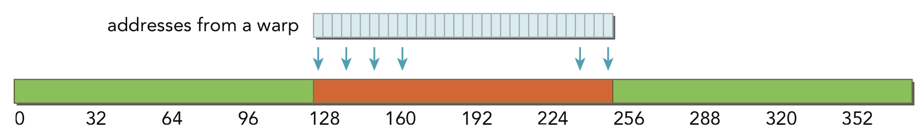
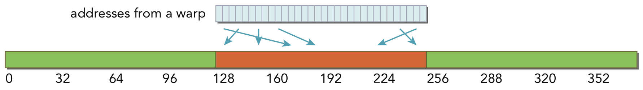
Kernel-Level Optimization
Aligned, coalesced global and shared memory accesses optimize memory bandwidth utilization
Constant memory prefers a broadcast access pattern

Slide 63
Kernel-Level Optimization
Optimizing Instruction Execution focuses on:
Hiding instruction latency by keeping a sufficient number of warps active
Avoiding divergent execution paths within warps
If inside a kernel
Experimenting with thread execution configuration can produce unexpected performance gains from more or less active warps
Divergent execution within a warp produces reduced parallelism as warp execution of multiple code paths is serialized

Slide 64
Profile-Driven Optimization
Profile-driven optimization is an iterative process to optimize program based on quantitative profiling info
As we apply optimization techniques, we analyze the results using nvprof and decide if they are beneficial
Gather profiling information
Repeat
Identify hotspots
Optimize
Determine performance inhibitors

Slide 65
Profile-Driven Optimization
The key challenge in profile-driven optimization is to determine performance inhibitors in hotspots
nvvp and nvprof are invaluable tools for this

Slide 66
Profile-Driven Optimization
nvprof profiling modes:
Summary Mode: default mode, displays execution time information on high-level actions such as kernels or data transfers
Trace Mode: Provides a timeline of CUDA events or actions in chronological order
Event/Metric Summary Mode: Aggregates event/metric counts across all kernel invocations
Event/Metric Trace Mode: Displays event/metric counts for each kernel invocation

Slide 67
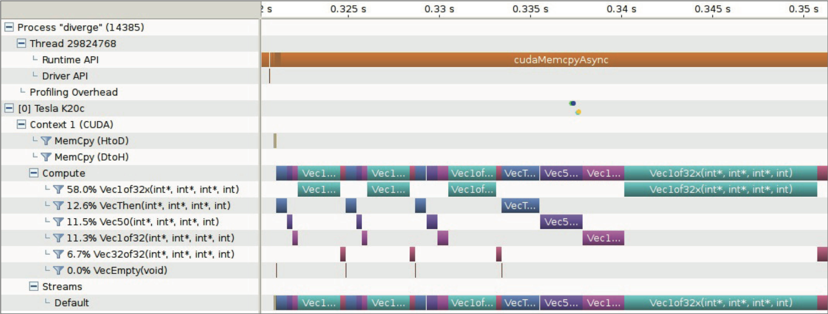
Profile-Driven Optimization
The NVIDIA Visual Profiler (nvvp) is also a powerful tool for guiding profile-driven optimization
Offers a number of views to inspect different parts of a CUDA application

Slide 68
CUDA Debugging
An important part of CUDA software development is the ability to debug CUDA applications
CUDA offers a number of debugging tools, split into two categories:
Kernel Debugging
Memory Debugging

Slide 69
CUDA Debugging
Kernel Debugging tools help us to analyze the correctness of running CUDA kernels by inspecting running application state
Memory Debugging Tools help us detect application bugs by observing irregular or out-of-bound memory accesses performed by CUDA kernels

Slide 70
CUDA Kernel Debugging
Primary tool for the job: cuda-gdb
Intentionally built to be similar to the host debugging tool gdb
Requires compilation with special flags to be useful:
$ nvcc –g –G foo.cu -o foo
Once an application is compiled in debug mode, running it under cuda-gdb is possible using:
$ cuda-gdb foo
...
(cuda-gdb)

Slide 71
CUDA Kernel Debugging
cuda-gdb uses most of the same commands as gdb
One main difference is the idea of CUDA Focus, or the current thread that cuda-gdb is focused on and against which all commands run
Query the current focus using:
(cuda-gdb) cuda thread lane warp block sm grid device kernel
Example of setting focus to the 128th thread in the current block:
(cuda-gdb) cuda thread (128)
Notes:
Instructor note: At this point, it is useful to run through the hands-on cuda-gdb example provided in Chapter 10 under the section “Hands-On with CUDA-GDB”

Slide 72
CUDA Kernel Debugging
printf is another form of CUDA Kernel Debugging
Only available on devices of compute capability 2.0 or higher
Prints are buffered on the device and periodically transferred back to the host for display
Size of this buffer configurable with cudaSetDeviceLimit
Buffer contents are transferred to the host after any CUDA kernel launch, any host-side explicit synchronization, any synchronous memory copies

Slide 73
CUDA Memory Debugging
Memory Debugging detects memory errors in CUDA kernels that are likely indicative of bugs in the code
For example: out-of-bounds memory accesses
There is a single tool for Memory Debugging, cuda-memcheck, which contains two utilities:
The memcheck tool
The racecheck tool

Slide 74
CUDA Memory Debugging
The compilation process for cuda-memcheck is more involved than for cuda-gdb
Building with full debug options affects performance, which may make memory errors harder to hit
Applications should always be compiled with -lineinfo
Applications should also be compiled to include symbol information, but doing this varies by platform
Linux: -Xcompiler –rdynamic
Windows: -Xcompiler /Zi
...

Slide 75
CUDA Memory Debugging
Once the application is compiled, memcheck can be used to check for 6 different types of memory errors:
Memory Access Error: Out-of-bounds or misaligned memory access
Hardware Exception: Error reported by hardware
malloc/free Errors: Improper use of CUDA dynamic memory allocation
CUDA API Errors: Any error return code from a CUDA API call
cudaMalloc Memory Leaks: cudaMalloc allocations that are not cudaFree’d
Device Heap Memory Leaks: Dynamic memory allocations that are never freed

Slide 76
CUDA Memory Debugging
The two cuda-memcheck utilities offer very different capabilities:
memcheck performs a wide range of memory correctness checks
racecheck verifies that __shared__ memory usage is correct in an application, a particularly difficult task to perform manually
cuda-memcheck offers a more automated approach to debugging than cuda-gdb

Slide 77
CUDA Error Handling
Proper error handling is an important part of robust CUDA deployment
Every CUDA function returns an error code that must be checked
If asynchronous operations are used, this error may be a result of a different asynchronous operation failing
Return code of cudaSuccess indicates success
CUDA also offers a number of error-handling functions

Slide 78
CUDA Error Handling
cudaError_t cudaGetLastError();
Retrieve the latest CUDA error, clearing the CUDA runtime’s internal error state to be cudaSuccess
cudaError_t cudaPeekLastError();
Retrieve the latest CUDA error, but do not clear the CUDA runtime’s internal error state
const char *cudaGetErrorString(cudaError_t error);
Fetch a human-readable string for the provided error

Slide 79
Suggested Readings
Chapter 10 in Professional CUDA C Programming
Adam DeConinck. Introduction to the CUDA Toolkit as an Application Build Tool. GTC 2013. http://on-demand.gputechconf.com/gtc/2013/webinar/cuda-toolkit-as-build- tool.pdf
Sandarbh Jain. CUDA Profiling Tools. GTC 2014. http://on-demand.gputechconf.com/ gtc/2014/presentations/S4587-cuda-profiling-tools.pdf
Thomas Bradley. GPU Performance Analysis and Optimization. 2012. http://people.maths .ox.ac.uk/gilesm/cuda/lecs/NV_Profiling_lowres.pdf
Julien Demouth. CUDA Optimization with NVIDIA Nsight(TM) Visual Studio Edition: A Case Study. GTC 2014. http://on-demand.gputechconf.com/gtc/2014/presentations/S4160- cuda-optimization-nvidia-nsight-vse-case-study.pdf

