Slide 1
TechXPerience 2024:
Embedded Systems Laboratory
Denisa Constantinescu, Rubén Rodriguez Alvarez, Christodoulos Kechris, Riselda Kodra, Juan Sapriza, Lara Orlandic, Dr. Giovanni Ansaloni, Prof. David Atienza
EPFL - Embedded Systems Laboratory
esl.epfl.ch

Slide 2
Robot assembly - done
https://www.ti.com/lit/ml/swrp249/swrp249.pdf
MAX Edition video tutorial (we have the maze version!) https://www.youtube.com/watch?v=ArbcRff2V8I&t=1s

Slide 3
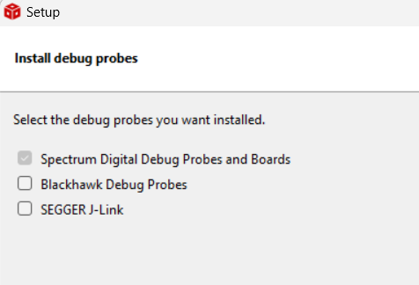
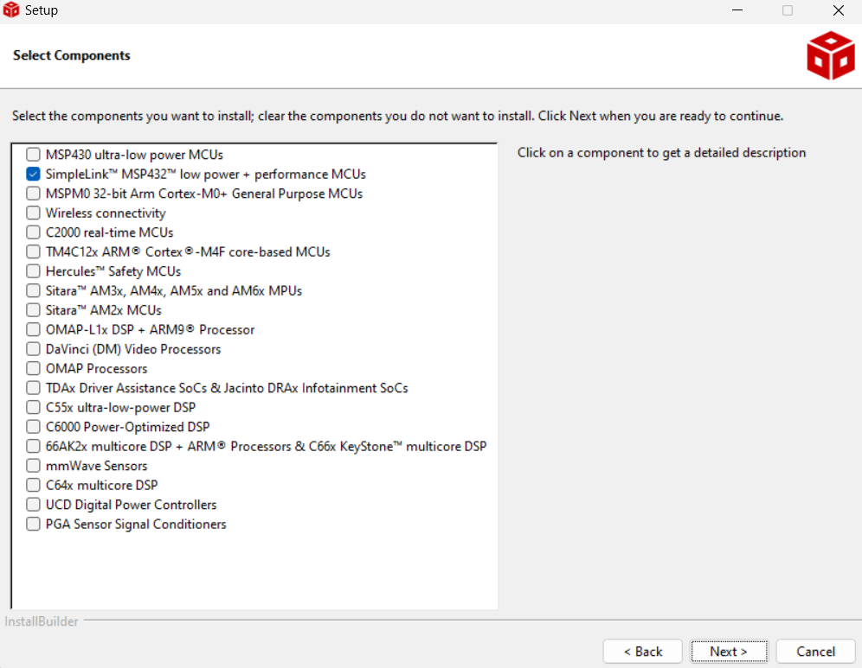
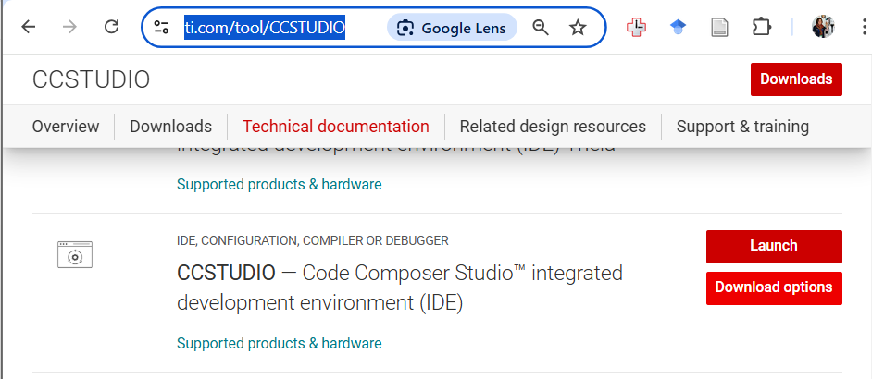
IDE (CCS) Installation
Download and install: https://www.ti.com/tool/CCSTUDIO
https://www.ti.com/lit/ml/swrp132/swrp132.pdf?ts=1733155018264&ref_url=https%253A%252F%252Fwww.ti.com%252Fvideo%252F5631983376001

Slide 4
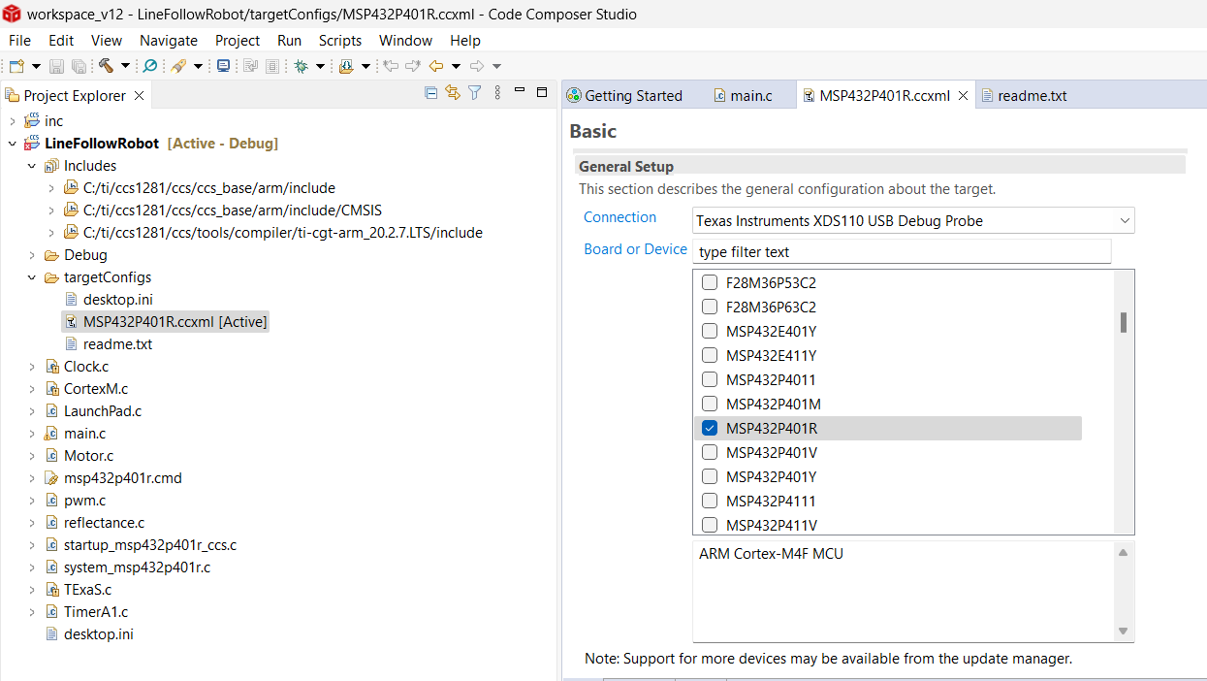
Target configuration

Slide 5
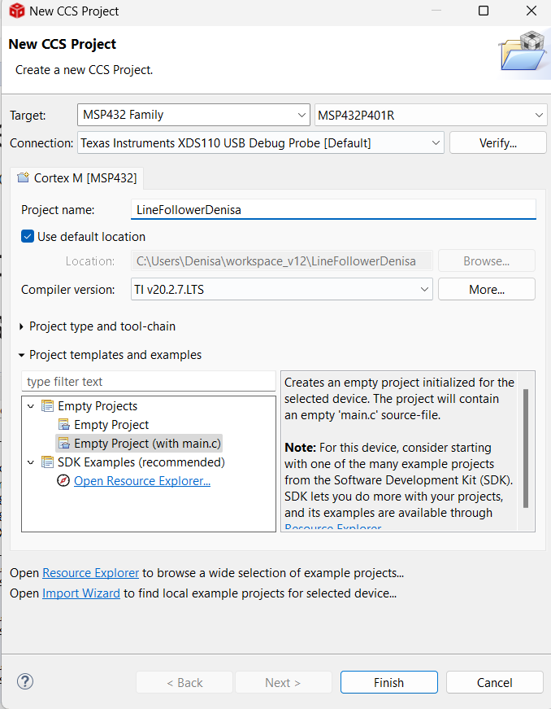
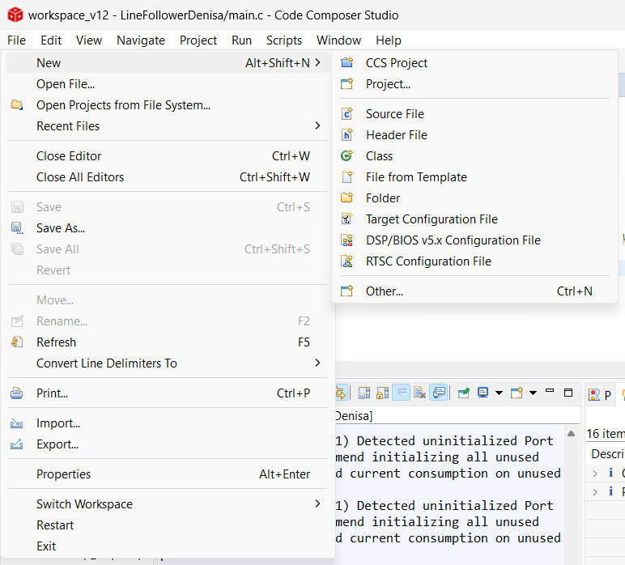
New Project

Slide 6
C tutorials and references
Scope:
You are expected to learn how to read C code and understand the examples. This process takes students from a few weeks to a whole semester, so don’t get frustrated if you don’t grasp it straight away.
Activities:
Watch the video: Introduction to C Programming
Check code examples and discuss them with your teammate.
Follow the Design Tutorial: TI Robotics System Learning Kit Curriculum
Learn about Running Code on LaunchPad: Video Tutorial

Slide 7
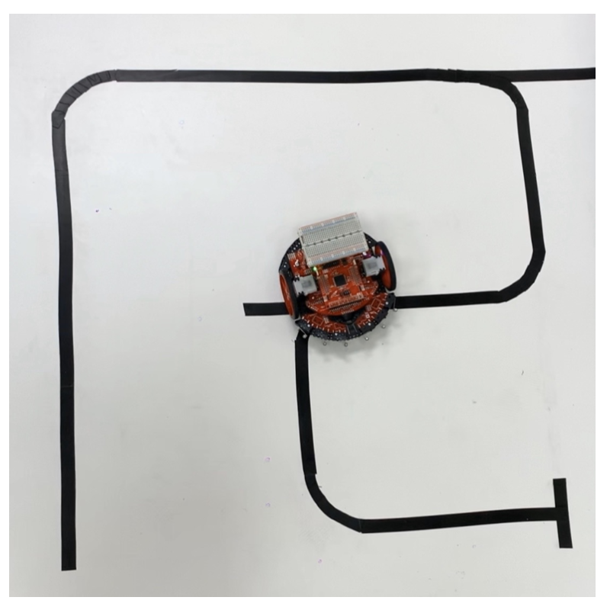
Robot programming - code examples
Git clone https://github.com/yfjobs97/TI-RSLK
→ check https://github.com/yfjobs97/TI-RSLK/blob/main/project_maze.c
Git clone https://github.com/esl-epfl/ti_robot_maze
Git clone https://github.com/PhatLe15/Line-Follower-Treasure-Hunt-Robot

Slide 8
Backup IDE (Arduino)

Slide 9
Energia (Arduino IDE for TI)
Download: https://energia.nu/download/
Drivers: https://www.ti.com/tool/download/SIMPLELINK-MSP432-SDK

Slide 10
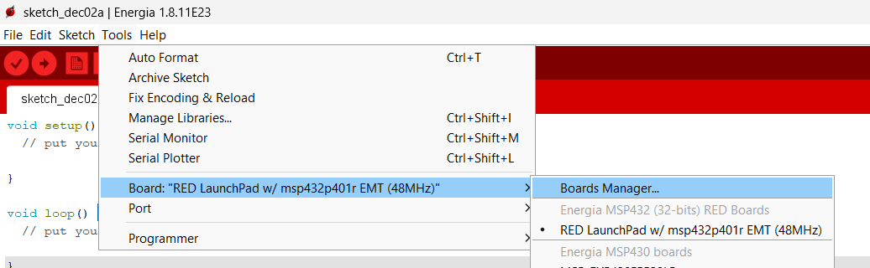
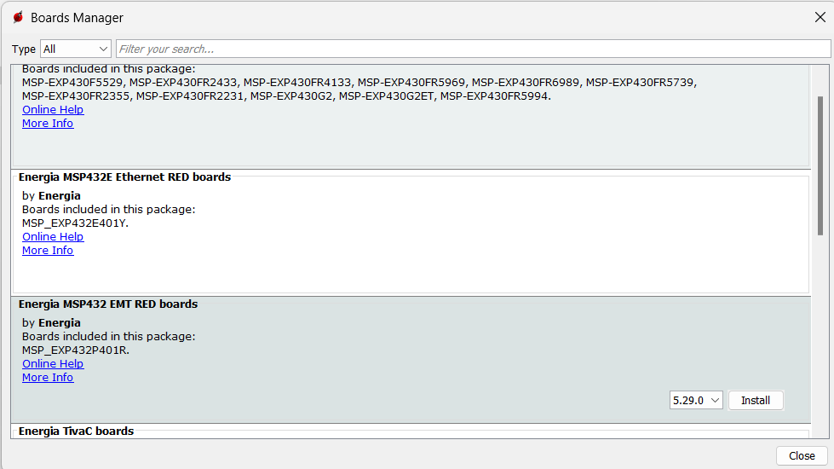
Board Manager – Install MSP432 RED boards package

Slide 11
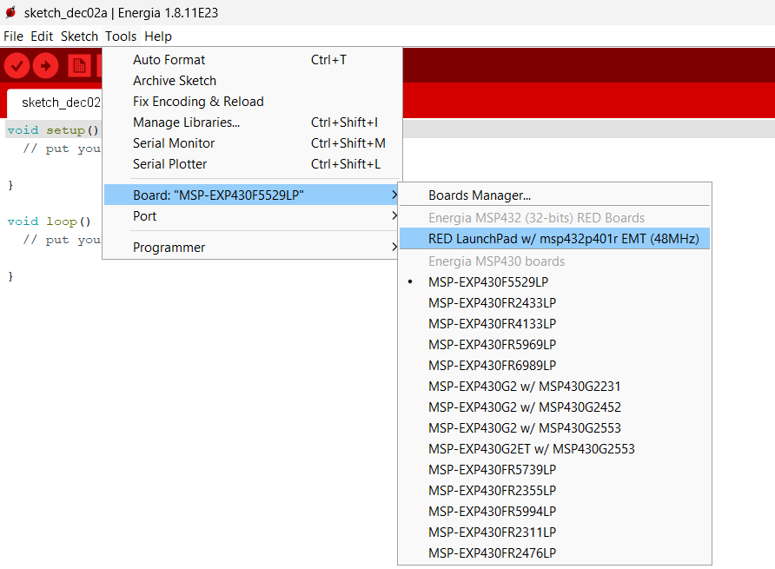
Install board support

Slide 12
Code example - Arduino
git clone https://github.com/combobulate/TinyCar

Slide 13

TechXperience Organizers EPFL - Embedded Systems Laboratory esl.epfl.ch
Thank you!

