Slide 1

IMS PROJECT
By Arthur eoin rafferty

Slide 2
Presentation Contents
The presentation will begin with an overview of the project with all the technologies used throughout the life cycle. Following the technologies, I will proceed with a demonstration of my programme and an example of a test class. Any evidence needed for the technologies used can be given upon asking.

Slide 3
Project Objective
The objective of this project was to develop an Inventory Management System (IMS) encapsulating all of the fundamental coding and software practices we have developed over the first 5 weeks. In the following slides, I will take you through all of the software I used and the reasoning behind my choices within them.

Slide 4
Scope
Code fully integrated into a Version Control System, using Agile methodology and the Feature-Branch Model.
A Kanban board with full expansion on user stories and tasks needed to complete the project. It should also provide a record of any issues or risks that you faced creating your project.
A relational database used to store data persistently for the project, containing at least three tables. Relationships should be modelled using an ERD.
A functional application ‘back-end’, following best practices and design principles, in the language that you have covered during training, meeting the requirements set on your Kanban Board.
A build of your application, including any dependencies it might need, produced using an integrated build tool.
Unit tests for validation of the application. You should aim to reach the industry standard of 80% test coverage.

Slide 5
Technologies used during the project
Kanban Board: Jira
Version Control System: Git
Source Code Management: GitHub
Database Management System: MySQL Server
Back-End Programming Language: Java
Build Tool: Maven
Unit Testing: JUnit

Slide 6
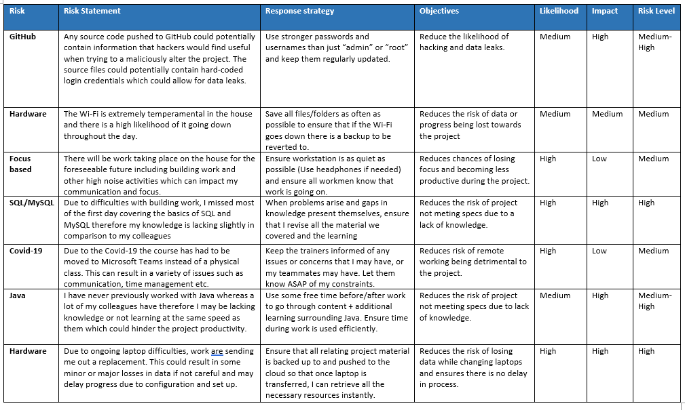
Project foundations
Before beginning the project, I developed a risk assessment for hurdles I may find during the development of the project a long with proposed solutions.

Slide 7

Project foundations cont.
Following the initial risk assessment, I brainstormed all the necessary things I had to do for the completion of a successful project. What I decided upon was a Kanban board specifically using Jira software.
Jira gave me the ability to precisely plan out exactly what I had to do and work out the time effort that would be needed for each task using an app named Planning Poker so I could create an estimate for the overall timeline of the project.
On the following slide is what a completed task looked like on my Kanban board.

Slide 8
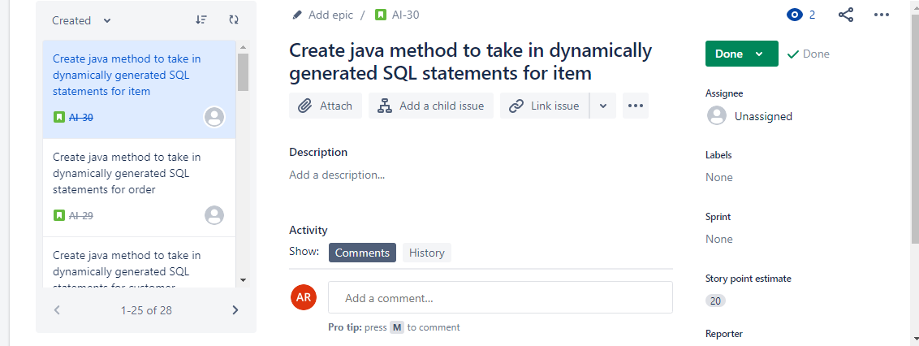

Slide 9
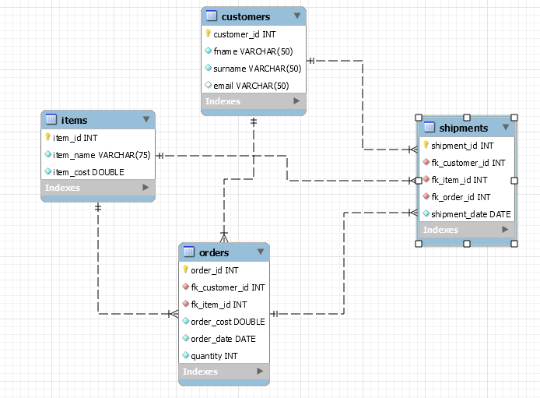
Database beginning
Once I had Jira completed I began the tasks required. This began with the development of necessary tables I will be using throughout the project. After the tables and columns were decided upon, I created an ERD for the tables. The ERD essentially shows the relationships between the tables in the database.

Slide 10

Version Control System
Throughout the whole project it was essential I had a repository that contained all of the necessary files relating to the project.
The VCS that was decided upon is the commonly used Git. Git allows me not only to edit my local machine but to push all of my work with commits to a cloud system named GitHub.
This was ultimately essential not only for ease of use to showcase the project or if I intended to work on the project from a different device but also for project integrity meaning if I was to mistakenly edit any aspect of the project or code in an unintended way, I can just pull a previous commit with the file progress I made up until then.

Slide 11
Project Demonstration
I will now take you through the functionality of the project. To summarise, we linked the JDBC to a MySql database to not only access the database but also to create, read, update and delete contents within the tables so that the user can control the inventory of their store.

Slide 12

Testing
Following the completion of the JDBC, I began the testing of the project. For this it was decided upon the use of Junit testing as the programme was built using Maven. The industry standard of 80% was the goal but unfortunately I fell short at 75% due to the project being my first venture with practical Java and Junit testing.
I will now take you through a variety of my test cases and the logic behind them.

Slide 13
Project end - Questions
Once testing was completed, I knew the functionality of the project was working and I was confident on the release.
Are there any questions?
Thank you for your time.

