Slide 1
THESIS
GaussFM: Compact Foundation-Feature Gaussian Memory
Turn view-local foundation features into a compact, queryable 3D scene memory.
Input
Memory
Queries
posed RGB + frozen foundation features
low-dimensional Gaussian feature codes
2D rendered maps, 3D primitives, point queries
One representation; three open-vocabulary query modes.
GaussFM | Academic Short Talk
1

Slide 2
MOTIVATION
Why 2D foundation features are not yet 3D scene memory
View-local
High-dimensional
Not directly 3D
single-frame features vary with viewpoint, scale, and occlusion
storing dense 1280-D features per view or primitive is expensive
2D heatmaps do not automatically answer primitive- or point-level queries
The missing object is a compact scene-level foundation-feature memory.
It should render dense feature maps for novel views.
It should support direct Gaussian/point queries without a view cache.
It should preserve downstream usability under frozen heads.
GaussFM | Academic Short Talk
2

Slide 3
PROBLEM
Research question
How can high-dimensional, multiview foundation features be compressed into a 3D Gaussian field without losing queryability?
Q1. Compression
Q2. Consistency
Q3. Query modes
low memory, preserved RADIO-compatible feature space
multiview evidence must become stable primitive support
one field should serve rendered, primitive, and point queries
GaussFM | Academic Short Talk
3

Slide 4
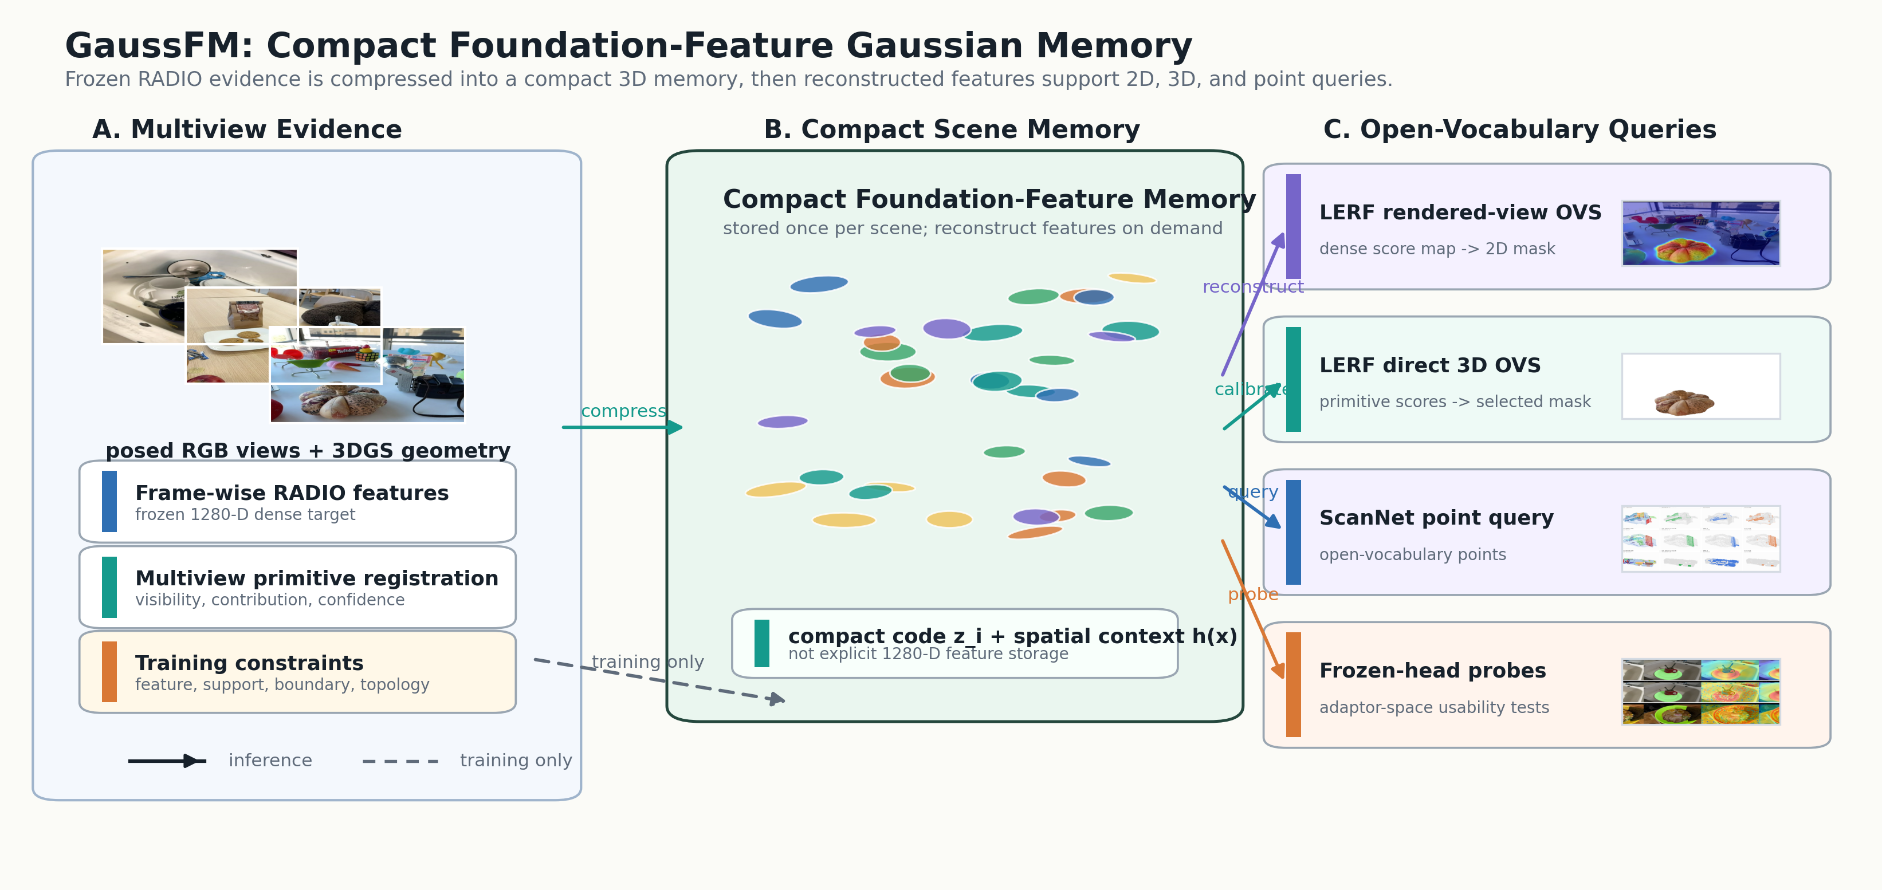
METHOD
Method overview: one compact memory, three query modes
Training reconstructs RADIO-compatible scene features; inference queries the stored Gaussian memory.
GaussFM | Academic Short Talk
4

Slide 5
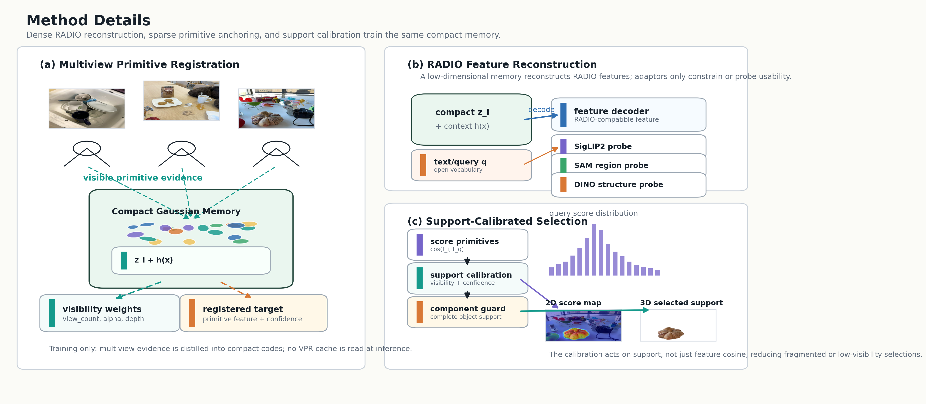
METHOD
Core components in the compact feature field
1. Compact Gaussian codes
store low-dimensional feature latents per Gaussian
2. Spatial context
inject neighborhood and scene-level support for stable features
3. Foundation-space decoding
recover RADIO-compatible features on demand
4. Reliability / visibility
calibrate support for rendered and direct queries
Compact storage is paired with reconstruction and support calibration.
GaussFM | Academic Short Talk
5

Slide 6
CONTRIBUTIONS
Main contributions and innovations
Contribution 1
Contribution 2
Contribution 3
A compact foundation-feature Gaussian memory that stores low-dimensional codes rather than full RADIO features.
A unified query interface for rendered 2D grounding, direct 3D object selection, and point-level open-vocabulary query.
Evidence that reconstructed scene features can remain compact while improving selected downstream usability.
The novelty is the reusable scene memory, not a benchmark-specific readout.
GaussFM | Academic Short Talk
6

Slide 7
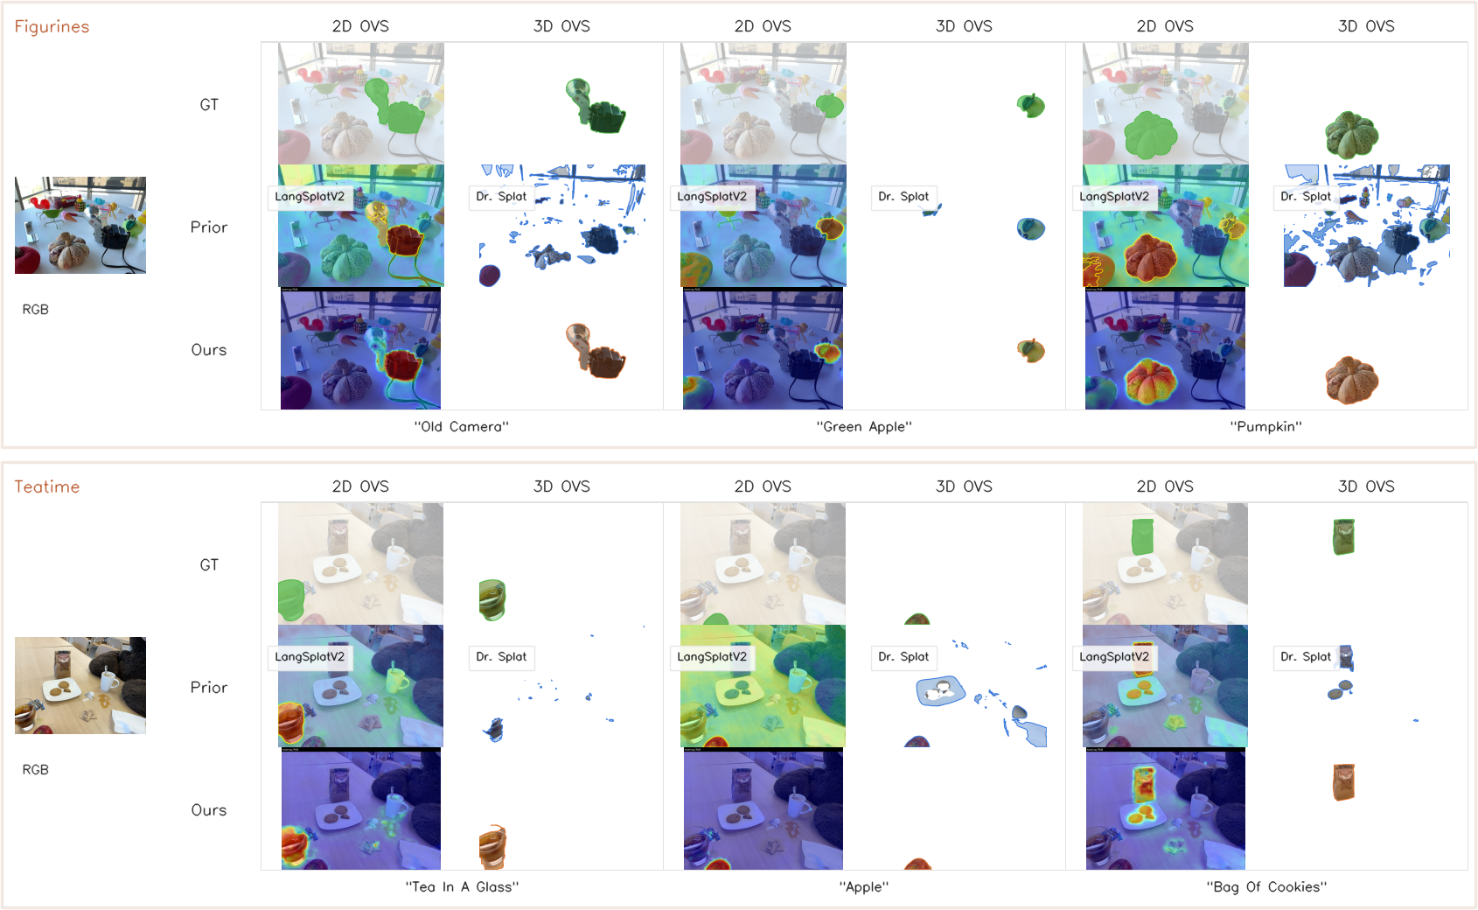
EVIDENCE
Result 1: rendered-view open-vocabulary grounding
Method | mIoU | Acc
LangSplat | 33.92 | 64.01
LangSplatV2 | 46.24 | 75.84
OpenGaussian | 49.74 | 72.75
GaussFM | 64.98 | 82.68
Rendered GaussFM features support strong 2D open-vocabulary localization under the same reproduced protocol.
GaussFM | Academic Short Talk
7

Slide 8
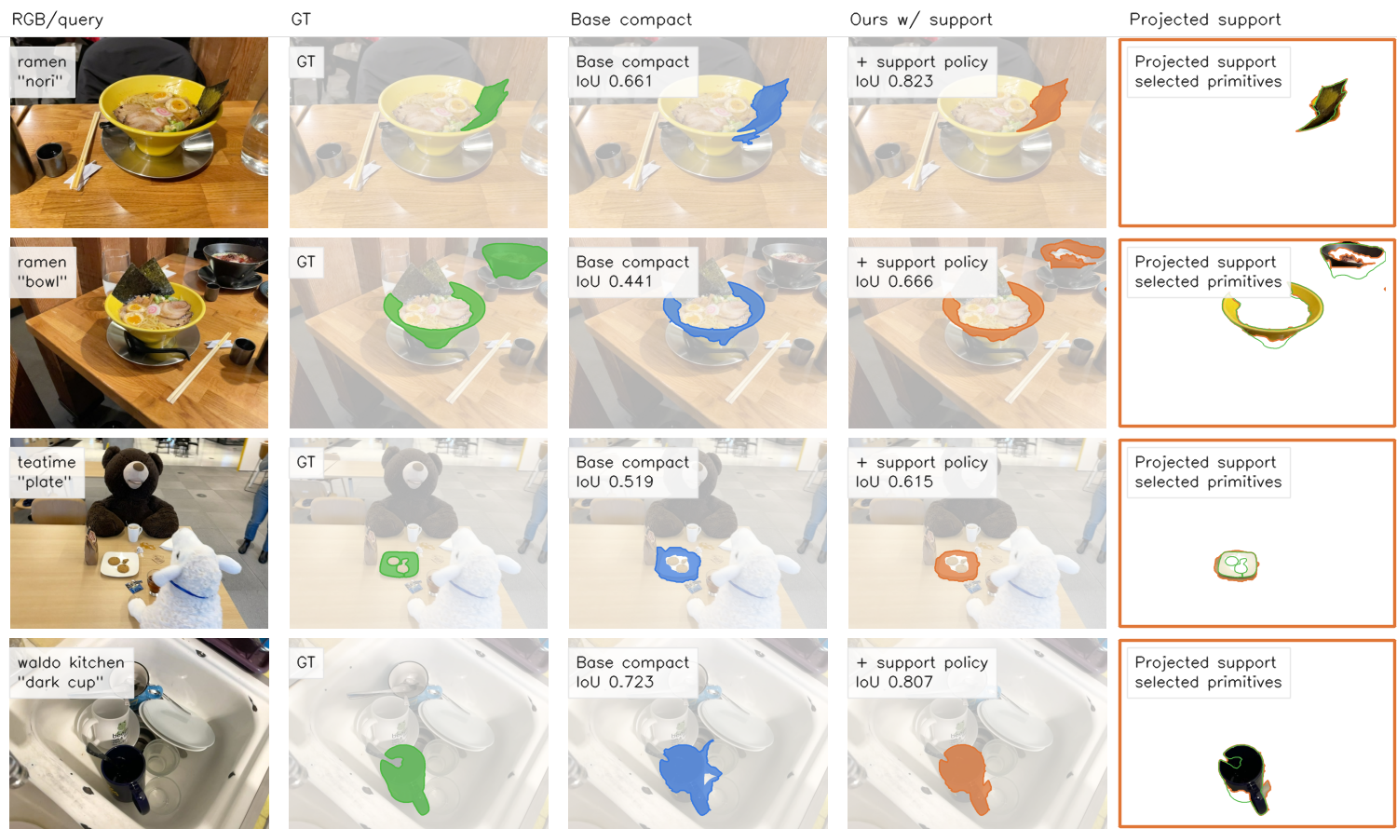
EVIDENCE
Result 2: direct 3D open-vocabulary object selection
Method | mIoU | Acc
OpenGaussian | 41.06 | 51.44
Dr. Splat | 39.77 | 65.48
LangSplatV2 | 35.87 | 55.80
GaussFM | 54.36 | 80.84
Interpretation
The compact memory can be queried at the primitive level, not only after rendering a 2D heatmap.
GaussFM | Academic Short Talk
8

Slide 9
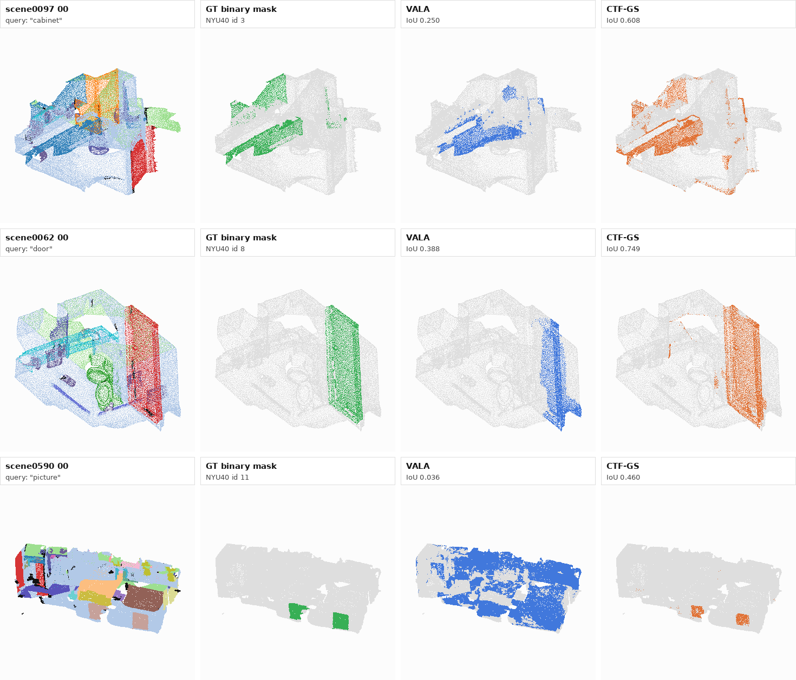
EVIDENCE
Result 3: VALA-aligned ScanNet point query
Method | 19 mIoU | 15 mIoU | 10 mIoU
OpenGaussian | 27.73 | 29.67 | 39.93
Dr. Splat | 29.31 | 33.25 | 44.19
OccamLGS | 31.93 | 34.25 | 45.16
VALA | 32.11 | 35.10 | 46.21
GaussFM | 36.55 | 42.78 | 57.85
The same feature-memory idea transfers beyond LERF scenes to point-level open-vocabulary querying.
GaussFM | Academic Short Talk
9

Slide 10
ANALYSIS
Why it works: compact reconstruction plus support calibration
Ablation | Task | Main gain
Foundation-space reconstruction | LERF rendered | +0.366 mIoU
Frame-wise RADIO -> GaussFM | same evaluator | +0.107 mIoU
Prompt ensemble + component support | Direct 3D | +0.053 mIoU
SAM3 point-prompt feature readout | frozen-head probe | +0.047 mIoU
Compactness
20x smaller latent payload than explicit 1280-D fp16 features.
Usability
6/6 selected primary downstream probes favor rendered GaussFM features.
Boundary
Secondary metrics and diagnostics are reported separately to avoid overclaiming.
GaussFM | Academic Short Talk
10

Slide 11
SUMMARY
Takeaway
GaussFM converts frame-wise foundation features into a compact, reusable, queryable 3D Gaussian scene memory.
Compact
Unified
Effective
low-dimensional per-Gaussian feature memory
2D rendered, 3D primitive, and point queries
strong reproduced results across three protocols
One compact memory can carry foundation-model semantics into 3D scene understanding.
GaussFM | Academic Short Talk
11

