Slide 1
STORE MANAGEMENT SYSTEM
Submitted By:
Group No. 19
Anshumala Jaiswal(219029)
Arti Rathore(219031)

Slide 2
INTRODUCTION
This project is a web-based store management system for an existing shop. The project objective is to deliver the online management application into web platform.
The objective of this Store Management System is to develop a high digitized details maintenance in the departmental store to analyze and improve the business activities.
This project is an attempt to provide the advantages of online store management system to sellers of a real shop. It helps storing the products in the shop anywhere through internet by using an website device. This system can be implemented to any shop in the locality or to multinational branded shops having retail outlet chains.
Here Admin can add any number of users i.e. Seller and Supplier.
Seller can add various categories and add products into them.They are required to add the address of their shop. They can order the products required from any of the supplier available in the application and see the status of products whether delivered or not.
Supplier can change the status of ordered products and can view the address where the required product is to be supplied.

Slide 3
Scope of Project
TECHNOLOGY USED
Spring Boot
React
MySql
FEATURES:
We can Add any numbers of users and can update or delete their information.
We can add the products in the specified category and can further order for products which we require for the shop
We can view and change the status of the ordered products.

Slide 4
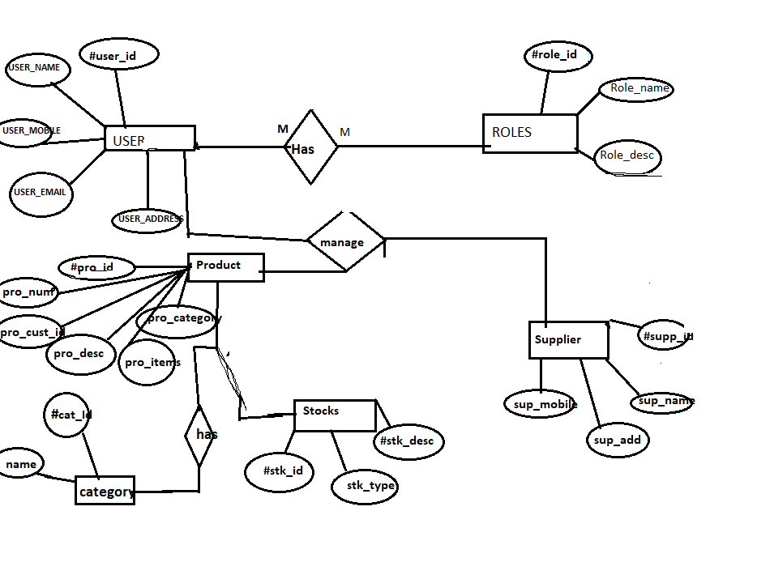
E-R Diagram

Slide 5
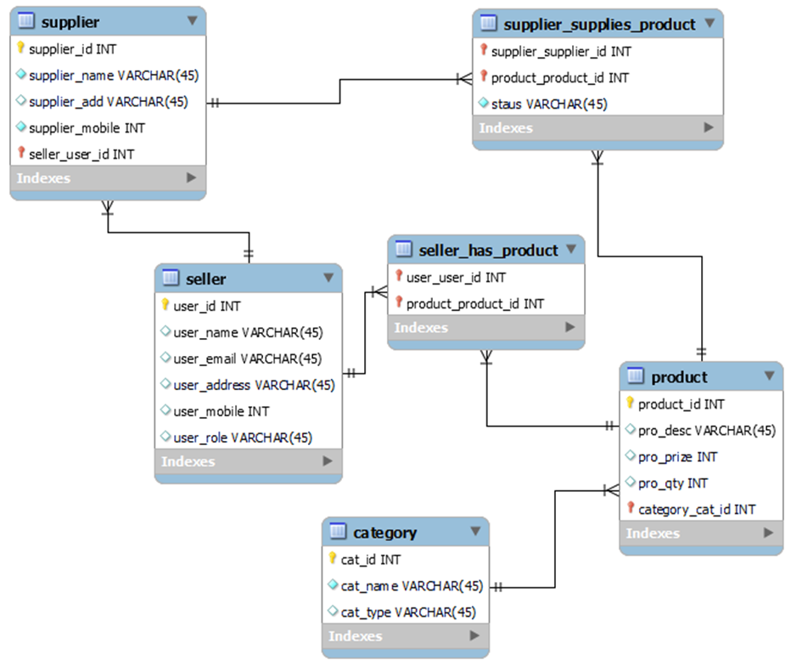

Slide 6
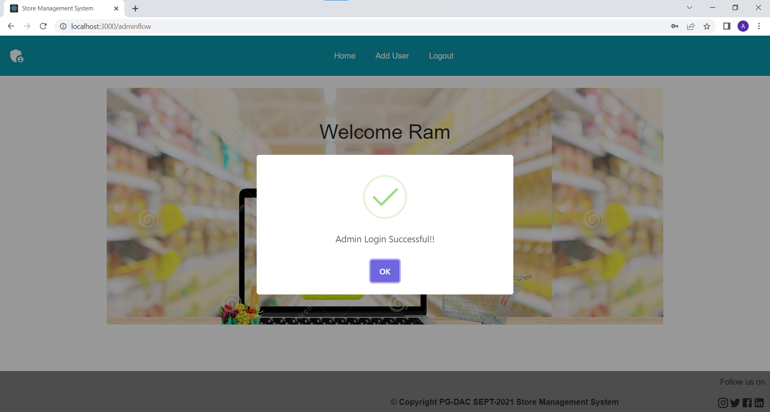
Admin Role:
Login
Add User
Update/delete User
View User List
Logout

Slide 7
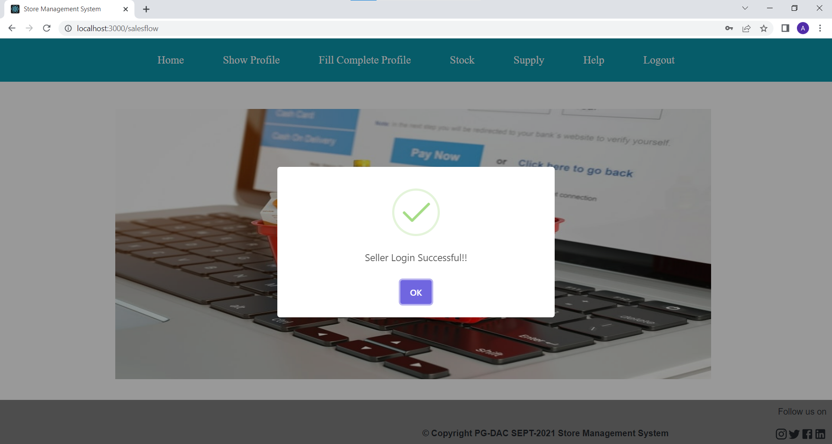
Salesman Role:
Sign Up/Login
View Profile
Add Adress Details
View Complete Profile
Stock
(Add Categories and Products)
Supply
(Order Products via Supplier)
Logout

Slide 8
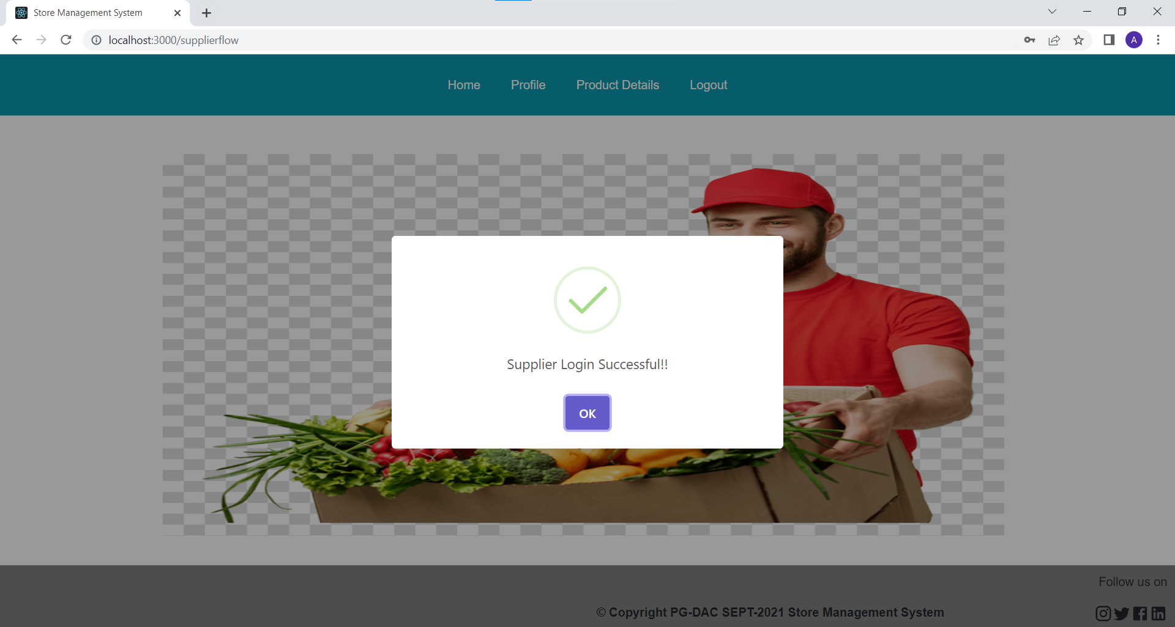
Supplier Role:
View Profile
Product Details
(change the status of products)
Logout

Slide 9
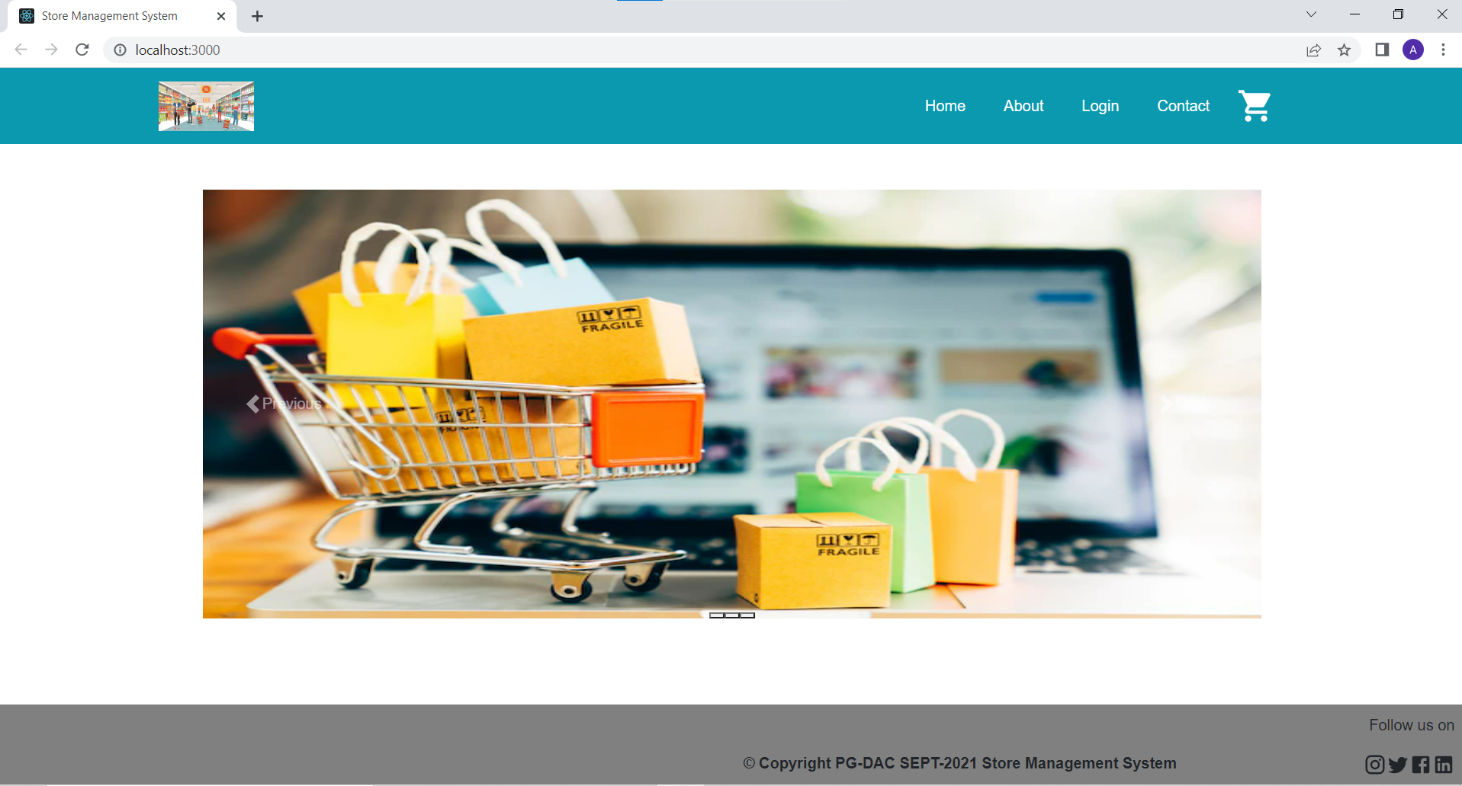
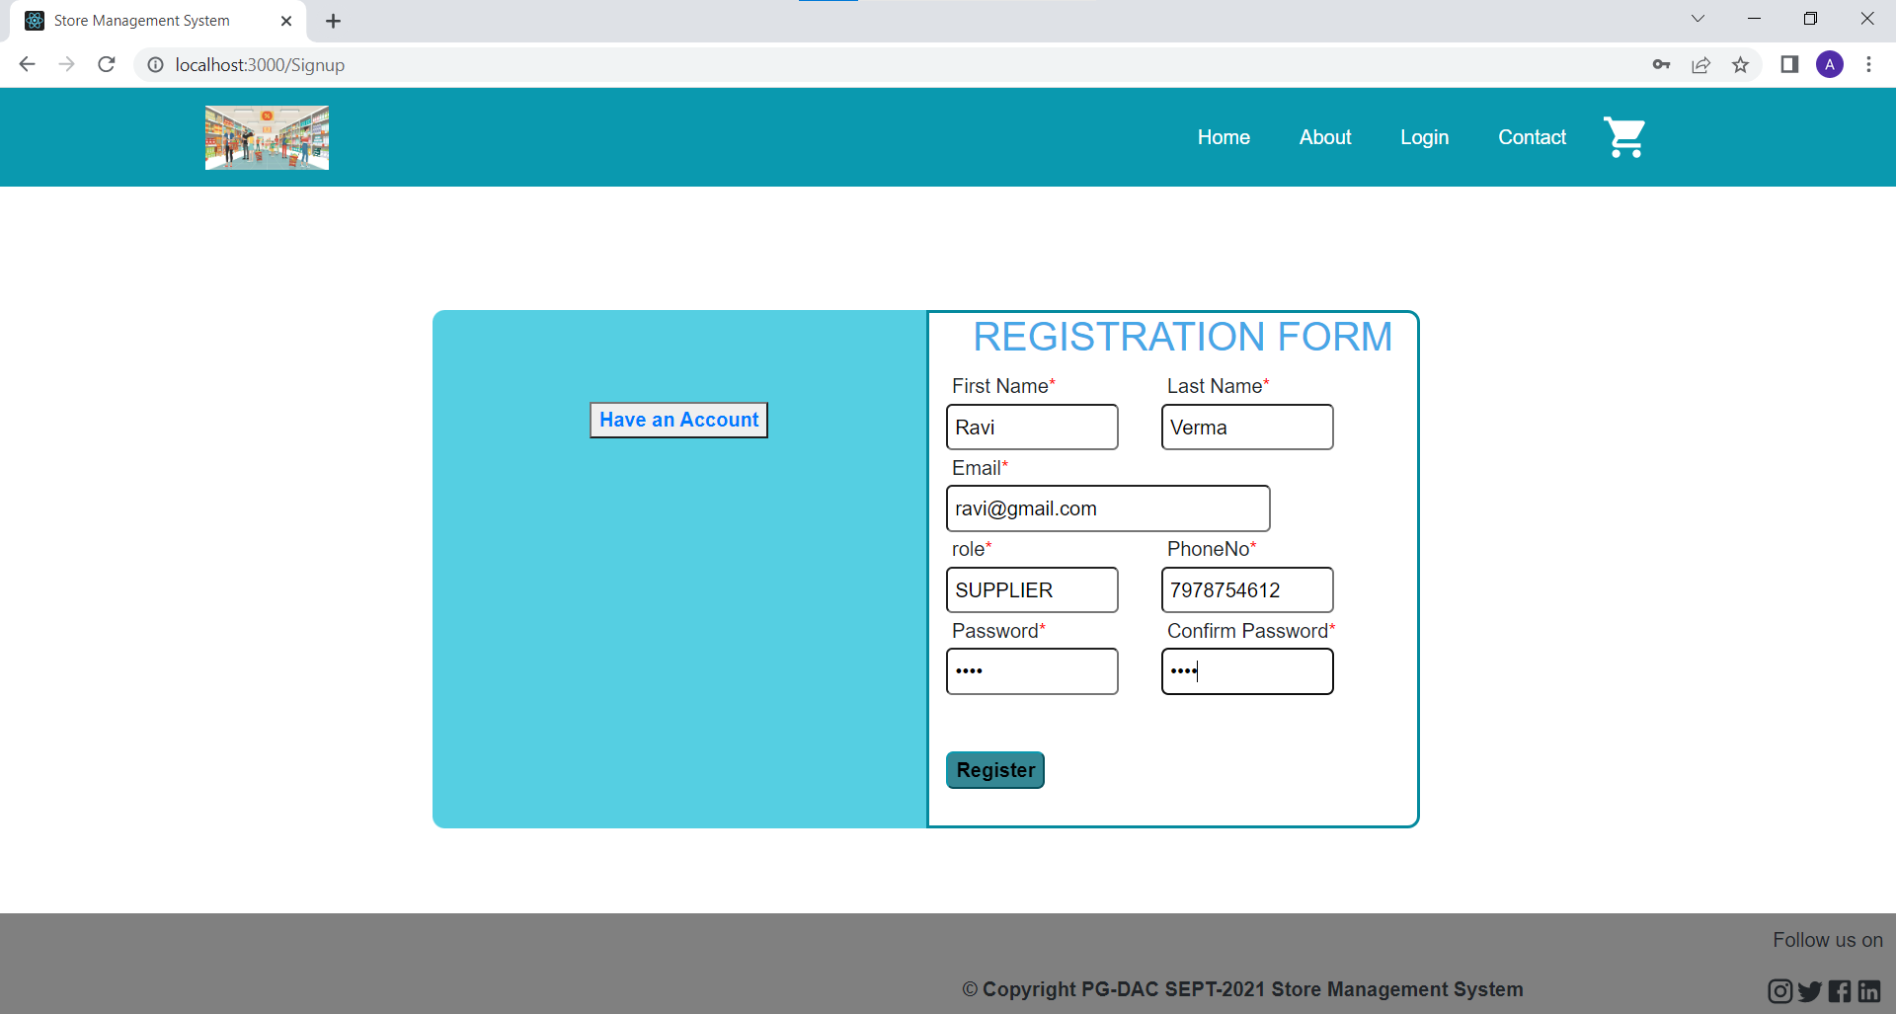
Project Images

Slide 10
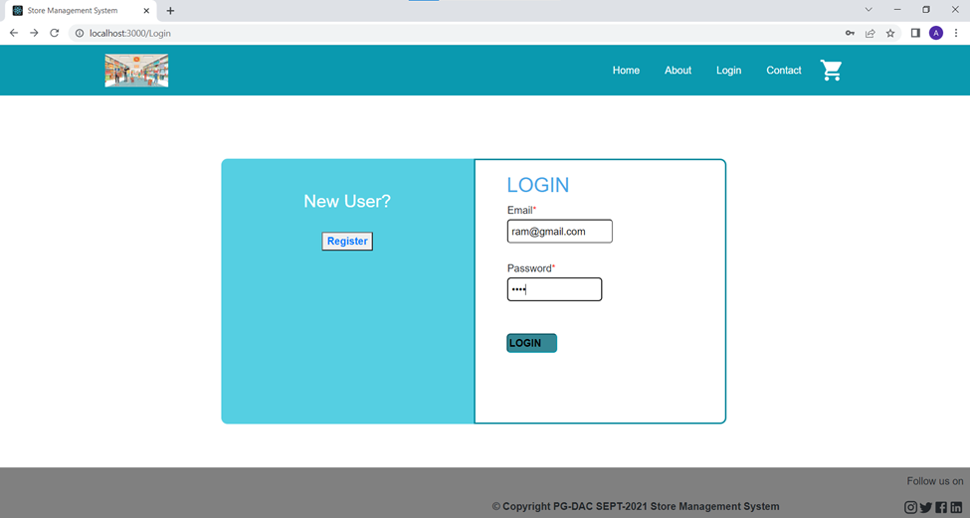
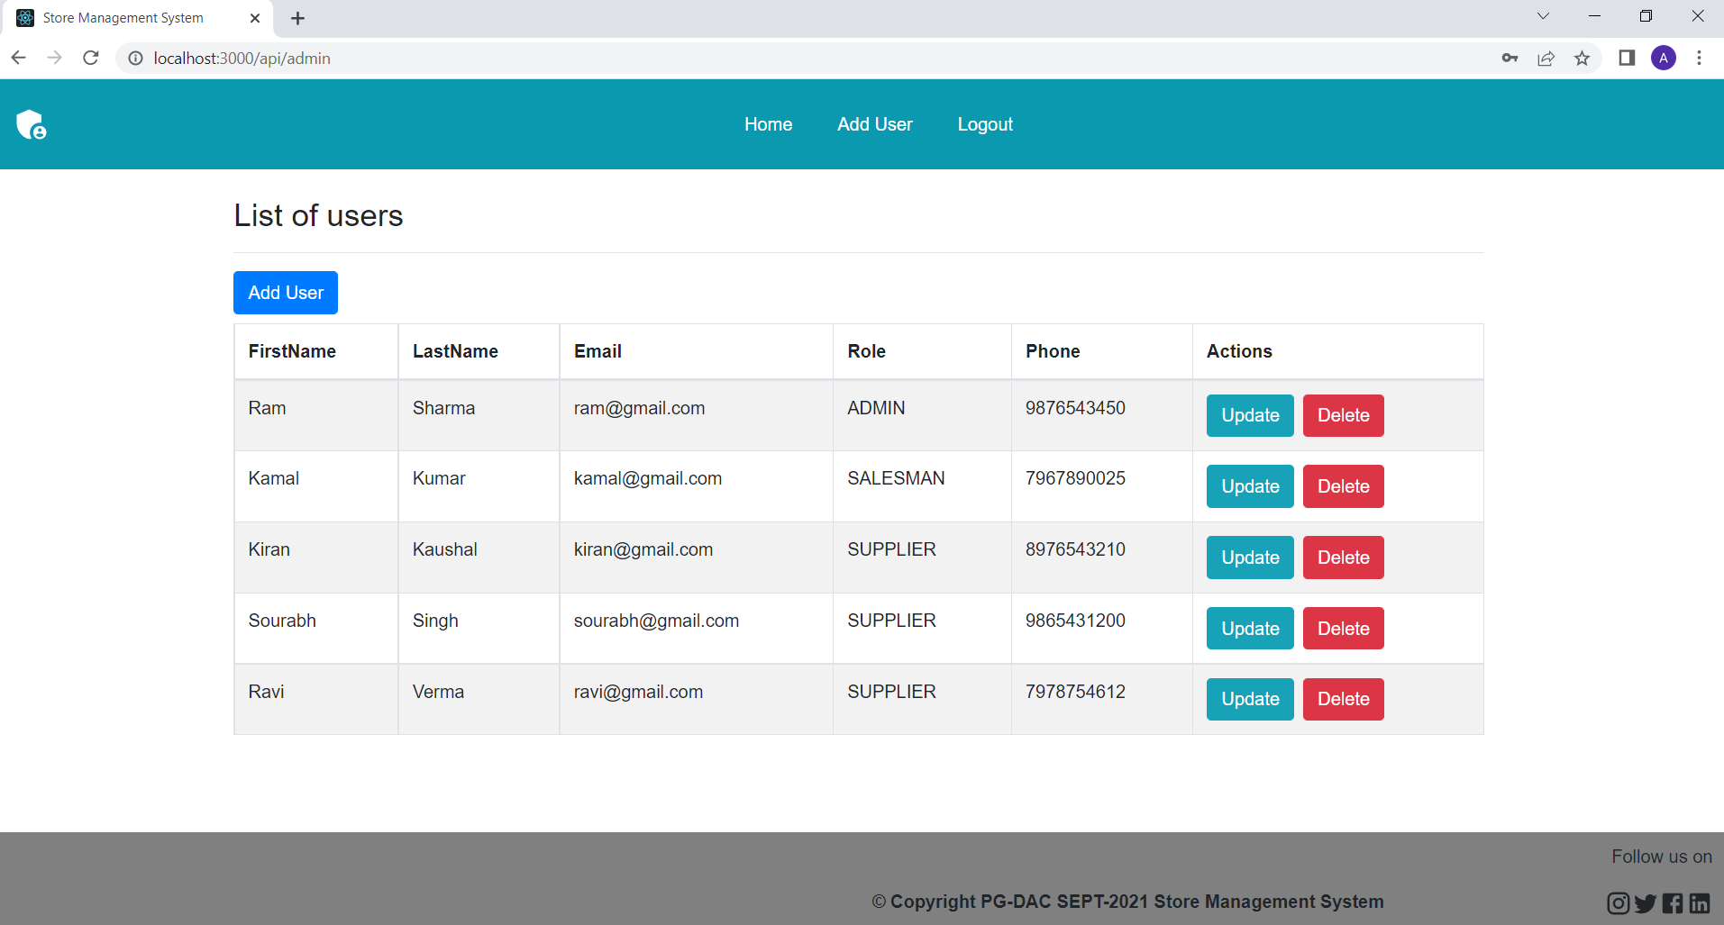

Slide 11
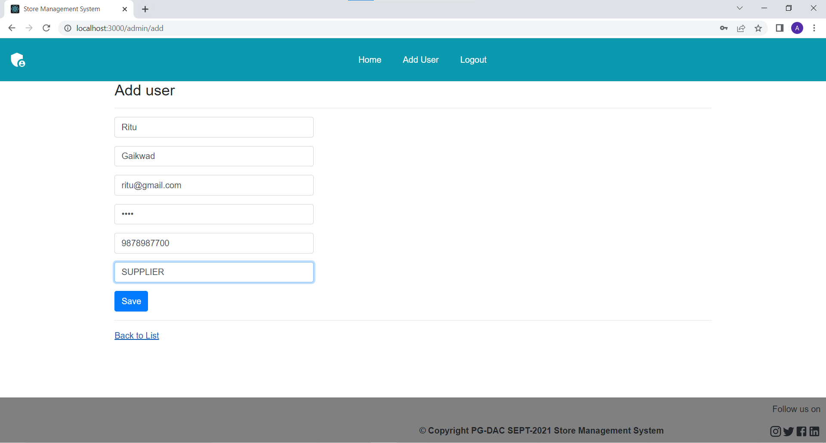

Slide 12
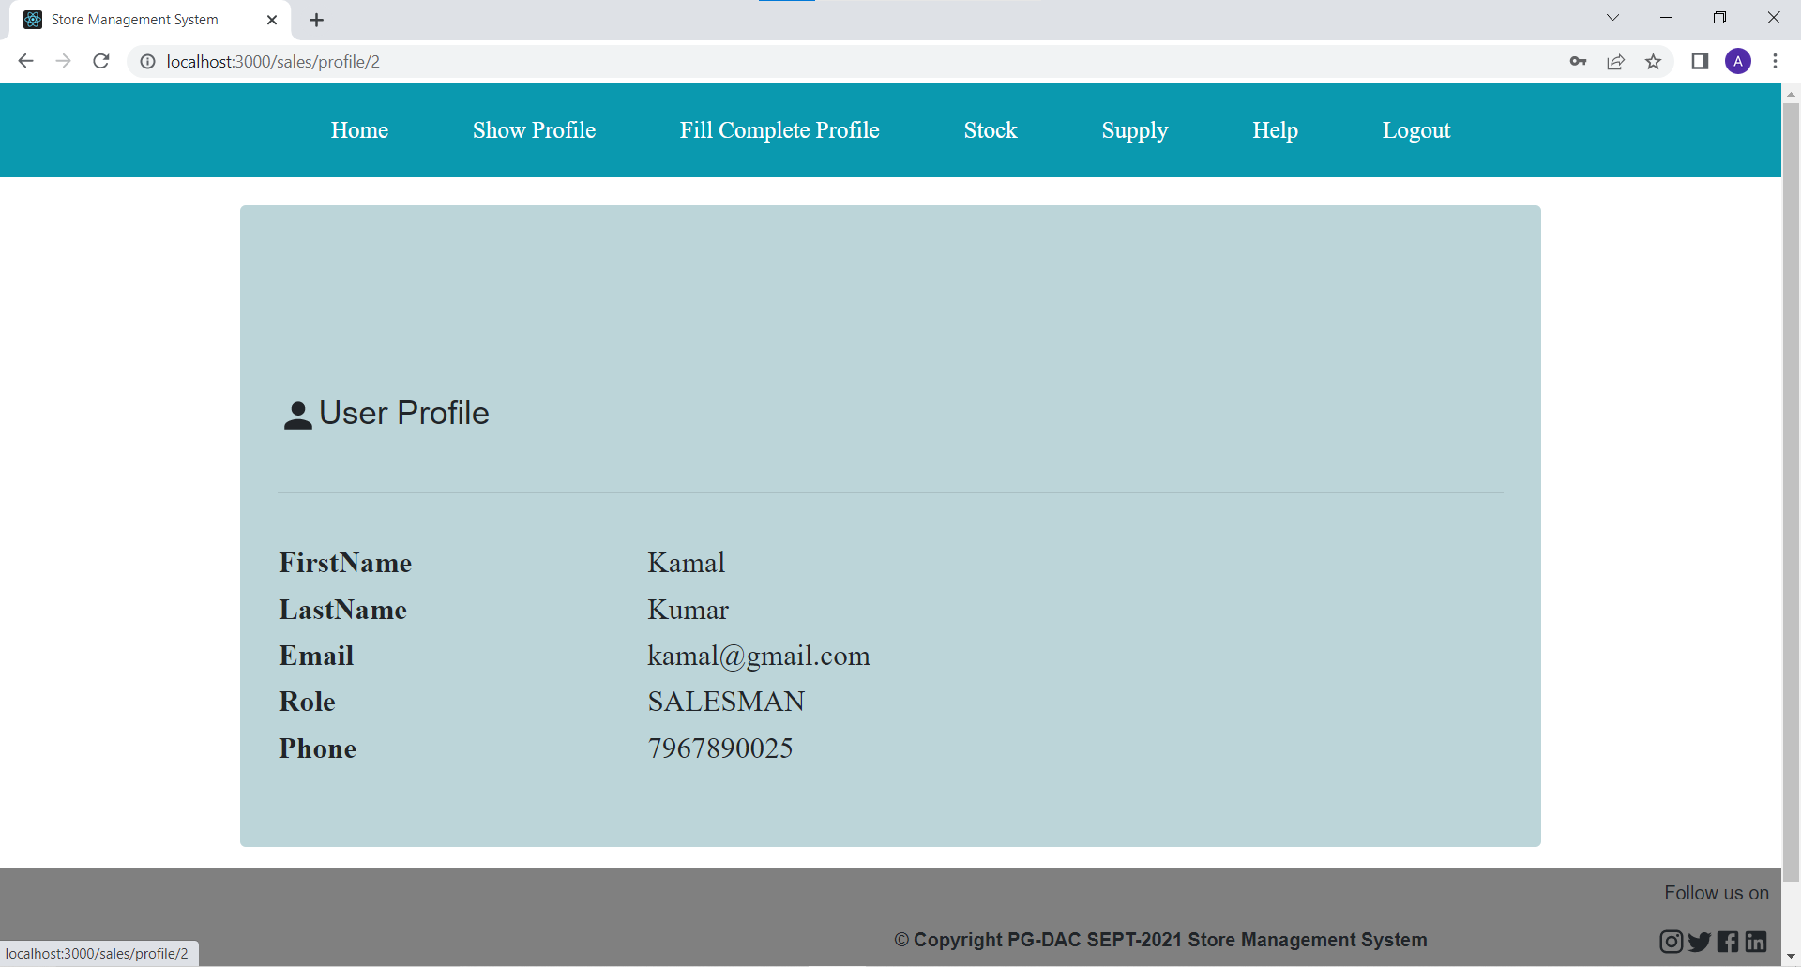
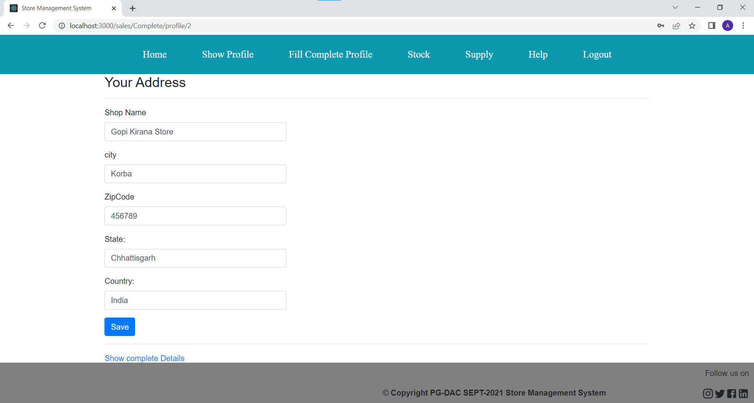

Slide 13
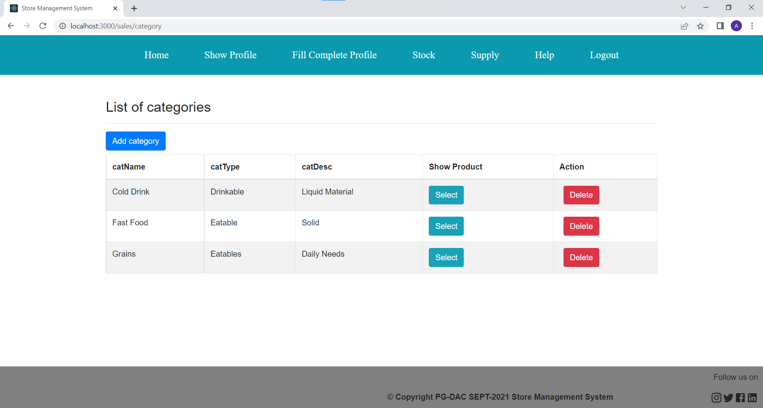
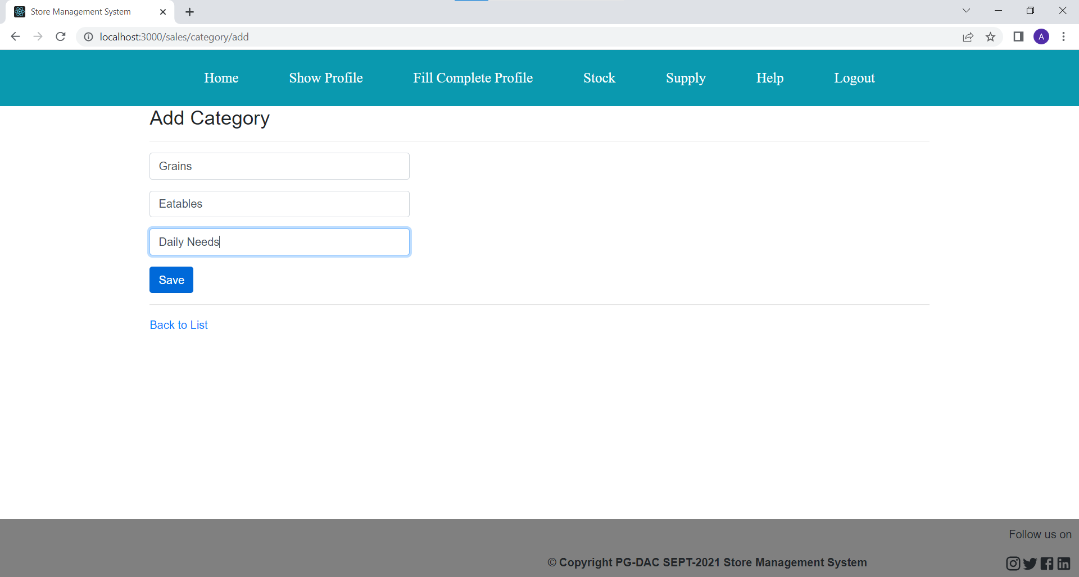

Slide 14
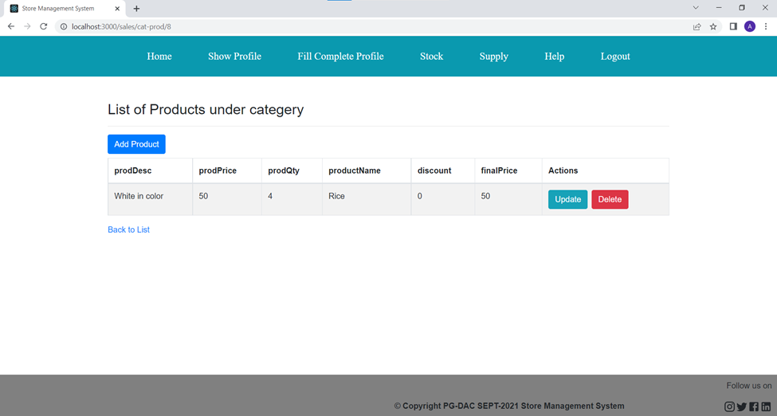
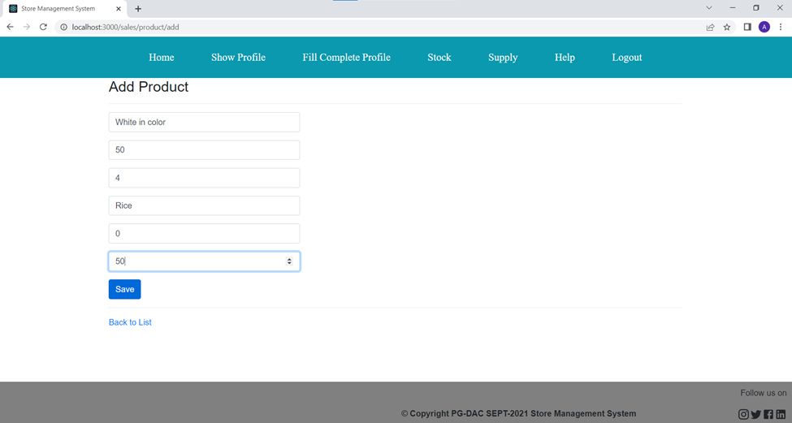

Slide 15
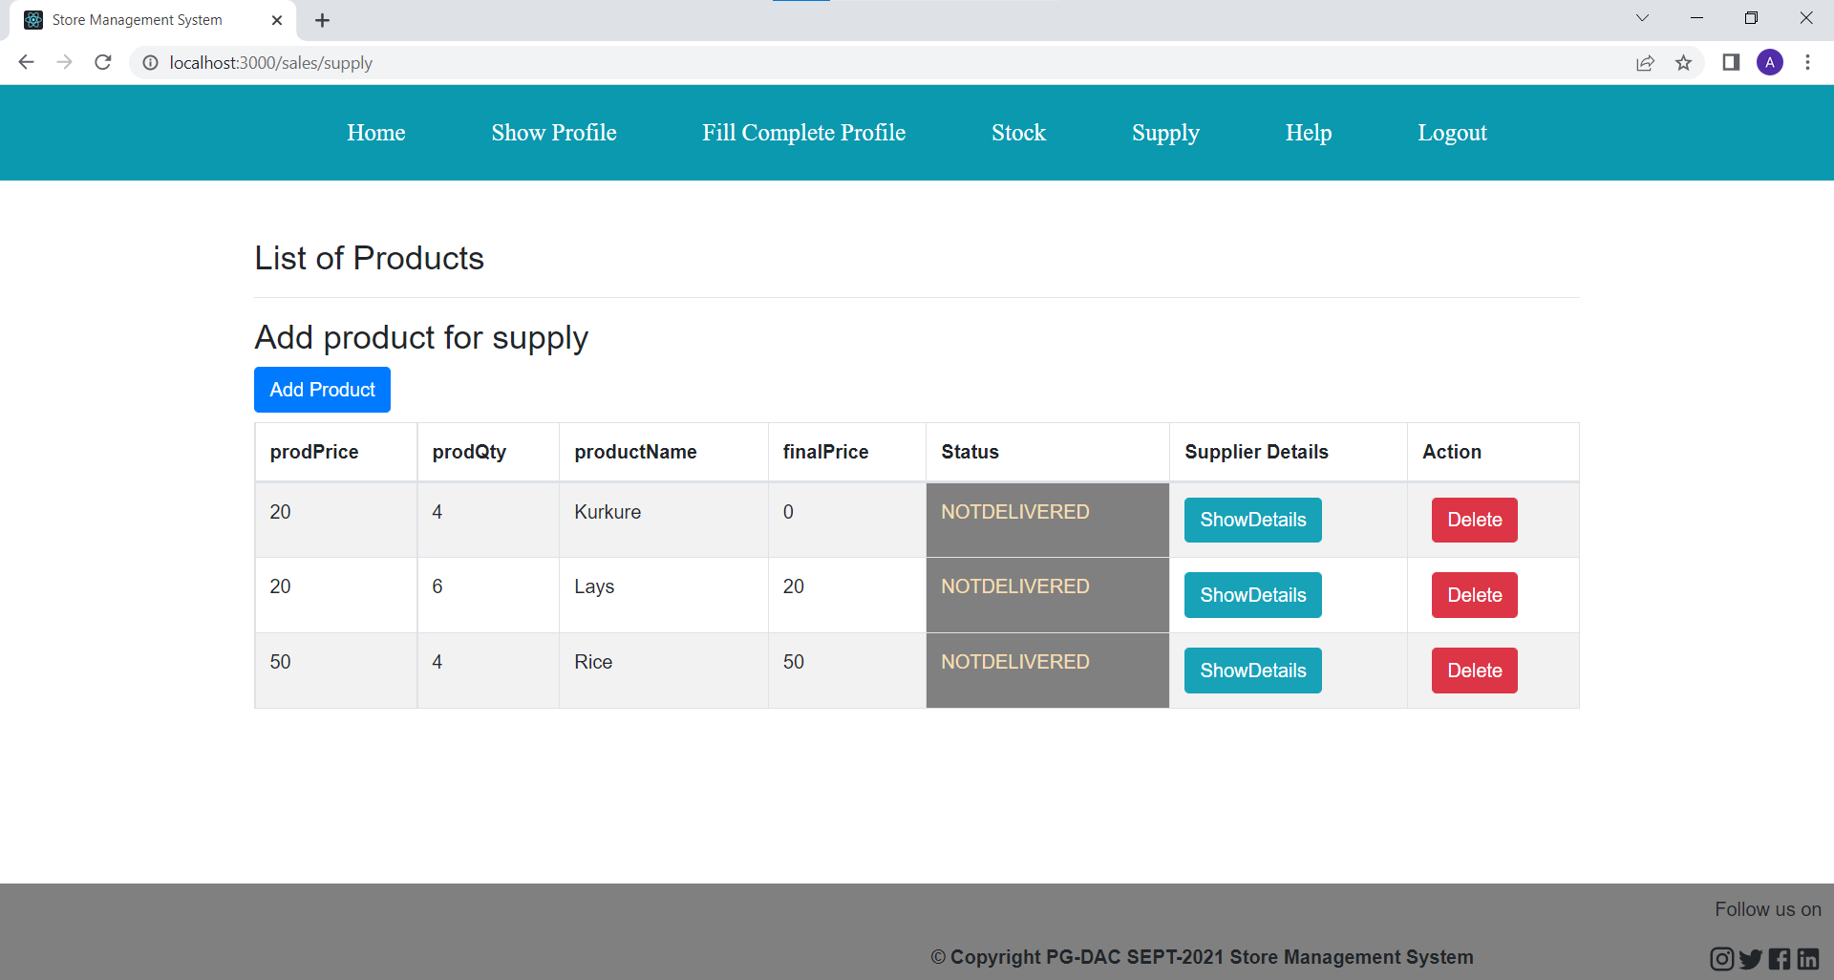
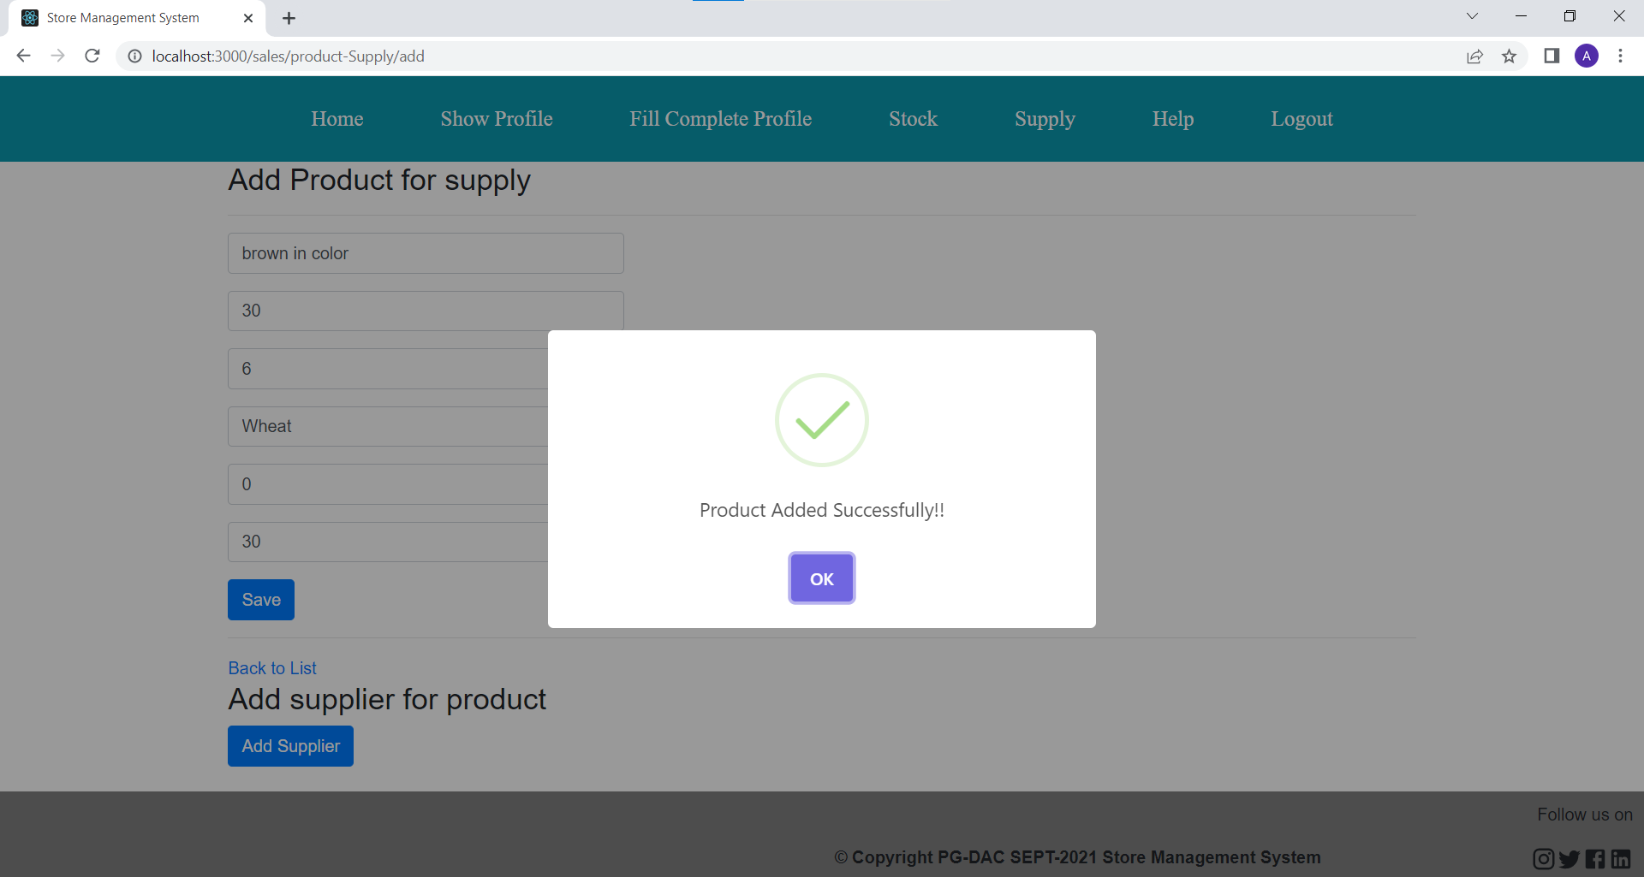

Slide 16
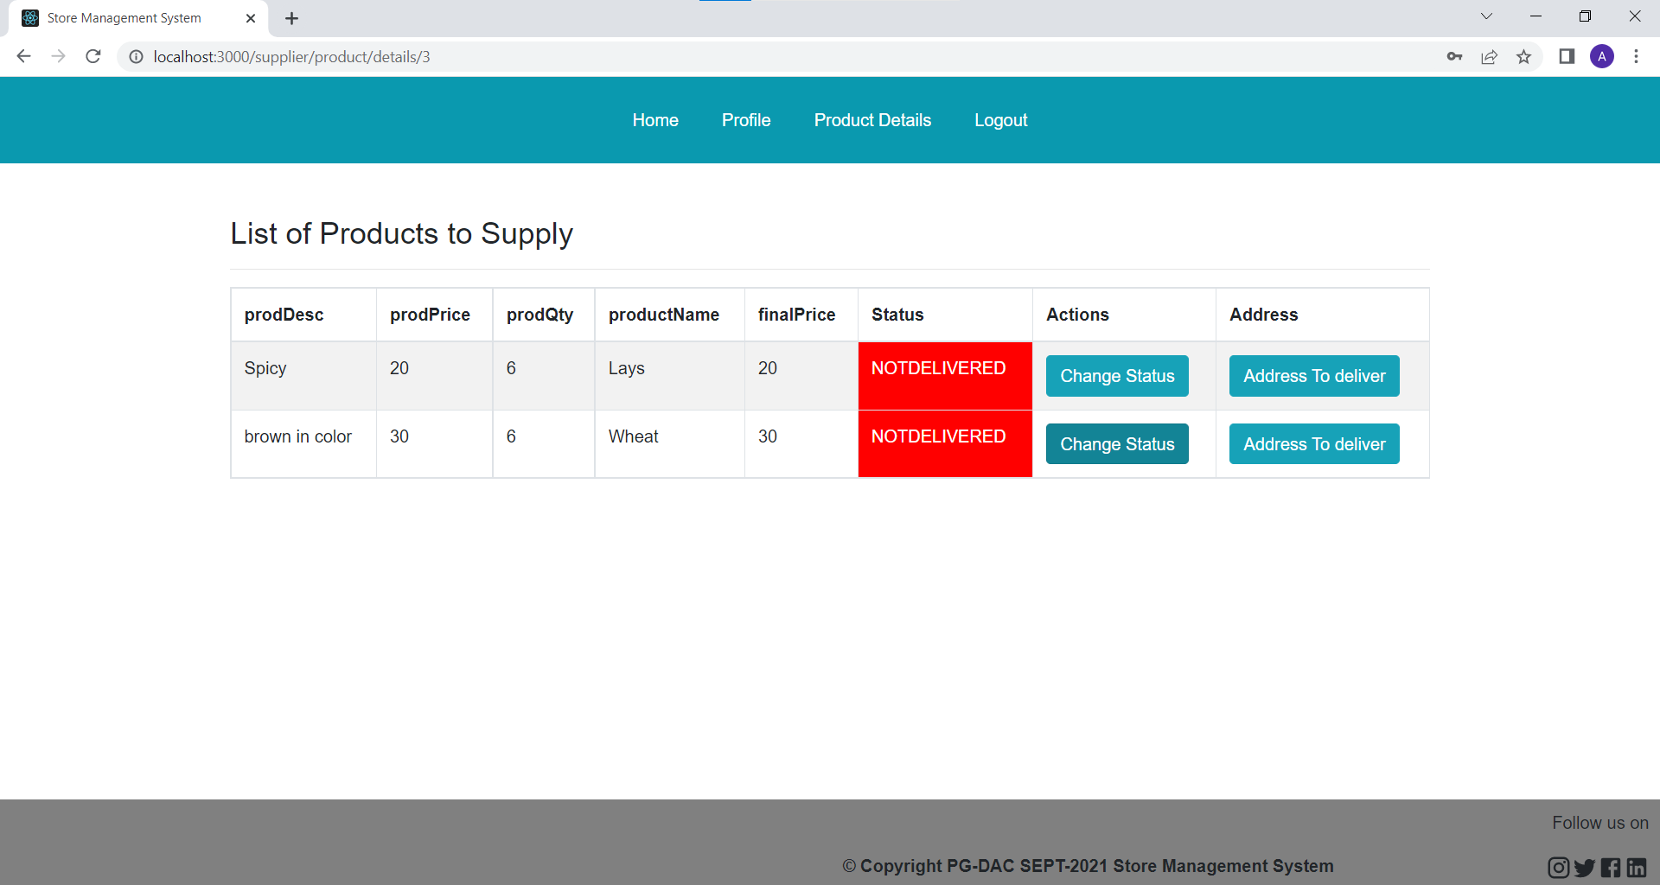
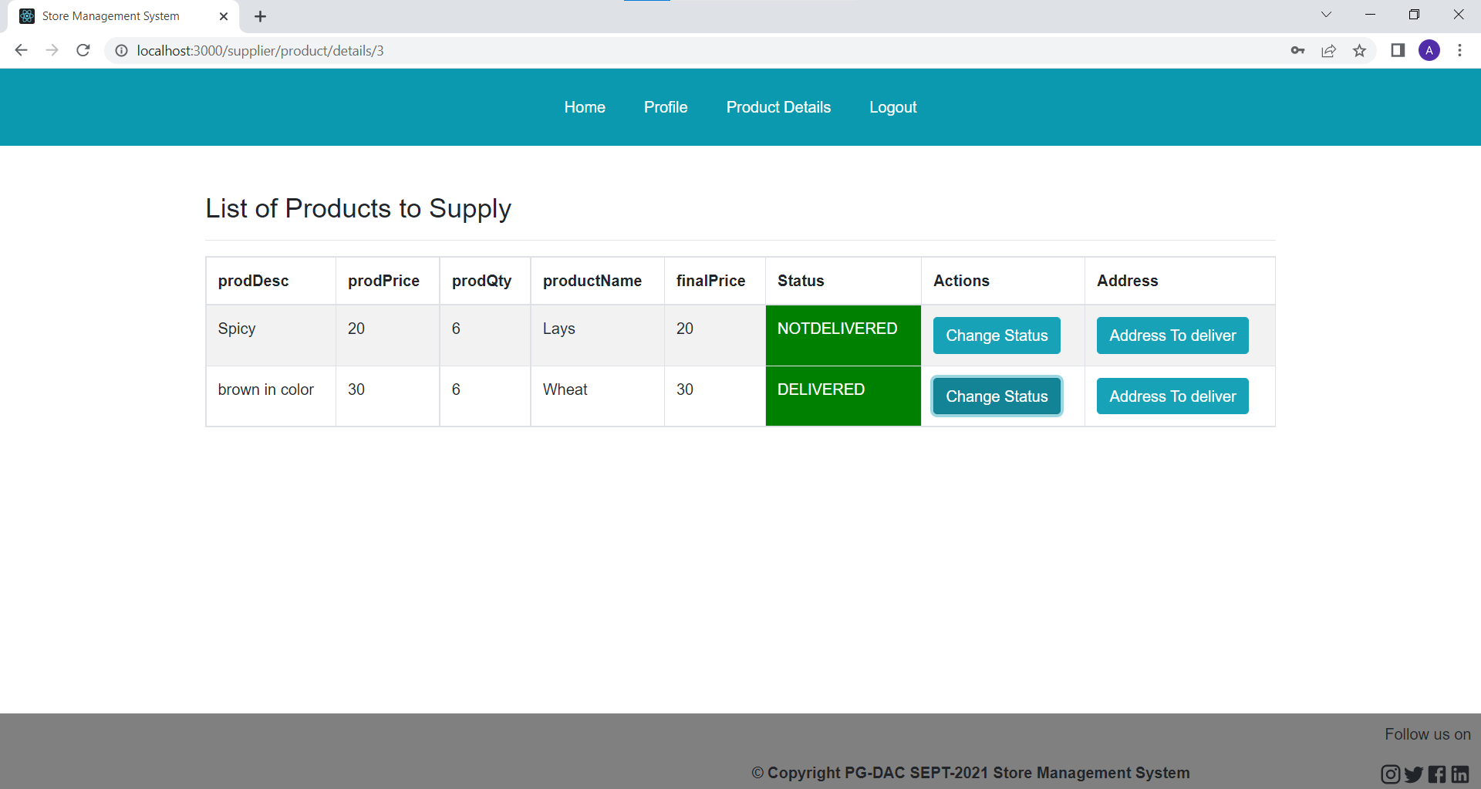

Slide 17
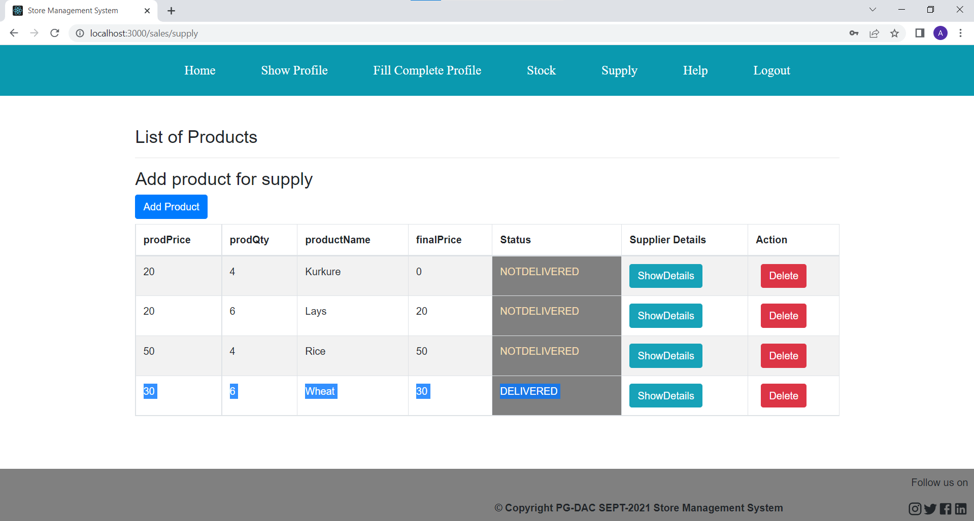

Slide 18
Future Scope
There is a scope for further development in our project to a great extend. We can add more module like customer module and add their functionality.
Further we can calculate and show the total cost of ordered products in one of the sections.
System may keep track of the items where the products are arrived

Slide 19
Conclusion
It is efficient and less time consuming.The purpose of this project was to develop a web application for easy maintenance of all the products in a shop.
This project helps us in gaining practical knowledge and we a got a hands on experience on several topics like designing a web page using React.js,use of responsive templates ,using bootstrap components easily and helps in management of database using Mysql.
This project can help various shopkeepers of big retail shop to easily maintain all the products category-wise.Also they can track whether their ordered product is delivered or not.

Slide 20
THANK YOU

