Slide 1
CLUBench: A Clustering Benchmark
Do we really need complex AI to find groups in data?
CMPE 255 • Data Mining Short Story
Arti Ramesh Nalawade
Based on Xiao et al., 2026 · ACM SIGKDD 2026

Slide 2
Why do we need clustering?
Imagine a supermarket with hundreds of customers. Can we discover groups with similar shopping habits- without labeling each customer first?
Frequent small purchases
Occasional large purchases
Different product preferences
Clustering finds patterns in data without requiring predefined group labels.
CMPE 255 • CLUBench short story
02

Slide 3
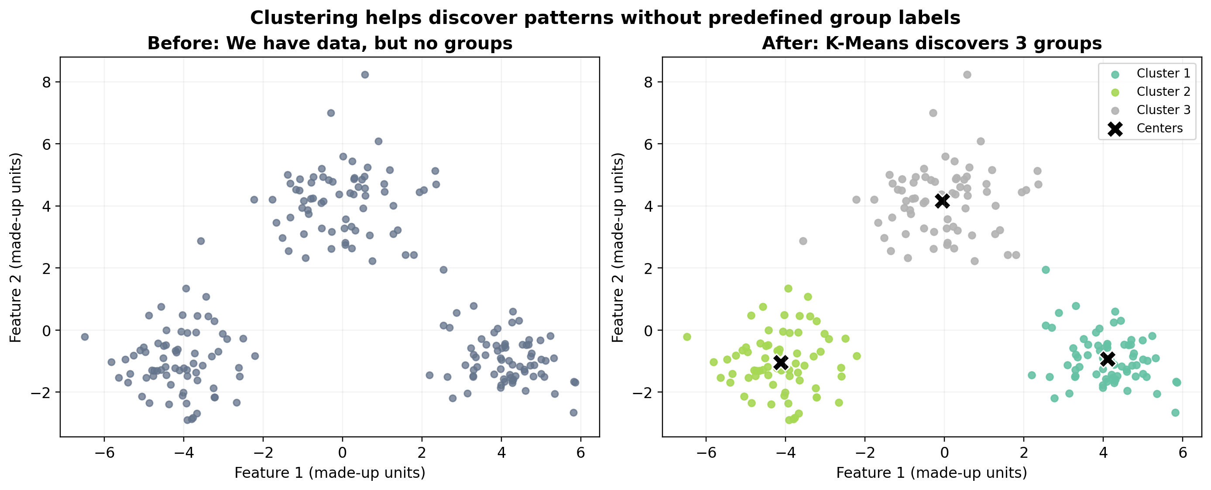
K-Means: from points to groups
Educational example created with Python - not an original CLUBench figure.
CMPE 255 • CLUBench short story
03

Slide 4
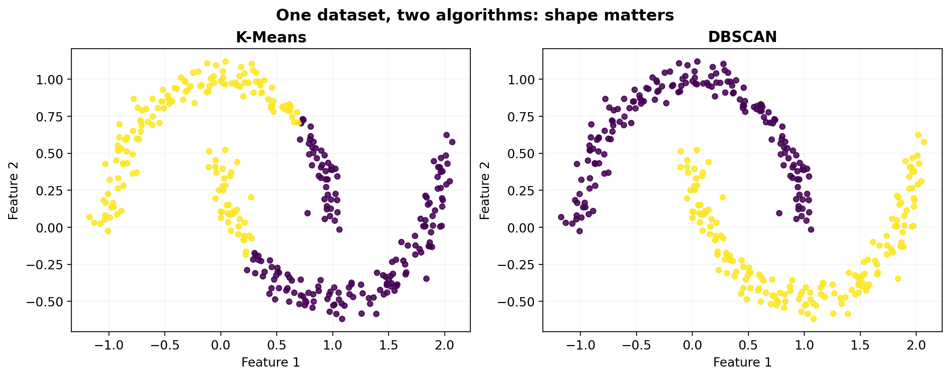
Different methods make different assumptions
K-Means
Groups points around centers.
DBSCAN
Looks for dense regions; can label noise.
Both visual examples use synthetic teaching data.
CMPE 255 • CLUBench short story
04

Slide 5
The research question
Modern deep and foundation-model approaches
Traditional methods
versus
Are complicated algorithms always better? How can we compare them fairly?
CMPE 255 • CLUBench short story
05

Slide 6
What CLUBench actually studied
24
131
178,815
Clustering algorithms
Datasets
Experiments
Data types: tabular data • text • images
Numbers and study scope reported in Xiao et al. (2026).
CMPE 255 • CLUBench short story
06

Slide 7
CLUBench comparison workflow
Datasets
Features / embeddings
Clustering methods
Evaluation metrics
→
→
→
Change data, algorithms, representations, and parameter settings- then compare the results.
A simplified conceptual diagram inspired by the research, not a verbatim paper figure.
CMPE 255 • CLUBench short story
07

Slide 8
How do researchers measure clustering quality?
ACC
How many cluster assignments agree with reference classes after matching IDs?
NMI
How much information do produced groups share with reference labels?
ARI
How similar are two groupings after accounting for chance?
Labels can be used to evaluate clustering- even though they were not used to form the groups.
CMPE 255 • CLUBench short story
08

Slide 9
Key findings reported by CLUBench
The evaluated deep-clustering methods did not show a significant average advantage over the strongest conventional methods.
1
For text and images, pretrained embeddings paired with traditional clustering performed effectively and efficiently.
2
Algorithm selection remains challenging, even with modern foundation models.
3
Summary of the authors’ findings: arxiv.org/abs/2605.29933
CMPE 255 • CLUBench short story
09

Slide 10
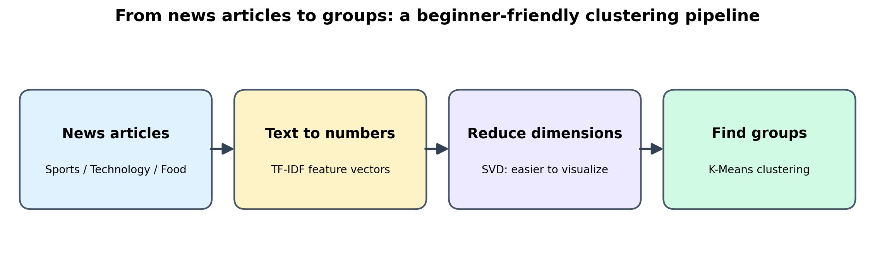
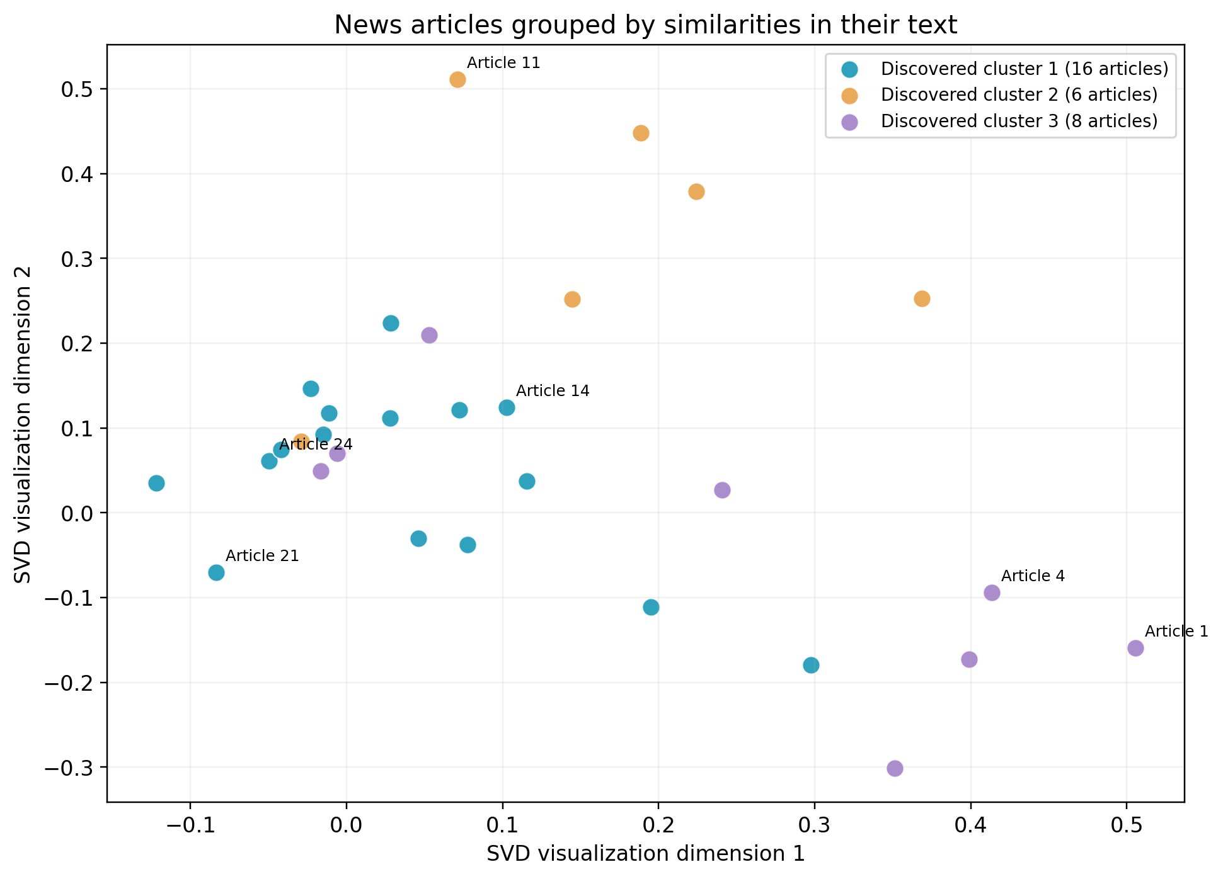
My mini demo: articles become groups
Demo uses TF-IDF, dimensionality reduction, and K-Means- not a pretrained LLM.
CMPE 255 • CLUBench short story
10

Slide 11
Ablations, comparisons, and limitations
What changes?
Algorithm, representation, dataset, or hyperparameters
What can we measure?
Cluster quality, stability, efficiency, sensitivity
What is my demo?
A small classroom illustration, not the full benchmark
What should we avoid?
Claiming one simple demo proves a universal winner
CMPE 255 • CLUBench short story
11

Slide 12
What I learned
The best method is not always the newest or most complicated one.
Understand the dataset. Choose suitable techniques. Compare them fairly.
Paper: arxiv.org/abs/2605.29933
Authors’ code: github.com/xiaofeng-github/CLUBench
CMPE 255 • CLUBench short story
12

