Slide 1
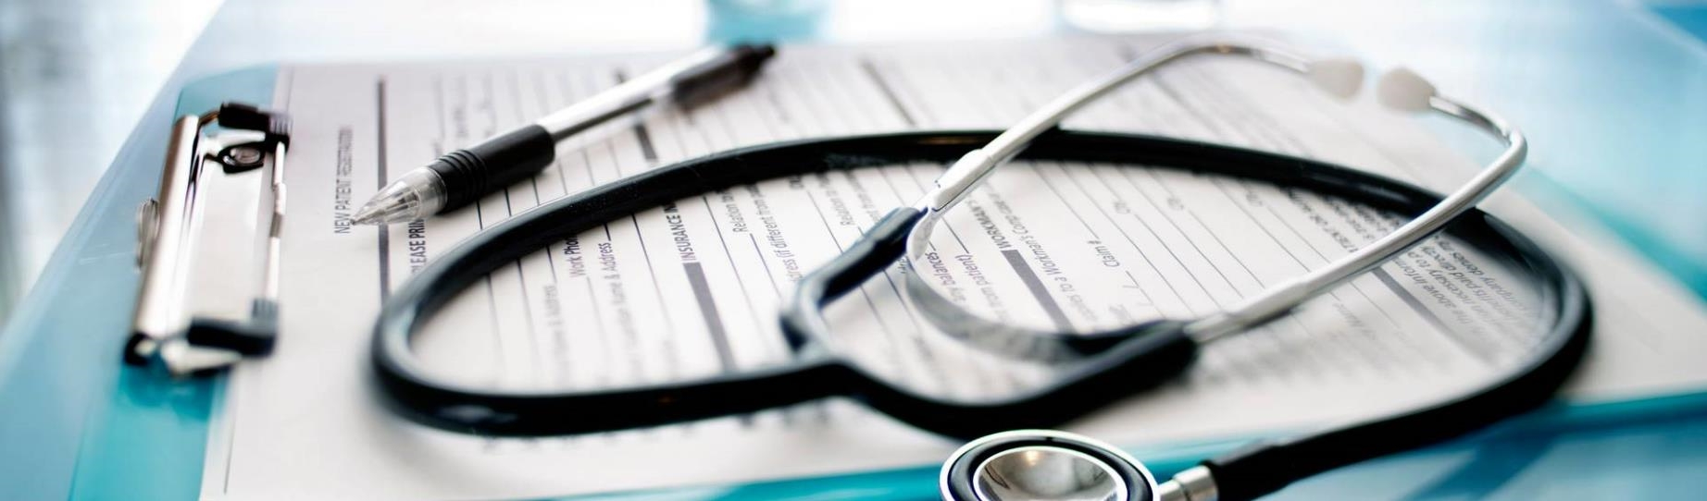
MEDI-CONSULT
DISEASE PREDICTION FROM SYMPTOMS

Slide 2

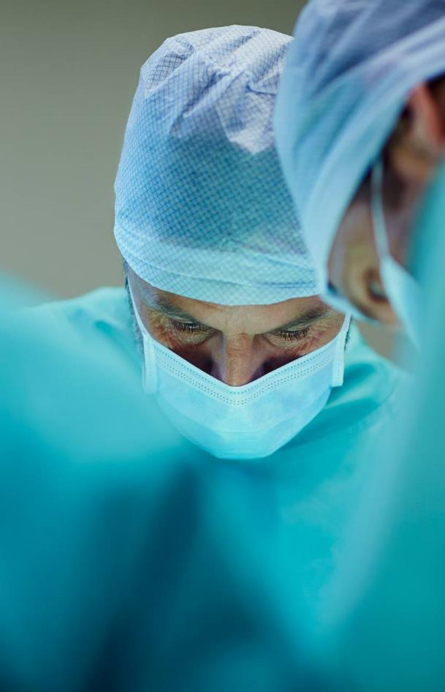
Agenda
PROBLEM STATEMENT
INTRODUCTION
OBJECTIVES
MODEL APPROACH
SYSTEM ARCHITECTURE
MODULES
RESULT & IMPLEMENTATION
ADVANTAGES
CONCLUSION

Slide 3

ARE YOU HEALTHY ???
What will happen if you are suffering from any disease and you are unaware of it ???

Slide 4
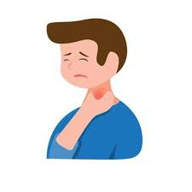

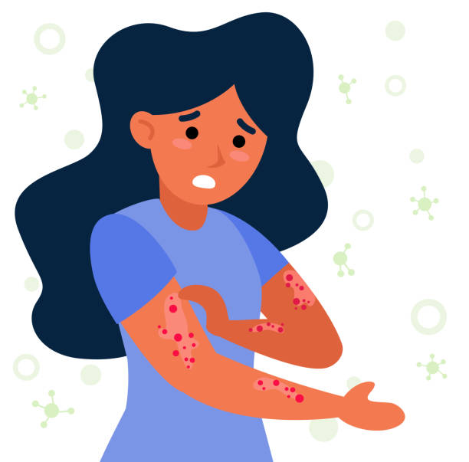
PROBLEM STATEMENT
There is quite a confusion among people in recognizing and predicting their diseases based on their symptoms.
At times of pandemic people can't consult doctors through physical communication.
Sometimes people feel shy to tell about what they are suffering from.
Some rural areas don’t have hospitals.
Because of busy schedules people avoid going to hospitals.

Slide 5
INTRODUCTION
Disease prediction is to supply prediction for the assorted and customarily occurring diseases that when unchecked and sometimes ignored can turn into fatal diseases and cause a lot of problems to the patient and moreover their members of the family.
This method will predict the foremost possible disease supported by the symptoms.
Machine learning algorithm has two passes: Training, Testing.
Machine Learning technology gives a good platform in the medical field so that a healthcare issue can be solved efficiently.

Slide 6


OBJECTIVES
To enhance the prediction level to diagnose the disease at an earlier stage.
To reduce the cost of medical tests.
To provide a quick medical diagnosis to patients living in rural areas.
To be useful for post covid contactless systems.
To save the time of the Doctor in the decision.
To increase accuracy and yields of diagnosis.

Slide 7
DESIGN OF MODEL
MEDI-CONSULT
SELECT SYMPTOM 1
DECISION TREE
RESULT
SELECT SYMPTOM 2
RANDOM FOREST
RESULT
SELECT SYMPTOM 3
NAÏVE BAYES
RESULT
SELECT SYMPTOM 4
RESULT 1

Slide 8

MODEL APPROACH
Gathering data
Data Wrangling
Data analysis
Training the Model
Testing the Model
Inference

Slide 9
SYSTEM ARCHITECTURE
Pre-processing and splitting the data
Training Decision Tree Classifier
Training Random Forest Classifier
Training Naïve Bayes Classifier
Train Data(80%)
Dataset
Data
Performing Cross Validation for Model Selection
Predictions on Validation dataset by Decision Tree Classifier
Predictions on Validation dataset by Random Forest Classifier
Predictions on Validation dataset by Naïve Bayes Classifier
Test Data(20%)
Validation Data
Final Prediction

Slide 10

Modules
DECISION TREE
RANDOM FOREST
NAÏVE BAYES
TKINTER

Slide 11


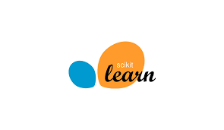
LIBRARIES
NUMPY – It is used for working with arrays. It is used for performing mathematical and scientific calculation.
PANDAS – It is used for data analysis and machine learning tasks. It supports multi-dimensional arrays.
SKLEARN – It provides selection of efficient tools for machine learning including classification, regression etc

Slide 12
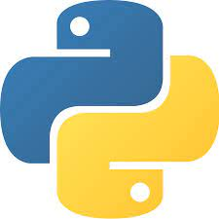


SYSTEM REQUIREMENTS
Operating system: WINDOWS
IDE: Jupyter notebook, Anaconda, pycharm, Google collab, etc.
Dataset: CSV
Programming: Python

Slide 13


KILL THE DISEASE BEFORE THE DISEASE KILLS YOU !!!

Slide 14
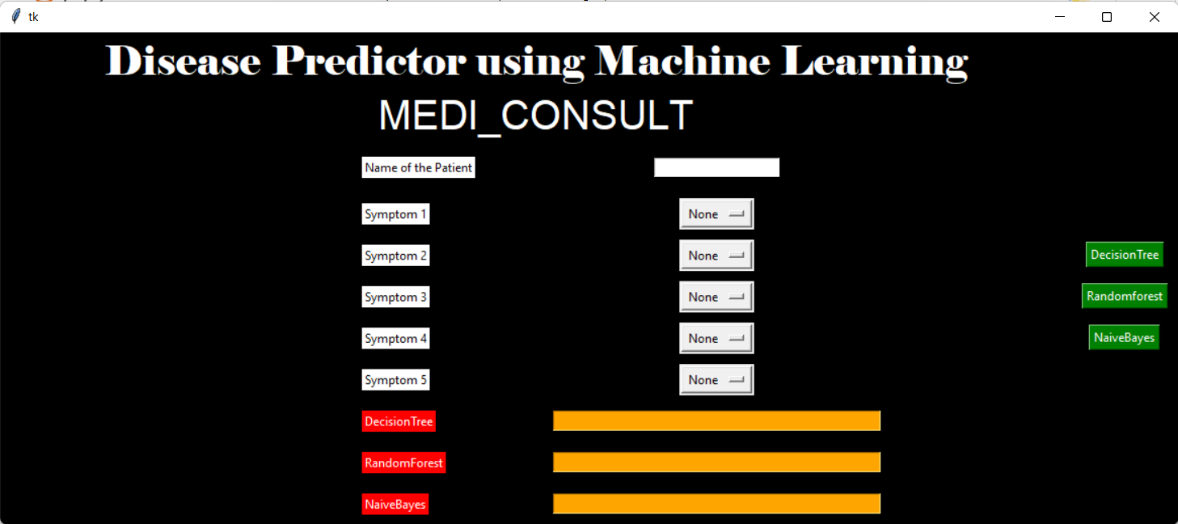
Implementation & result

Slide 15
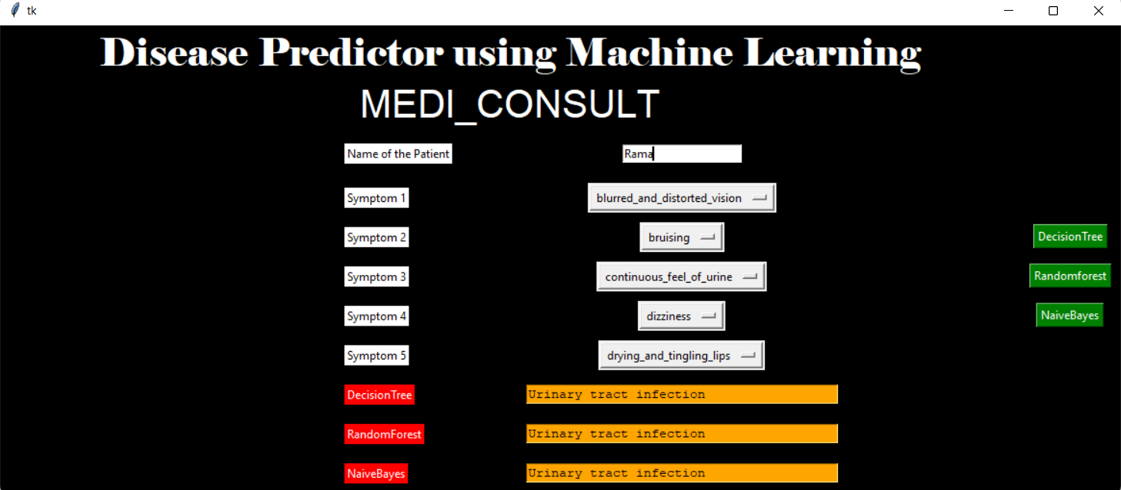
Implementation & result

Slide 16

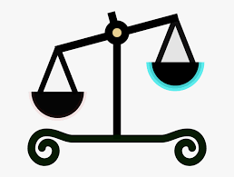
ADVANTAGES OF MODEL
Know about the disease in a fraction of a second.
Accurate results.
Saves time.
Easy method.
Saves money.

Slide 17




CONCLUSION
We are developing this project for predicting and analyzing diseases using various Machine Learning algorithms for early cure and ailment of diseases based on symptoms provided by users which indeed became very fruitful on the symptoms provided the highest accuracy and accurate predictions.
Once the disease is predicted, we could easily manage the medical resources required for the treatment. This model would help in lowering the cost required in dealing with the disease and would also improve the recovery process

Slide 18


Thank you

