Slide 1

Chocolate Sales Analysis
Business Summary & Visual Insights

Slide 2
Key Insights
• Top-selling products identified by revenue.
• Monthly sales trends help detect seasonality.
• Country-wise performance highlights market strengths.
• Top-performing salespeople revealed.
• Boxes shipped vs revenue compared for product efficiency.

Slide 3
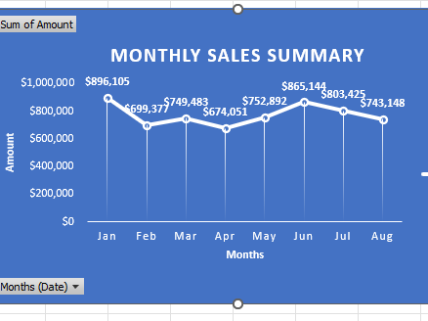
Sales Over Time (Line Chart)

Slide 4
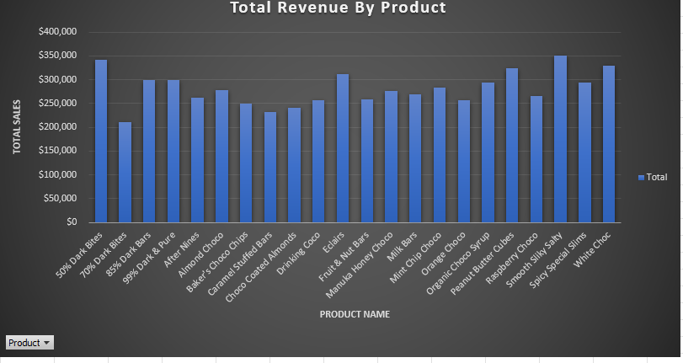
Top Products (Bar Chart)

Slide 5

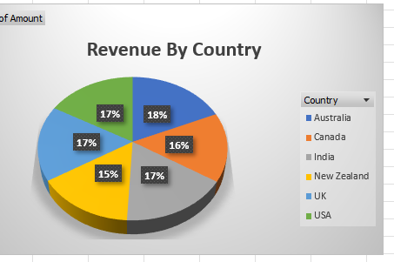
Sales by Country (Pie Chart)

Slide 6
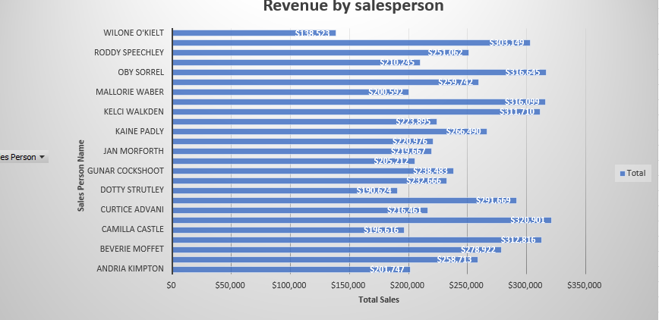
Top Salespeople (Column Chart)

Slide 7
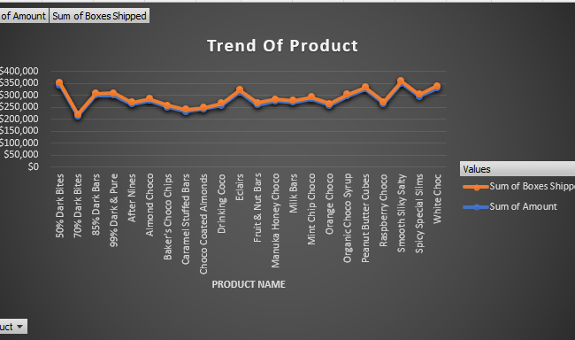
Boxes vs Revenue (Trend line)

Slide 8
Business Use Cases
• Focus efforts on high-performing products.
• Reward top salespeople and train low performers.
• Target countries with high growth potential.
• Plan inventory based on high-return products.
• Adjust strategy for seasonal spikes in sales.

