Slide 1


Global Sales Analysis
With Python

Slide 2
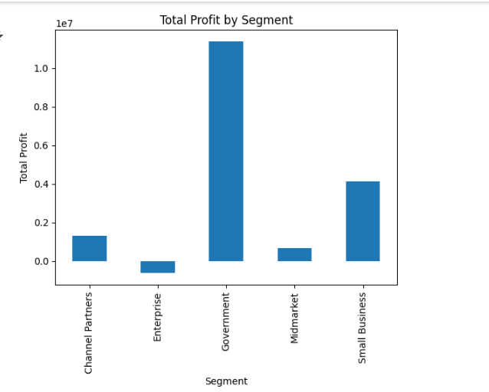
Segment Profitability Analysis:
I have analysed the profitability of various segments and identified which segment generated the highest total profit.
A bar chart was created to visually represent the total profit by segment, providing an easy-to-understand view of segment performance.

Slide 3

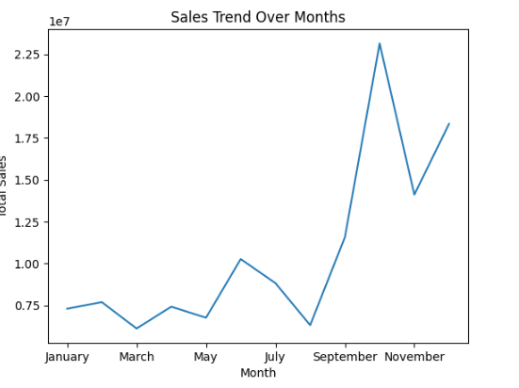



Sales Trend Over Months: The trend of sales was analysed over the months to understand seasonal patterns and variations. A line chart was created to display the total sales for each month, ensuring the months are ordered correctly for a clear trend analysis.

Slide 4
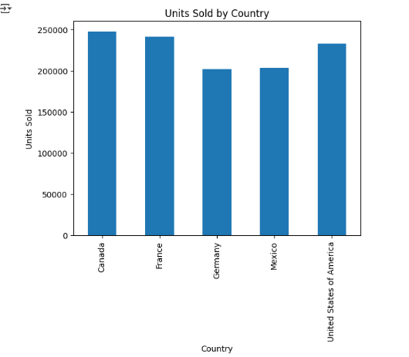
Top Performing Country by Units Sold:
We examined the total units sold by each country and identified the country with the highest units sold overall.
A bar chart was created to visualize the total units sold for each country, highlighting the best-performing country.

Slide 5
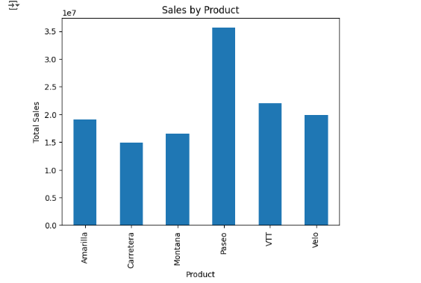
Comparison of Sales Across Products: Total sales were compared across different products to determine which products generated the most revenue. A bar chart was created to visualize the sales for each product, enabling a comparison of product performance.

Slide 6
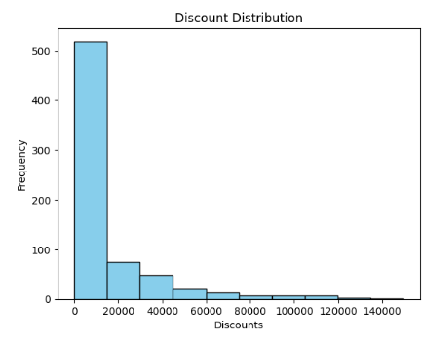
Discount Distribution Analysis:
We explored the distribution of discounts provided across different sales transactions.
A histogram was created to show the frequency of discounts, helping to identify how often discounts were applied and their distribution.

