Slide 1



What is a computer?
A computer is an electronic device that can be programmed to accept, process, and store data. It consists of hardware, the physical components, and software, the programs that tell the hardware what to do. Computers have become essential tools for communication, entertainment, education, and work.

Slide 2
Components of a computer
Central Processing Unit (CPU)
Random Access Memory (RAM)
Storage Devices
The "brain" of the computer, responsible for processing instructions and data.
Temporary storage for data and programs that the CPU is actively using.
Hard drives, SSDs, and other devices used to store data permanently.

Slide 3


Input and output devices
1
Input Devices
Allow users to enter data and instructions into the computer, such as keyboards, mice, and scanners.
2
Output Devices
Display or present processed information from the computer, such as monitors, printers, and speakers.

Slide 4

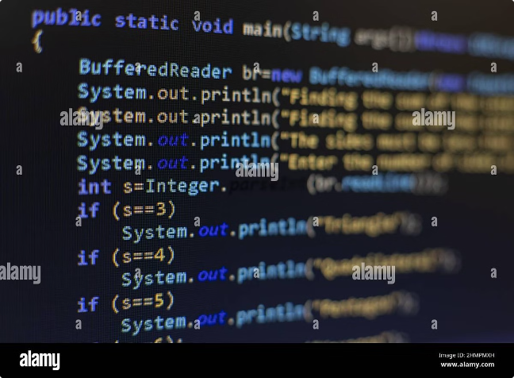
Computer software and programming
Operating System (OS)
Manages the computer's resources and provides a platform for applications.
Application Software
Programs designed for specific tasks, such as word processors, web browsers, and games.
Programming Languages
Used to create instructions for computers, allowing developers to write software.

Slide 5

Types of computers
Desktop Computers
Powerful and versatile, designed for stationary use.
Laptops
Portable computers with built-in keyboards and screens.
Tablets
Touchscreen devices primarily used for mobile computing and entertainment.
Smartphones
Mobile phones with advanced computing capabilities and internet connectivity.

Slide 6

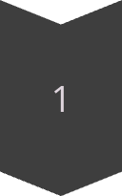

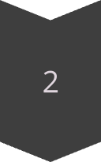
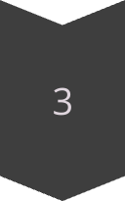
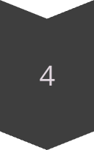
Uses of computers
Communication
Email, video conferencing, social media, and instant messaging.
Education
Online courses, research, and educational software.
Entertainment
Gaming, streaming movies and music, and virtual reality experiences.
Work
Office applications, data analysis, and business management tools.

