Slide 1
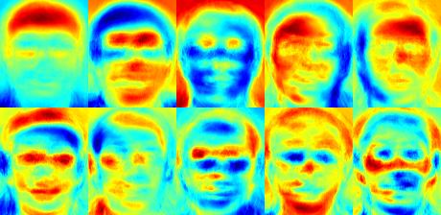
The EigenFacebook
Craig Perkins, Jeff Rabinowitz, Cory Pisano

Slide 2
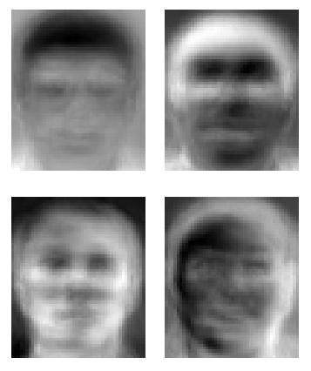
Overview
What is an Eigenface?
Using Eigenfaces for facial recognition
Face Recognition GUI written in MATLAB
Image Processing for Eigenfaces
GUI Demo

Slide 3
What is an Eigenface?
Eigenfaces is the name given to a set of eigenvectors when they are used in the computer vision problem of human face recognition.
Developed in 1987 by Sirovich and Kirby.
Generated by performing Principal Component Analysis on a large set of images depicting different human faces.
Can be considered a set of “standardized face ingredients”
Any face can be reconstructed from a linear combination of Eigenfaces

Slide 4
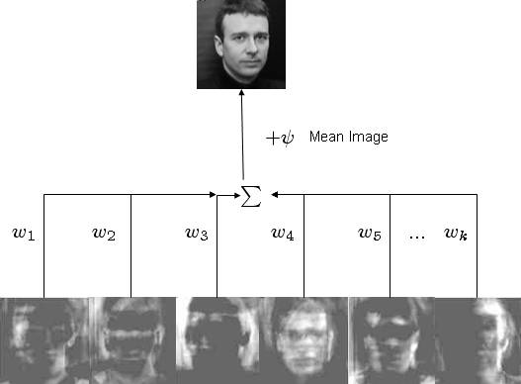
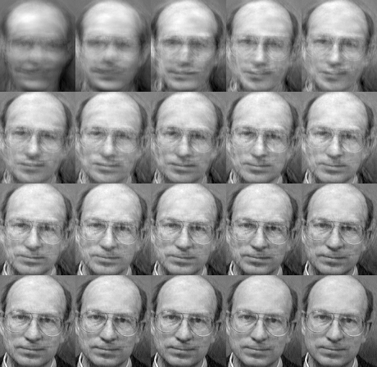
Pictures

Slide 5
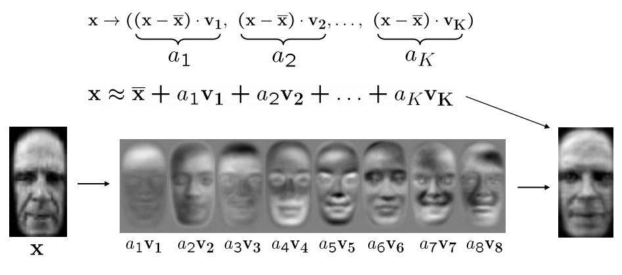
Face Recognition
When a new face is presented to the system for classification, its own weights are found by projecting the image onto the collection of eigenfaces.
To find the closest subject it uses a nearest neighbor algorithm to find the minimum of the Euclidean distance.

Slide 6
Algorithm for Recognition
Align training images x1, x2, …, xN
Compute average face u = 1/N Σ xi
Compute the difference image φi= xi – u
Compute the covariance matrix (total scatter matrix)
Compute the eigenvectors of the covariance matrix
Compute training projections in subspace

Slide 7
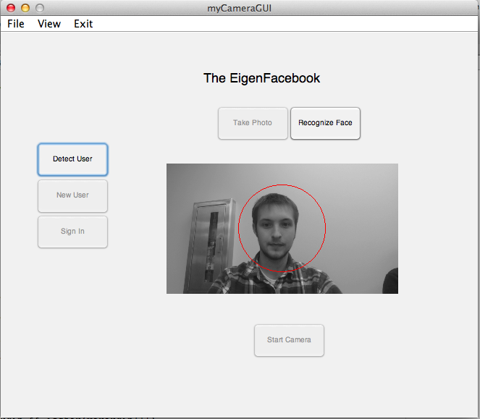
The EigenFacebook GUI

Slide 8
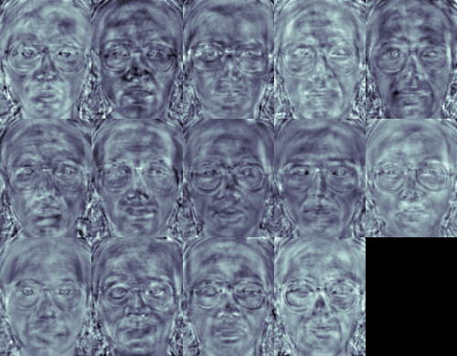
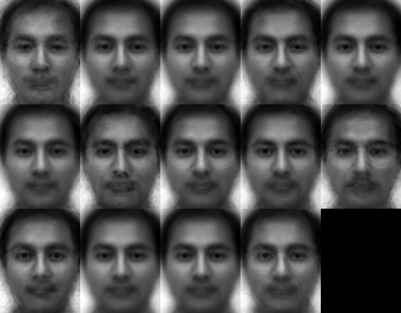
Limitations and Alternatives
Experiments in the original Eigenface paper presented the following results: an average of 96% with light variation, 85% with orientation variation, and 64% with size variation.
Alternatives include Fisherfaces, Linear Discriminate Analysis, Hidden Markov Model and others.

Slide 9
GUI Demo

Slide 10
References
http://cronos.rutgers.edu/~meer/UGRAD/cv19pcaface.pdf
http://docs.opencv.org/modules/contrib/doc/facerec/facerec_tutorial.html
http://www.cse.psu.edu/~rcollins/CSE486/lecture32.pdf
http://en.wikipedia.org/wiki/Eigenface

