Slide 1
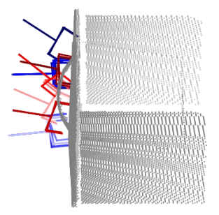
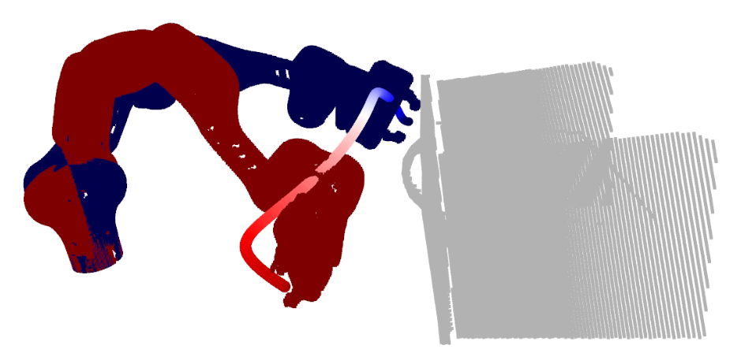
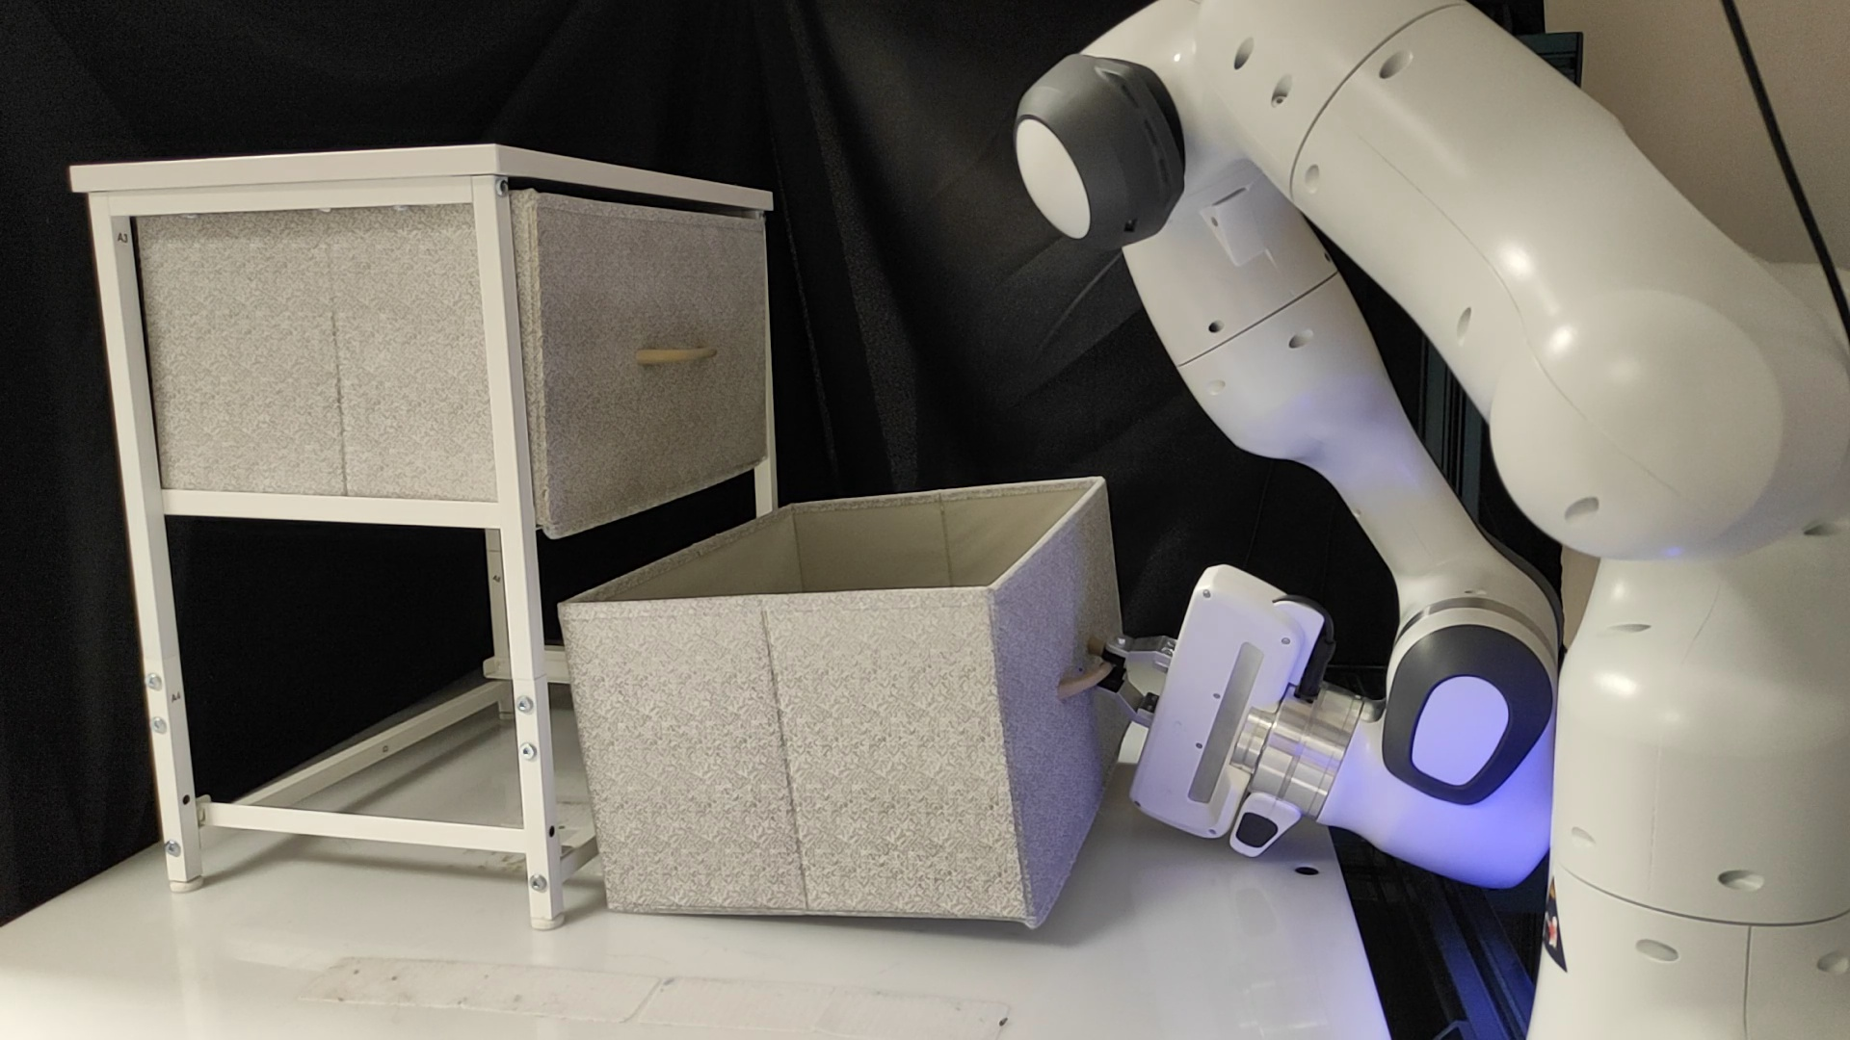
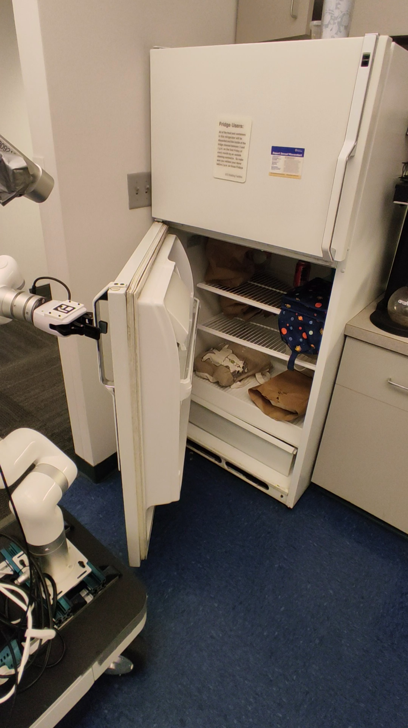
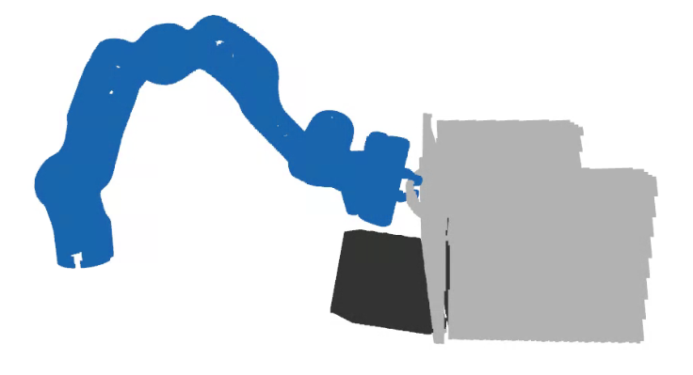



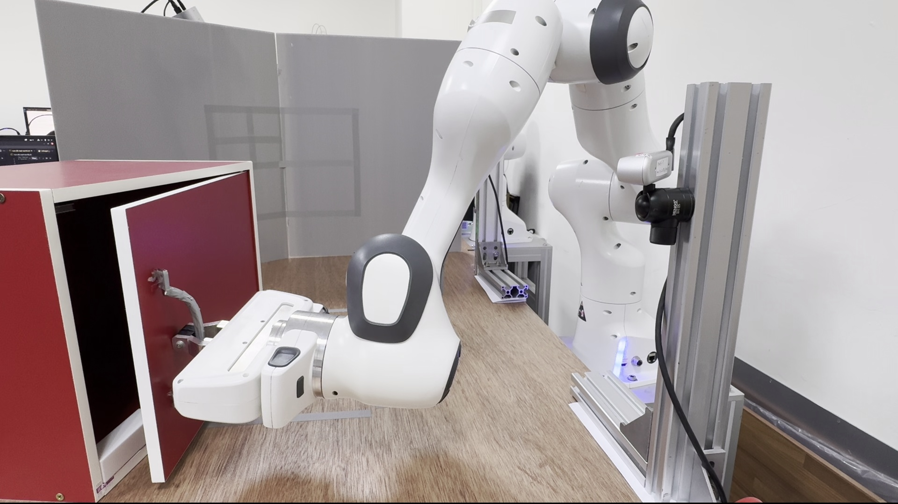
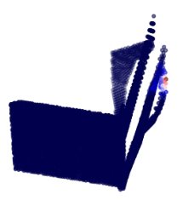
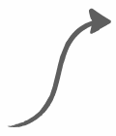
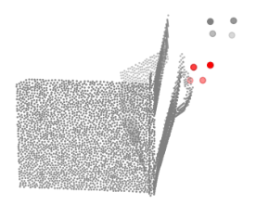
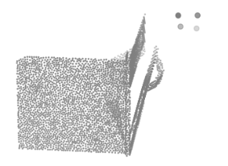
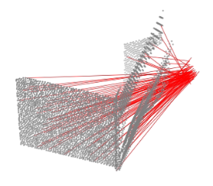
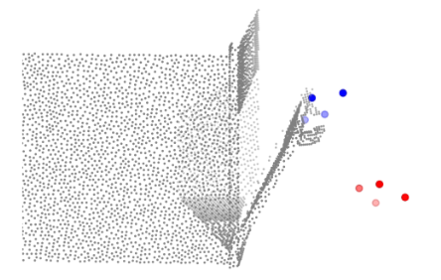

ArticuBot System Overview
1.Demonstration Generation in Sim
2. Hierarchical Policy Learning
3. Zero-shot Transfer to real
High-level policy
Low-level policy
Grasp Sampling
Motion Planning
Opening Action
2. Hierarchical Policy Learning -- High-level Policy Architecture
Per-point Weight
Point Cloud Obs.
Predicted
Sub-goal eef
Weighted Displacement
Model
Weighted Average
Per-point Displacement
to sub-goal eef
2. Hierarchical Policy Learning -- Low-level Policy Architecture
Perception Encoder
Diffusion Head
tokens
Latent Embed.
Obs-Scene
Cross
Attn.
Robot
State
Diffusion
step k
Scene points
MLP
Obs. eef
Conditioning
[Learnable Embed., MLP]
Noisy
Action
Action
Noise
Obs-Goal
Cross
Attn.
U-Net
Goal. eef
[Learnable Embed., MLP]
$×$ K

