Slide 1
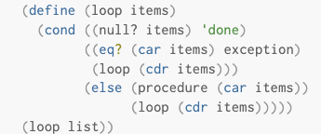
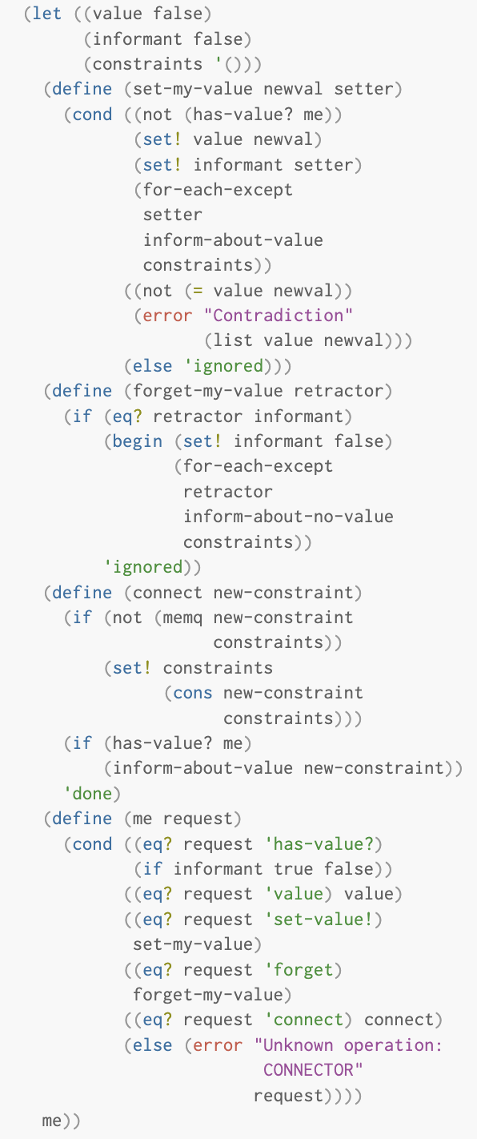
a
b
inform-about-value
for-each
e1 (make-connector)
e3 (make-connector)
e5 (set-value! ...)
e8 (for-each ...)
connector: a
new-value: 10
informant: ‘user
exception: ‘user
procedure: inform-about-value
list: ‘()
e2 lambda
e4 lambda
value false
informant false
constraints ‘()
value false
informant false
constraints ‘()
loop
e9 (loop ‘())
set-my-value
set-my-value
items: ‘()
forget-my-value
forget-my-value
connect
connect
me
me
e6 (a ‘set-value)
e7 (set-my-value ...)
m: ‘set-value
newval: 10
informant: ‘user

