Slide 1
vezeeta
File created on: 9/1/2025 6:46:29 PM

Slide 2
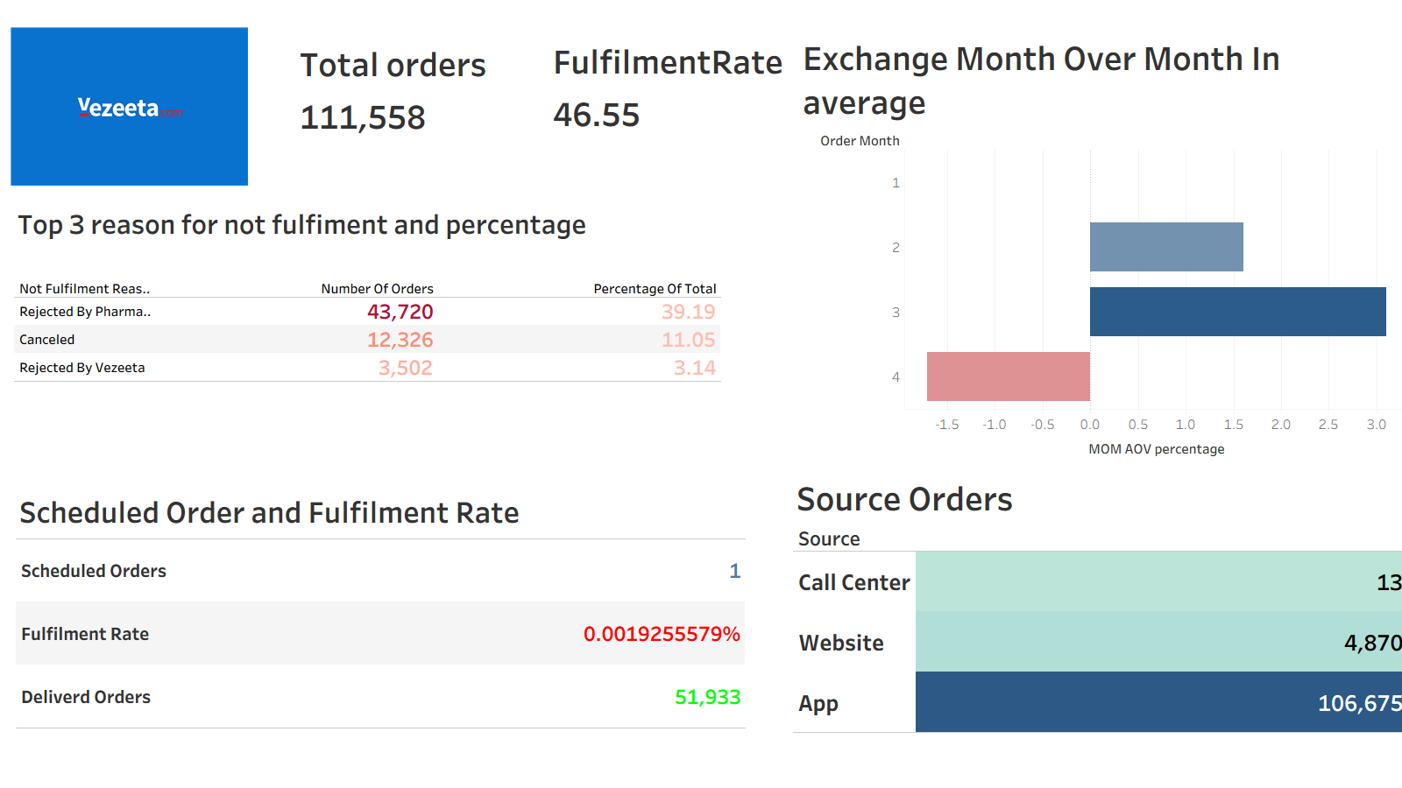

Slide 3
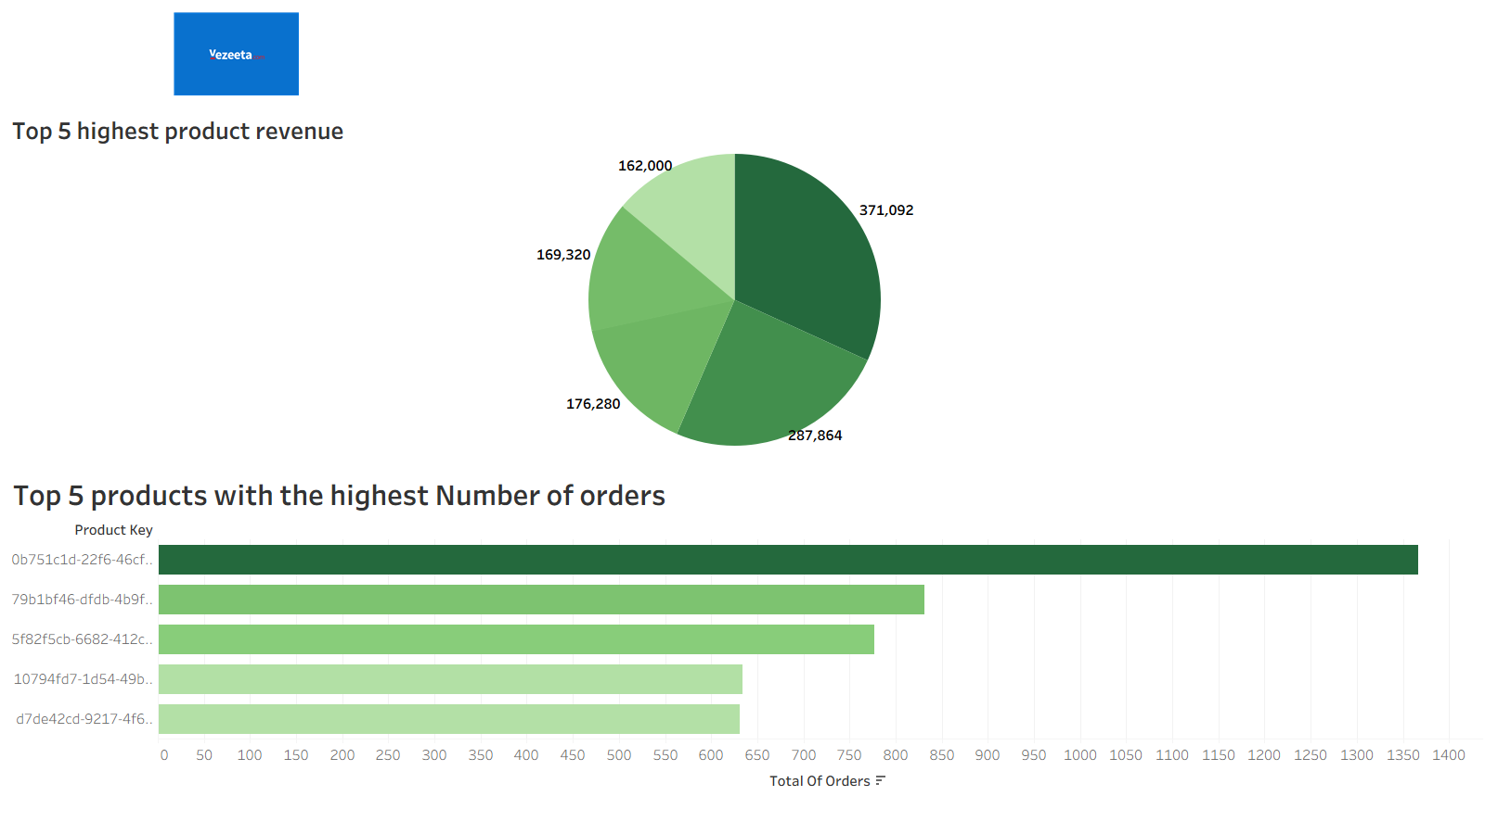

Slide 4
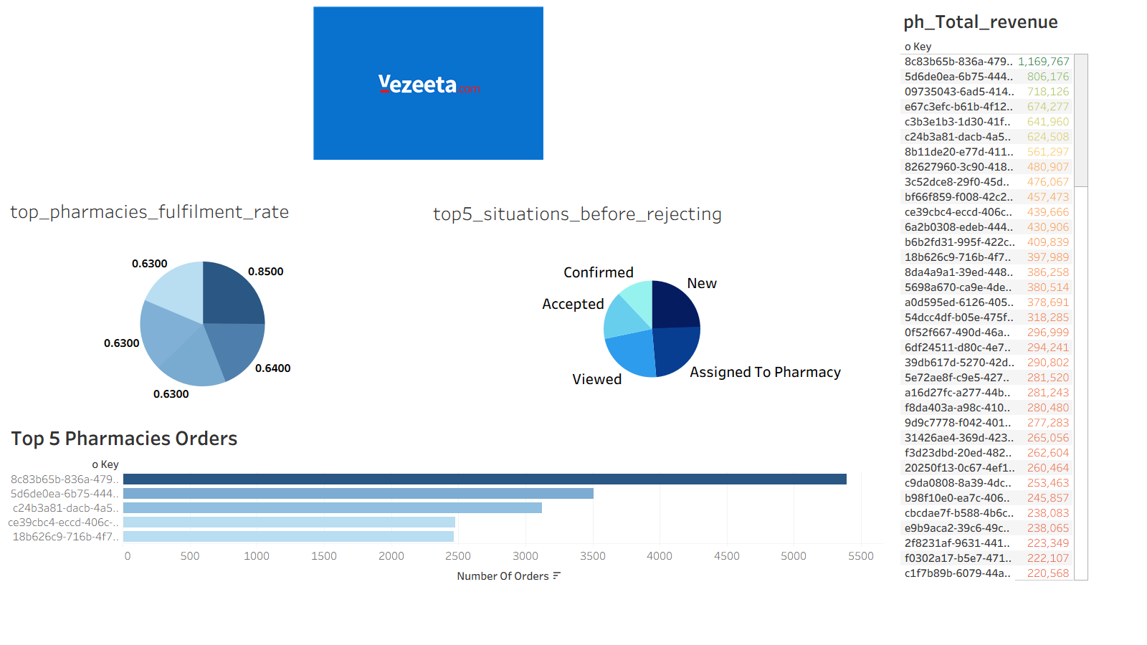

Slide 5
