Slide 1
SOA Repository Project (S-RAMP)
The S-RAMP project provides a Repository to store and manage SOA artifacts and their metadata throughout their life-cycle. The JBoss SOA repository implements the S-RAMP API.
S-RAMP (SOA Repository And Model Protocol) is a new standard being finalized within the S-RAMP OASIS working group. S-RAMP
- defines a common data model to facilitate the use of common tooling and sharing of data.
- S-RAMP defines an ATOM binding for create, read, update, delete and query operations
Governance WorkFlow for release artifacts
Maven API integration for upload and download of release artifacts
Integration with deployment systems (direct deployment, JON)

Slide 2
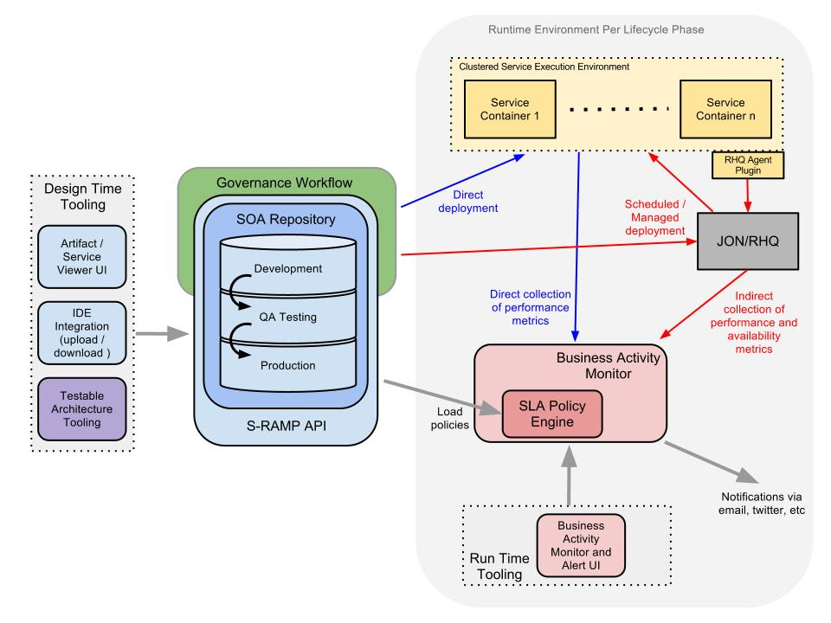
Governance Architecture

Slide 3
Roadmap
Out-of-the-Box Governance WorkFlows
One Repository Strategy (Guvnor)
Artifact Browser & Search
IDE Integration & Tooling support
Github: https://github.com/governance
JBoss.org: http://www.jboss.org/overlord/

