Slide 1
Data Processing using Input-Output Examples with the Microsoft PROSE SDK
PROSE Team
prosetalk@microsoft.com
Alex Polozov
polozov@cs.washington.edu
https://microsoft.github.io/prose

Slide 2
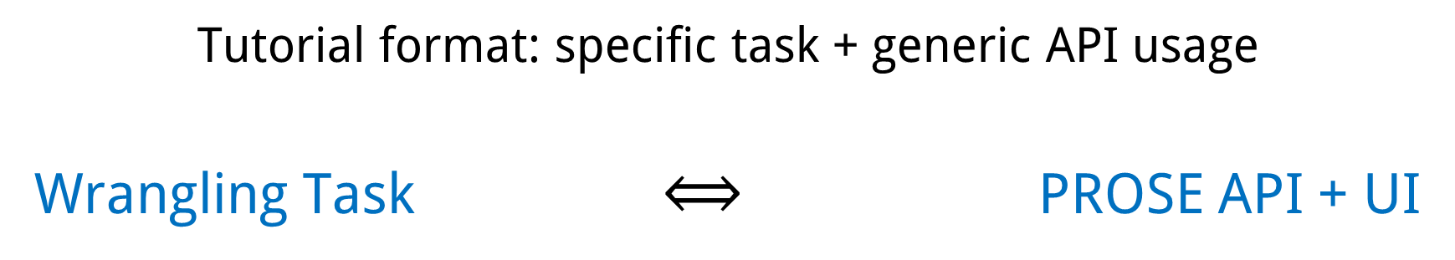
Let’s Try it Out!
Tutorial format: specific task + generic API usage
Wrangling Task $⟺$ PROSE API + UI
Extraction.Json
Transformation.Text
Split.Text
Matching.Text*

Slide 3
Materials
> git clone https://github.com/Microsoft/prose --branch demo
> cd prose
# This slide deck: > ./Slides/Tutorial1.pptx
# Requires .NET Core 1.1 and a supporting editor/IDE: > ./ProseDemo.sln
# Build (installs NuGet, Node.js, and Bower packages) & Run.

Slide 4
PROSE Architecture
Text Extraction & Transformation
JSON Extraction & Transformation
Column Splitting
Column Profiling
…
…
Data Processing APIs
Other Domains
Program Synthesis Framework

Slide 5
Tutorial 1: Data Processing Applications
Text Extraction & Transformation
JSON Extraction & Transformation
Column Splitting
Column Profiling
…
…
Data Processing APIs
Other Domains
Program Synthesis Framework

Slide 6
Tutorial 2: Your Own By-Example Domains
Text Extraction & Transformation
JSON Extraction & Transformation
Column Splitting
Column Profiling
…
…
Data Processing APIs
Other Domains
Program Synthesis Framework

Slide 7
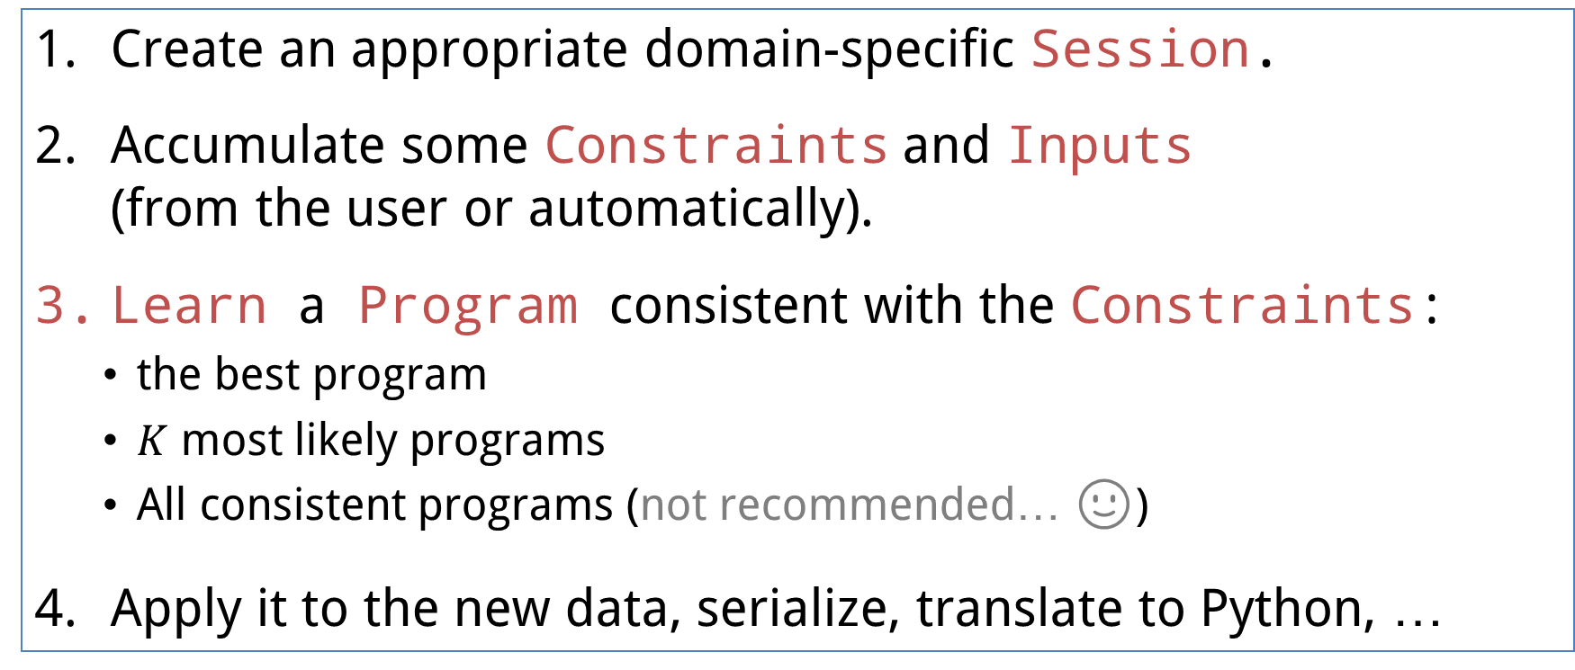
Data Processing APIs
Create an appropriate domain-specific Session.
Accumulate some Constraints and Inputs (from the user or automatically).
Learn a Program consistent with the Constraints:
the best program
$K$ most likely programs
All consistent programs (not recommended… 🙂)
Apply it to the new data, serialize, translate to Python, …

Slide 8
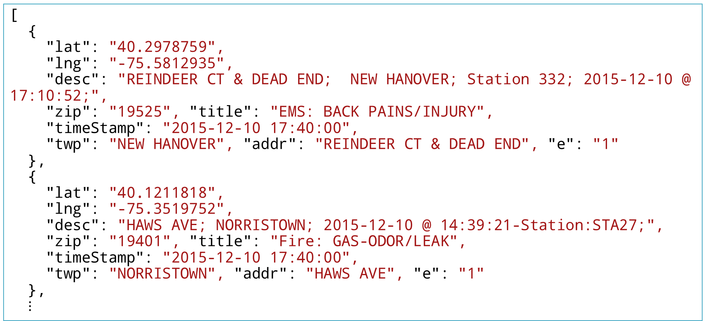
Subject: 911 Call Log
[
{
"lat": "40.2978759",
"lng": "-75.5812935",
"desc": "REINDEER CT & DEAD END; NEW HANOVER; Station 332; 2015-12-10 @ 17:10:52;",
"zip": "19525", "title": "EMS: BACK PAINS/INJURY",
"timeStamp": "2015-12-10 17:40:00",
"twp": "NEW HANOVER", "addr": "REINDEER CT & DEAD END", "e": "1"
},
{
"lat": "40.1211818",
"lng": "-75.3519752",
"desc": "HAWS AVE; NORRISTOWN; 2015-12-10 @ 14:39:21-Station:STA27;",
"zip": "19401", "title": "Fire: GAS-ODOR/LEAK",
"timeStamp": "2015-12-10 17:40:00",
"twp": "NORRISTOWN", "addr": "HAWS AVE", "e": "1"
},
$⋮$

Slide 9
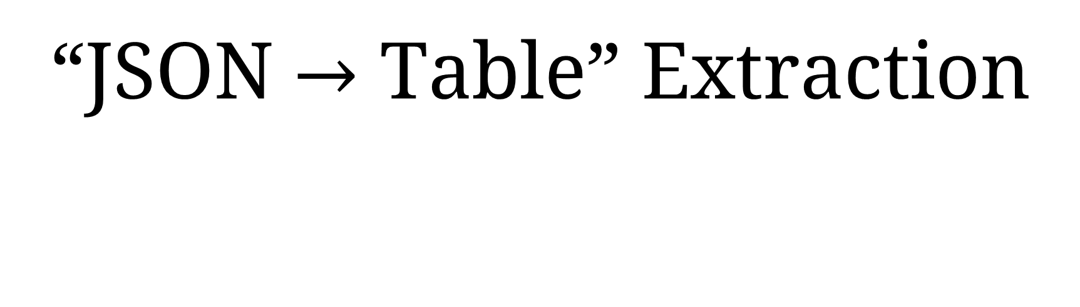
“JSON $→$ Table” Extraction
Scenario 1

Slide 10
Derived Column by Example
Scenario 2

Slide 11
Text Splitting
Scenario 3

Slide 12
Column Profiling
Scenario 4

Slide 13
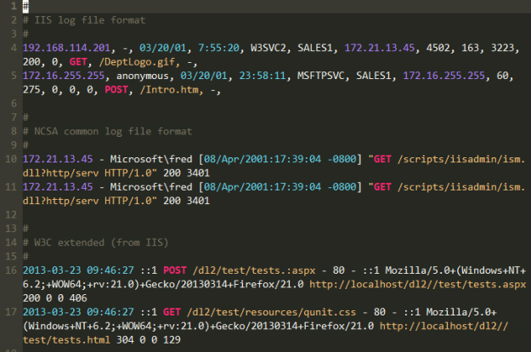
“Data Processing” is not just Data Science!
For instance:
Automatic syntax highlighting for log files

Slide 14
“Data Processing” is not just Data Science!
For instance:
Automatic syntax highlighting for log files
Code refactoring
def product(n, term):
total, k = 1, 1
while k <= n:
- total = total * k
+ total = total * term(k)
k = k + 1
return total
def product(n, term):
if n==1:
return 1
- return product(n-1, term) * n
+ return product(n-1, term) * term(n)

Slide 15
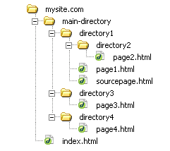
“Data Processing” is not just Data Science!
For instance:
Automatic syntax highlighting for log files
Code refactoring
Folder management automation (via JSON transformations)
…

Slide 16
Next Time
Learn how to create by-example technologies in any domain
Create your own Wrangling SDK from scratch in 2 hours
Exploration of topics
prosetalk@microsoft.com
https://microsoft.github.io/prose
Thank you!

