Slide 1
Week 7
Clustering & Dimensionality Reduction
AI@UCI • Winter Quarter • Presented by David P.
Notes:
Week 7, Quarter 2. This is the club's first unsupervised learning session — everything to date has been handed labels. Set that up early; it frames the whole hour.

Slide 2
RECAP
Where we left off
Decision Trees
A way to segment a complex classification problem into smaller individual gates that together determine the overall status.
Ensembling
Take multiple weak models — often decision trees — and chain them together, aggregating their outputs to form a stronger model.
The thread running through everything so far
Linear regression, classifiers, KNN, neural networks, decision trees, ensembles — every single one was handed a target value y and asked to predict it. We measured success by comparing the prediction to the truth.
Today the labels go away — and with them, the idea of a right answer.
Notes:
Ask for questions on trees and ensembling first; Week 6 was a social event, so there is a two-week gap. Land the bottom card hard — it is the pivot for the whole lecture.

Slide 3
A question first
I hand you 300 photographs of animals
from an island nobody has visited.
No names. No labels. Nothing.
What is the first thing you do?
Notes:
Take two or three answers out loud. Every answer will be a version of 'sort them into piles.' Follow up: how many piles? Nobody told you. That is the lecture. Keep the answer off the slide.

Slide 4
OUTLINE
What we cover today
1
Clustering
Learning when there is no answer key
2
K-Means
The most intuitive clustering algorithm
3
Optimizing K-Means
Local minima, K-Means++, and choosing K
4
Hierarchical Clustering
Build the whole tree, cut it later
5
Dimensionality Reduction
PCA, t-SNE, and UMAP
Notes:
Sections 1-4 cluster the rows of the data. Section 5 reduces the columns. Flag that split now so the second half does not feel like a different lecture.

Slide 5
CORE CONCEPT
The metaphor we will use all lecture
Sorting photos into piles
→
Clustering
Group points that look alike
Deciding how many piles
→
Choosing K
Nobody tells you — and no answer is provably right
Noticing only fur and beak matter
→
Dimensionality reduction
Most measurements were not doing any work
Supervised learning asks “is this right?” Unsupervised learning asks “is this a useful description?”
Notes:
Return to the photo pile at every section transition. It is the visual anchor the style guide asks for.

Slide 6
VOCABULARY
Words we will use today
Unsupervised learning
Finding structure in data that has no target values
Cluster
A group of points more similar to each other than to the rest
Centroid
The mean position of all points in a cluster
SSE (inertia)
Total squared distance from every point to its own centroid
Dendrogram
A tree recording the order in which clusters merged
Principal component
A direction along which the data varies the most
Notes:
Do not read this slide top to bottom. Point at it, say it is a reference, and move on — each term gets defined properly when it appears.

Slide 7
1
Clustering
Learning when there is no answer key
Notes:
Back to the photo pile: you are about to formalize 'sort into piles.'

Slide 8
CONCEPT
Two kinds of learning
Supervised learning
Uses labeled data to predict a known outcome.
Linear regression · classification · decision trees · KNN
Unsupervised learning
Analyzes unlabeled data to find underlying patterns.
K-Means · hierarchical clustering · PCA · autoencoders
Careful: KNN is supervised.
K-Nearest Neighbours finds your neighbours and then takes a vote on their labels — remove the labels and there is nothing to vote on. K-Means is its unsupervised cousin: the same distance computation, with no labels to look up.
Notes:
Adit taught KNN in Q1 Week 4, so the club knows it. The shared 'K' invites confusion — worth 30 seconds.

Slide 9
CONCEPT
There is no answer key
Clustering is an unsupervised machine learning technique used to group together similar unlabeled datapoints based on their features and other characteristics.
Every loss you have written
MSE, classification error, cross-entropy — all of them compare a prediction to a truth.
ℓ(θ) = (1/n) Σᵢ (yᵢ − ŷᵢ)²
There is no yᵢ today
So we cannot score correctness. Instead we score description quality: how tightly do the groups hold together?
That single change is why nothing in this lecture has a provably correct answer.
Notes:
Do not soften this. Students expect an accuracy number and there is not one. Saying so now prevents confusion when the elbow plot turns out ambiguous.

Slide 10
2
K-Means
The most intuitive clustering algorithm
Notes:
Transition: we have a goal (tight groups) and no method. Here is the simplest one.

Slide 11
CONCEPT
You already know half of this algorithm
Week 4 last quarter: the nearest-centroid classifier
You were given one centroid per class. To classify a new point you measured the distance to each centroid and took the closest. That is the assignment step of K-Means, already done.
The only thing that changes: nobody gives us the centroids either.
Guess place K centroids somewhere to start
Assign each point joins its closest centroid — nearest-centroid, exactly as before
Update each centroid moves to the mean of the points that just joined it
Repeat until nothing moves
K-Means is the nearest-centroid classifier with the labels taken away — so it has to invent the centroids as it goes.
Notes:
This framing saves five minutes. Half the algorithm is already familiar; only the alternation is new. Ask the room to recall nearest-centroid before revealing the card.

Slide 12
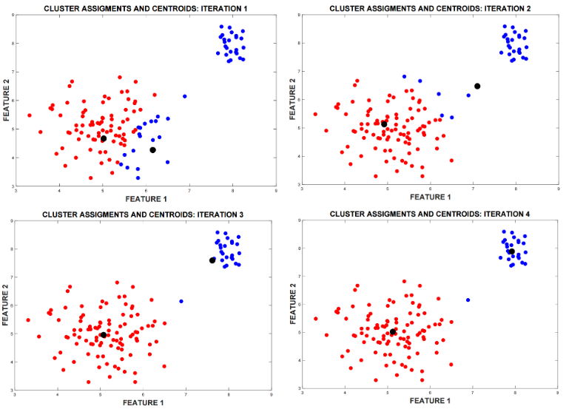
CONCEPT
The K-Means algorithm
Input: K, and dataset X = { xᵢ }, i = 1, …, n
Output: centroids c₁ … cₖ and assignments z₁ … zₙ
1. Initialize K centroids
2. Assignment step
zᵢ = argminₖ ‖xᵢ − cₖ‖²
3. Update step
cₖ = mean of all xᵢ with zᵢ = k
4. Repeat 2–3 until the assignments stop changing
Two steps, alternating. Neither is complicated — the interesting part is what they are jointly optimizing.
Notes:
Walk one iteration on the whiteboard with about eight dots and two centroids before showing the figure. The style guide asks for whiteboard use and this is the natural place.

Slide 13
CONCEPT
What K-Means is actually minimizing
SSE(c, z) = Σᵢ ‖xᵢ − c[zᵢ]‖² the total squared distance from every point to its own centroid
The assignment step
minimizes SSE with the centroids held fixed — each point simply picks the centroid nearest to it.
The update step
minimizes SSE with the assignments held fixed — the mean is the point that minimizes squared distance to a set.
So SSE can only ever go down, and it is bounded below by zero — which is the whole convergence proof.
Notice this is the same squared-error objective as MSE in linear regression. We just cannot reach it with gradient descent, because z is a discrete choice rather than a continuous parameter.
Notes:
The 'mean minimizes squared distance' claim is worth one line of algebra if the room looks unconvinced: d/dc Σ(x-c)² = -2Σ(x-c) = 0 gives c = mean.

Slide 14
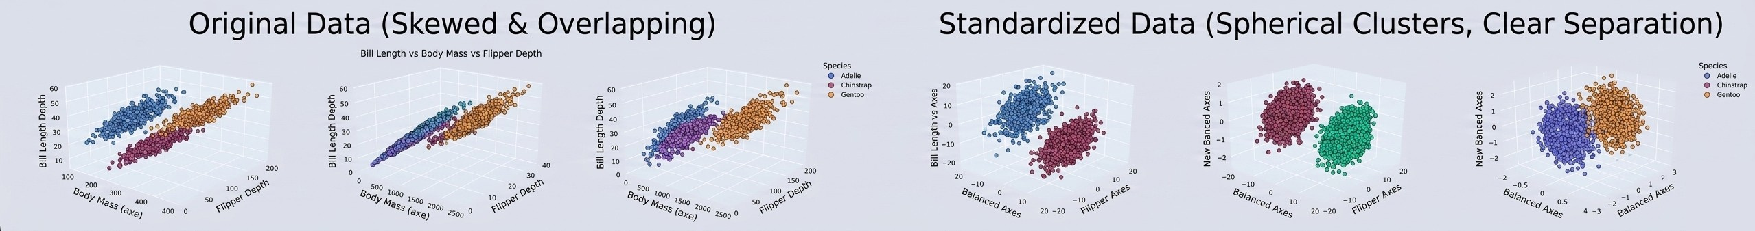
CONCEPT
Distance has units — and units decide the answer
Squared differences in body mass are thousands of times larger than anything else, so the Euclidean distance is effectively body mass alone. K-Means dutifully splits the penguins into heavy, medium and light.
The penguins, unscaled
bill_length ≈ 44 mm
bill_depth ≈ 17 mm
flipper_length ≈ 201 mm
body_mass ≈ 4200 g
Standardize every feature first. Same algorithm, same data, completely different clusters.
Notes:
Callback to the CS 175 penguin distance slide from Q1 (grams vs kilograms). The lesson pays off twice: K-Means uses Euclidean distance, PCA maximizes variance, and both are scale-dependent. Protect this slide if time is short.

Slide 15
3
Optimizing K-Means
Local minima, K-Means++, and choosing K
Notes:
We have an algorithm that converges. Now: converges to what, and how do we pick K?

Slide 16
CONCEPT
Converged does not mean correct
K-Means is only guaranteed to reach a local minimum of the SSE, not the global one. It is highly sensitive to where the centroids start.
Why it cannot escape
Getting out of a local well would require the algorithm to temporarily accept a worse SSE and climb back out. But we just proved both steps can only decrease SSE. K-Means has no mechanism to go uphill, so wherever it lands, it stays.
The cheap fix: restart it
Run K-Means several times from different random initializations and keep whichever run reached the lowest SSE. In scikit-learn this is the n_init parameter, and it defaults to 10 for exactly this reason.
Notes:
Connect to Week 5 last quarter (gradient descent) and Week 2 this quarter (neural nets) — local minima are a recurring theme, not a K-Means quirk. The difference is that here we cannot even take a noisy step.

Slide 17
CONCEPT
K-Means++ : start them far apart
An enhanced initialization that spreads the starting centroids out, so the algorithm is far less likely to fall into a bad local minimum.
1
Pick the first center: select exactly one datapoint uniformly at random
2
Compute distances: for every remaining point x, find D(x), the distance to the nearest centroid chosen so far
3
Pick the next center: choose a new point with probability proportional to D(x)²
4
Repeat: steps 2 and 3 until all K centroids are established
5
Run K-Means: proceed with the standard assign / update loop from there
Squaring the distance is the trick: a point twice as far away is four times as likely to be chosen, so the centroids scatter.
Notes:
Ask why D(x)² rather than D(x) — squaring exaggerates the gap. Also worth noting sklearn uses k-means++ by default, so students have been getting this for free.

Slide 18
CONCEPT
Choosing K : a trap you have seen before
SSE always decreases as K grows
More centroids means every point is closer to one of them. At K = n every point is its own cluster and SSE is exactly zero.
“Pick the K with lowest SSE” always answers “the biggest one.”
Last quarter, Week 7
Training MSE also fell forever as the polynomial degree m grew, so it could not choose m either. Same curve, same trap.
But this time cross-validation cannot rescue us.
Holding out data only helps if the held-out points come with answers you can be scored against. They do not. There is no generalization error to estimate, because there is nothing to generalize to — so we are left with heuristics rather than estimators.
Notes:
The strongest moment in the lecture, and it only works because you taught cross-validation in Q1. Ask the room what they would do, wait for someone to say 'cross-validate', then explain why it fails. Do not rush it.

Slide 19
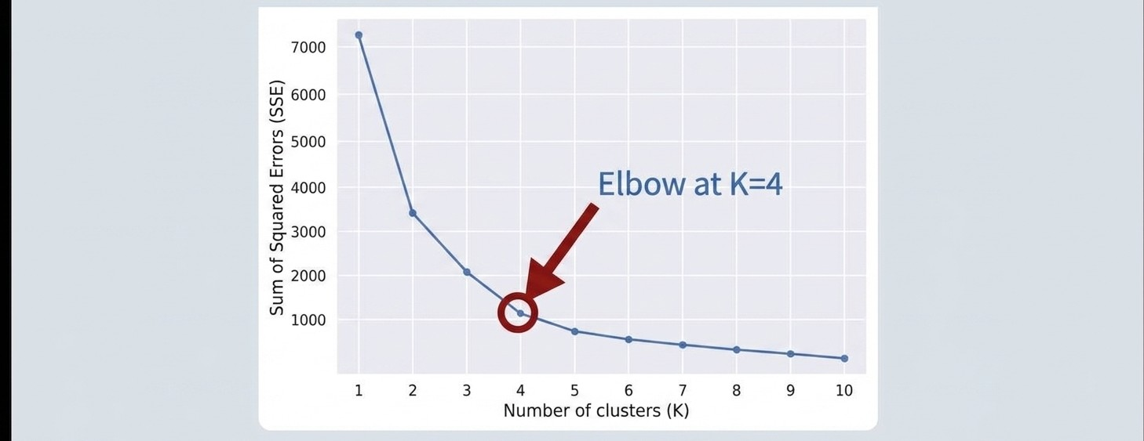
CONCEPT
Two heuristics for K
The elbow method
Plot SSE against K and look for the point where the improvement flattens out. Adding clusters past there buys very little.
Silhouette score
s = ( b − a ) / max( a, b )
a = mean distance to its own cluster, b = mean distance to the nearest other cluster. Average over all points; pick the K that scores highest.
Both are heuristics, not estimators — and on real data they will sometimes disagree with each other.
Notes:
Silhouette runs -1 to 1: near 1 means well inside its own cluster, near 0 means on a boundary, negative means it probably belongs elsewhere. In the notebook the two criteria disagree on the penguins — that disagreement is the point.

Slide 20
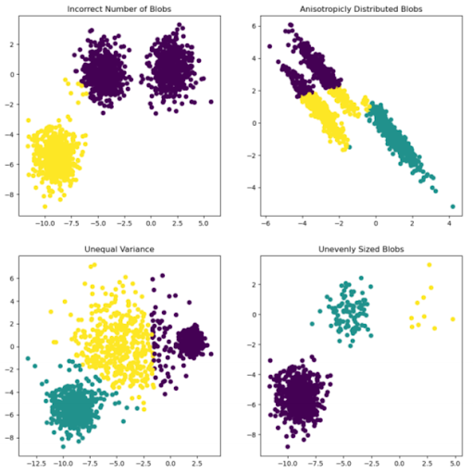
CONCEPT
Where K-Means simply cannot help you
K-Means minimizes squared distance to a single center point. That objective can only ever produce clusters that are compact, roughly spherical and roughly equal in size — because those are the only shapes a centroid can describe.
Non-Standard Clusters
Obvious to your eye. Impossible for K-Means, which draws a straight boundary halfway between two centroids and cuts the modified clusters.
Take the elongated clusters, points in one sliver are not close to a common center. They are close to each other, yet in a form that K-means cannot easily differentiate.
That failure is the entire reason the next section exists.
Notes:
Do not present hierarchical clustering as 'another algorithm we should also cover.' Present it as the answer to this specific failure plus the choose-K-in-advance problem.

Slide 21
4
Hierarchical Clustering
Build the whole tree, cut it later
Notes:
Two complaints about K-Means so far: commit to K blind, and only spherical clusters. This section answers both.

Slide 22
CONCEPT
Do not choose K. Build every K at once.
Agglomerative clustering
1. Start with every point as its own cluster, and compute all pairwise distances.
2. Merge the two closest clusters.
3. Repeat until a single cluster remains.
The merge history is a tree — and the tree contains every K simultaneously.
Cut the tree high and you get a few large clusters. Cut it low and you get many small ones. You run the algorithm once and then decide, with the structure of the data already in front of you. Especially useful for smaller datasets, where the quadratic cost is not a problem.
Notes:
Emphasize the inversion: K-Means demands the answer before it starts; agglomerative defers it until after. A genuinely different philosophy, not a minor variation.

Slide 23
CONCEPT
“Closest” needs a definition: three linkages
Distance between two points is obvious. Distance between two groups of points is a choice, and the choice changes what we define as a new cluster.
Single-link
nearest neighbour
Merge the two clusters holding the closest pair of points, one from each. Follows chains and finds long, non-compact shapes — this is what solves the crescents.
Complete-link
furthest neighbour
Merge the two clusters whose furthest pair is closest. Produces tight, compact, roughly equal-diameter clusters.
Average
centroid distance
Merge the two clusters whose centroids are closest. A middle ground between the two extremes.
Same data, same algorithm, three different sets of clusters. Linkage is not a footnote.
Notes:
All three assume Euclidean distance by default, but any distance measure works — edit distance between strings, for example. One of the few places you can cluster non-numeric data directly.

Slide 24
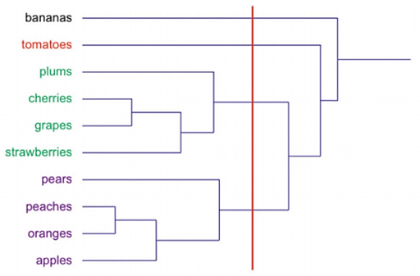
CONCEPT
Reading a dendrogram
Leaves one per datapoint, at the bottom
Each join two clusters merging
Height of a join how dissimilar they were when merged
A long vertical edge a merge that had to reach a long way — evidence of a real gap in the data
Cutting horizontally everything below the line becomes one cluster; the height you cut at chooses K
Notes:
Point at an actual long edge on the figure and say 'that gap is why three is a defensible answer here.' Reading a dendrogram is a skill; give them the vocabulary and one worked read.

Slide 25
CONCEPT
Which one, when
 | K-Means | Hierarchical
K is chosen | before you run it | afterwards, by cutting the tree
Cluster shapes | compact and roughly spherical | any shape, with single-link
Cost in n | linear | at least quadratic
Same answer twice? | no — depends on initialization | yes, deterministic
What you get out | one partition | the entire hierarchy
Large n and a known K → K-Means. Small n, unknown K, or non-compact structure → hierarchical.
Notes:
The quadratic cost is the real constraint: agglomerative needs all pairwise distances, so it becomes painful in the tens of thousands of points. At n = 342 the penguins are trivially fine.

Slide 26
5
Dimensionality Reduction
PCA, t-SNE, and UMAP
Notes:
Explicit pivot: the first four sections grouped ROWS. This one asks about COLUMNS. Same dataset, orthogonal question.

Slide 27
CONCEPT
Why reduce dimension at all?
Real datasets carry hundreds or thousands of features, and each feature is a dimension. Most of them are not necessary to see the broad pattern.
Distance stops working
Nearest-centroid and KNN rely on distance, and distance is corrupted by noisy irrelevant features. Those methods cannot select the useful features and ignore the rest causing them to overfit.
You cannot look at it
The penguins already live in 4 dimensions. You cannot plot that, let alone 400.
Cost
Fewer columns means less storage, faster training, and less noise for the next model to fit.
Dimensionality reduction: using unsupervised algorithms to retain the core relationships in the data while dropping the extra feature noise.
Notes:
The first card is a direct callback to Q1 Week 6 (nearest-centroid sensitivity to dimensionality). Reminding them that a method they know breaks in high dimensions is more persuasive than an abstract curse-of-dimensionality argument.

Slide 28
CONCEPT
The landscape of methods
Algorithm | Type | Supervised? | Best used for
PCA | Linear | Unsupervised | General preprocessing, noise reduction, fast baselines
LDA | Linear | Supervised | Maximizing class separability ahead of classification
t-SNE | Non-linear | Unsupervised | 2D/3D cluster visualization for smaller datasets
UMAP | Non-linear | Unsupervised | Visualizing complex structures, fast clustering
Autoencoders | Neural network | Unsupervised | Scalable deep feature extraction, complex non-linear data
Highlighted: the three we will go over in this lecture. Autoencoders are neural networks as seen in Week 2.
Notes:
LDA is here for contrast only: the one supervised method, optimizing class separation rather than variance. One sentence, then move on. Autoencoder callback to David C.'s Week 2.

Slide 29
VOCABULARY
Eigenvectors, in one slide
A square matrix acts on a vector and generally hands back something pointing in a different direction. Eigenvectors are the special directions that come back pointing the same way — only rescaled.
A v = λ v λ is the eigenvalue: the factor by which that direction is stretched
Try it on a covariance matrix: C = [ 3 1 ]
[ 1 3 ]
C(1, 1)ᵀ = (4, 4)ᵀ = 4 · (1, 1)ᵀ → λ = 4 eigenvector = (1, 1)ᵀ
C(1, −1)ᵀ = (2, −2)ᵀ = 2 · (1, −1)ᵀ → λ = 2
Two directions survive, and they are perpendicular — which is guaranteed, because a covariance matrix is always symmetric. Two positively correlated features, and the 45° diagonal is the direction that stretches most.
Notes:
Most of the club has not seen eigenvectors. Do the arithmetic live on the whiteboard rather than reading it off the slide — four multiplications, and it demystifies the word. Budget six minutes for this slide and the next.

Slide 30
CONCEPT
Variance along a direction
C is the covariance matrix of the data. Project the data onto a unit direction w, and the variance you keep is exactly wᵀCw.
w = (1, 1)/√2
4
the top eigenvector
w = (1, 0)
3
a raw feature axis
w = (1, −1)/√2
2
the second eigenvector
The eigenvector beats every raw feature axis. That, in three lines of arithmetic, is the entire motivation for PCA.
Notes:
Compute wᵀΣw for at least one of these live. The payoff line is that nobody chose the 45° direction — it fell out of the matrix.

Slide 31
CONCEPT
PCA as a constrained optimization
Ask for the unit direction that keeps the most variance. Without the constraint you would just make w enormous.
maximize wᵀ Σ w subject to wᵀ w = 1
the problem
ℒ(w, λ) = wᵀΣw − λ ( wᵀw − 1 )
build the Lagrangian
∇w ℒ = 2Σw − 2λw = 0
stationarity
Σ w = λ w
… which is the eigenvector equation
We never assumed eigenvectors mattered. Stationarity handed them to us — exactly the move we used for Ridge and LASSO.
Notes:
Explicit callback to Q1 Week 7: constrained objective, Lagrangian, read the answer off stationarity. Same three moves. If running long, compress this slide — assert Σw = λw and move on.

Slide 32
CONCEPT
The variance kept is the eigenvalue
Substitute Σw = λw back into the objective: wᵀΣw = wᵀ(λw) = λ ‖w‖² = λ
Everything else falls out for free
Explained variance ratio:
λⱼ / Σₖ λₖ
Sort the eigenvalues largest to smallest, keep the top few, and you know exactly how much of the data you kept. That plot is called a scree plot.
The same thing, said backwards
PCA equivalently minimizes the reconstruction error
‖ X − XWWᵀ ‖²_F
Keeping the most variance and losing the least information are not two goals. They are the same optimization written two ways.
Notes:
In practice PCA is computed by SVD of the centered data matrix rather than eigendecomposing Σ, because forming XᵀX squares the condition number. One sentence — do not derive SVD.

Slide 33
CONCEPT
What PCA gives you — and where it fails
Strengths
Deterministic — the same data always gives the same answer.
It is just a matrix multiply, so new data transforms for free.
Invertible — you can reconstruct an approximation of the original.
An orthogonal projection never pulls points closer than they really are.
Failure modes
Variance is not the same as interest — a high-variance direction can be pure measurement noise, and the class signal can hide in a low-variance one.
Scale-dependent, for the same reason K-Means was. Standardize first.
Outlier-sensitive, because variance squares deviations.
Linear. A spiral or a rolled-up sheet stays tangled — no flat projection can unroll a curved surface.
Notes:
The last failure mode bridges to t-SNE and UMAP. Say it out loud: 'PCA can only rotate and flatten. If the structure is curved, we need something that can bend.'

Slide 34
CONCEPT
When linear is not enough: t-SNE and UMAP
Both are neighbour-embedding methods. Rather than finding a global direction, they place points so that whoever was near you in high dimensions is still near you on the page.
t-SNE
Turns distances into neighbour probabilities in both spaces, then moves the points until the two distributions match.
Knob: perplexity — roughly the effective number of neighbours each point pays attention to.
UMAP
Builds a fuzzy nearest-neighbour graph and lays it out to match. Faster, and it holds on to a little more of the global shape.
Knobs: n_neighbors, min_dist — how local to be, and how tightly to pack.
Both are stochastic: run either one twice and you get two different pictures of the same data.
Notes:
Keep this at the level of intuition. The KL-divergence and cross-entropy derivations are in the appendix if anyone asks — do not open them in the main flow.

Slide 35
CONCEPT
Side by side
 | PCA | t-SNE | UMAP
Type | Linear projection | Neighbour embedding | Neighbour embedding
Preserves | Global structure, variance | Local only | Local, some global
Same answer twice? | Yes | No | No
Handles new data | Exactly, for free | No | Approximately
Can you invert it? | Yes | No | No
Main knob | k, the number of components | perplexity | n_neighbors, min_dist
Safe as model input? | Yes | No | Risky
Notes:
The bottom row is the one that matters practically. Everything above it is context for that judgement.

Slide 36
CONCEPT
Which one should you reach for?
PCA — when the output feeds something else
Clustering, regression, compression, denoising. Also as preprocessing for the other two: reduce to about 50 dimensions with PCA first, then run t-SNE or UMAP. It strips noise and cuts the runtime.
t-SNE / UMAP — when the output is a picture
Exploratory visualization where you care about which points sit near which. t-SNE at moderate n; UMAP when n gets large or you need speed. Initialize t-SNE from PCA, not randomly.
Never feed t-SNE or UMAP coordinates into a downstream model.
They are pictures, not features. The axes carry no units, the geometry is not a metric, and a model trained on those coordinates is fitting artefacts of the optimizer. Worse: t-SNE will happily produce convincing-looking clusters from pure random noise.
Notes:
State the red box flatly and do not qualify it. This is the most common mistake people make with these tools, and it is the sentence students will need two years from now.

Slide 37
RESOLUTION
Two questions, one dataset
Clustering asks about rows
Which datapoints belong together? K-Means and hierarchical clustering both group the observations.
Dimensionality reduction asks about columns
Which measurements actually carry the structure? PCA and its non-linear cousins reduce the features.
Neither one was given a single label. Both found real structure anyway — and in the notebook you will check their work against the species column we hid.
Next quarter, Week 3: large language models represent every word as a vector in hundreds of dimensions. Everything today is how we look at them.
Notes:
Close the loop on the photo pile metaphor, then hand forward to Q3 Week 3 (your own LLM session). The forward reference gives the club a reason to remember PCA.

Slide 38
Coding Notebook
Open VS Code and pull the latest from the repository.
github.com/Artificial-Intelligence-UC-Irvine/Workshops-Code-2627
Notes:
Task for the block: the species column is removed. Recover the three penguin species from four measurements, with no labels. Protect the standardization comparison and the hand-computed Lloyd iteration if you run short.

Slide 39
Connect with us!
Discord — https://discord.gg/CZCgunt
Website — https://aiclub.ics.uci.edu/
YouTube — https://tinyurl.com/aiatuci
Instagram — @AIatUCI
Notes:
Standard closing slide.

Slide 40
APPENDIX
Backup slides
Not part of the 48-minute run. Open only if someone asks how t-SNE or UMAP actually work.
Notes:
Do not present these. They are here so the deck matches the notes document and so you are covered on questions.

Slide 41
APPENDIX
t-SNE mechanics
1. In high dimensions, convert distances to conditional probabilities pⱼ|ᵢ ∝ exp( −‖xᵢ − xⱼ‖² / 2σᵢ² ), with each σᵢ found by binary search so the entropy hits the target set by perplexity. Note σᵢ is per point: dense regions get narrow kernels, sparse regions wide ones.
2. Symmetrize: pᵢⱼ = ( pⱼ|ᵢ + pᵢ|ⱼ ) / 2n
3. In the 2-D map use a Student-t with one degree of freedom: qᵢⱼ ∝ ( 1 + ‖yᵢ − yⱼ‖² )⁻¹
4. Minimize KL( P ‖ Q ) by gradient descent on the yᵢ
Why the heavy tail? The crowding problem.
In d dimensions the volume available at moderate radius vastly exceeds what exists in 2-D, so moderately distant points physically cannot all be placed at moderate distance. The t-distribution's fat tail lets them be pushed far away at low cost, relieving the crush.
Notes:
Appendix. Only open on a direct question.

Slide 42
APPENDIX
Why t-SNE only preserves local structure
KL( P ‖ Q ) = Σᵢ₊ⱼ pᵢⱼ · log ( pᵢⱼ / qᵢⱼ )
Large pᵢⱼ , small qᵢⱼ
True neighbours placed far apart. Heavily penalized.
Small pᵢⱼ , large qᵢⱼ
Distant points placed together. Costs almost nothing, because the term is weighted by pᵢⱼ ≈ 0.
The loss function is explicitly indifferent to where non-neighbours land. This is not a limitation people discovered empirically — it is written into the objective.
Notes:
Appendix. The cleanest one-slide answer to 'why can't I trust the distance between two clusters in a t-SNE plot?'

Slide 43
APPENDIX
UMAP mechanics
Build an approximate k-NN graph. For each point set ρᵢ to its nearest-neighbour distance (guaranteeing local connectivity) and σᵢ so that Σⱼ exp( −(dᵢⱼ − ρᵢ) / σᵢ ) = log₂ k.
Symmetrize by fuzzy union: wᵢⱼ = wᵢ|ⱼ + wⱼ|ᵢ − wᵢ|ⱼ wⱼ|ᵢ
Lay the points out in 2-D with similarity ( 1 + a‖yᵢ − yⱼ‖²ᵇ )⁻¹, minimizing cross-entropy by SGD with negative sampling.
The one substantive difference from t-SNE is the loss.
Cross-entropy carries a second term penalizing qᵢⱼ being large where wᵢⱼ is small — an explicit repulsion between non-neighbours that KL divergence lacks. Plus negative sampling, which is what makes it fast.
Careful before claiming UMAP is simply better: Böhm, Berens and Kobak (2022) argue much of its apparent advantage on global structure comes from spectral initialization rather than the loss — t-SNE initialized from PCA closes most of the gap.
Notes:
Appendix. The 2022 result is worth knowing so you do not overstate UMAP's advantages if a student asks which is better.

