Slide 1
Go Artificial Intelligence

Slide 2
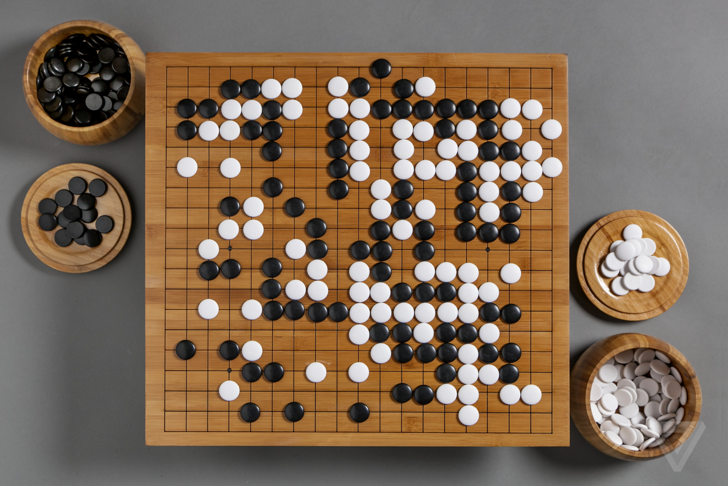
What is Go?
Is an abstract strategy board game for two players, in which the aim is to surround more territory than the opponent.

Slide 3
How the Ai works!

Slide 4
Monte Carlo Tree Search

Slide 5
Monte Carlo tree search (MCTS) is a heuristic search algorithm for some kinds of decision processes, most notably those employed in game play.

Slide 6
The Idea!
Monte carlo use few random simulations to determine which way is the best way possible.

Slide 7
The Idea!
Backpropagation
Simulation
Expand
Selection

Slide 8

Application in Go

Slide 9
Main Objective
To surround a larger total area of the board with one’sstones than the opponent

Slide 10
General Rules
The game ends when the board is full
When the game ends, the system proceeds to calculate of one’s area and the other’s
The winner is the one who has the larger area in board

Slide 11
General Rules
Players can choose to pass with maximum of 2 times
Player who passes 3 times will lose
The game ends when either players passes more than 2 times
Other chess go rules can be viewed at https://en.wikipedia.org/wiki/Go_(game)#Basic_rules

Slide 12
Play!
1
2
3
4
5
6
7
8
A B C D E F G H

Slide 13
Main Idea of the application
The program uses a monte carlo heuristic search which determines the next move it gonna choose
The system also calculates the probability of each of those node’s win ratio by estimating the opponents next move
The nodes which have highest win rate will be choosen as the program’s next move

Slide 14
Error Handling
Error Handling consists of three types of error, of which are err0, err1, and err 2
Err0 defines that the move that the program choose is unrecognizeable by the main program
Err1 defines that the move is not on an empty tile
Err2 defines that the move is not acceptable by the rules of chess go

Slide 15
Thanks!
Any questions?

