Slide 1
Machine Learning Techniques for Distracted Driver Detection
Team F-28 · Project 75 · Section F · ML Mini Project
Chiranth R (PES1UG24AM354)
Vihaan Wadhwa (PES1UG24AM319)
Notes:
Introduce the team and the project title.

Slide 2
The problem
Goal: classify a dashboard-camera photo of a driver into one of 10 activities.
Why it matters: a system that notices texting, phone calls or reaching behind could warn the driver in time.
Input: one RGB photo taken from the passenger side.
Output: c0 safe driving, or one of nine distractions (c1–c9).
Our question: does the usual way of measuring accuracy hold up on drivers the model has never seen?
c0
safe driving
c1
texting - right
c2
talking on phone - right
c3
texting - left
c4
talking on phone - left
c5
operating the radio
c6
drinking
c7
reaching behind
c8
hair and makeup
c9
talking to passenger
Team F-28 · Distracted Driver Detection
2
Notes:
Explain the task: one photo in, one of ten activities out.

Slide 3
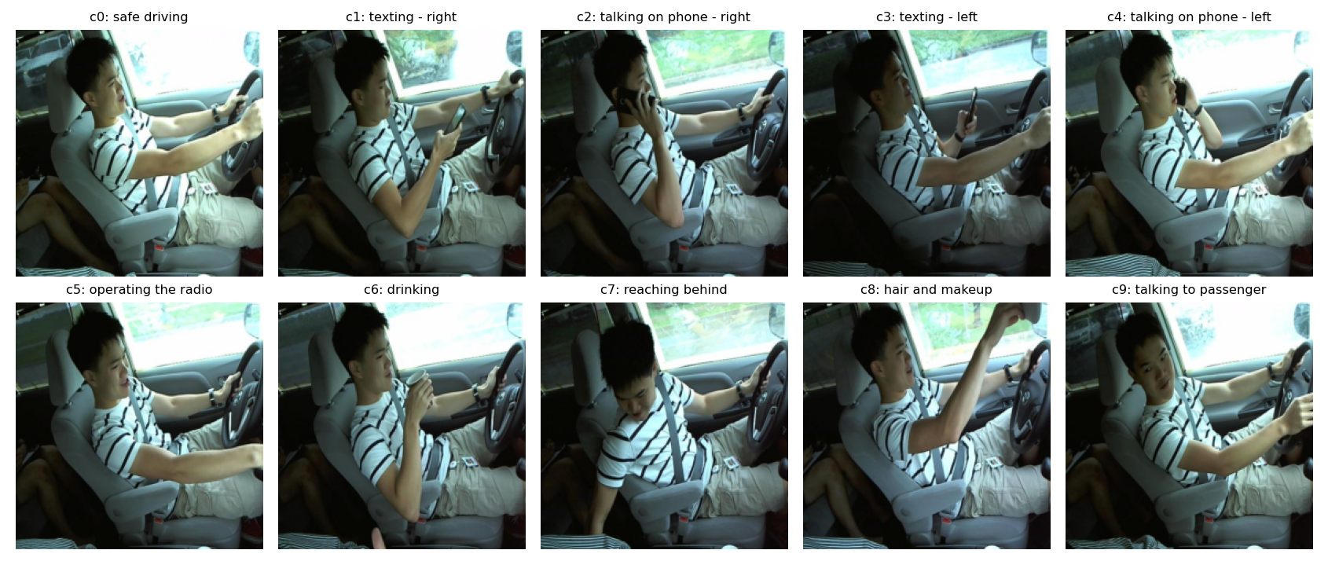
Dataset: State Farm (Kaggle)
22,424 labelled photos across 10 classes
26 different drivers each appears in many photos
Classes are fairly balanced: 1,911 to 2,489 photos per class
Consecutive frames of the same person look very alike. That's why a random split can leak.
Team F-28 · Distracted Driver Detection
3
Notes:
All numbers here come from the labelled training set of the Kaggle competition.

Slide 4
Reference: Stanford CS229 (Spring 2019), project 24
Features: 64×64×3 images flattened into 12,288 numbers.
Models: Naive Bayes, linear SVM, softmax regression, decision tree, 2-layer neural network.
Evaluation: a random 80/20 split of the photos; best accuracy reported around 92%.
What we add: (1) a driver-grouped split that keeps test drivers out of training, (2) a pretrained MobileNetV3, (3) Grad-CAM to see where models look.
Team F-28 · Distracted Driver Detection
4
Notes:
We reproduce the paper's classical baselines and add a pretrained CNN.

Slide 5
Our method: two ways to split the same data
Random split
Driver split
Photos shuffled, stratified by class. The same drivers appear in train, val and test.
Whole drivers assigned to train, val or test. Test drivers are never seen in training.
train
15,696 photos · 26 drivers
train
15,313 photos · 18 drivers
val
3,364 photos · 26 drivers
val
3,598 photos · 4 drivers
test
3,364 photos · 26 drivers
test
3,513 photos · 4 drivers
Driver-split test drivers: p022, p039, p047, p056
Team F-28 · Distracted Driver Detection
5
Notes:
Both splits are 70/15/15 with seed 42. Only the grouping differs.

Slide 6
Models
Classical (like CS229)
Deep: MobileNetV3-Large
Input: 64×64×3 pixels, flattened, standardised (train only)
Models: Gaussian Naive Bayes, linear SVM (hinge SGD), softmax (multinomial logistic), decision tree
Training set: subsample of 8,000 / 8,000 photos (random / driver) for speed
Input: 224×224 RGB, ImageNet-pretrained weights
Training: 8 epochs, AdamW, one-cycle LR 0.001, batch 64, mixed precision on a Tesla T4
Augmentation: small shifts, rotations, colour jitter. No horizontal flip: left/right-hand classes would swap.
Model selection: best epoch by validation accuracy, never the test set
Team F-28 · Distracted Driver Detection
6
Notes:
Classical models follow the paper; MobileNetV3 is our deep model.

Slide 7
Results: every model on both splits
Model | Random-split acc | Driver-split acc | Drop (points) | Macro-F1 random | Macro-F1 driver
Naive Bayes | 51.1% | 26.0% | 25.1 | 0.508 | 0.228
Linear SVM | 95.9% | 33.0% | 62.8 | 0.959 | 0.338
Softmax | 97.9% | 34.3% | 63.6 | 0.979 | 0.334
Decision Tree | 74.6% | 30.4% | 44.2 | 0.748 | 0.303
MobileNetV3 | 99.9% | 87.5% | 12.4 | 0.999 | 0.872
Test sets: 3,364 photos (random split) and 3,513 photos from 4 unseen drivers (driver split).
Team F-28 · Distracted Driver Detection
7
Notes:
Read the drop column: that's the cost of testing on new drivers.

Slide 8
Unseen drivers: MobileNetV3 99.9% → 87.5%
Team F-28 · Distracted Driver Detection
8
Notes:
This is the main finding. Random splits measure partly how well the model recognises people it has already seen.

Slide 9
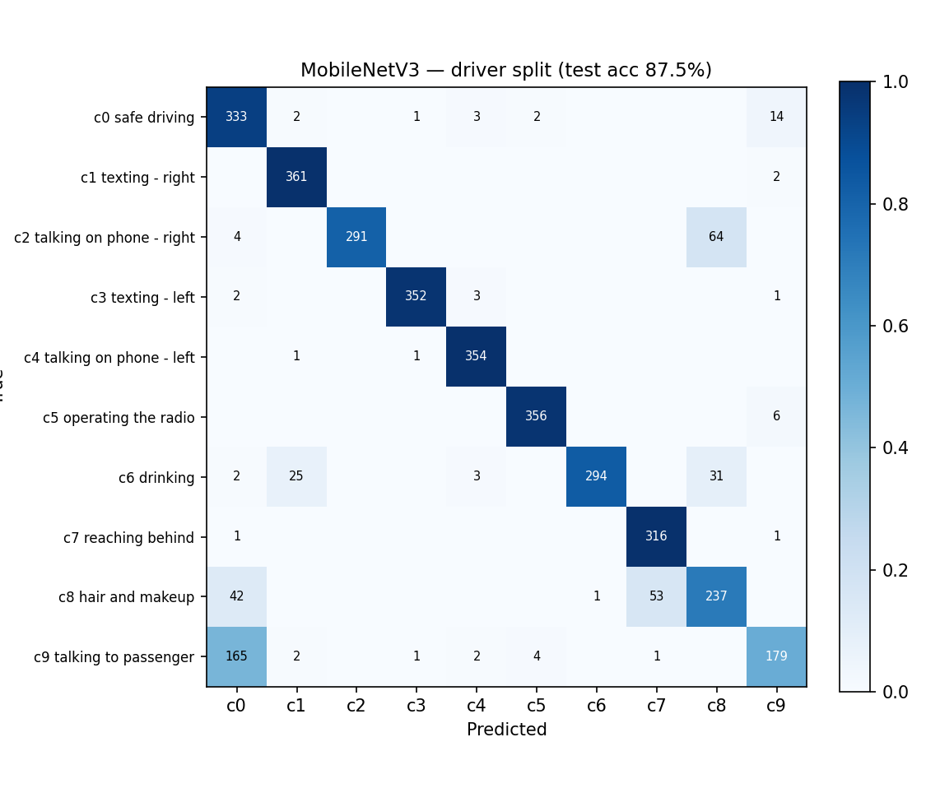
Where MobileNetV3 gets confused on new drivers
Hardest classes (driver split)
c9 talking to passenger: 50.6% correct
c8 hair and makeup: 71.2% correct
c2 talking on phone - right: 81.1% correct
Per-class accuracy on the random split for the same classes: c9 99.4%, c8 100.0%, c2 100.0%.
Team F-28 · Distracted Driver Detection
9
Notes:
Rows are true classes, columns are predictions. Off-diagonal cells show mix-ups.

Slide 10
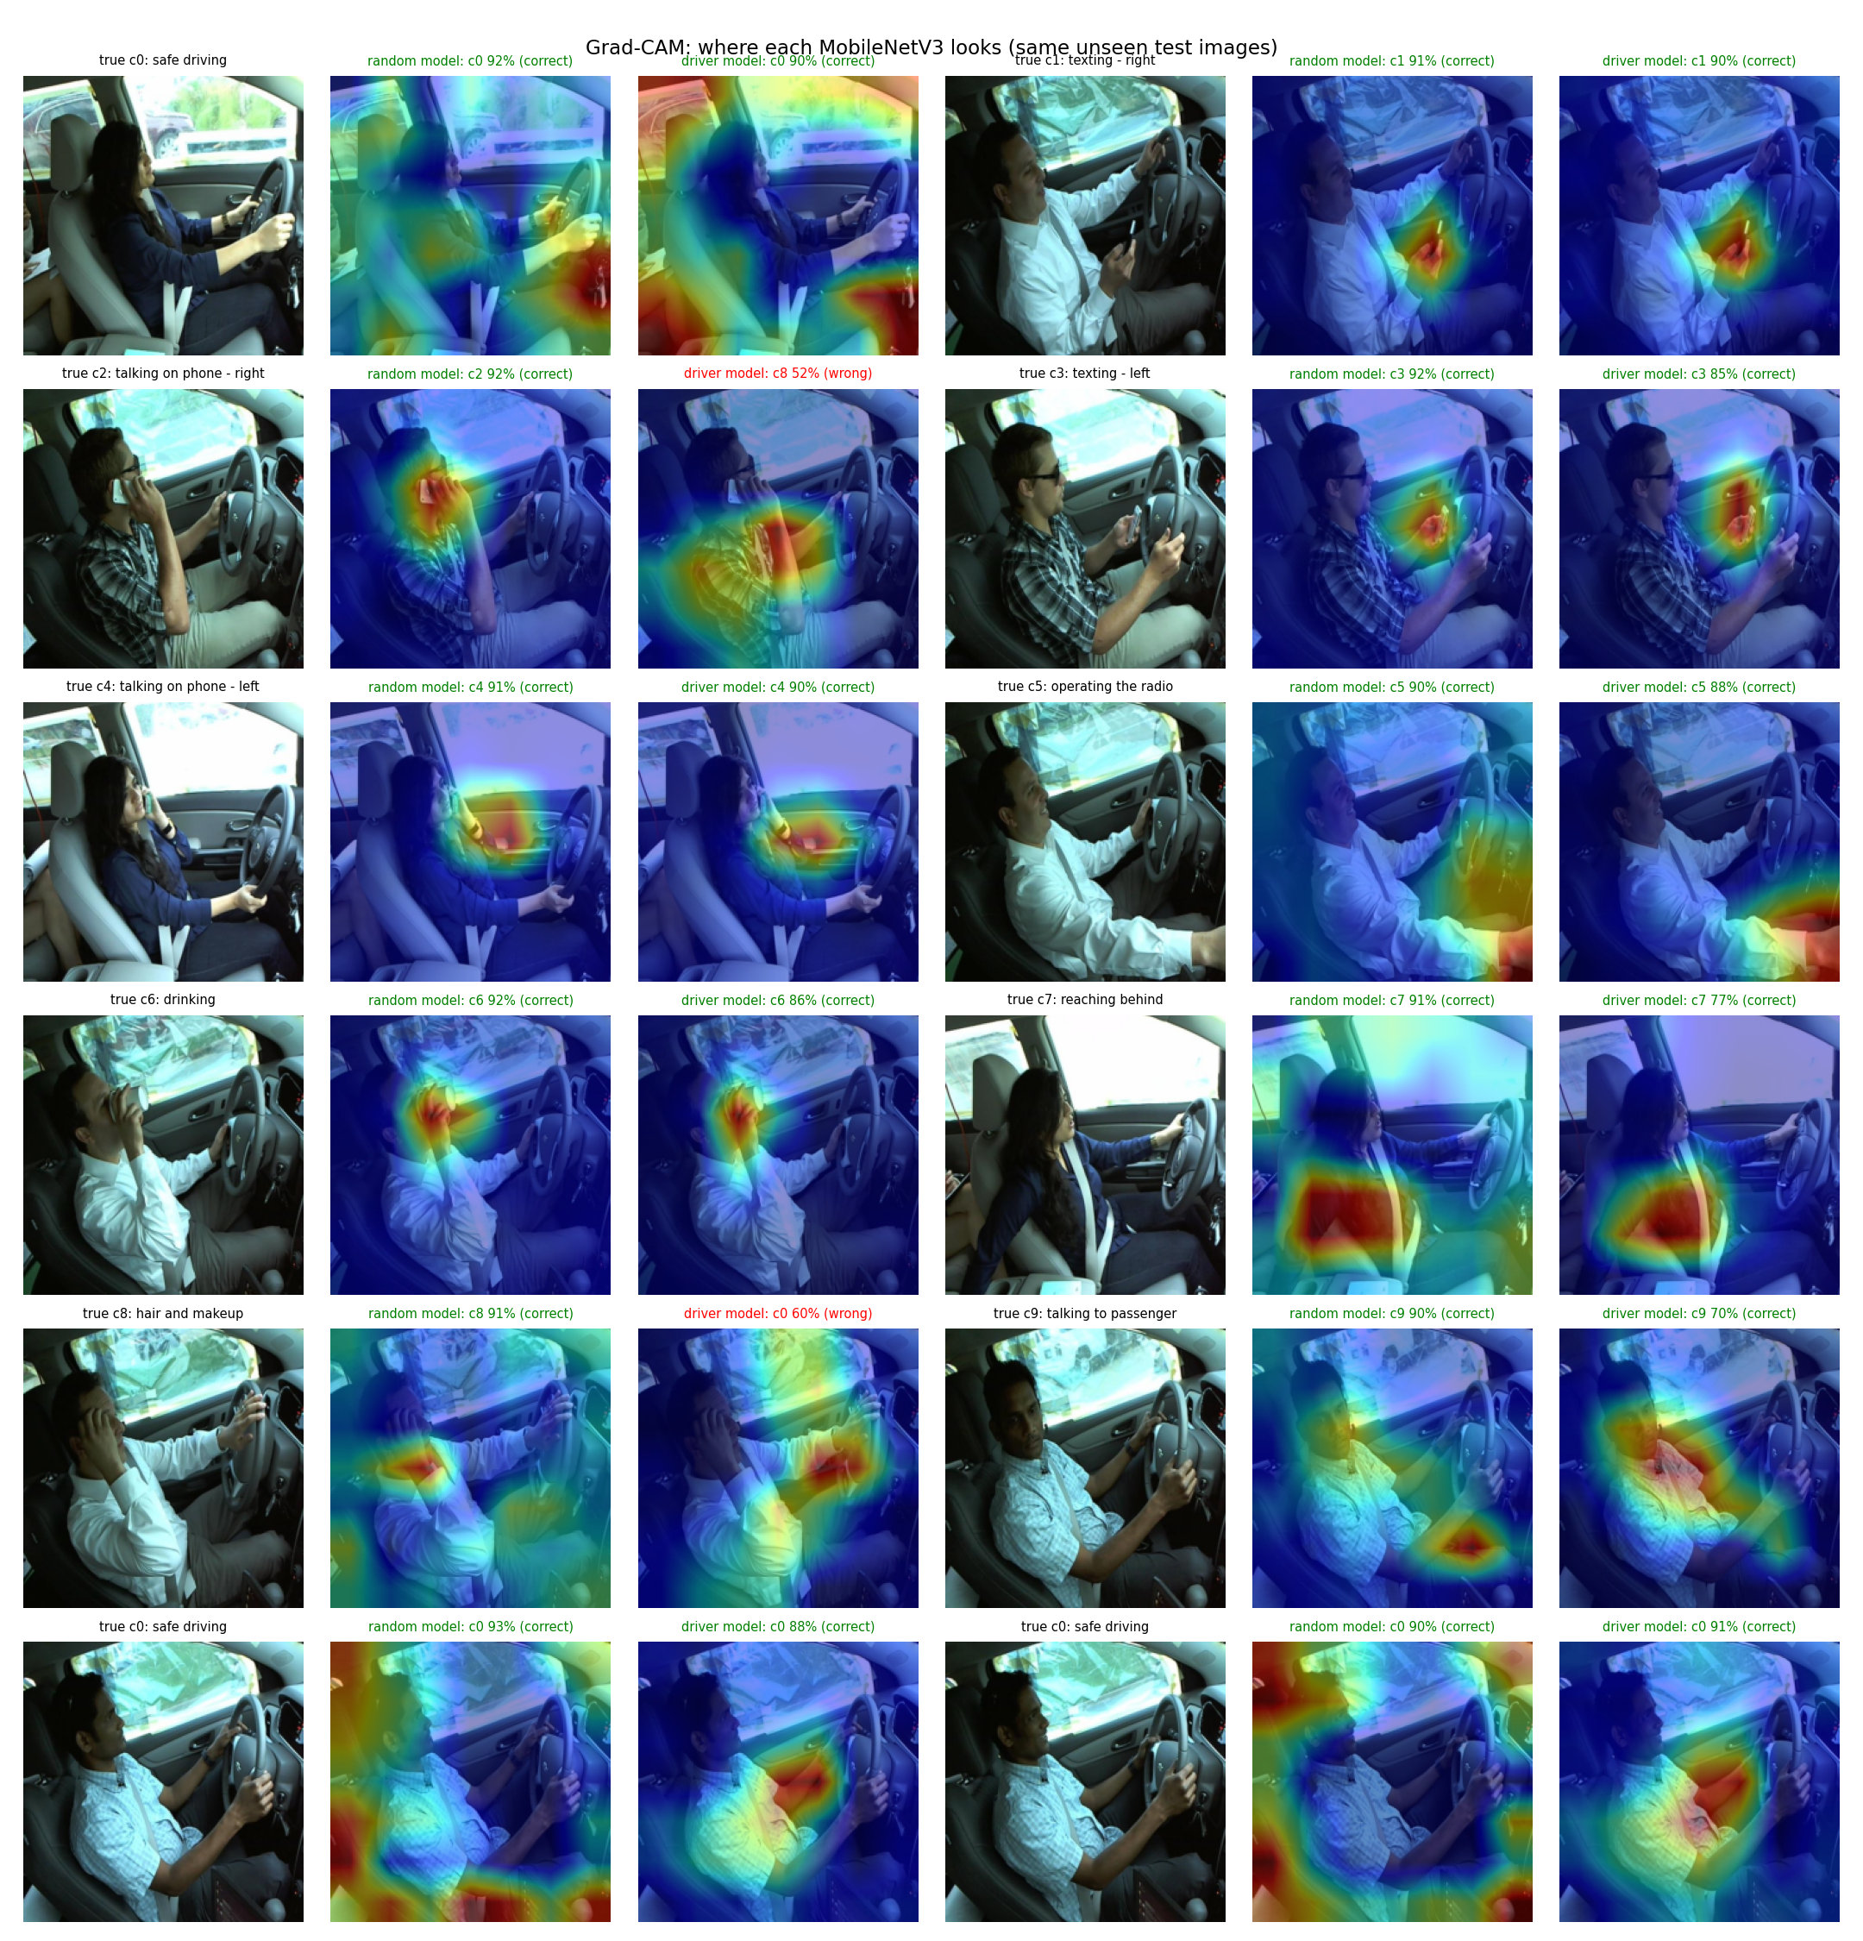
Grad-CAM: where each model looks
On these 12 photos (neither model trained on them):
random-split model correct on 12, driver-split model correct on 10.
Columns per photo: original · random-split model · driver-split model.
Look for heat on hands, phone, cup and face, versus heat on the background or the person's appearance.
Team F-28 · Distracted Driver Detection
10
Notes:
Same unseen test photos for both models. Heatmap = regions that pushed the predicted class up.

Slide 11
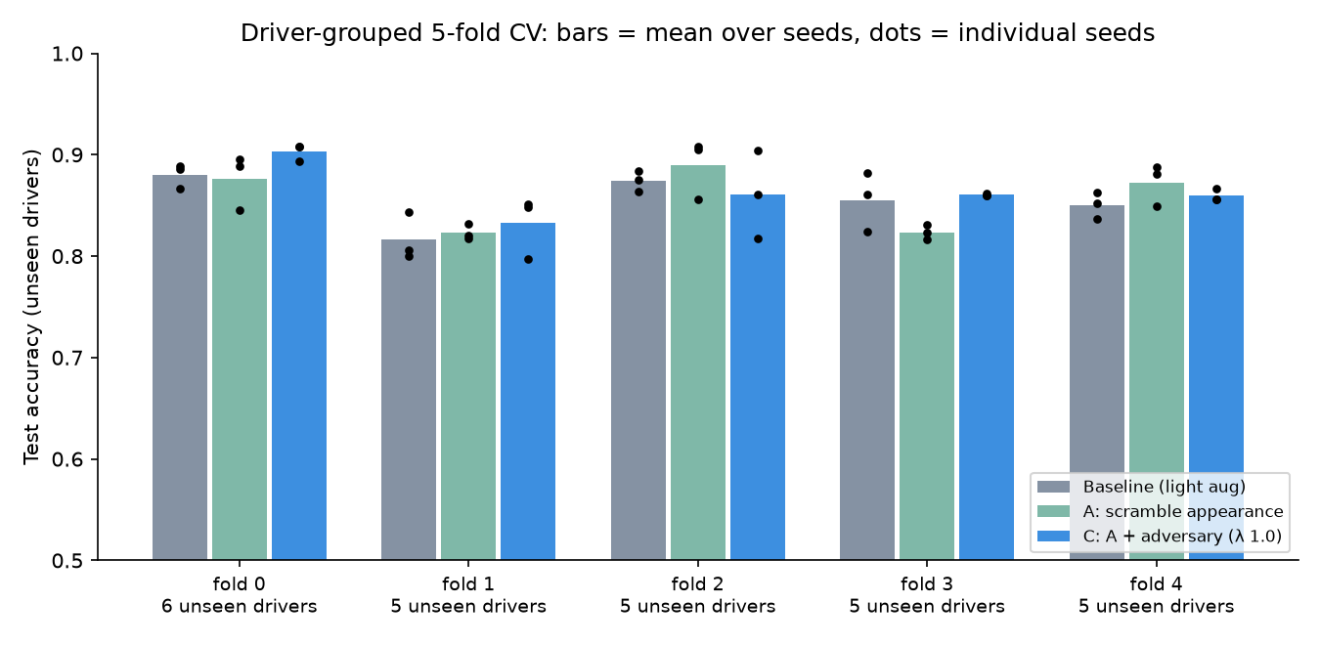
Is it real? 5-fold driver cross-validation (45 runs)
Driver-split model | Unseen-driver acc | vs baseline | p
Baseline (light augmentation) | 85.5% ± 2.8 | – | –
A: scramble appearance | 85.7% ± 3.4 | +0.2 pts | 0.86
C: A + adversary (λ 1.0) | 86.3% ± 3.1 | +0.8 pts | 0.26
The leak is robust: random split 99.9% vs 85.5% ± 2.8 on unseen drivers, averaged over all 26 drivers.
Debiasing helps only a little: On our single split it looked like 87.5% → 91.5%. Across all drivers C is +0.8 pts (95% CI -0.9 to +2.5), better on 4/5 folds, not significant (p = 0.26).
Lesson: one split with 4 test drivers can mislead by several points.
Team F-28 · Distracted Driver Detection
11
Notes:
Every one of the 26 drivers is an unseen test driver once; 3 seeds per fold. Each run picks its epoch on separate validation drivers. p-values: paired t-test over the 5 folds (seeds averaged).

Slide 12
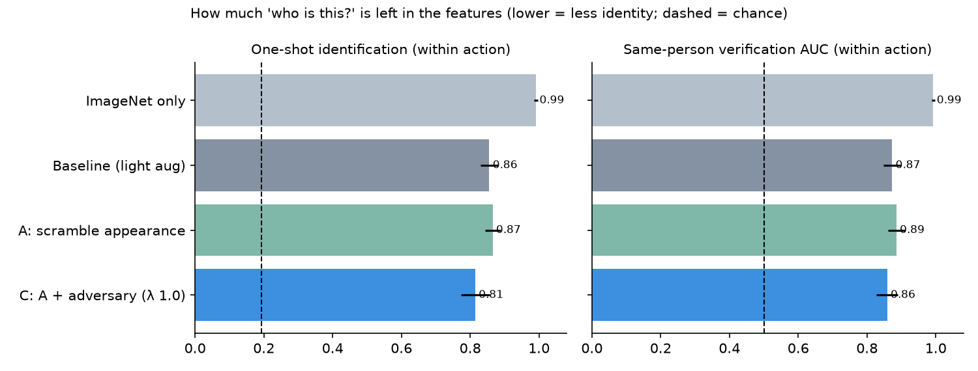
Did the adversary remove 'who is this?'
ImageNet features identify people 99% of the time from one photo, even within the same action.
Fine-tuning on actions lowers it to about 86%.
The adversary (C) lowers it further, to 81%: lower on all 5 folds, p = 0.006.
But identity stays far above chance, and the accuracy gain is small, so appearance is only part of the problem.
Team F-28 · Distracted Driver Detection
12
Notes:
One-shot identification: within one action, match each photo to one reference photo per test driver using the model's features. Chance is about 1 in 5. Lower means less identity information.

Slide 13
Limitations
Few drivers: only 26 people, and 4 in the driver-split test set, so per-driver results vary a lot.
One camera setup: same car, angle and lighting style; a new car or camera would be another shift.
Classical models used a 8,000-photo subsample for speed.
One seed, one split of drivers, no hyperparameter search: numbers would move somewhat with a different driver assignment.
Grad-CAM is a rough explanation, not proof of what the model reasons about.
Team F-28 · Distracted Driver Detection
13

Slide 14
Future work and conclusion
Driver-grouped cross-validation to average over many driver assignments.
More drivers and cameras for a fairer test of generalisation.
Next research step: test vision-language models (CLIP) with driver-appearance decoupling under realistic calibration.
Conclusion
On a random split, MobileNetV3 reaches 99.9%.
On unseen drivers, MobileNetV3 scores 87.5% (12.4 points lower than on the random split).
Random splits overstate how well distracted-driver models work on new people. Report driver-grouped results.
Team F-28 · Distracted Driver Detection
14

