Slide 1
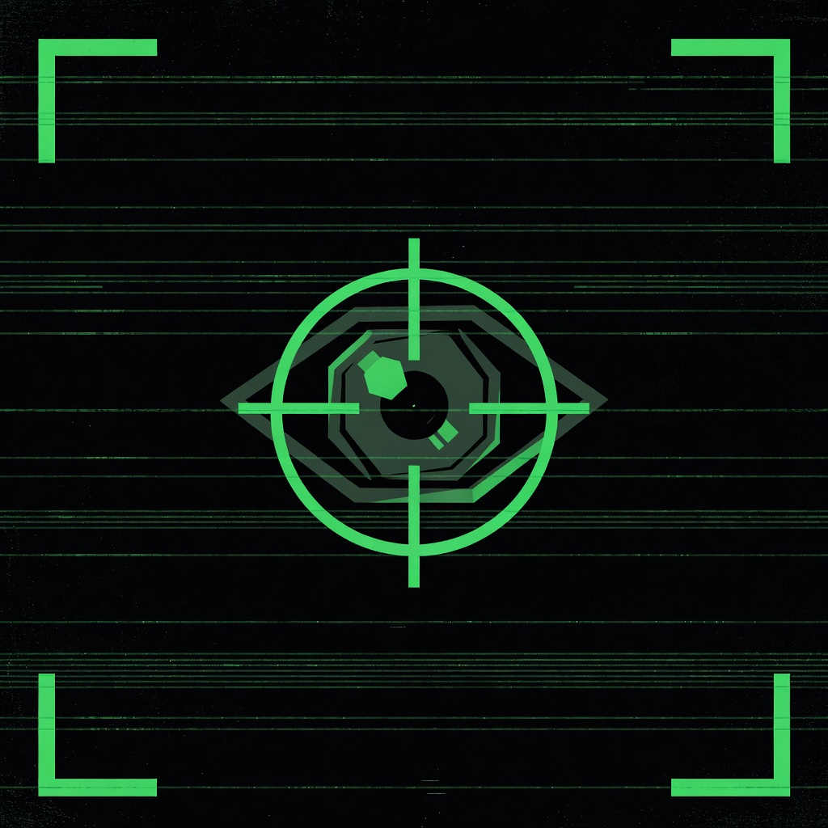
HOW WE BUILT
CREEPER
v1.0
With a Lot of AI Help
A totally normal app, built with totally normal tools.
[ 6 AI TOOLS · 0 HUMANS WRITING CODE · 1 VERY WEIRD APP ]

Slide 2
01
STEP 01 / 06
ELEVENLABS
Voice Synthesis
Generated all 4 audio assets using a custom AI voice model.
▸ Voice is a first-class UX decision — not an afterthought
▸ The prompt was the creative brief:
"...like the AI is into some sick stuff
you don't want to know about."
▸ No recording studio, no voice actor, no problem

Slide 3
02
STEP 02 / 06
HIDOCK
AI Session Recorder + Transcriber
Recorded the design session with voice narration → auto-transcribed → structured text.
▸ Thinking out loud is a valid design tool
▸ Turns a rambling voice memo into AI-ready input
▸ The transcript became the hand-off document

Slide 4
03
STEP 03 / 06
CLAUDE
System Architect
Took the HiDock transcript and produced a full structured development plan.
▸ Defined modules, interfaces, threading model, state machine
▸ AI as architect — not just a code monkey
▸ Planning first made generation reliable downstream

Slide 5
04
STEP 04 / 06
OPENCODE
+ MINIMAX M2.5
Code Generator (free tier)
Generated the bulk of the application from Claude's plan.
▸ All major modules: detector, overlay, audio, pixelator, config
▸ Open-source terminal agent + free model
▸ The plan made the generation reliable

Slide 6
05
STEP 05 / 06
CLAUDE CODE
AI QA Engineer
Reviewed the MiniMax-generated codebase, caught bugs, resolved final issues.
▸ AI reviewing AI-written code — the circle of life
▸ Fast final mile to get the app working end-to-end
▸ Human in the loop: just barely enough

Slide 7
06
STEP 06 / 06
NUDENET
The ML Model That Makes CREEPER... CREEPER
AGPL-3.0 open-source body detection. ~7MB ONNX. Runs entirely on CPU.
▸ Standing on the shoulders of open source
▸ Classifies body parts in real time on a MacBook
▸ AGPL-3.0 — free to use, free to be weird with

