Slide 1




Hotel Booking Cancelation Prediction
Arti Ganjale
PGA 45
Capstone Project - I

Slide 2
Content
Sr. No | Content
1. | Introduction
2. | Objective
3 | Data Information
4 | Flowchart
5 | Exploratory Data Analysis
6 | Data Preprocessing -1
7 | Data Preprocessing -2
8 | Data Preprocessing – 3
9 | Random sampling
10 | Basic Model And Evaluation
11 | Feature Selection
12 | Model Building
13 | Final Model Selection
14 | Business Conclusion

Slide 3

Introduction
.
Hotel industry is one industry that can utilize data and machine learning in helping management to increase revenue. one of them by using machine learning as a tool to take preventive action against the possibility of a consumer to cancel their bookings.
So in this project I use booking data from a hotel in Portugal that is used to take insight and design a simple machine learning model

Slide 4


Objective
Goal is to leverage machine learning techniques to develop a robust and accurate Hotel booking Cancelation prediction model that assists both Customer and Hotel owner in making informed decisions.
Notes:
Pricing used cars is a multifaceted challenge influenced by factors such as make, model, mileage, year of manufacture, and additional features.
Traditional methods often fall short in capturing the nuanced relationships between these variables, leading to inaccuracies in price estimation.
Our goal is to leverage machine learning techniques to develop a robust and accurate price prediction model that assists both sellers and buyers in making informed decisions.

Slide 5
Data Information
For this project, data is sourced from the Kaggle Data Source.
Dataset Source : Kaggle.com
Dataset Info :
https://www.kaggle.com/datasets/arezaei81/hotel-bookingcvs
Total Rows : 119390 rows
Total Features / Columns : 36 features

Slide 6

Flow chart
Explore Dataset
Dataset Basic Information
Summary Statistics for numerical Variables
Data Preprocessing
Feature Selection and Engineering
1)Remove Directly Related Features
2)Drop Irrelevant Features
3)Engineering and Drop High Cardinality Features
Data Visualization
Visualizing categorical columns
Summary Statistics for Numerical Variables
Handling Outliers
Summary Statistics for Categorical Variables
Visualizing Numeric columns
Visualizing outliers with Box Plot
Removing Outliers
Model Building
Handle Noisy Data
Handle Missing Values
Encode Categorical Variables

Slide 7

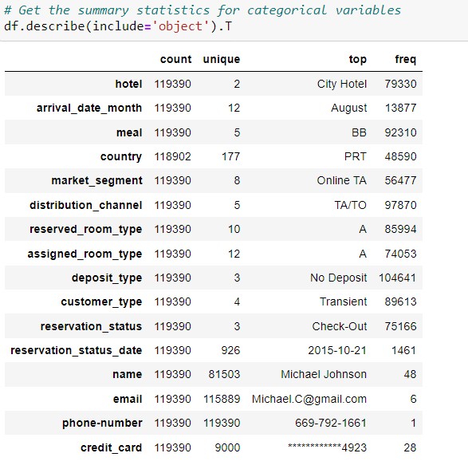
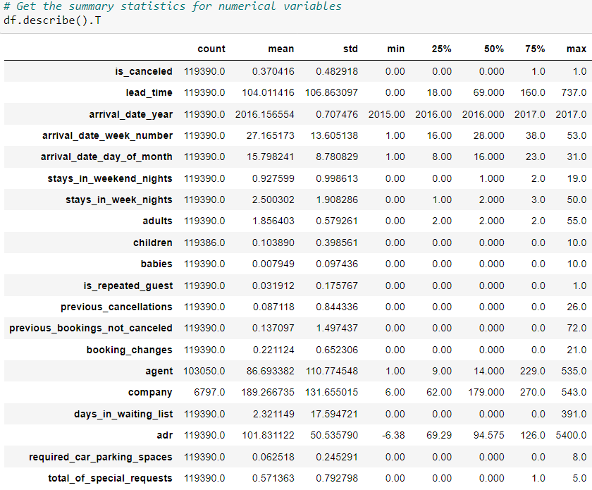
Data Preprocessing - I
Summary Statistics for Categorical Variables And Numeric Variable

Slide 8

Column Description
1. hotel : Type of hotel (Resort Hotel, City Hotel)
2. is _canceled : Reservation cancellation status (0 = not canceled, 1 = canceled)
3. lead_time: Number of days between booking and arrival
4. arrival_date_year : Year of arrival
5. arrival_date_month : Month of arrival
6. arrival_date_week_number : Week number of the year for arrival
7. arrival_date_day_of_month : Day of the month of arrival
8. stays_in_weekend_nights : Number of weekend nights (Saturday and Sunday) the guest stayed or booked
9. stays_in_week_nights : Number of week nights the guest stayed or booked
10. adults : Number of adults
11. children : Number of children
12. babies : Number of babies
13. meal: Type of meal booked (BB, FB, HB, SC, Undefined)

Slide 9
15.market_segment : Market segment designation
16. distribution_channel: Booking distribution channel
17. is_repeated_guest: If the guest is a repeat customer (0 = not repeated, 1 = repeated)
18. previous_cancellations: Number of previous bookings that were canceled by the customer
19. previous_bookings_not_canceled: Number of previous bookings that were not canceled by the customer
20. reserved_room_type: Type of reserved room
21. assigned_room_type: Type of assigned room
22. booking_changes: Number of changes made to the booking
23. deposit_type: Type of deposit made (No Deposit, Refundable, Non Refund)
24. agent: ID of the travel agent responsible for the booking
25. company: ID of the company responsible for the booking
26. days_in_waiting_list: Number of days the booking was in the waiting list
27. customer_type: Type of customer (Transient, Contract, Transient-Party, Group)

Slide 10
28. **adr**: Average Daily Rate
29. **required_car_parking_spaces**: Number of car parking spaces required
30. **total_of_special_requests**: Number of special requests made
31. **reservation_status**: Last reservation status (Check-Out, Canceled, No-Show)
32. **reservation_status_date**: Date of the last reservation status
33. **name**: Guest's name
34. **email**: Guest's email address
35. **phone-number**: Guest's phone number
36. **credit_card**: Last four digits of the guest's credit card

Slide 11
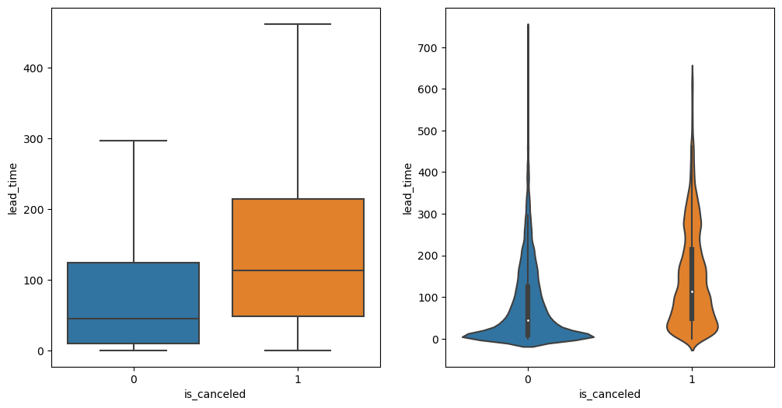
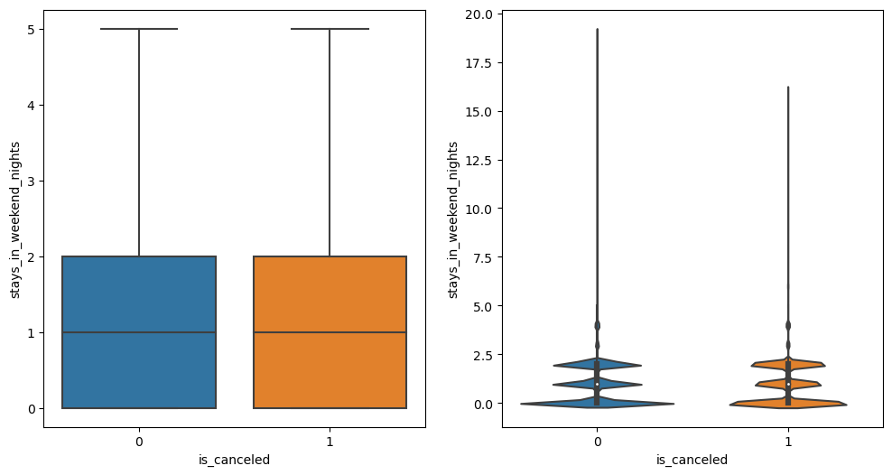
Checking for outliers

Slide 12
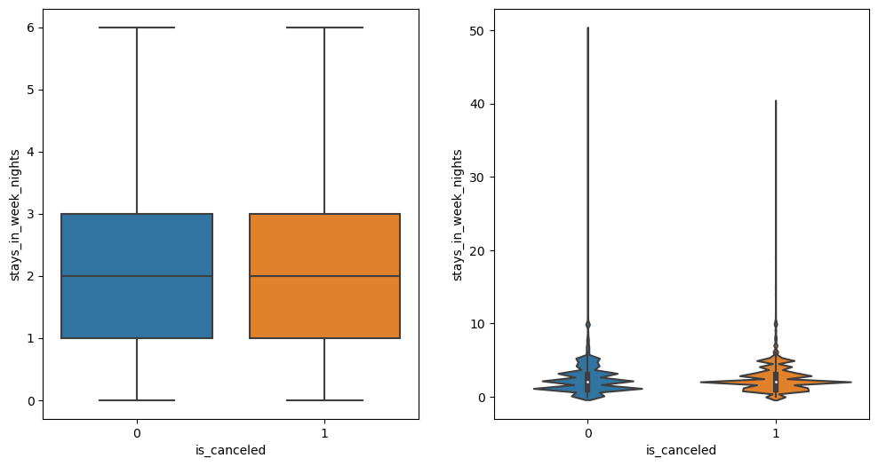
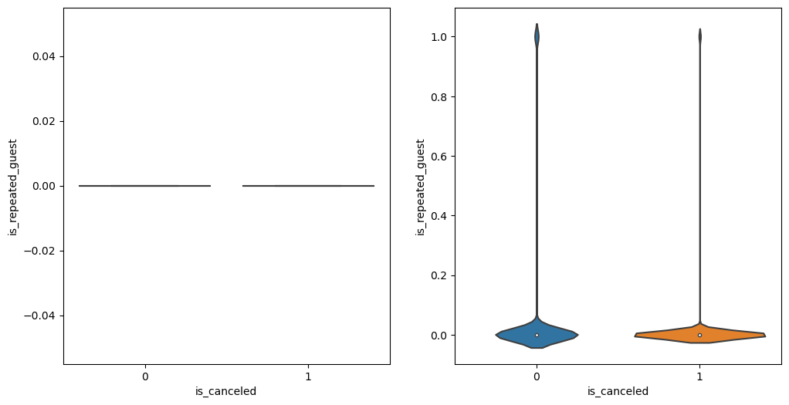
Stays in week night and stay in weekened nights

Slide 13
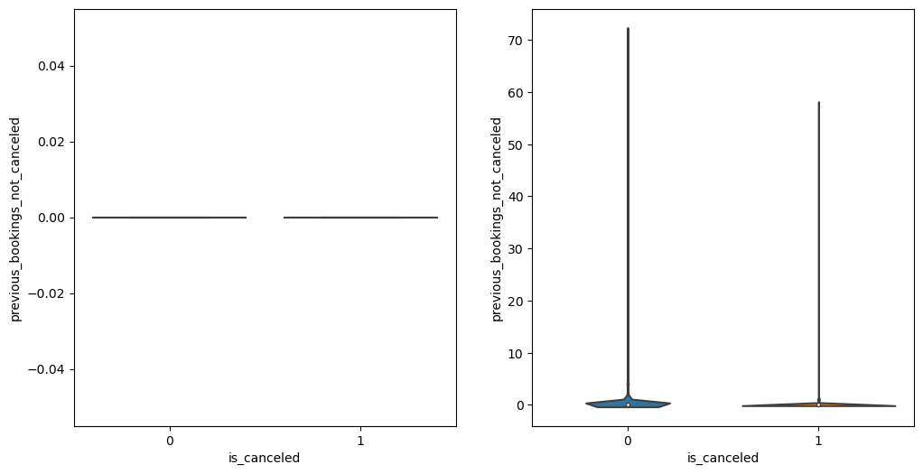
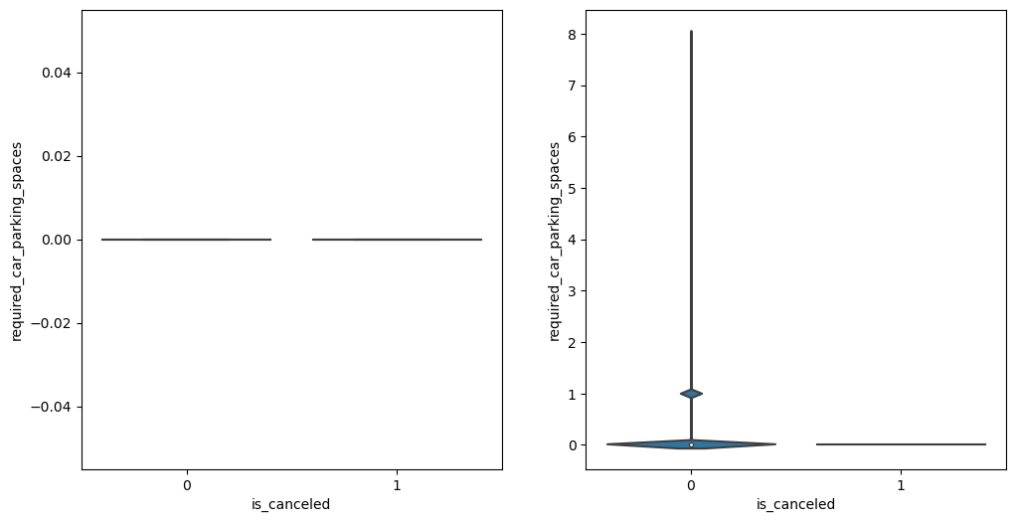
Previous Booking Not Canceled and Required parking spaces

Slide 14
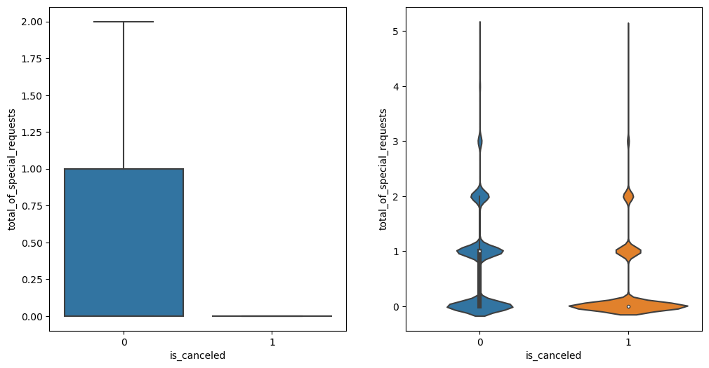
Total of Special Guest
Observation
few of the features contribute very less to tell whether the customer will cancel the booking. They are - stays in wekkend nights
stay in week nights
repeated guest
previous booking canceled or not
required car parking spaces
The special request feature's limited usefulness for prediction is evident because, despite a difference in median between the groups, around 75% of individuals have zero special requests, making it less informative and challenging for accurate predictions.
Now, lets discuss about the lead time.
It is quite significantly different for both of the groups.
The people more likely to cancel have longer lead time for booking.

Slide 15
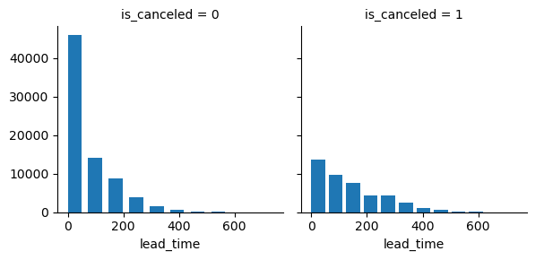
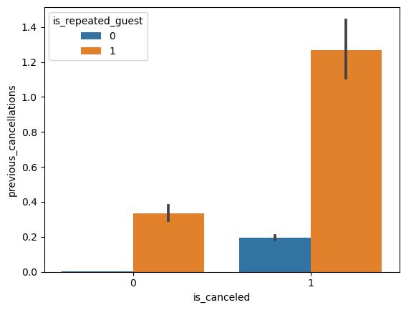
Lead Time
Observation
Maximum cancelations occur if the booking is made 60-70 days before the checking date. Longer the lead_time, lower is the cancelation.
previous_cancellations
Observation
Customers with the history of cancellation tend to cancel more often.
Interestingly repeated guests tend to cancel more

Slide 16
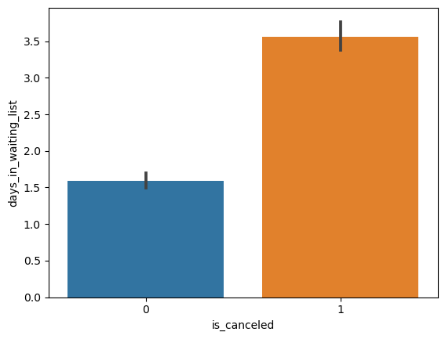
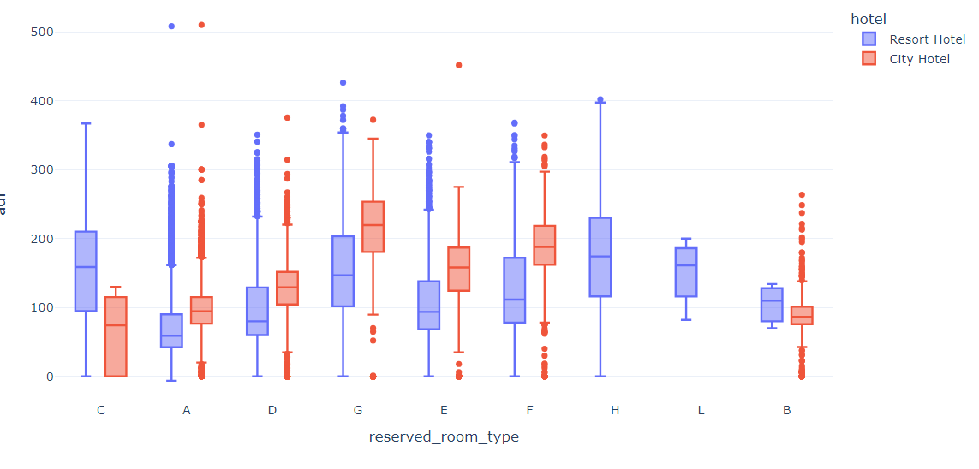
days_in_waiting_list
Observation
More days in waiting list, more chance of cancelling
ADR Vs Reserved room type
Observation:
* The figure shows that the average price per room depends on its type and the standard deviation.

Slide 17

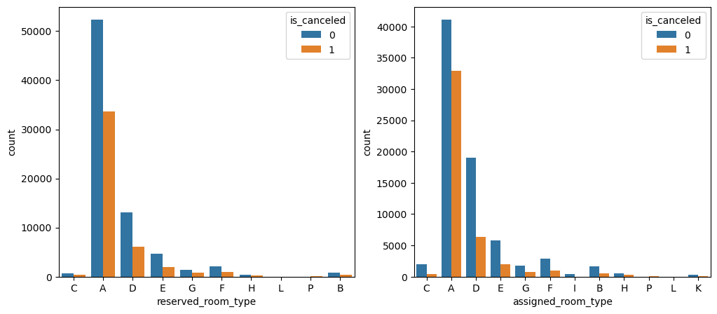
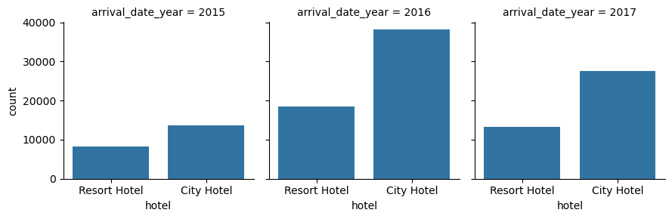
Data Visualization
Room Type
Room Types A,D,E have quite high reservation and assignment status. But as a result, they have high cancellation rate as well. Although one cancellation reason might be the allotment of unwanted room type. Lets check it.
Arrival date year
In all three years city hotels saw more bookings than resort hotels.

Slide 18

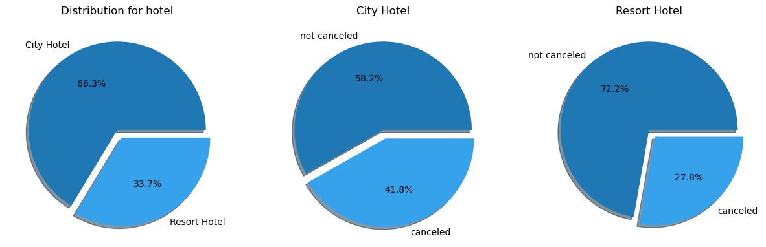
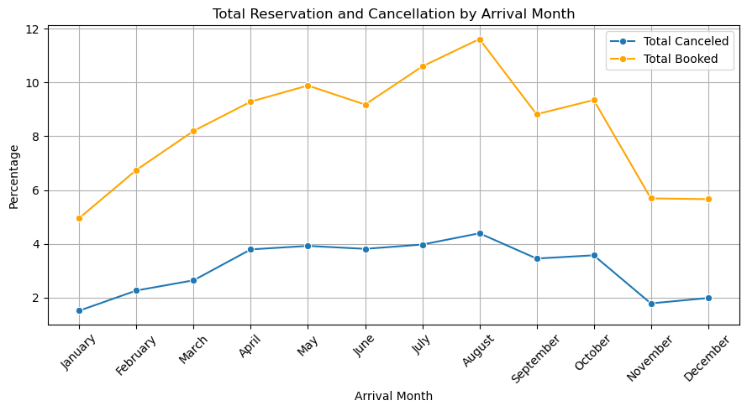
Data Visualization
Hotel Distribution
Number of Percentage of City hotel is greater than Resort Hotel
Cancelation Percentage is more in City Hotel than Resort Hotel.
Cancelation % By Month
August has the highest cancellation rate (4.39%).
January has the lowest cancellation rate (1.51%).

Slide 19

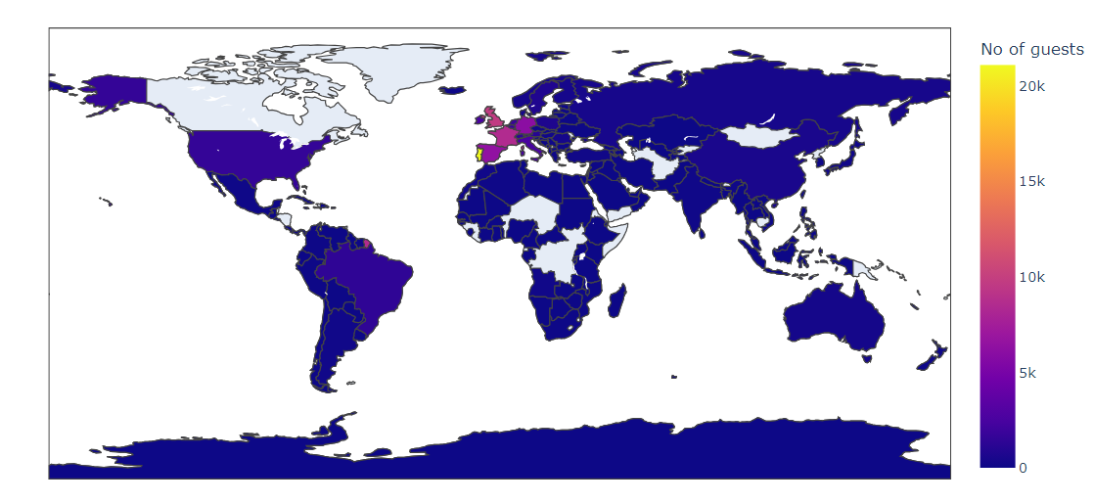
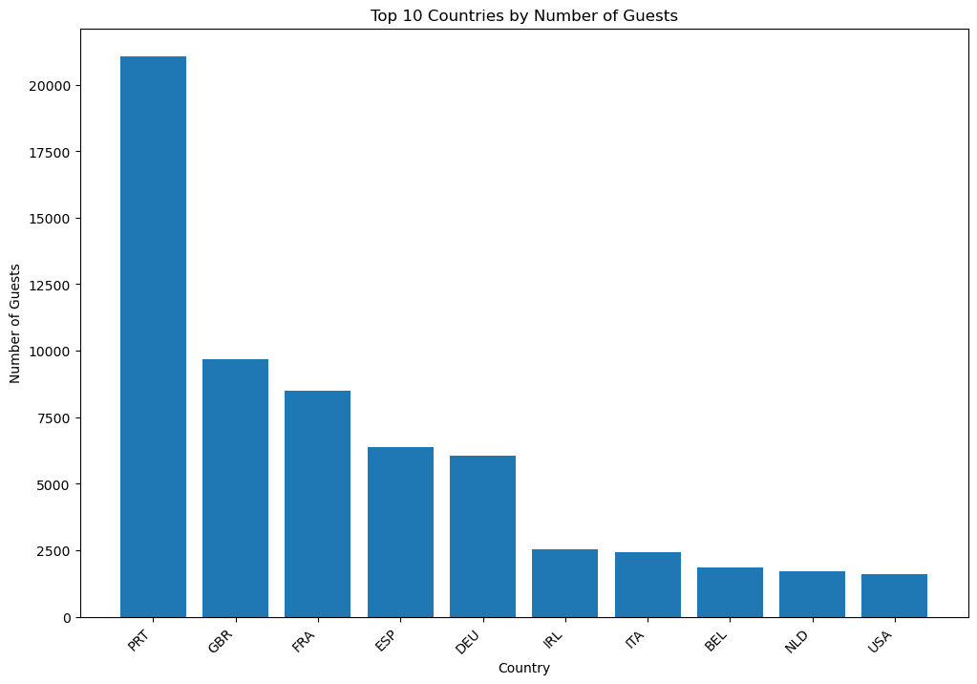
Data Visualization
Country
People from all over the world are staying in these two hotels. Most guests are from Portugal(21071)and other countries in Europe.

Slide 20
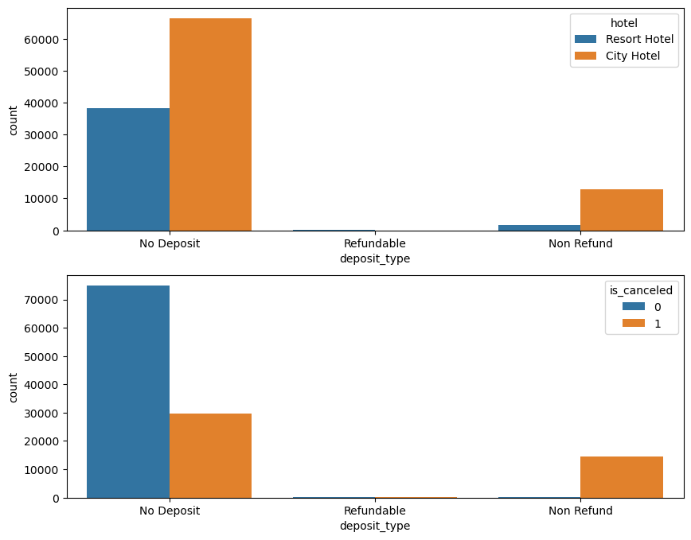
Data Visualization
**Observation**
* Deposit type has 3 categories - No Deposit, refundable, Non Refund
* Either customers have opted for no deposit or non refundable deposits.
* Maybe refundable deposit type is not offered by the hotels.
* All of the non refund bookings have been cancelled in our dataset. That might prove important feature based on how many such bookings are part of cancelled bookings.
* No hotel has refundable deposit type

Slide 21
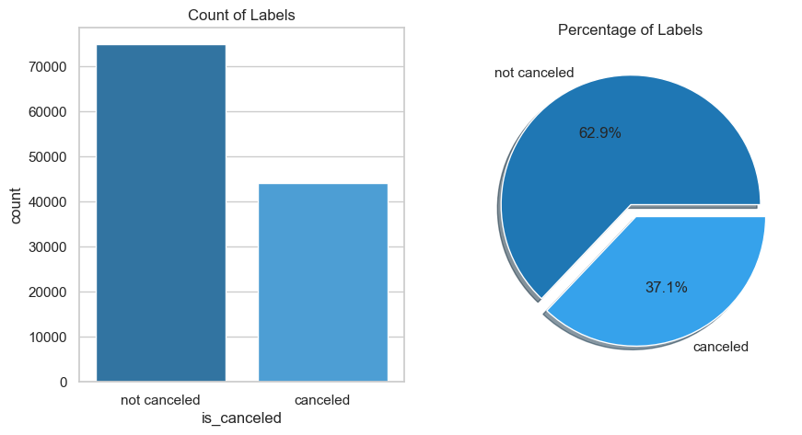
Data Visualization
Observation
The bar plot shows the percentage of cancellations and non-cancellations in the dataset. Approximately 37.1% of the bookings were canceled, and 62.92% were not canceled. This indicates that there is some imbalance in the target variable, but it is not highly imbalanced. Generally, a dataset is considered highly imbalanced if one class represents over 80-90% of the data. In this case, the minority class (canceled) is still well-represented, so it may not be necessary to apply any resampling techniques (e.g., oversampling, undersampling) to balance the classes. However, it is always good to try different approaches and evaluate the model's performance to decide the best approach.

Slide 22
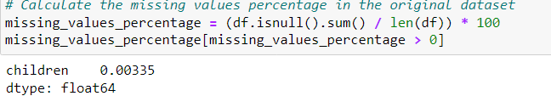
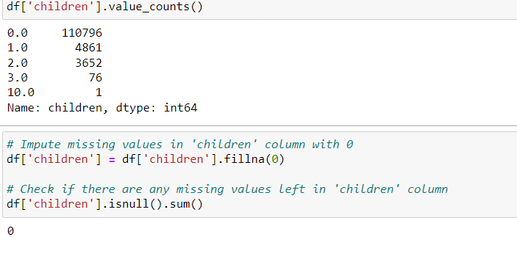
Data Preprocessing
Missing Value Handling
Observations
The children feature has a very low percentage of missing values (0.003350%) and is a numerical feature. Given the distribution of values in the children column, the majority of bookings have 0 children, which is a strong mode. Therefore, it would be reasonable to impute the missing values with 0 (the mode of the column). This approach is simple and will not introduce significant bias:

Slide 23
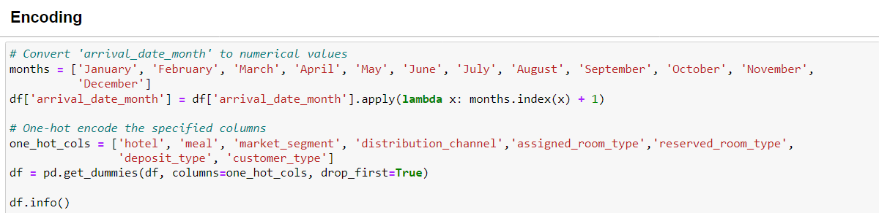
Data Preprocessing

Slide 24
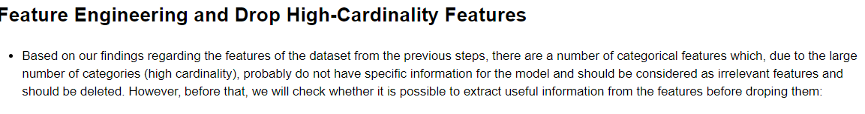
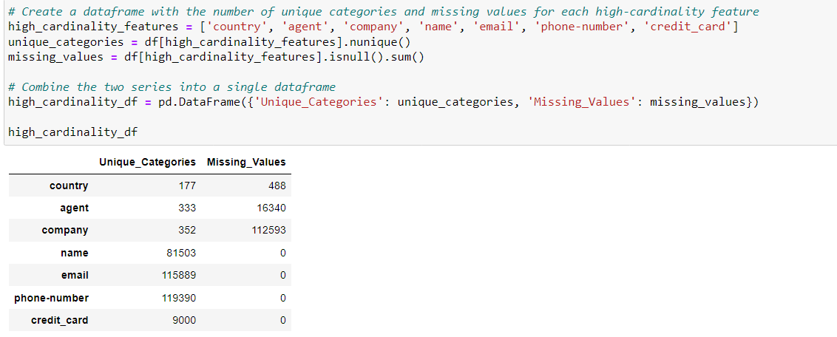
Data Preprocessing

Slide 25
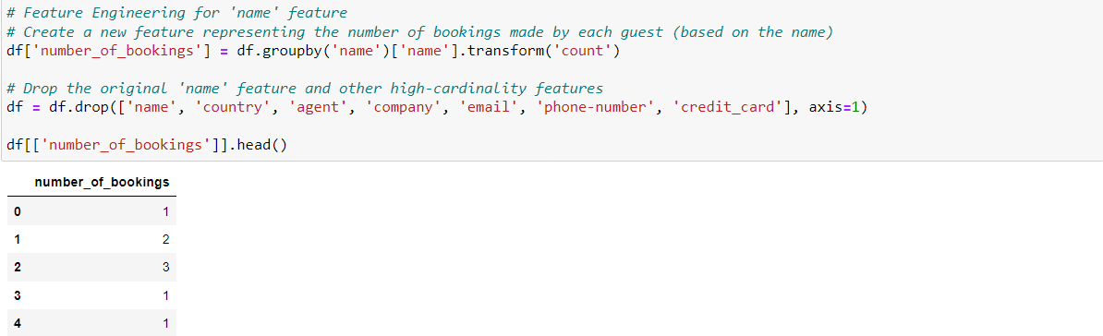
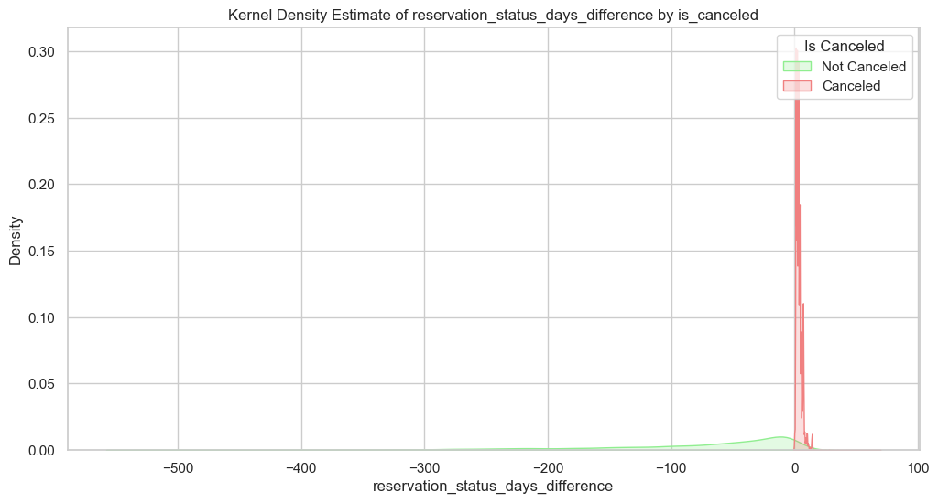
Data Preprocessing
Here we making reservation_status_days_difference
When 'reservation_ status_days_difference' is positive, there were no cancellations (is_canceled = 0).
When 'reservation_status_days_difference' is negative, all instances resulted in cancellations (is_canceled = 1).

Slide 26
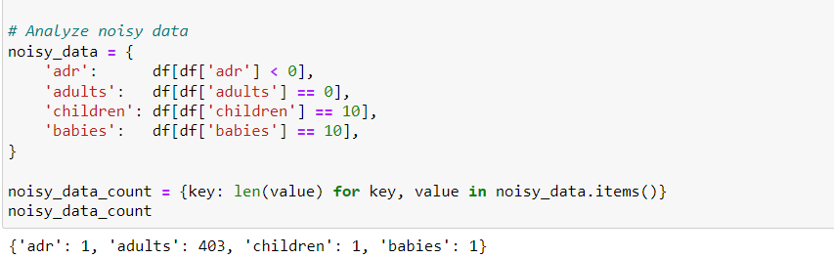
Data Preprocessing
Handle Noisy Data
Observations
We have identified some noisy data in the following features:
adr: There is 1 booking with a negative Average Daily Rate (ADR), which doesn't make sense and indicates a potential error or special case.
adults: There are 403 bookings with 0 adults, which could be a data entry error unless there are legitimate cases where only children or babies book a room.
children: There is 1 booking with 10 children, which seems unusually high for a single booking and could be a potential outlier or data entry error.
babies: There is 1 booking with 10 babies, which seems unusually high for a single booking and could be a potential outlier or data entry error.

Slide 27
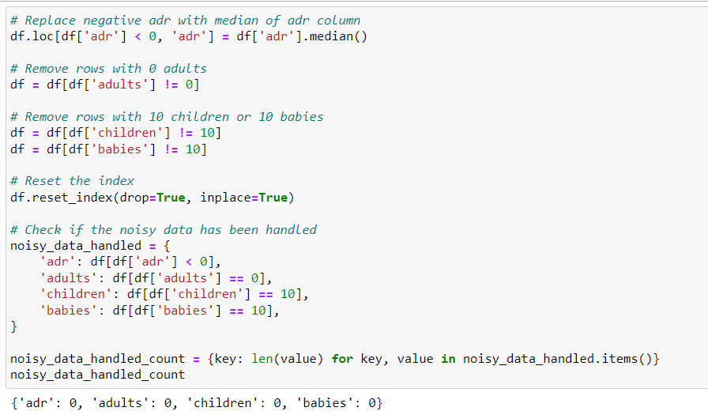
Data Preprocessing
Handle Noisy Data

Slide 28
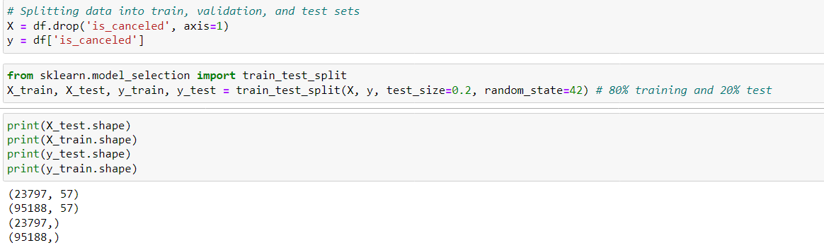
Random Sampling

Slide 29
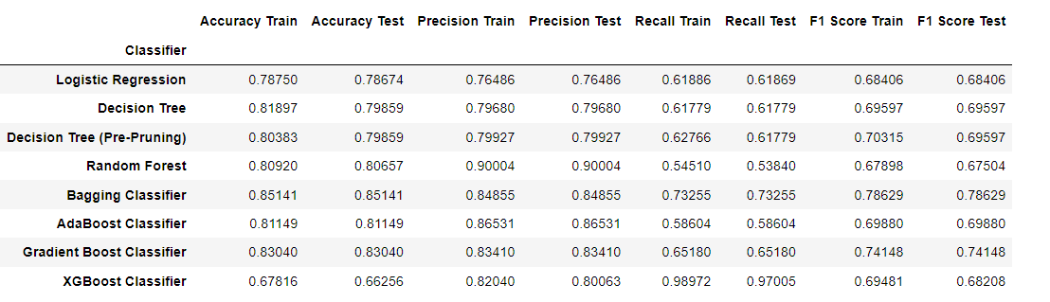
Basic Model Building and Evaluation
Model Choice:
XGBoost Classifier is chosen for hotel booking cancellation prediction due to its superior overall performance. The XGBoost model has found that features related to the deposit type, previous cancellations, car parking requirements, market segment,Lead time and customer type are the most important features for predicting cancellations. This suggests that the financial and logistical aspects, as well as the booking channel and customer category, are particularly important in determining whether a booking will be canceled.

Slide 30
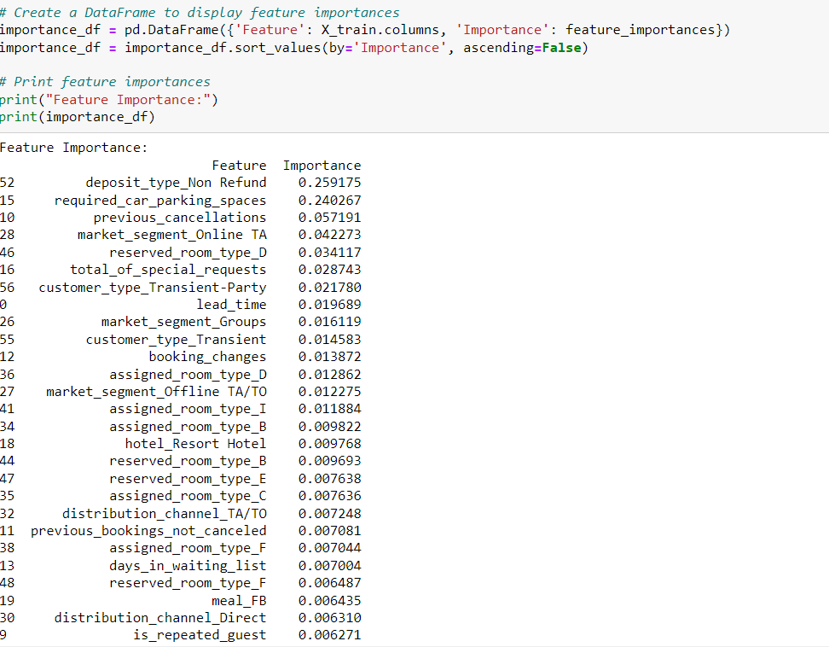
Feature Selection - I

Slide 31
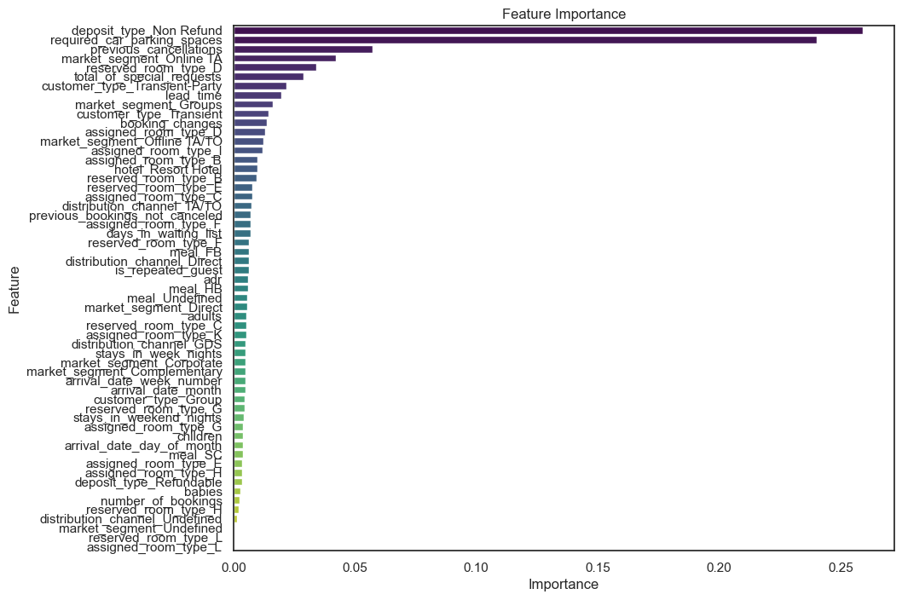
Feature Selection - II
Visualizing Feature Importance XG boost algorithm

Slide 32
Conclusion
The project successfully addressed Features which are responsible for Hotel Booking Cancelation
The visualization observations shed light on Customer Behaviour and Hotel Booking Cancelation.
.
The feature selection step identified key attributes affecting Hotel Booking Cancelation, streamlining the model for better performance.
The comparison out of all model XGBoost Classifier Performed Best.

Slide 33

Thank You

