Slide 1
Introduction
DATA
Methods
Results
Conclusion
INFORMATION FRICTIONS AND ADVERSE SELECTION: POLICY
INTERVENTIONS IN HEALTH INSURANCE MARKETS
Benjamin R. Handel, Jonathan T. Kolstad, and Johannes Spinnewijn
Slides by Artimes Rashidi
ECON 6363: Graduate Public Economics I The University of Texas at Dallas

Slide 2



Introduction
DATA
Methods
Results
Conclusion
Paper authors
Benjamin R. Handel
University of California, Berkeley
Associate Professor
Jonathan T. Kolstad
University of California, Berkeley
Associate Professor
Johannes Spinnewijn
London School of Economics
Associate Professor

Slide 3
Introduction
DATA
Methods
Results
Conclusion
What is the research question?
How do information frictions and adverse selection in insurance markets impact market equilibrium and welfare, and what are the welfare implications of different policy interventions aimed at addressing these frictions, particularly in the presence of insurer risk-adjustment policies?

Slide 4
Introduction
DATA
Methods
Results
Conclusion
Why is it worth asking?
Insurance markets are critical components of healthcare and financial systems.
policymakers can enhance market efficiency and consumer outcomes.
protect consumers from suboptimal choices and affect consumer welfare
policy prescriptions may differ depending on specific market conditions.
Governments are heavily involved in insurance markets and fund social insurance programs directly in the U.S. and many other countries

Slide 5
Introduction
DATA
Methods
Results
Conclusion
What did earlier papers have to say about this
question?
Einav, Finkelstein, and Cullen (2010) find evidence of adverse selection and limited consumer information. They show that consumers tend to choose plans that are not optimal for their individual needs, leading to welfare losses.
Polyakova (2016) importance of understanding the impact of information frictions on consumer plan choices and the effectiveness of policy interventions.
Rothschild and Stiglitz (1976) They show that adverse selection can lead to market unraveling and inefficiency.
Spinnewijn (2017) explores the relationship between heterogeneity, demand for insurance, and adverse selection.
Baicker et al. (2015)distinction between willingness to pay and welfare-relevant valuation in health care purchasing.
Taubinsky and Rees-Jones (2016): This paper explores the role of tax in consumer decision-making.

Slide 6
Introduction
DATA
Methods
Results
Conclusion
What did earlier papers have to say about this
question?
Adverse selection is a big problem for insurance markets in theory (e.g., Akerlof, 1970; Rothschild and Stiglitz, 1976)
Empirical evidence suggests adverse selection exists in some but not all insurance markets (not as big of a problem as we thought)
Advantageous selection also exists (opposite of adverse selection)
This JEP article is based on Cullen, Einav, and Finkelstein (2010)

Slide 7
Introduction
DATA
Methods
Results
Conclusion
What is this paper’s contribution?
theoretical framework that incorporates consumer choice frictions and adverse selection to analyze insurance market equilibrium and welfare.
empirical analysis using data from a large employer to estimate the key microfoundations and measure the impact of different policies. distribution of consumer costs, consumer surplus from risk protection, and the impact of choice frictions on willingness to pay.
the paper highlights the importance of considering both demand-side and supply-side policies in addressing information frictions and adverse selection
effectiveness of friction-reducing policies depends on the distribution of microfoundations and the effectiveness of risk-adjustment transfers.
consider trade-offs and consequences of different policy interventions.
the paper recognizes that the effectiveness of policy interventions may vary across different insurance market environments.
offering insights into the welfare implications of policy interventions in insurance markets.
theoretical models and incorporates empirical evidence to examine the positive and normative implications of friction-reducing policies and risk-adjustment transfers.

Slide 8
Introduction
DATA
Methods
Results
Conclusion
What data are being used in this paper?
The data used in this paper are proprietary data from a large self-insured employer covering more than 35,000 U.S. employees and 105,000 lives overall and families.
health care claims, demographics, and plan choices, cost
AND individually-linked survey data on consumer information
Survey data provides additional information on consumer information and beliefs, allowing for a more comprehensive analysis of choice determinants and preference factors.

Slide 9
Introduction
DATA
Methods
Results
Conclusion
How were they collected?
The data used in this paper were collected through a combination of administrative records and a survey.

Slide 10
Introduction
DATA
Methods
Results
Conclusion
What are the important variables? How are they defined?
insurance coverage and plan choice: This variable represents whether an individual chooses to purchase insurance or not. It is a binary variable, where 1 indicates coverage and 0 indicates no coverage.
Willingness to pay (WTP): This variable measures the maximum amount an individual is willing to pay for insurance. It represents the individual's valuation of the insurance plan.
Frictions: Frictions refer to the information barriers or limitations that individuals face when making insurance plan choices. These frictions can include limited knowledge about available plans, their own risk profiles, or the costs and benefits of different plan options.
Surplus: Surplus represents the net benefit or utility that individuals derive from having insurance coverage. It captures the difference between the value individuals place on the insurance plan and the cost they incur to obtain it.
Costs: Costs refer to the expenses incurred by individuals and insurers in providing and obtaining insurance coverage. These costs can include premiums, deductibles, copayments, and other out-of-pocket expenses.
Risk-adjustment transfers: Risk-adjustment transfers are policy interventions that aim to mitigate adverse selection by compensating insurers based on the underlying risk of the insured pool. These transfers help to equalize the costs and risks faced by insurers and reduce the incentives for adverse selection.

Slide 11
Introduction
DATA
Methods
Results
Conclusion
What is the unit of observation?
The data used in the analysis include detailed administrative data on enrollee health care claims, demographics, and plan choices, as well as survey data linked to the administrative data at the individual level and their families on consumer information and beliefs.

Slide 12
Introduction
DATA
Methods
Results
Conclusion
What is the empirical strategy (method) for answering the research question?
The empirical strategy used in this paper is based on structural estimation and analysis. The authors utilize detailed proprietary data, They apply a structural model to estimate key microfoundations related to frictions, surplus, and costs, and use these estimates to analyze the impact of potential policy interventions on insurance market outcomes and welfare. The empirical analysis involves estimating choice parameters and conducting counterfactual simulations to evaluate the effects of friction-reducing policies and risk-adjustment transfers.
The paper uses a simulated maximum likelihood estimation approach
(a method of estimating the parameters of an assumed probability distribution, given some observed data.)

Slide 13
Introduction
DATA
Methods
Results
Conclusion
What would be the ideal dataset?
The ideal dataset to answer this research question would be a randomized experiment where individuals are randomly assigned to different insurance plans with varying levels of information frictions and adverse selection.
manipulate the level of information provided to participants
detailed information on consumer characteristics, such as age, income, and health risk
design of the insurance plans
presence or absence of certain policy interventions
comprehensive data on individual-level costs, plan choices, and consumer information and consumer preferences, beliefs, and information frictions .
Include a larger sample size of individuals ant not just particular groups.

Slide 14
Introduction
DATA
Methods
Results
Conclusion
What would be the empirical strategy to use on this ideal dataset?
randomized controlled trial (RCT)
difference in difference

Slide 15
Introduction
DATA
Methods
Results
Conclusion
How is this paper's dataset different than the ideal one?
The paper's dataset is based on proprietary data from a large self-insured employer, while the ideal dataset would be a randomized controlled trial
but it would additionally include variables such as the level of information frictions and the degree of adverse selection in each insurance plan
paper's dataset is based on a specific population of employees and dependents at one large firm, which may not be representative of the general population.

Slide 16
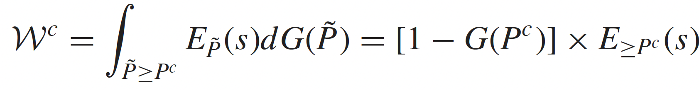
Introduction
DATA
Methods
Results
Conclusion
Theory
Setup
wi = si + ci + fi. (wi: Willingness to pay, si: Surplus from risk protection, ci: The expected cost of providing coverage, fi: Information friction)
si ≡ vi − ci (Surplus from Risk Protection)
vi = wi − fi (welfare-relevant value of the plan)
Demand, Equilibrium, and Welfare
D(P)=1−G(P) (Demand for Insurance, (P) is calculated as the complement of the cumulative distribution function (cdf) of willingness to pay (w))
(Expected Surplus for Marginal Buyers)
Proposition 1. A change in policy x that increases equilibrium
Coverage Q(x) but maintains the ordering increases welfare
if and only if
[P(x) − EP(x)(c)] − EP(x)( f ) ≥ 0.
(marginal surplus at the equilibrium price, interaction between supply and demand frictions)
˜w(α)=w−α×f (˜w(α): Adjusted WTP, α: reduction in demand frictions, f: Demand friction)

Slide 17
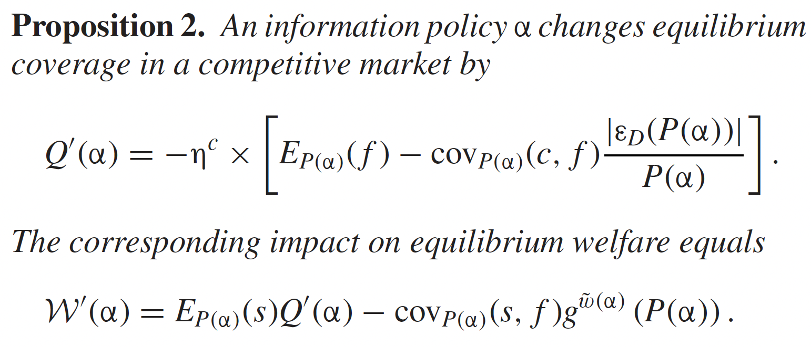
Introduction
DATA
Methods
Results
Conclusion
Theory
All after policy changes
Equilibrium Coverage (Q(α))
how an information policy α changes the equilibrium coverage in the market.
ηc: The impact of α
EP(α)( f ): The marginal friction value after the policy change
Equilibrium Welfare (W(α))
impact of the information policy on equilibrium welfare
EP(α)(s): The marginal surplus (difference between value and cost)
g˜w (α) (P(α)): A function that captures the relationship between welfare and price
˜ ci (β) = ci − β * [ci − Ec]
Expected Cost with Risk Adjustment (˜ ci(β))
β: A parameter that controls the degree of risk adjustment(β = 1 full risk adjustment)
ci: The individual's true cost (related to their health risk)
Ec: The expected (average) cost in the entire pool of insured individuals

Slide 18
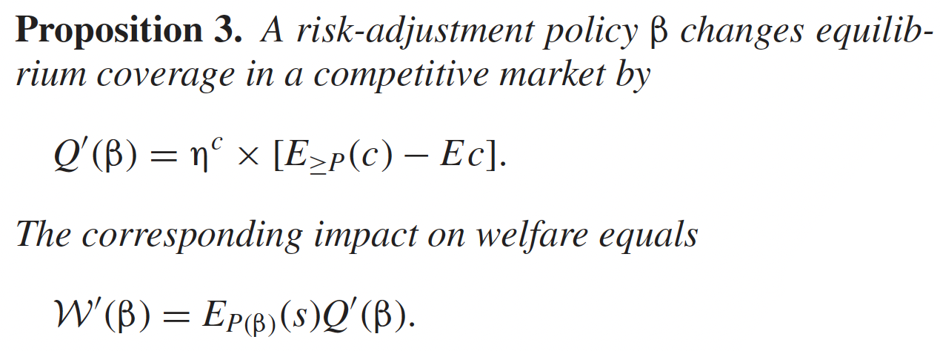
Introduction
DATA
Methods
Results
Conclusion
Theory
Impact of Risk-Adjustment on Equilibrium Coverage (Q(β))
ηc: A parameter representing the effect of risk adjustment on coverage
E≥P(c): The expected cost of individuals who are willing to buy insurance
Ec: The expected average cost (entire)
Impact of Risk-Adjustment on Welfare (W(β))
EP(β)(s): The surplus among the marginal buyers under the risk-adjustment policy β
Information policies can enhance the effectiveness of risk-adjustment transfers and increase their
impact on welfare. Conversely, risk-adjustment policies can help mitigate the adverse selection
consequences of information policies by preventing a significant increase in the equilibrium price.

Slide 19
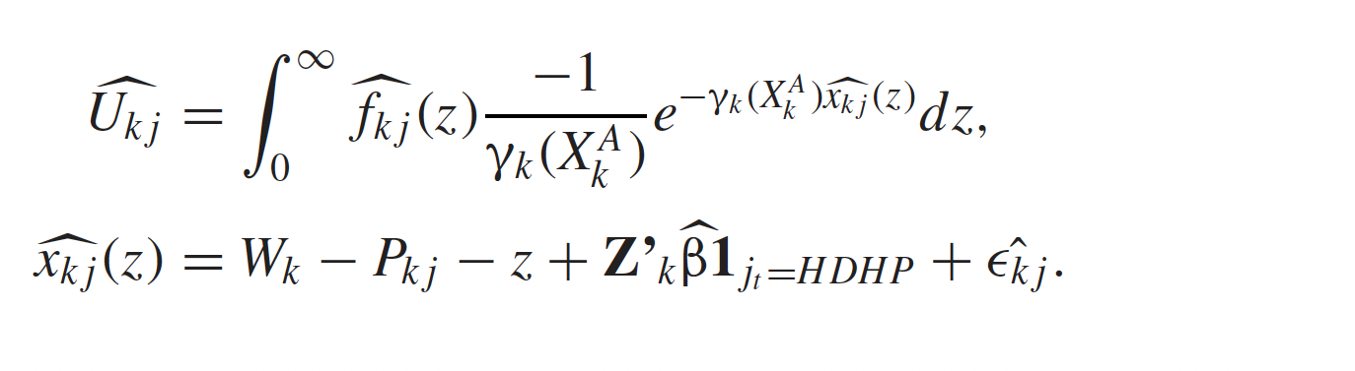
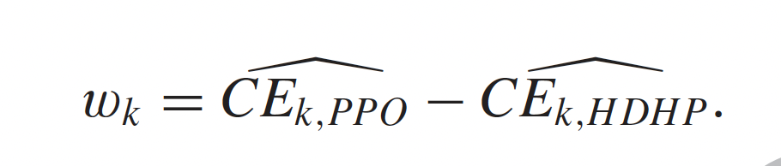
Introduction
DATA
Methods
Results
Conclusion
Theory
Ukj denotes consumers’ constant absolute risk aversion(CARA) utility
Xkj denotes observed heterogeneity (e.g., in age and income) for each family k
γ denotes the family specific CARA risk-aversion coefficient
The vector Z represents various information frictions
2 plan: PPO option with no cost sharing
high-deductible health plan (HDHP)
define the willingness to pay for the PPO, relative to the HDHP
CEk, j is the certain financial payment that gives family k utility Uk j

Slide 20
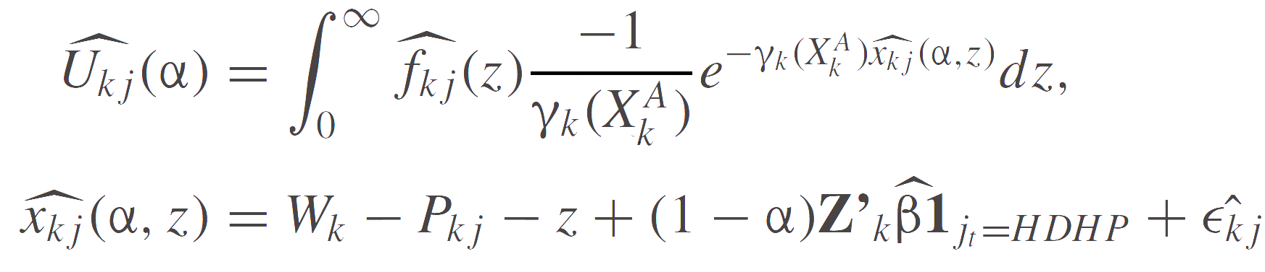
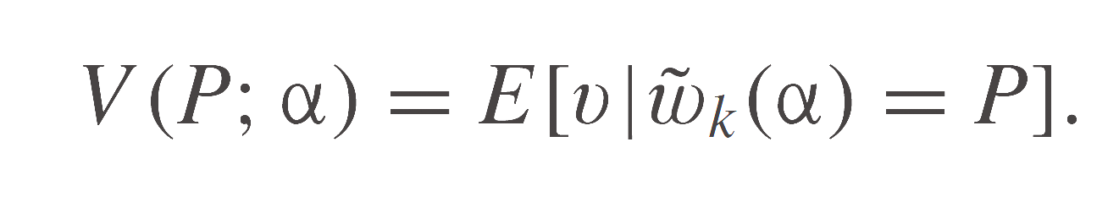
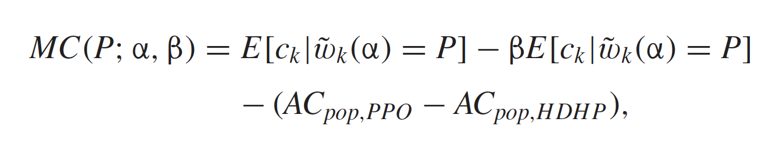
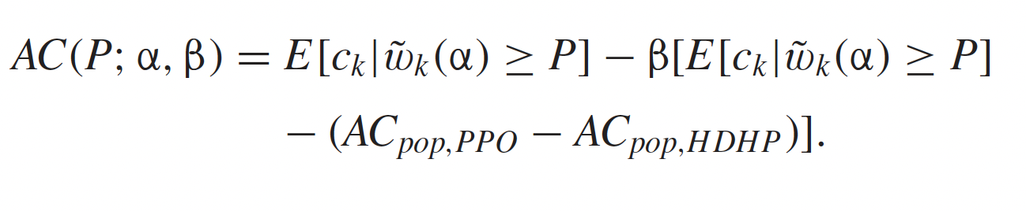
Introduction
DATA
Methods
Results
Conclusion
Empirical Method
consumer willingness to pay for each plan j given a specific information friction reduction policy α is
when α = 0, all information frictions are present and consumer demand is composed of estimated willingness to pay for each plan in our given environment.

Slide 21
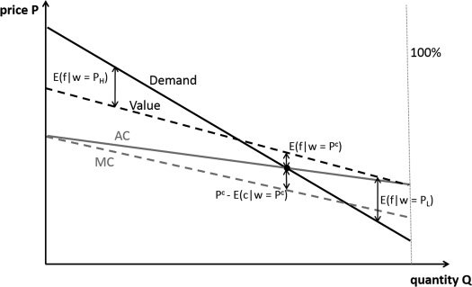
Introduction
DATA
Methods
Results
Conclusion
DEMAND, VALUE, AND COST CURVES IN AN ADVERSELY SELECTED
MARKET WITH HETEROGENEOUS FRICTIONS
The vertical difference between the value curve and the marginal cost curve for a given level of market coverage equals the expected surplus for the marginal buyers
Total welfare corresponds to the difference between the value curve and the marginal cost curve for all individuals buying insurance
*uniform friction. *heterogeneous demand frictions(higher willingness➔ over estimate

Slide 22
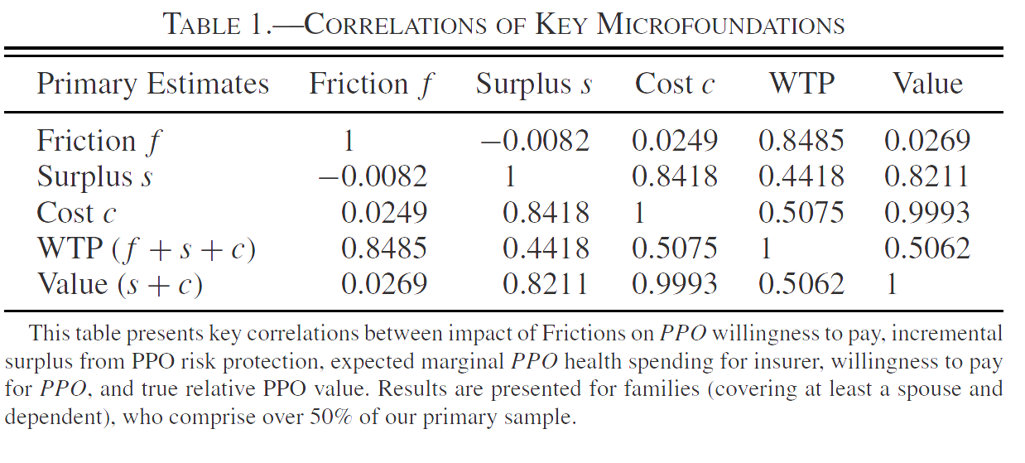
Introduction
DATA
Methods
Results
Conclusion
Table 1
Frictions and WTP information frictions significantly influence consumers' WTP for the PPO plan. when consumers face informational barriers, they may be willing to pay more for a plan due to uncertainties or lack of knowledge about their choices.
Surplus and C&V These correlations suggest that consumers with a strong preference for risk protection are more likely to choose the PPO
Cost and True Value consumers are sensitive to the cost-benefit ratio of insurance

Slide 23
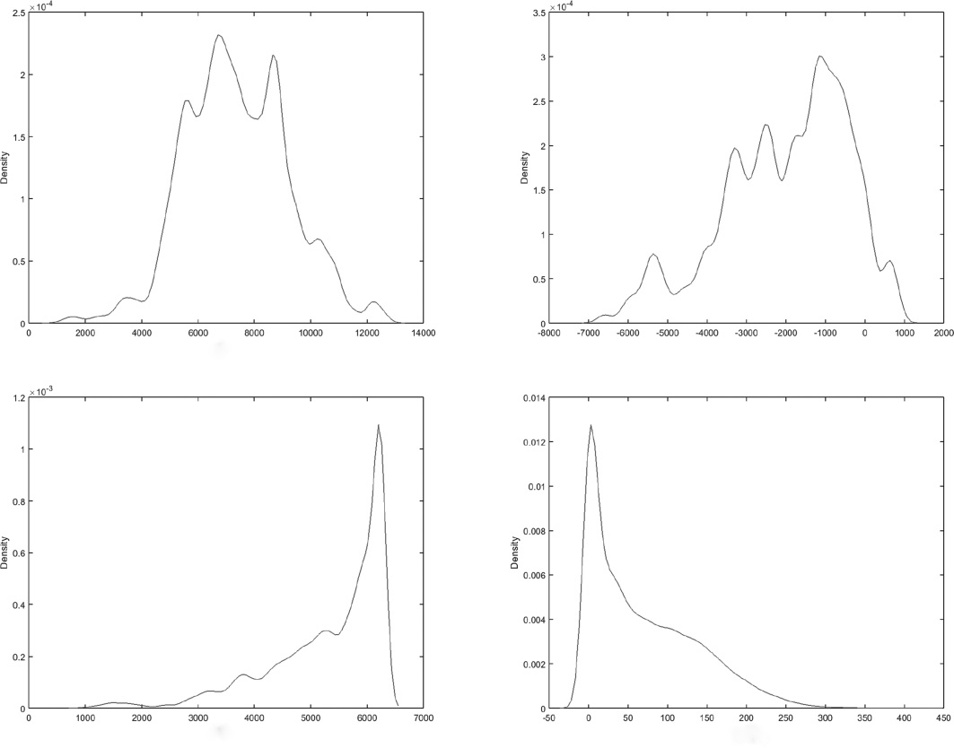
Introduction
DATA
Methods
Results
Conclusion
Figures
(a)Consumer Willingness to Pay for the PPO relative to the HDHP
This subplot shows the distribution of consumer willingness to pay for the PPO compared to the HDHP. It reveals the variation in how much consumers are willing to pay for the PPO plan relative to the HDHP.
(b) Total Impact of Frictions on Willingness to Pay for the HDHP relative to the PPO:This subplot displays the distribution of the total impact of information frictions on consumer willingness to pay for the HDHP in comparison to the PPO. It shows how frictions affect consumer preferences.
(c) Expected Supplemental Insurer Costs from the PPO relative to the HDHP:
This subplot illustrates the distribution of expected costs for insurers providing supplemental coverage in the PPO compared to the HDHP. It accounts for the additional costs associated with the PPO plan.
(d) Surplus from Risk Protection for the PPO relative to the HDHP:
This subplot represents the distribution of surplus that consumers derive from risk protection offered by the PPO relative to the HDHP. It indicates how much additional value consumers gain from the PPO plan in terms of risk protection.

Slide 24
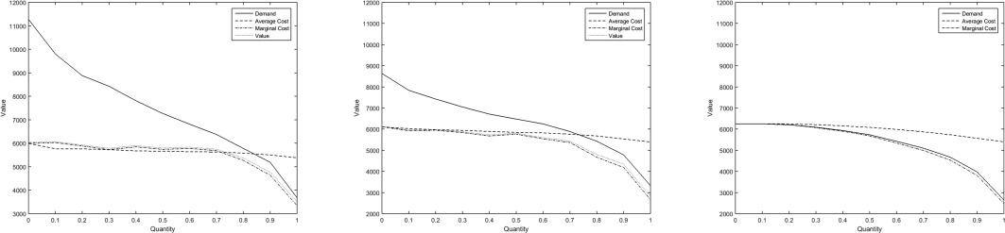
Introduction
DATA
Methods
Results
Conclusion
Figures
MARKET EQUILIBRIUM WITH VARYING LEVELS OF INFORMATION FRICTONS
(Left) Market equilibrium, including information frictions. (Middle) Market equilibrium with partial information frictions (α = 0.5). (Right) Market equilibrium without information frictions.
α = 0, consumers face significant barriers, demand curve consumers are willing to purchase PPO rather HDHP
value curve consumers' true WTP
average cost curve flat slope indicates limited adverse selection because marginal enrollee costs are not different other enrollees
Surplus between value & average cost, surplus small
α = 0.5, demand curve shift downward, fewer PPO, value curve unchanged since true preferences but reduction in information frictions smaller gap b.w demand and value
The average cost flat slope, indicating limited adverse selection.
α = 1, no information frictions, demand curve and value curve are identical, average cost curve steeper, reflecting increased adverse selection. marginal costs coor with demand healthier more likely HDHP, small percentage buy the PPO

Slide 25
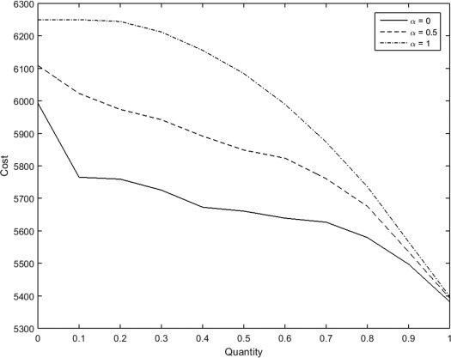
Introduction
DATA
Methods
Results
Conclusion
Figures
AVERAGE COST CURVES WITH VARYING LEVELS OF INFORMATION FRICTIONS
correlation between consumer costs and consumer demand as information frictions change, When information frictions are high α = 0, flatter, presence of significant information frictions, marginal costs of PPO not different from other ➔ limited adverse selection
stronger correlation between consumer costs and consumer demand as frictions decrease. In other words, healthier individuals are more likely to choose certain plans, resulting in increased adverse selection.
When all information frictions are eliminated α = 1, high degree of correlation between consumer costs and consumer demand. adverse selection is higher, and the average cost of enrolling consumers in the PPO plan is significantly higher.

Slide 26
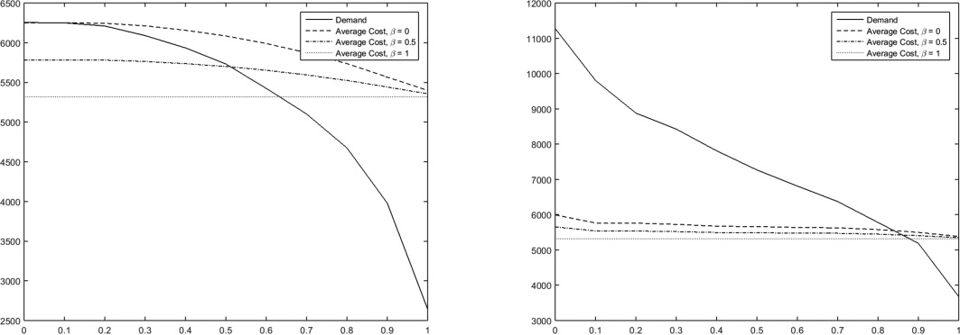
Introduction
DATA
Methods
Results
Conclusion
Figures
MARKET EQUILIBRIUM WITH VARYING LEVELS OF RISK ADJUSTMENT (Left) Market equilibrium with three levels of β, for α = 1. (Right) Market equilibrium with three levels of β, for α = 0.
information frictions are fully removed α=1, As risk adjustment (β) becomes more effective, the market share of the PPO plan increases. This indicates that stronger risk adjustment policies lead to more individuals choosing the PPO plan.
risk adjustment improves, the relative premiums for the PPO plan decrease. In other words, the PPO plan becomes more affordable compared to the HDHP plan.
effect of risk adjustment is weaker in this case compared to when information frictions are fully removed (α = 1). This is because the observed environment already has some degree of adverse selection due to information frictions, making the impact of risk adjustment less pronounced.
__________________________________
Stronger risk adjustment is more effective at reducing adverse selection when information frictions are fully removed.

Slide 27
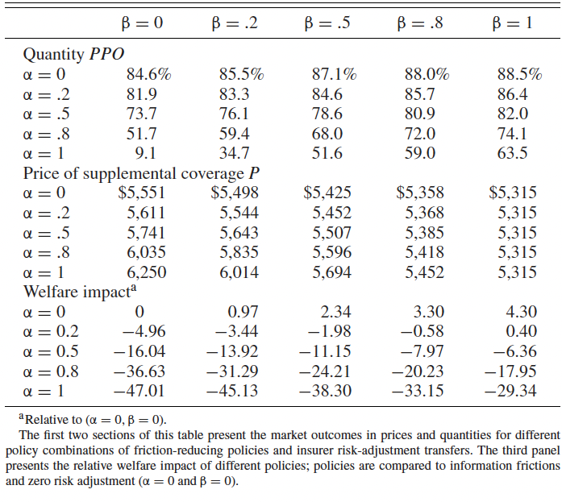
Introduction
DATA
Methods
Results
Conclusion
Table

Slide 28
Introduction
DATA
Methods
Results
Conclusion
How does identification work?
In the simplest case where there are two people and one is exposed to a policy change.
The two people should be similar in all characteristics except for the exposure to the policy change so the policy change should be exogenous this means that the policy change should only affect the exposed person and not the other one.

Slide 29
Introduction
DATA
Methods
Results
Conclusion
What are the sources of exogenous variation?
the presence of choice frictions and information asymmetry in health insurance markets
Random variation in individuals' exposure to information frictions
Random variation in individuals' health risk profiles
Moral Hazard
Random variation in individuals' plan choices.

Slide 30
Introduction
DATA
Methods
Results
Conclusion
What are the main results?
It suggests that reducing consumer choice frictions can have both positive and negative impacts on welfare, depending on the specific market environment and the effectiveness of complementary supply side policies such as insurer risk-adjustment transfers.
It suggests that risk adjustment transfers can mitigate adverse selection and enhance welfare in health insurance markets.
It finds that the mean impact of frictions on willingness to pay is high, pushing consumers towards more generous coverage. However, the variance in these friction values is also substantial.
It suggests that lower cost consumers may not have high enough true surplus to justify the purchase of incremental insurance when frictions are reduced.
It finds that removing frictions completely leads to the market fully unraveling, while the policy that eliminates frictions reduces the share of first best surplus achieved. However, risk adjustment transfers are shown to be strongly complementary to friction reducing policies.

Slide 31
Introduction
DATA
Methods
Results
Conclusion
What are some alternative explanations for the results?
Market Structure
Consumer Moral Hazard
Unobserved heterogeneity: unobserved differences in individuals like income, education and ….., that are driving the observed differences in insurance market outcomes.
Selection bias: The sample used in the analysis may suffer from selection bias

Slide 32
Introduction
DATA
Methods
Results
Conclusion
Does the author test for alternative explanations?
The document does not explicitly mention whether the author tests for alternative explanations. However, the paper acknowledges that its framework contains stylized assumptions that could affect the conclusions

Slide 33
Introduction
DATA
Methods
Results
Conclusion
What new questions arise from the paper?
further research to explore the implications of different microfoundations and policy
Impact of Imperfect Competition
the relationship between the extent of competition, consumer information, and the effectiveness of risk adjustment policies.
Incorporating Consumer Moral Hazard
Generalizability to Different Contexts(other insurance markets)

Slide 34
Introduction
DATA
Methods
Results
Conclusion
What are the policy implications of the results?
Policymakers should consider the implications of imperfect competition, such as market power or strategic behavior by insurers, when designing and implementing policy interventions.
friction-reducing policies, such as information provision, plan recommendations, or smart defaults, should be considered alongside effective risk-adjustment transfers.
Policymakers should tailor policy interventions based on the distribution of consumer surplus, costs, and the impact of frictions on willingness to pay in the specific insurance market environment. The effectiveness of policies to reduce information frictions should be approached with caution, especially in cases where insurer risk-adjustment policies are not highly effective. In such situations, policymakers may need to be more conservative in implementing friction-reduction policies, particularly if the mean and variance of costs are high relative to consumer surplus.
coordination between demand-side interventions (friction-reducing policies) and supply-side policies (risk-adjustment transfers).

Slide 35
Introduction
DATA
Methods
Results
Conclusion
Do you buy the main conclusions of the paper?
The conclusions suggest that friction-reducing policies alone may not lead to welfare improvements in insurance markets, and that risk-adjustment transfers should be implemented as a complementary supply-side policy to mitigate adverse selection.
since the market was perfect competition, It is also important to note that the conclusions are specific to the context and assumptions of the paper and may not necessarily apply universally to all insurance markets or policy environments.
so it is logical that in each situation, consider different aspects and consequences of policy intervention

Slide 36
Introduction
DATA
Methods
Results
Conclusion
Conclusion
the paper appears to provide a comprehensive analysis of the impact of information frictions and adverse selection in health insurance markets, as well as the effectiveness of different policy interventions. It combines theoretical modeling with empirical analysis using real-world data. The paper also highlights the importance of considering both demand-side and supply-side policies in order to improve market outcomes and welfare. The paper provides insights for policymakers.

