Slide 1
Skoltech
Education for Innovation
Nigmatzyanov Artur
High Performance Image processing in Computer Tomography
Notes:
We have been operating under a strategy, we believe in it, and it has served us well
It led to the operations plan, which you approved in October
Drafted when much of context and stakeholder expectations were less well known, and when we had no little operational experience
Therefore time to update:
fold in stakeholder expectations (3 studies)
learning from past 18 months
benchmarking of peer programs (about 8 – alto, Imperial, ETH, EPFL, HKUST, SUTD,
, Stanford)
Process was kicked off in March, internally run, with cycles throughout team, mit and foundation,
Now a converged draft, but important to get your input and thoughts
Intentionally long, because this is how academics communicate, and a shorter concise version will be created
Three outcomes : strategy as allocation of resources and guidance for organization; project to gov; and communication plan to stakeholders

Slide 2
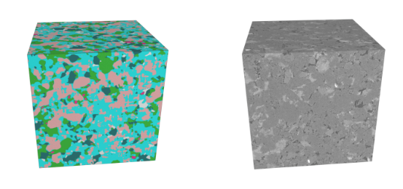
CT images combined into voxels representation

Slide 3
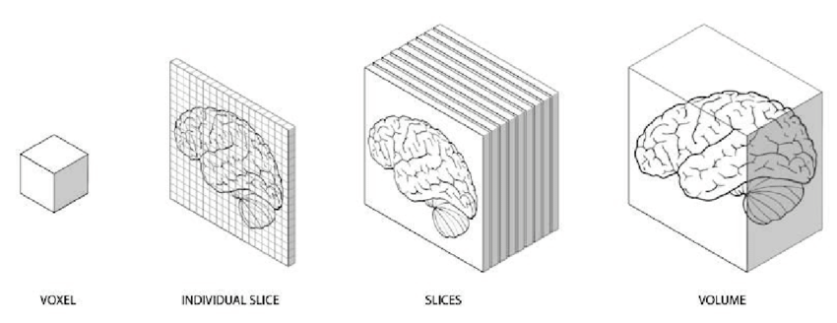
Voxel idea

Slide 4




Big data image processing

Slide 5
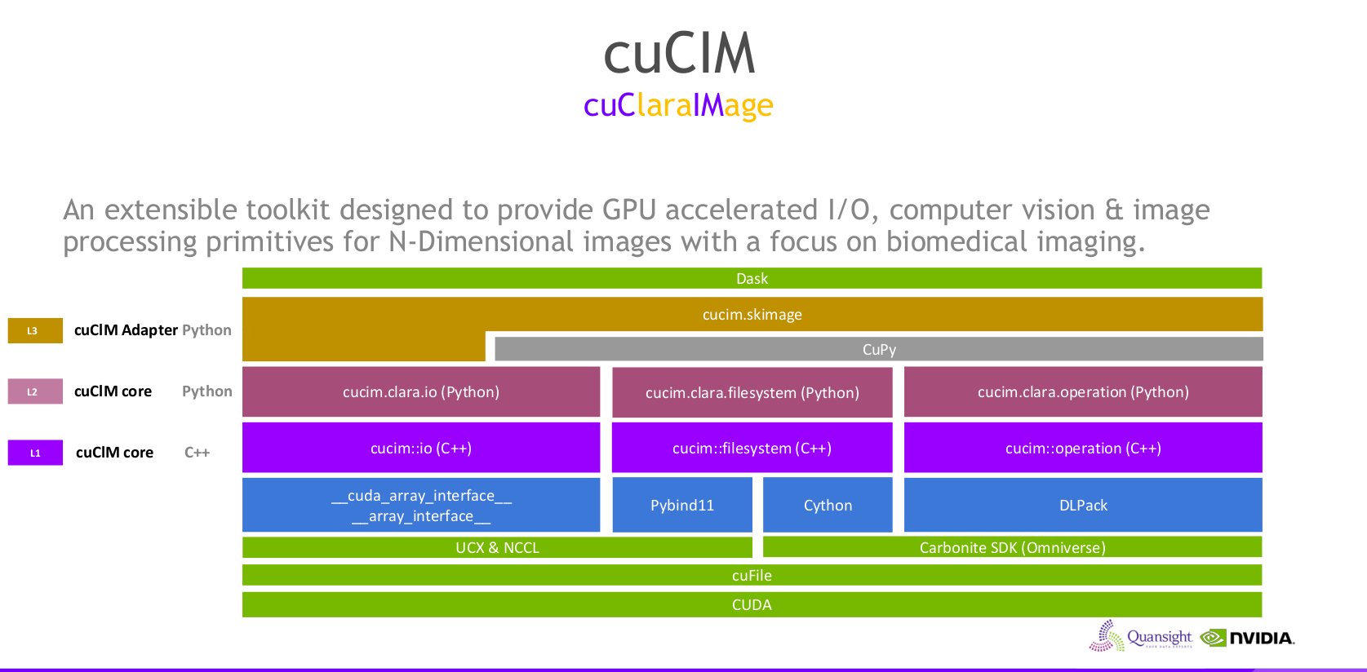
Cucim library by Nvidia

Slide 6
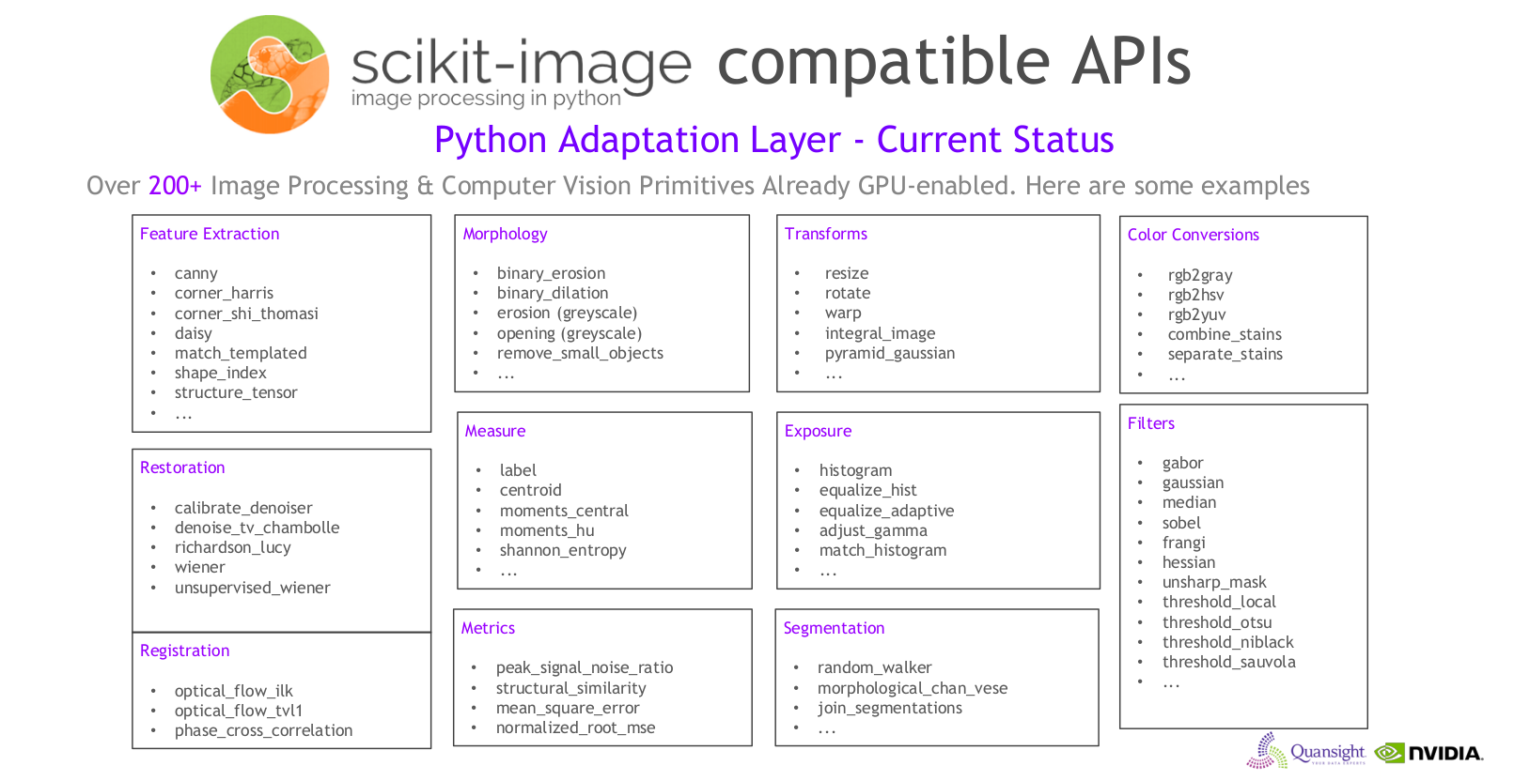

Slide 7
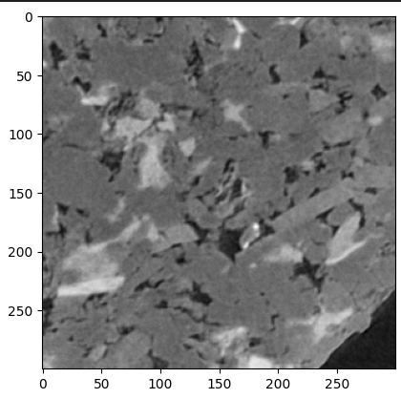
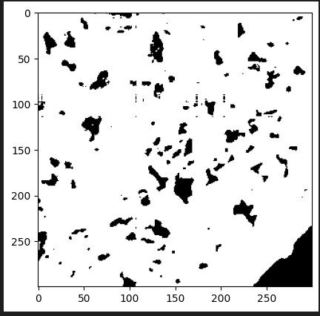
Distributed segmentation on several gpus

