Slide 1


Summer Internship Training
Deogiri Institute of Engineering and Management Studies, Aurangabad
Department of Computer Science and Engineering
MSPM’s
on
Cloud Services
Name: Arti Mule
Roll No: 36036
1
19/1/2021

Slide 2
2
WEEK 1:

Slide 3
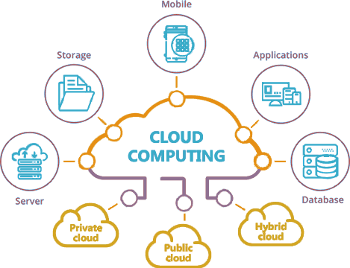
Introduction
3
Cloud Computing:
Cloud computing is the on-demand delivery of IT resources over the internet with pay-as-you go pricing. Instead of buying , owning, and maintaining physical data centers and servers, you can access technology services, such as computing power, storage, and database, on an as needed basis from a cloud provider like Amazon Web Services(AWS)

Slide 4
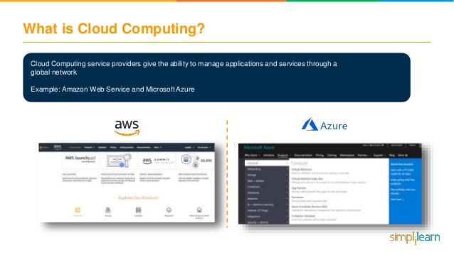
4

Slide 5
Benefits of Cloud computing
5
Hosted and maintained by the provider.
Self-service through a web interface.
Pay for use.
Near-limitless scalability

Slide 6
Types of Cloud Computing Services:
Infrastructure as a Service (IaaS)
Platform as a Service (PaaS)
Software as a Service (SaaS).

Slide 7
Infrastructure as a Service (IaaS)
IaaS contains the basic building blocks for cloud IT. It typically provides access to networking features, computers (virtual or on dedicated hardware), and data storage space. IaaS gives you the highest level of flexibility and management control over your IT resources. It is most similar to the existing IT resources with which many IT departments and developers are familiar.

Slide 8
Platform as a Service (PaaS)
PaaS removes the need for you to manage underlying infrastructure (usually hardware and operating systems), and allows you to focus on the deployment and management of your applications. This helps you be more efficient as you don’t need to worry about resource procurement, capacity planning, software maintenance, patching, or any of the other undifferentiated heavy lifting involved in running your application.

Slide 9
Software as a Service (SaaS)
SaaS provides you with a complete product that is run and managed by the service provider. In most cases, people referring to SaaS are referring to end-user applications (such as web-based email). With a SaaS offering, you don’t have to think about how the service is maintained or how the underlying infrastructure is managed. You only need to think about how you will use that particular software.

Slide 10
WEEK 2:

Slide 11
Create a network interface
11
Open the Amazon EC2 console at https://console.aws.amazon.com/ec2/.
In the navigation pane, choose Network Interfaces.
Choose Create Network Interface.
For Description, enter a descriptive name.
For Subnet, select the subnet.
For Private IP (or IPv4 Private IP), enter the primary private IPv4 address. If you don't specify an IPv4 address, we select an available private IPv4 address from within the selected subnet.
(IPv6 only) If you selected a subnet that has an associated IPv6 CIDR block, you can optionally specify an IPv6 address in the IPv6 IP field.
To create an Elastic Fabric Adapter, select Elastic Fabric Adapter.
For Security groups, select one or more security groups.
(Optional) Choose Add Tag and enter a tag key and a tag value.
Choose Yes, Create.

Slide 12
Manage IP addresses
12
Elastic IP addresses (one per private IPv4 address)
IPv4 addresses
IPv6 addresses

Slide 13
To manage the Elastic IP addresses of a network interface using the console:
13
Open the Amazon EC2 console at https://console.aws.amazon.com/ec2/.
In the navigation pane, choose Network Interfaces.
Select the network interface.
To associate an Elastic IP address, do the following:
Choose Actions, Associate Address.
For Address, select the Elastic IP address.
For Associate to private IP address, select the private IPv4 address to associate with the Elastic IP address.
Choose Allow reassociation to allow the Elastic IP address to be associated with the specified network interface if it's currently associated with another instance or network interface, and then choose Associate Address.

Slide 14
To manage the IPv4 and IPv6 addresses of a network interface using the console:
14
Open the Amazon EC2 console at https://console.aws.amazon.com/ec2/.
In the navigation pane, choose Network Interfaces.
Select the network interface.
Choose Actions, Manage IP Addresses.
For IPv4 Addresses, modify the IP addresses as needed. To assign an IPv4 address, choose Assign new IP and then specify an IPv4 address from the subnet range or let AWS choose one for you. To unassign an IPv4 address, choose Unassign next to the address.
For IPv6 Addresses, modify the IP addresses as needed. To assign an IPv6 address, choose Assign new IP and then specify an IPv6 address from the subnet range or let AWS choose one for you. To unassign an IPv6 address, choose Unassign next to the address.
Choose Yes, Update.

Slide 15
WEEK 3:

Slide 16
How to Launch one T2 micro type windows server instance on AWS. Configure an IIS server with default web page:
Open the AWS EC2 Management Console
Click Launch Instance
Choose an instance type (t2 micro-free-tire eligible)
Select an Configure Instance Details you may be keep default or change it yours choice and click on Next: Add Storage
Keep the default Storage and click on Next: Add tags.
Keep default Security Group and click on Review and Launch.
Then Launch Instance by clicking Launch.

Slide 17
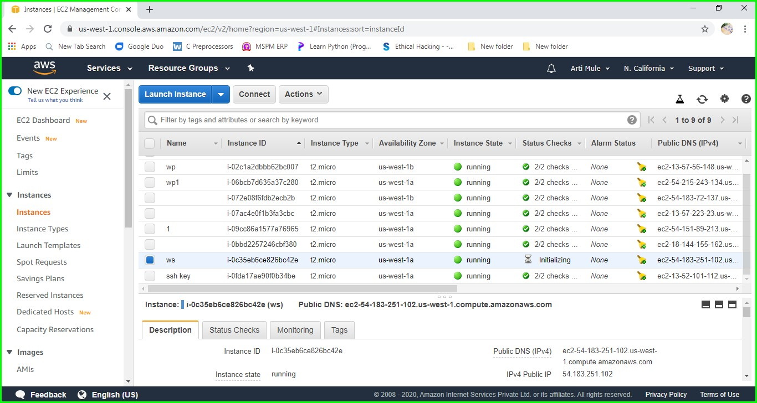
Then we will see this window, now open the Remote Desktop with the IPV4 Public IP of Instance then enter Username and Password. (We will get this Username and Password by Clicking Connect).

Slide 18
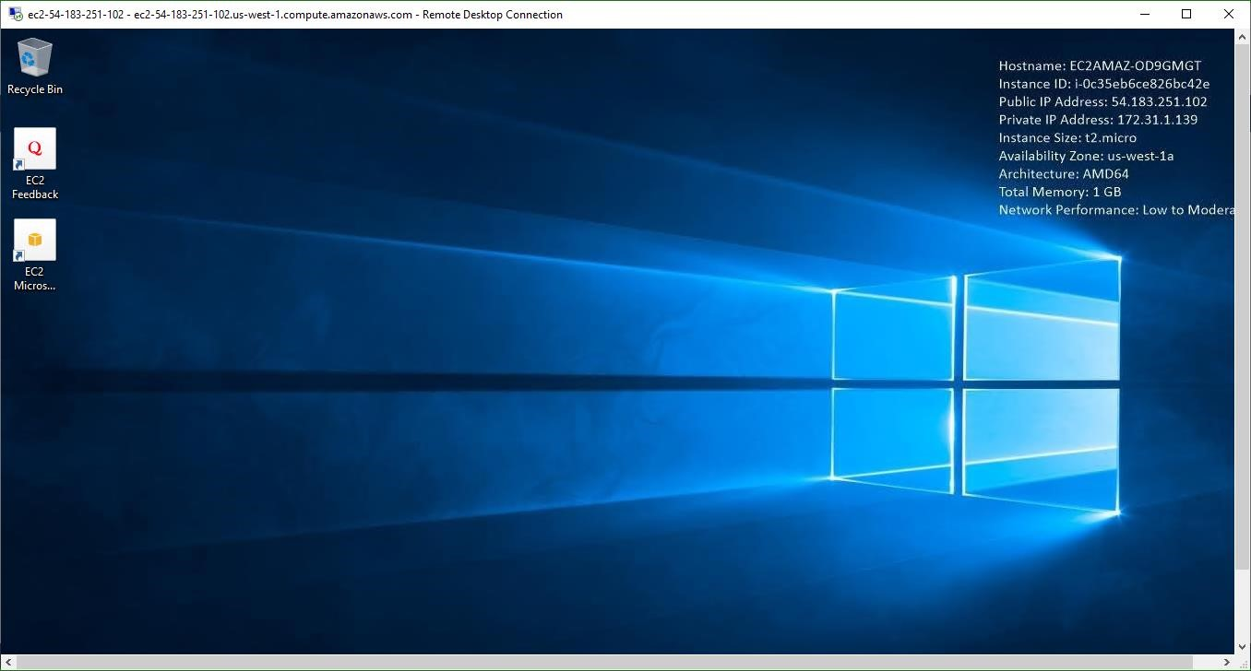
Once we have entered the username and password our remote desktop will start and the below screen will be appear.

Slide 19
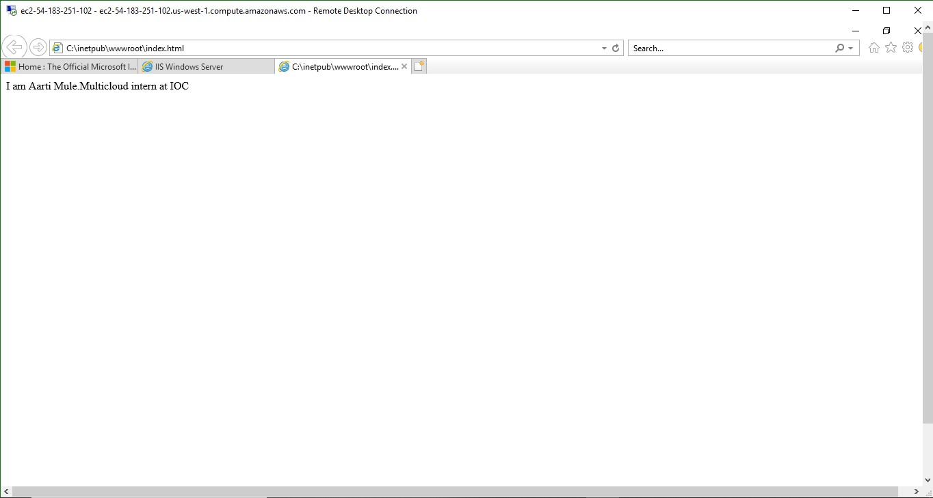
Now go to Sever Manager and Click Add role and Features then create web page and Save it at location c:/inetpub/wwwroot as index.html.

Slide 20
WEEK 4:

Slide 21
Google Cloud Platform:
Google Cloud Platform (GCP), offered by Google, is a suite of cloud computing services that runs on the same infrastructure that Google uses internally for its end-user products, such as Google Search, Gmail and YouTube. Alongside a set of management tools, it provides a series of modular cloud services including computing, data storage data analytics and machine learning.

Slide 22
Compute:
App Engine
Compute Engine
Kubernetes Engine
Cloud Functions
Cloud Storage
Cloud SQL
Cloud Big table
Machine learning:
Cloud AutoML
Cloud Machine Learning Engine
Cloud Translation API
Cloud Vision API
Cloud Video Intelligence

Slide 23
Storage:
Cloud Storage
Cloud SQL
Cloud Bigtable
Cloud Spanner
Cloud Datastore
Persistent Disk
Cloud MemoryStore
Local SSD
Filestore

Slide 24
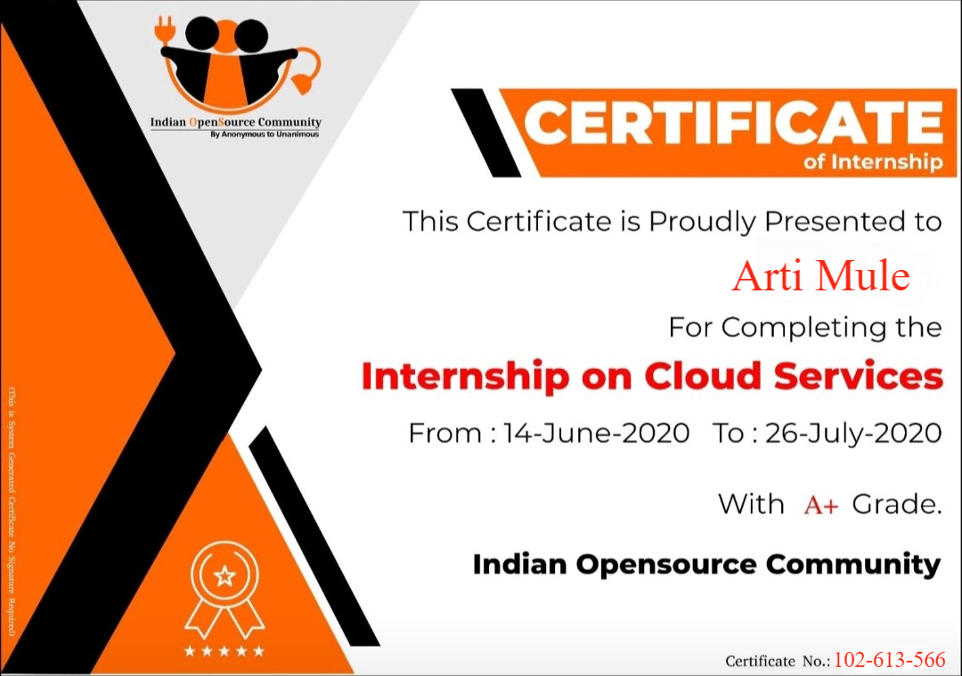

Slide 25
Thank you!!!

