Slide 1
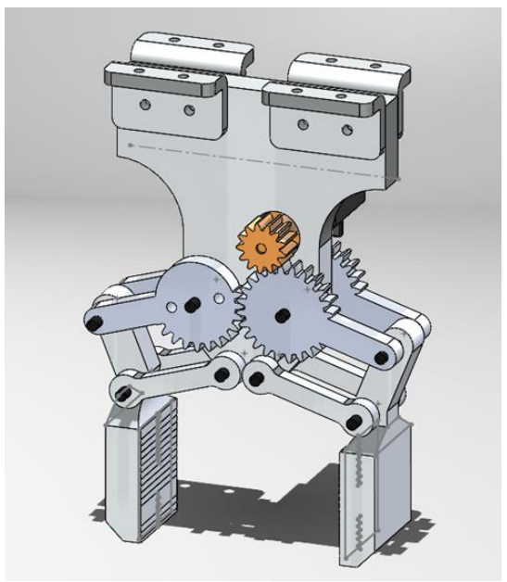
Gripper Mechanism
Our robotic gripper's mechanism is based on a four-gear transmission system that converts the rotational movement of a servo motor into a controlled gripping motion. The design phase focused on ensuring smooth, safe, and reliable transmission of force while maintaining a compact and efficient layout.
Each of the four gears plays a critical role in distributing torque evenly across the gripper's arms, ensuring synchronized movement. The selection of gear sizes and the module were optimized to minimize backlash and prevent any undesired jerky motion. We also conducted stress analysis within SolidWorks to confirm that the mechanism could withstand repeated operation under varying load conditions without significant wear or failure.
Moreover, we implemented precision constraints within the design to prevent misalignment or excessive friction, which could compromise the gripper's efficiency. The material selection was also an essential part of the design phase, ensuring durability while keeping the weight as low as possible for optimal performance.

Slide 2
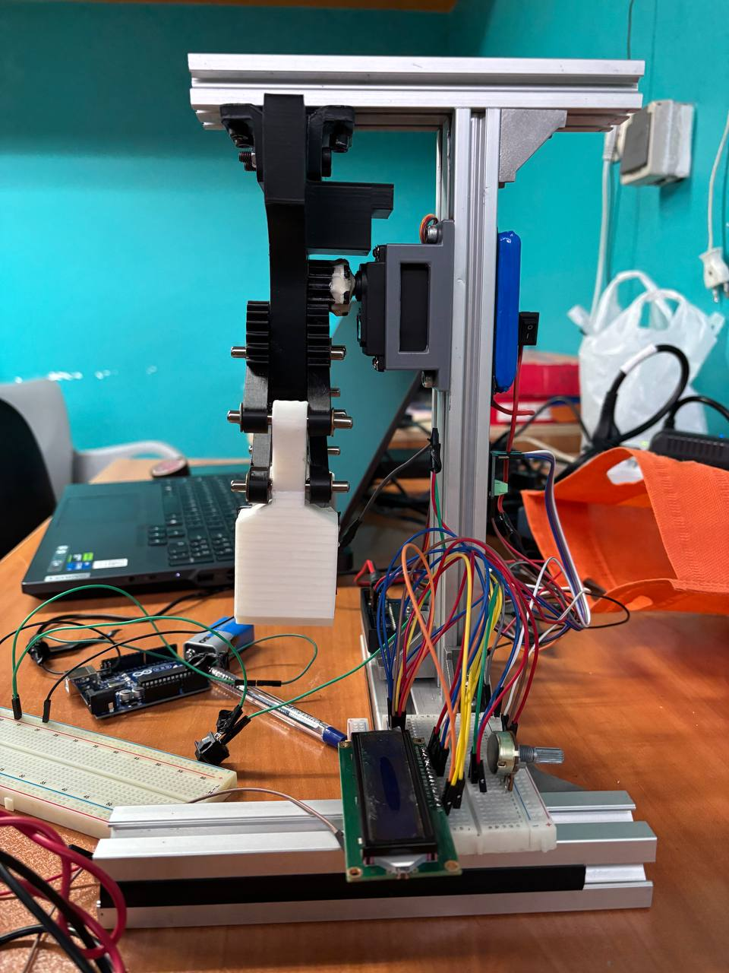
Stand Design for the Gripper
Stable Base
Servo Motor Housing
It houses the servo motor within an enclosed box, ensuring protection against external impacts and allowing for efficient cable management.
It provides a stable base for testing the gripper's functionality.
To support our gripper in a stable and structured manner, we designed a custom aluminum stand that securely holds the entire assembly. The choice of aluminum as the primary material was driven by its lightweight yet strong characteristics, providing a safe and durable setup. The stand's design also facilitates easy adjustments, allowing for future modifications if needed.

Slide 3
Challenge 1: Using Silicone for Improved Friction
The Challenge
Key Benefits of Silicone
During our testing phase, we identified a major challenge: insufficient friction on the gripper's grasping surface, which led to objects slipping out of the grip. To counter this, we experimented with various surface coatings and materials before finalizing on silicone plates attached to each grasper.
Enhanced horizontal friction: Once an object is gripped, the silicone significantly increases friction between the object and the grasper surface.
No vertical force applied: Unlike other gripping enhancements that rely on pressure-based adhesion, the silicone simply increases friction without exerting any additional vertical force.
Self-adjusting frictional properties: The silicone remains passive until the gripper makes contact with an object, preventing unnecessary resistance during the grasping motion.
This solution not only improved grip reliability but also maintained the integrity of delicate objects that could be damaged by excessive force.

Slide 4




Challenge 2: Force Detection Feedback via Current Sensor
No Load Condition
Under no load conditions, the servo motor rotates freely and consumes less than 10mA of current.
Object Contact
When the gripper touches an object, the reaction force increases, causing a spike in current consumption. This allows us to detect the first point of contact.
Increased Force
As we continue to apply more force on the object, the resistance from the object increases, leading to a proportional increase in current draw.
Force Quantification
By continuously monitoring the amperage, we can quantify the gripping force without requiring a separate force sensor.
An essential aspect of our gripper's functionality was detecting contact and measuring gripping force to ensure a controlled and adaptable grip. Initially, we experimented with FSR402 and FSR406 force sensors but found them unreliable due to inconsistent feedback and sensitivity issues. As an alternative, we adopted a current-sensing approach to detect force application.

Slide 5
Our Controller: Impedance Control & Current Feedback Integration
Control Mechanism Overview
Hybrid Force Control Strategy
Impedance Control: This method computes an appropriate gripping force based on the object's stiffness and displacement. It provides a soft and adaptive control mechanism that reacts to external forces.
Our controller operates using a hybrid force control strategy, combining Impedance Control and Current Feedback to regulate the gripping force dynamically. The fundamental goal is to ensure a secure yet adaptive grip that prevents excessive force on fragile objects while maintaining a firm hold on sturdier items.
Current Feedback-Based Force Estimation: Simultaneously, we use the current sensor to estimate the force being exerted on the object in real-time. Since current consumption correlates with applied force, this method serves as an effective feedback mechanism.

Slide 6



Decision-Making Policy for Gripper Control
Parallel Operation
1
Both force estimation methods operate in parallel, continuously calculating the required protection force.
Force Comparison
2
The system compares the force predicted by Impedance Control and the force estimated from current feedback.
Force Limit Determination
3
The first force limit reached (either from impedance control or current monitoring) determines the maximum force applied.
This hybrid approach enhances safety while maintaining the versatility of the gripper. By combining theoretical force computation (Impedance Control) with real-world feedback (Current Sensor), we achieve a robust and adaptive control system suitable for various objects and handling conditions.

Slide 7
Impedance Controller Usage in the Gripper
How It Works
Why It's Useful
The controller models the gripper's interaction as a mass-spring-damper system, where force is applied proportionally to displacement and resistance.
Adaptive gripping: Adjusts to different object properties without predefined force values.
Safe interaction: Prevents excessive force that could damage objects.
If the object is soft or fragile, the controller limits force application to prevent crushing.
Smooth handling: Reduces sudden jerks or unstable grip forces.
If the object is rigid, the controller allows more force to ensure a firm grip.
The Impedance Controller in our robotic gripper is used to regulate the interaction forces between the gripper and the object in a way that mimics natural compliance. Instead of applying a fixed gripping force, the controller adjusts force dynamically based on the resistance (impedance) it encounters.
In our gripper, impedance control works alongside current-based force feedback, ensuring a safe, reliable, and intelligent gripping mechanism.

Slide 8
Code Explanation: Brief Explanation of Your Code
1
Hardware Used
Servo Motor: Moves the gripper to control force.
Adafruit INA219: Measures current (which correlates with force).
Push Button: Initiates the gripping action.
LCD Display: Shows real-time force and impedance control data.
2
Setup (setup() function)
Initializes Serial Monitor for debugging.
Sets up INA219 for current sensing.
Attaches the servo motor to pin 9.
Initializes the LCD for displaying force values.
Configures the push button with INPUT_PULLUP mode.
3
Loop (loop() function)
Phase 1: Closing the Gripper
The servo gradually moves to increase grip force.
The system continuously reads current from INA219 and calculates force.
It stops increasing grip when force_raw ≥ 0.4N or max servo angle is reached.
Phase 2: Impedance Control
If force ≥ 0.4N, impedance-based force control starts.
It calculates displacement (X) and velocity (X_dot) using servo position.
Uses impedance model: F=C⋅X_dot+K⋅X
If force exceeds a saturation limit (3.7N), the servo pauses for 10 seconds and returns to the home position (8°).

Slide 9
Force Calculation and Display
Force Calculation
LCD Display Output
Saturation Handling
The force is estimated from current using: F=41.871×I−0.414 (where I is the current in amperes)
Line 1: Shows current force (F_cur) from current reading.
If force exceeds 3.7N, the system:
Pauses for 10 seconds.
Line 2: Shows impedance force (F_imp) based on displacement & velocity.
Returns servo to home angle (8°).
Resets impedance variables for a fresh start.

Slide 10
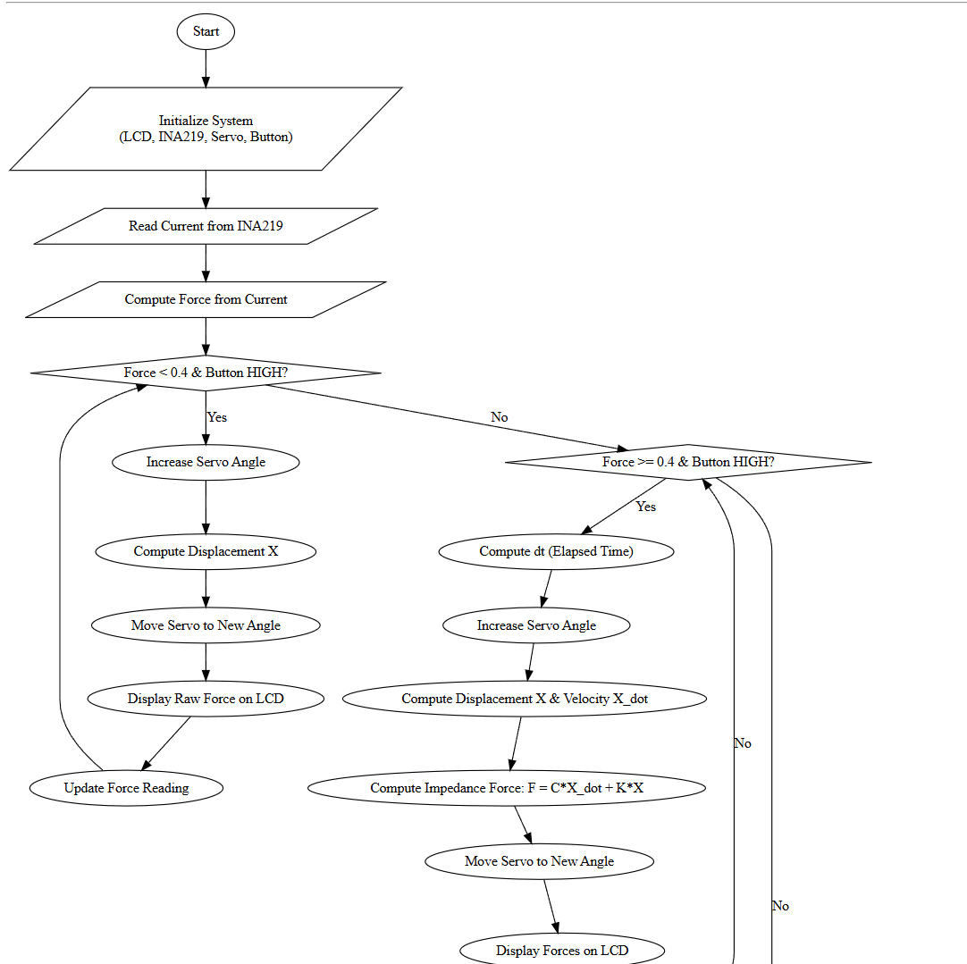
Flow Chart
(Event Based)

Slide 11
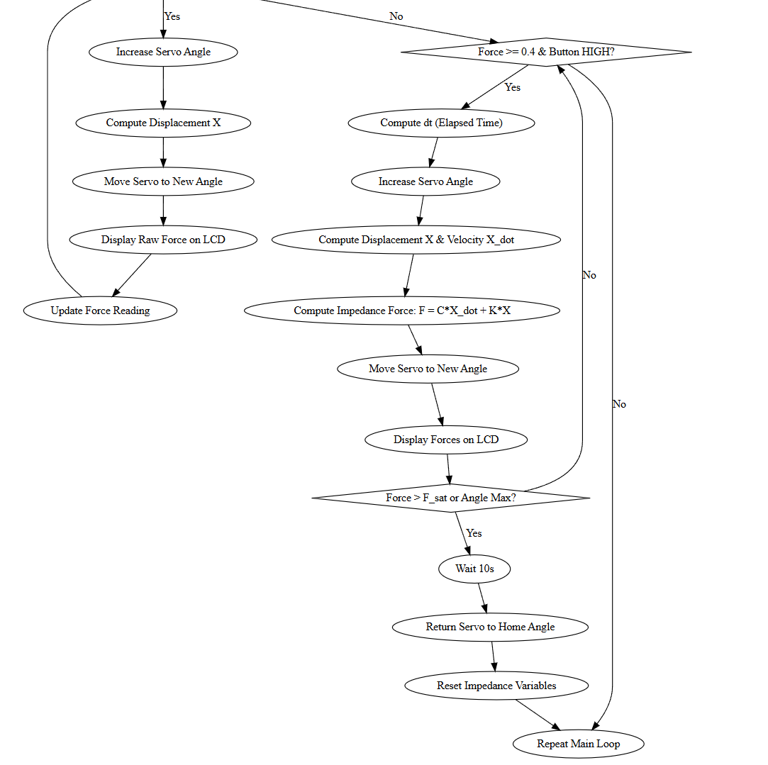
Flow Chart
(Event Based)

