Slide 1

User Input; Operations Details
Principles of Computer Programming I
Spring 2021

Slide 2
Outline
Reading Strings from the User
Math Operations Details
String Operations Details

Slide 3
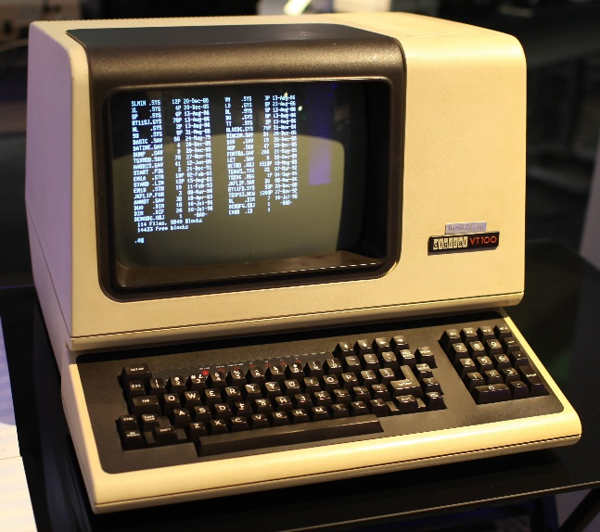
Input from the User
With a CLI, output = print text to screen, input = read text from keyboard
Console represents the “terminal” interface
Output:
Text to output
Input:
Waits until user presses “Enter”
Console.WriteLine("Hi!");
Console.ReadLine();
Result: Terminal displays “Hi!”
Result: A string value containing text typed in at terminal (one line)

Slide 4
Lab Recap
class PersonalizedWelcomeMessage
{
static void Main()
{
string firstName;
Console.WriteLine("Enter your first name:");.
firstName = Console.ReadLine();
Console.WriteLine($"Welcome, {firstName}!");
}
}
Declare a string variable named firstName
Print text to the console
Wait for a line of text to be typed in
Insert the text from firstName into this string and print it
Assign the text received from the console to firstName

Slide 5
Outline
Reading Strings from the User
Math Operations Details
String Operations Details

Slide 6
Operators For Each Type
Binary operators, like +, -, *, /, are really 2-input functions
Result type of function depends on input types:
Action taken (function code) also depends on input types:
int + int
float + float
double + double
decimal + decimal
int
float
double
decimal
int / int
integer division
int
double / double
floating-point division
double

Slide 7
Implicit Conversions in Math
If operands aren’t the same type, implicit conversion attempted
If implicit conversion doesn’t work, compile error
int value
double value
double fracDiv = 21 / 2.4;
implicit conversion
double / double operator
21.0 / 2.4
decimal value
No implicit conversion from double to decimal
double badMath = 3.75m * 2.66;
No implicit conversion from decimal to double

Slide 8
Casting in Math Expressions
Casting may be necessary to make types match:
Casting may be desirable to change which operator runs:
double a = 35.0;
decimal b = 0.5m;
decimal result = (decimal) a * b;
decimal * decimal operator
double can’t implicitly convert to decimal
int numCookies = 21;
int numPeople = 6;
double share = (double) numCookies / numPeople;
implicitly converted to double
share: 3.5
explicitly convert from int to double
double / double operator

Slide 9
Order of Operations
C# math operators follow standard PEMDAS order, left-to-right
Cast operator is higher priority than binary (math) operators
int x = 4 + 10 * 3 – 21 / 2 – (3 + 3);
4
+
30
–
10
–
6
18
double share = (double) numCookies / numPeople;
2. Implicitly convert to double so operands match types
1. Cast int to double
3. Execute / operator

Slide 10
Order of Operations
What will each of these results be? What is the difference?
int a = 5, b = 4;
double result;
result = a / b;
result = (double) a / b;
result = a / (double) b;
result = (double) a / (double) b;
result = (double) (a / b);
Parentheses: Highest priority
int / int operator

Slide 11
Outline
Reading Strings from the User
Math Operations Details
String Operations Details

Slide 12
String Interpolation
Casting won’t convert numbers to strings, interpolation will
Interpolation can convert any expression, not just a variable
int x = 47, y = 6;
double fraction = (double) x / y;
string text = $"{x} divided by {y} is {fraction}";
“47”
“6”
“7.8333333”
“7.8333333”
Console.WriteLine($"{x} divided by {y} is {(double) x / y}");
Console.WriteLine($"{x} plus 7 is {x + 7}");
“54”
This does not change the value of x or y:
Console.WriteLine($"x={x}, y={y}");
Prints “x=47, y=6”

Slide 13
Behind the Scenes
Interpolation doesn’t know how to convert numbers to strings
All data types in C# are objects, even int
All objects in C# have a ToString() method – “convert this object to a string”
int num = 42;
double fraction = 33.5;
string intText = num.ToString();
string fracText = fraction.ToString();
Call method ToString on object num
Result: “42”
Result: “33.5”
Call method ToString on object fraction

Slide 14
Behind the Scenes
Interpolation calls ToString() on the result of each expression
int num = 42;
string intText = num.ToString();
This:
Console.WriteLine($"num is {num}");
Is the same as:
Console.WriteLine($"num is {intText}");
Is the same as:
Console.WriteLine($"num is {num.ToString()}");

Slide 15
String Concatenation
The + operator is a different function for each operand type
If the operand types are string, it performs concatenation
Works as expected for string variables:
string greeting = "Hi there, " + "John";
Result: “Hi there, John”
string + string operator
string name = "Paul";
string greeting2 = "Hi there, " + name;
Result: “Hi there, Paul”

Slide 16
Mixed Types with +
What if we use + operator with a string and a number?
Answer: Converts the other argument to a string with ToString()
int bananas = 42;
string text = "Bananas: " + bananas;
string text = "Bananas: " + bananas;
bananas.ToString()
"Bananas: "
+
"42"
"Bananas: 42"
string + string, concatenation

Slide 17
Interpolation and Concatenation
Can “print out” variables two equivalent ways:
Interpolation is easier to write with many variables:
int num = 42;
Console.WriteLine($"num is {num}");
Console.WriteLine("num is " + num);
Console.WriteLine($"The variables are {a}, {b}, {c}, {d}, and {e}");
Console.WriteLine("The variables are " + a + ", " + b + ", "
+ c + ", " + d + ", and " + e);

Slide 18
Concatenation Puzzle
Code executes left-to-right, binary operators (like +) are grouped left-to-right
What does this produce?
int + int
int + string
int var1 = 6, var2 = 7;
Console.WriteLine(var1 + var2 + " is the result");
Console.WriteLine("The result is " + var1 + var2);
“13 is the result”
“The result is 67”
string + int
string + int

Slide 19
Parentheses Define Order
Parentheses make order, grouping explicit
Use to ensure compiler does what you mean
int var1 = 6, var2 = 7;
Console.WriteLine((var1 + var2) + " is the result");
Console.WriteLine("The result is " + (var1 + var2));
“13 is the result”
“The result is 13”
Evaluates second, concatenates string with result of parentheses
Evaluates first, so + operator sees int + int

Slide 20
Summary
Reading Strings from the User
Math Operations Details
String Operations Details

