Slide 1

Reading Input and Displaying Output
Principles of Computer Programming I
Spring/Fall 20XX

Slide 2
Outline
Reading user input
Parsing user input
Parse methods
Failures and correct formatting
Converting numbers to strings
The ToString method
String concatenation
String modifications

Slide 3
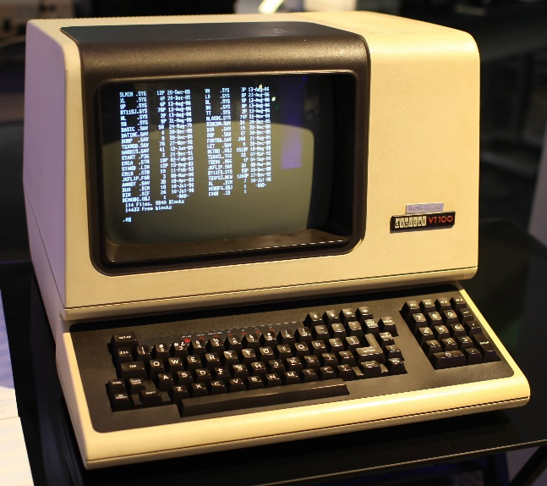
Input from the User
With a CLI, output = print text to screen, input = read text from keyboard
Console represents the “terminal” interface
Output:
Text to output
Input:
Waits until user presses “Enter”
Console.WriteLine("Hi!");
Console.ReadLine();
Result: Terminal displays “Hi!”
Result: A string value containing text typed in at terminal (one line)

Slide 4
User Input Example
class PersonalizedWelcomeMessage
{
static void Main()
{
string firstName;
Console.WriteLine("Enter your first name:");
firstName = Console.ReadLine();
Console.WriteLine($"Welcome, {firstName}!");
}
}
Declare a string variable named firstName
Print text to the console
Wait for a line of text to be typed in
Insert the text from firstName into this string and print it
Assign the text received from the console to firstName

Slide 5
Method Input and Output
WriteLine gets input from your program: the argument
ReadLine gives output to your program: the return value
Argument: a string value
Console.WriteLine("Enter your first name");
WriteLine does not return a value, nothing to assign
myVar = Console.WriteLine("Hi!");
string name = Console.ReadLine();
int result = 3 * 9 + 1;
No argument
Result of expression: an int value
Result of expression: a string value (the return value)

Slide 6
Outline
Reading user input
Parsing user input
Parse methods
Failures and correct formatting
Converting numbers to strings
The ToString method
String concatenation
String modifications

Slide 7
User Input and Data Types
Expressions have exactly one result type; methods have exactly one return type
ReadLine always returns a string, no matter what user enters
int
double
365 / 7.0
Console.ReadLine()
double
string
Console.WriteLine("Enter your age:");
string age = Console.ReadLine();
Console.WriteLine("Enter your height in meters:");
string height = Console.ReadLine();
Gets the value "30"
Gets the value "1.77" (not 1.77)

Slide 8
String Conversions
Recall: Converting int to string requires a specific function
Similarly, converting string to int uses a method
int myAge = 30;
string strAge = (string) myAge;
Error! Can’t convert int to string
string strAge = $"{myAge}";
string strAge = "30";
int myAge = (int) strAge;
Error! Can’t convert string to int
int myAge = int.Parse(strAge);
Result: int

Slide 9
Parse Methods
Each built-in numeric type has a “Parse” method
Useful for turning user input into correct data type:
int.Parse("42")
42
double.Parse("3.65")
3.65
long.Parse("42")
42L
float.Parse("3.65")
3.65f
Console.WriteLine("Enter your age:");
string ageString = Console.ReadLine();
int age = int.Parse(ageString);
Gets "30"
Gets 30

Slide 10
Method Input and Output
Parse methods have both argument (input) and return value (output)
Return value can be used in expressions
Argument: a string value
int answer = int.Parse("42");
Assigned value: 42
Result of method call: an int value
Implicitly convert to double
double result = double.Parse("3.65") * 4;
Assigned value: 14.6
Return value: 3.65

Slide 11
Parsing User Input
Input must be parsed before doing math:
Can call both methods in one statement:
Console.WriteLine("Please enter the year.");
string userInput = Console.ReadLine();
int curYear = int.Parse(userInput);
Console.WriteLine($"Next year it will be {curYear + 1}");
String interpolation will print result of expression
int + int
Assign return value to curYear
Console.WriteLine("Please enter the year.");
int curYear = int.Parse(Console.ReadLine());
Parse converts the string, returns an int
Argument to Parse is an expression, so evaluate it
Execute method, return result (a string)

Slide 12
Outline
Reading user input
Parsing user input
Parse methods
Failures and correct formatting
Converting numbers to strings
The ToString method
String concatenation
String modifications

Slide 13
What Could Go Wrong?
What if the string is not a number?
Answer: Program crashes with System.FormatException
The string is a number, but the wrong type of number?
int badIdea = int.Parse("Hello!");
FormatException!
int fromFraction = int.Parse("52.5");
FormatException!
int wholeNumber = int.Parse("45.0");
FormatException!

Slide 14
What Could Go Wrong?
The user adds extra text to their number?
The string is a number that can’t fit the desired type?
Integer types: Crash with System.OverflowException
Floating-point types: Normal overflow/underflow behavior
decimal money = decimal.Parse("$18.95");
int year = int.Parse("1999!");
FormatException!
FormatException!
int tooBig = int.Parse("-3000000000");
float tooSmall = float.Parse("1.5e-55");
OverflowException!
tooSmall gets 0

Slide 15
Correct Number Formatting
Acceptable string formats vary by number type
int and long:
decimal:
Sign is optional
"+6961 "
"-18005"
[ws][sign][digits][ws]
" 13 "
Can begin or end with whitespace
Decimal digits, optional
Not a valid int
[ws][sign][digits],[digits][.digits][ws]
"+18,999 "
"286669.4"
Can use commas!
" -6.378"

Slide 16
Correct Number Formatting
float and double:
References: Double.Parse, Int32.Parse, Decimal.Parse
Decimal digits
[ws][sign][digits],[digits](.[digits])(e[sign][digits])[ws]
Can use commas
“Exponent” notation
"-9.44e15"
"165,324,888.01"
"+950E-18"
"6.02e23 "
Parse will succeed, but value is stored as 9.5e-16

Slide 17
Outline
Reading user input
Parsing user input
Parse methods
Failures and correct formatting
Converting numbers to strings
The ToString method
String concatenation
String modifications

Slide 18
String Interpolation
Casting won’t convert numbers to strings, interpolation will
Interpolation can convert any expression, not just a variable
int x = 47, y = 6;
double fraction = (double) x / y;
string text = $"{x} divided by {y} is {fraction}";
“47”
“6”
“7.8333333”
“7.8333333”
Console.WriteLine($"{x} divided by {y} is {(double) x / y}");
Console.WriteLine($"{x} plus 7 is {x + 7}");
“54”
This does not change the value of x or y:
Console.WriteLine($"x={x}, y={y}");
Prints “x=47, y=6”

Slide 19
Behind the Scenes
Interpolation doesn’t know how to convert numbers to strings
All data types in C# are objects, even int
All objects in C# have a ToString() method – “convert this object to a string”
int num = 42;
double fraction = 33.5;
string intText = num.ToString();
string fracText = fraction.ToString();
Call method ToString on object num
Result: “42”
Result: “33.5”
Call method ToString on object fraction

Slide 20
Interpolation and ToString
Interpolation calls ToString() on variables to convert them
int x = 47, y = 6;
double fraction = (double) x / y;
string text = $"{x} divided by {y} is {fraction}";
x.ToString();
y.ToString();
fraction.ToString();
"47"
"6"
"7.833333333333333"
"47 divided by 6 is 7.833333333333333"

Slide 21
Interpolation and ToString
What about expressions? How do they get converted?
Result of expression is an object, so we can call ToString on it
Console.WriteLine($"{x} divided by {y} is {(double) x / y}");
A double object
x.ToString();
y.ToString();
7.833333333333333
7.833333333333333.ToString()
"47"
"6"
"7.833333333333333"
"47 divided by 6 is 7.833333333333333"

Slide 22
Storing and Printing Strings
To convert a single variable to a string, either works
To display a single variable on the screen, no conversion needed
To insert multiple variables into a string, use interpolation
int num = 42;
string intText = num.ToString();
int num = 42;
string intText = $"{num}";
Console.WriteLine(num);
WriteLine(int) internally converts num to a string
Console.WriteLine($"{num}");
Convert num to a string, then call WriteLine(string)
Console.WriteLine($"x={x}, y={y}");
string text = $"x={x}, y={y}";

Slide 23
Outline
Reading user input
Parsing user input
Parse methods
Failures and correct formatting
Converting numbers to strings
The ToString method
String concatenation
String modifications

Slide 24
String Concatenation
The + operator is a different function for each operand type
If the operand types are string, it performs concatenation
Works as expected for string variables:
string greeting = "Hi there, " + "John";
Result: “Hi there, John”
string + string operator
string name = "Paul";
string greeting2 = "Hi there, " + name;
Result: “Hi there, Paul”

Slide 25
Mixed Types with +
What if we use + operator with a string and a number?
Answer: Converts the other argument to a string with ToString()
int bananas = 42;
string text = "Bananas: " + bananas;
string text = "Bananas: " + bananas;
bananas.ToString()
"Bananas: "
+
"42"
"Bananas: 42"
string + string, concatenation

Slide 26
Interpolation and Concatenation
Two different ways to insert variables into a string:
Interpolation is easier to write with many variables
Also, only interpolation allows format specifiers
int num = 2500;
Console.WriteLine($"num is {num}");
Console.WriteLine("num is " + num);
Console.WriteLine($"The variables are {a}, {b}, {c}, {d}, and {e}");
Console.WriteLine("The variables are " + a + ", " + b + ", "
+ c + ", " + d + ", and " + e);
Console.WriteLine($"num is {num:N}");

Slide 27
Concatenation Puzzle
Code executes left-to-right, binary operators (like +) are grouped left-to-right
What does this produce?
int + int
int + string
int var1 = 6, var2 = 7;
Console.WriteLine(var1 + var2 + " is the result");
Console.WriteLine("The result is " + var1 + var2);
“13 is the result”
“The result is 67”
string + int
string + int

Slide 28
Parentheses Define Order
Parentheses make order, grouping explicit
Use to ensure compiler does what you mean
int var1 = 6, var2 = 7;
Console.WriteLine((var1 + var2) + " is the result");
Console.WriteLine("The result is " + (var1 + var2));
“13 is the result”
“The result is 13”
Evaluates second, concatenates string with result of parentheses
Evaluates first, so + operator sees int + int

Slide 29
Outline
Reading user input
Parsing user input
Parse methods
Failures and correct formatting
Converting numbers to strings
The ToString method
String concatenation
String modifications

Slide 30
Formatting Strings with Methods
strings are objects, and have methods (including ToString)
Some are useful for formatting input/output
ToUpper(): Returns an UPPERCASE version of the string
ToLower(): Returns a lowercase version of the string
These do not modify the original string
string greeting = "Hi there, " + "John";
Console.WriteLine(greeting.ToUpper());
HI THERE, JOHN
Console.WriteLine(greeting.ToLower());
hi there, john
Console.WriteLine(greeting);
Hi there, John

Slide 31
Formatting Strings with Methods
Trim(): Removes leading and trailing whitespace (in a copy)
Useful for “fixing” user input
Gets the value "George"
string name = " George ";
string trimmedName = name.Trim();
name is still " George "
Console.WriteLine("Enter your first name:");
string inputName = Console.ReadLine();
string name = inputName.Trim();
Console.WriteLine($"Welcome, {name}!");
User enters “ George ”
name gets "George"
Prints Welcome, George!
Without Trim(), output would be Welcome, George !
Notes:
ToUpper and ToLower will be useful later, when we do comparisons with user input – they can let you do a “case insensitive” comparison

