Slide 1

Datatypes and Variables: More Details
Principles of Computer Programming I
Spring 2021

Slide 2
Announcements
Quiz grades on D2L
“Rubric” should show question breakdown
Hard copies will be handed back next week
Project 1 will be available this weekend

Slide 3
Outline
More About C# Datatypes
Integer types and sizes
Floating-point type precision
Value vs. Reference Types
Mathematical Operators
Expressions with operators
Variable assignment

Slide 4
Variables: Memory Locations
Note: Numeric variables have a default value of 0
A variable names a memory location in which to store data
Declaring a variable = reserving memory, giving it a name
Assigning a variable = storing data to that address in memory
RAM addresses
int myAge;
myAge
29
myAge = 29;
int year
2021
decimal tax
0.08

Slide 5

Integer Types by Size
RAM addresses
How much memory do you use to store each variable?
Depends on the size of the number
int = 4 bytes = $−2^{31}…2^{31}−1$
long = 8 bytes = ${−2}^{63}…2^{63}−1$
short = 2 bytes = $−2^{15}…2^{15}−1$
byte = 1 byte = $0…255$
byte is unsigned by default
1 byte
int myInt
long myLong
short myShort
byte myByte

Slide 6




Signed vs. Unsigned
Unsigned versions of types can store larger (positive) values
ushort = 2 bytes = $0…2^{16}−1$
uint = 4 bytes = $0…2^{32}−1$
ulong = 8 bytes = $0…2^{64}−1$
Why? Storing the plus/minus sign takes one bit
Byte 4
Byte 3
Byte 2
Byte 1
The $2^{31}$ digit
11111111
11111111
11111111
11111111
The $2^{0}$ digit
The $2^{30}$ digit
0
1111111
11111111
11111111
11111111
Sign bit: 0 for +, 1 for –

Slide 7
Outline
More About C# Datatypes
Integer types and sizes
Floating-point type precision
Value vs. Reference Types
Mathematical Operators
Expressions with operators
Variable assignment

Slide 8
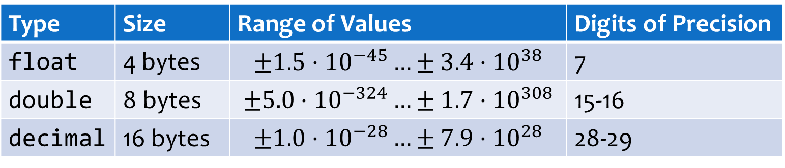
Floating-Point Types by Size
How many significant figures do you care about?
float and double: approximations of decimal values
decimal: exact decimal values, as long as they fit in range
Type | Size | Range of Values | Digits of Precision
float | 4 bytes | $$±1.5⋅{10}^{−45}…±3.4⋅{10}^{38}$$ | 7
double | 8 bytes | $$±5.0⋅{10}^{−324}…±1.7⋅{10}^{308}$$ | 15-16
decimal | 16 bytes | $$±1.0⋅{10}^{−28}…±7.9⋅{10}^{28}$$ | 28-29

Slide 9


Approximate Decimals
float and double use binary (base 2) fractions:
Why “floating point”? Actually it’s binary scientific notation:
2²
2¹
2⁰
2⁻¹
2⁻²
101.01
= 4+1 +
$$1/4$$
= 5.25
Mantissa
10101e-10
Exponent
Shift “.” left by 2
Or read it as a decimal
$$21⋅2^{−2}=\frac{21}{4}=5.25$$
101.01

Slide 10






Approximate Decimals
Some decimal (base 10) fractions can’t be expressed in binary
Decimal 0.1 = $\frac{1}{10}$. Can you express $\frac{1}{10}$ as a sum of $\frac{1}{4},\frac{1}{8},\frac{1}{16},\frac{1}{32},…$ ?
Truncating the infinite sequence leads to errors, just like with $\frac{1}{3}$:
$$\frac{1}{16}$$
$$\frac{1}{32}$$
$$\frac{1}{256}$$
$$\frac{1}{512}$$
=.099609375
.000110011…
(…00110011…)
$\frac{1}{3}+\frac{2}{3}$ in decimal =
.33333333 + .66666666 = .99999999 $≠$ 1

Slide 11

Exact Decimals
The decimal type uses decimal (base 10) fractions
Finite decimals stay finite, so no unexpected errors
But computers can only use binary, how does that work?
Decimal 5.1:
110011 e₁₀-1
Mantissa
Exponent, but as a power of 10
51
10⁻¹
$$51⋅{10}^{−1}=\frac{51}{10}=5.1$$

Slide 12
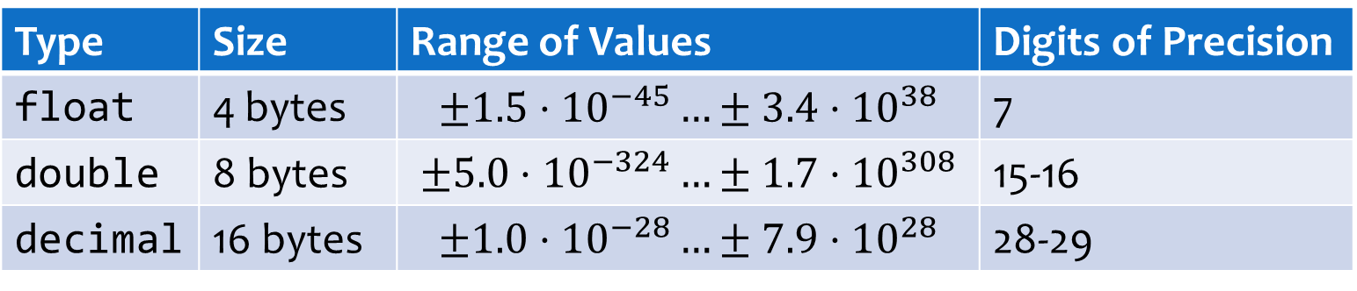
Choosing a Floating-Point Type
More precision sounds good, why not always use decimal?
Much slower to compute with than double
Base-10 exponent is hard, base-2 exponent is easy
Only use if you really need exact values of .01, i.e. money
Physical measurements are not that exact
Type | Size | Range of Values | Digits of Precision
float | 4 bytes | $$±1.5⋅{10}^{−45}…±3.4⋅{10}^{38}$$ | 7
double | 8 bytes | $$±5.0⋅{10}^{−324}…±1.7⋅{10}^{308}$$ | 15-16
decimal | 16 bytes | $$±1.0⋅{10}^{−28}…±7.9⋅{10}^{28}$$ | 28-29

Slide 13
Outline
More About C# Datatypes
Integer types and sizes
Floating-point type precision
Value vs. Reference Types
Mathematical Operators
Expressions with operators
Variable assignment

Slide 14
Value Types
Variables name memory locations
Value Type: Named memory location just stores the value – what you’d expect
Numeric types (int, uint, double, decimal, etc.)
char
bool – logical true or false
RAM addresses
int myAge
29
4 bytes
bool isOn
true
char initial
't'
double height
1.28
8 bytes

Slide 15
Reference Types
Named memory location stores a reference to the data, not the data itself
Contents of the named memory location = the address of another memory location
This location stores the actual data
string
object – and all objects you create
RAM addresses
string word
0x7ff4238
"Hello"

Slide 16
Implications of Reference Types
Assignment copies the value, but not the data it refers to
RAM addresses
string word = "Hello";
string word
0x7ff4238
string word2 = word;
string word2
0x7ff4238
"Hello"

Slide 17
Outline
More About C# Datatypes
Integer types and sizes
Floating-point type precision
Value vs. Reference Types
Mathematical Operators
Expressions with operators
Variable assignment

Slide 18

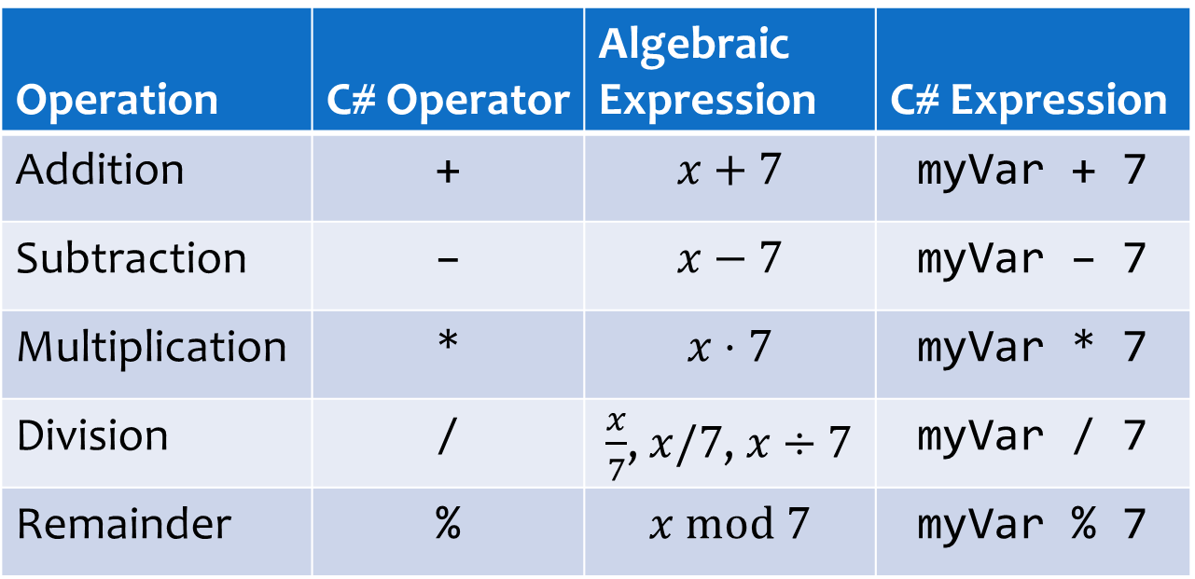
Doing Arithmetic
C# has math operators for numeric data
Operation | C# Operator | Algebraic Expression | C# Expression
Addition | + | $$x+7$$ | myVar + 7
Subtraction | – | $$x−7$$ | myVar – 7
Multiplication | * | $$x⋅7$$ | myVar * 7
Division | / | $\frac{x}{7}$, $x/7$, $x÷7$ | myVar / 7
Remainder | % | $$x \text{mod} 7$$ | myVar % 7
Remainder after integer division: $44 mod 7=2$ because $44÷7=6$ with remainder $2$

Slide 19
Arithmetic and Assignment
Result of an arithmetic expression is a numeric value
Numeric values can be assigned to variables
Variable in arithmetic expression = read its current value
int myVar = 3 * 4;
The value 12 is stored in myVar
This expression evaluates to 12
int a = 4;
int b = a + 5;
a = b * 2;
a has value 4, so b gets the resulting value 9
b has value 9, now a is assigned new value 18

Slide 20
Self-Assignment
A variable can appear on both sides of the = operator
Compound assignment operators: a shortcut
int myVar = 4;
myVar = myVar * 2;
What does this do?
Store result of 4 * 2 into myVar
Read myVar’s current value, 4
Statement | Equivalent
x += 2; | x = x + 2;
x -= 2; | x = x – 2;
x *= 2; | x = x * 2;
x /= 2; | x = x / 2;

Slide 21
Conclusion
More About C# Datatypes
Integer types and sizes
Floating-point type precision
Value vs. Reference Types
Mathematical Operators
Expressions with operators
Variable assignment

