Slide 1

C# Fundamentals
Principles of Computer Programming I
Spring 2021

Slide 2
Outline
C# Introduction
Example C# program
Rules vs. Conventions of C#
Reserved words and identifiers (preview of next week)

Slide 3
C#: A Managed Language
More portable and safe than C or C++, older “unmanaged” languages
Similar to Java
JVM is the runtime for Java Bytecode, the IL
Comes with large standard library (.NET Framework)
static void SayHi() {
Console.WriteLine("Hi");
}
High-level language: C#
C# Compiler
CIL (Common Intermediate Language)
.maxstack 8
IL_0000: nop
IL_0001: ldstr "Hi"
.NET Runtime (CIL Interpreter)
Machine code chunks
0000001110011011 1100101001011000
1100010011010011
0100011101011110

Slide 4

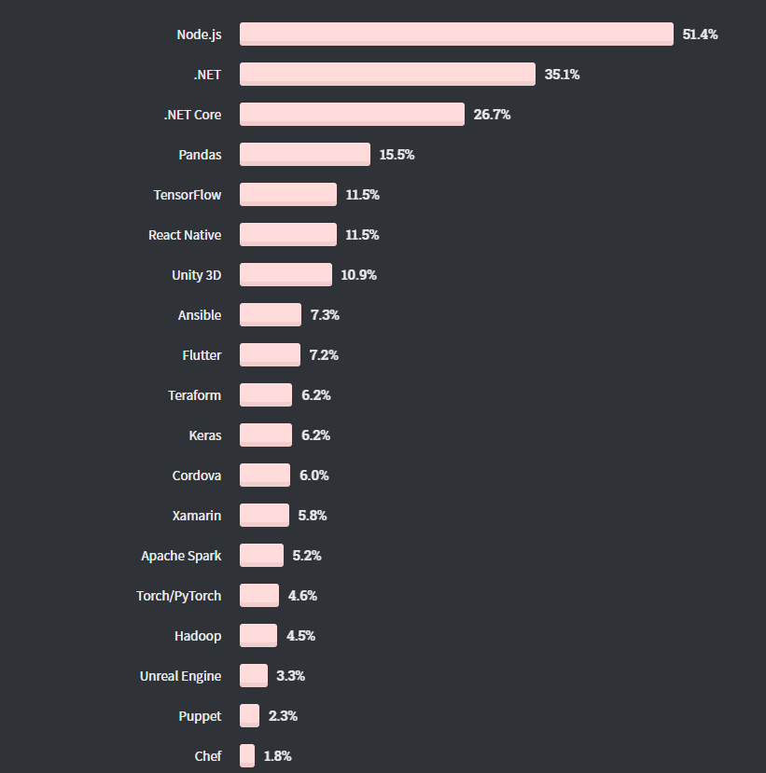
C#: Widespread and Popular
Most Used Languages 2020
Most Used Libraries/Frameworks
For websites, not applications
Written in C#
StackOverflow Developer Survey 2020

Slide 5
C#: Object-Oriented
Paradigms for programming languages: Functional, procedural, logical, object-oriented, event-based
Philosophies for organizing code and expressing ideas in code
C# is primarily object-oriented
Program mostly consists of objects, reusable modules of code
Set of data (attributes)
Functions related to that data (methods)
Object
Data (attributes, state)
Function (method)
Function (method)

Slide 6
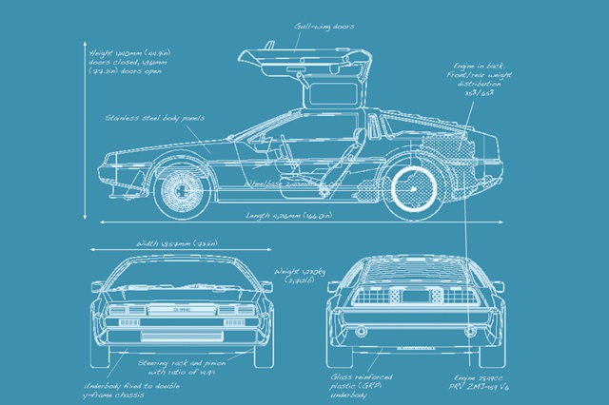

Object Terminology
Class = blueprint, template for object
Code that describes an object
Object = single instance of class
Running code, with specific values/state
Each object is a “copy” of the class
Method = function that modifies object
Defined in class, but executed on specific object (usually)
Attribute = data stored in object

Slide 7
Object Examples
Car object:
Attributes:
Engine status (off, idle, accelerating)
Transmission/gear position
Methods:
Press/release pedals
Turn steering wheel
Shift transmission
Audio object:
Attributes:
Sound data
Current playback position
Target playback device
Methods:
Play, pause, stop
Fast forward, rewind

Slide 8
Outline
C# Introduction
Example C# program
Rules vs. Conventions of C#
Reserved words and identifiers

Slide 9
A Simple Program
Single-line comment
// Hello!
using System;
class Welcome
{
static void Main()
{
Console.WriteLine("Welcome to PCP!");
}
}
/*
This is a multi-line
comment
*/
Import code definitions in the namespace System
Class name
Method name
Class declaration
Method declaration
Statement ends in semicolon
Class
Method call
Argument to WriteLine
Real content of program: One action, print a line of text to the console

Slide 10
Outline
C# Introduction
Example C# program
Rules vs. Conventions of C#
Reserved words and identifiers

Slide 11
Basic C# Syntax Rules
Each statement must end in a semicolon ;
Class and method declarations are not statements – they contain statements
All words are case-sensitive
A class named welcome is not the same as one named Welcome
Braces { } and parentheses ( ) must be matched
Finish what you start: once you start a class definition with {, you must end it with }

Slide 12
More C# Rules
Whitespace – spaces, tabs, newlines – has (almost) no meaning
Unless it is within string data, like "Welcome to PCP!"
Must have 1 space between words
Note: Colors also don’t matter – they’re added by Visual Studio
All C# applications must have a method named Main
When the application starts, the Main method is the first code to run
Same program as before
using System;class Welcome{static void Main(){Console.WriteLine("Welcome to PCP!");}}

Slide 13
C# Conventions
Not enforced by compiler, but expected by humans
Indentation: Each time you start a block with {, indent 4 spaces
class Welcome
{
static void Main()
{
Console.WriteLine("Welcome to PCP!");
Console.WriteLine("Hello World!");
}
}
Beginning of class-definition block
Inside class definition: Indent
Beginning of method-definition block
Inside method definition: Indent
Next line stays at same indentation
End of method-definition block: un-indent

Slide 14
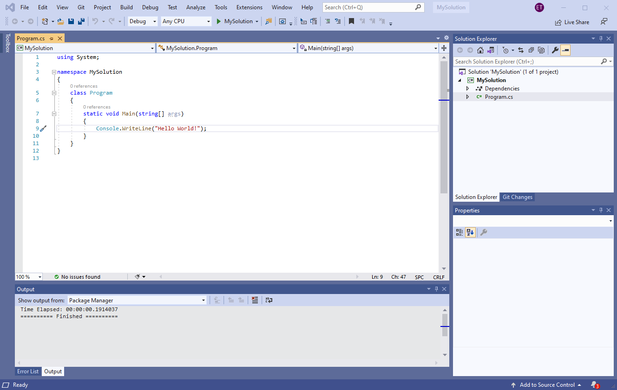
C# Conventions
Each .cs file contains one class
The .cs file has the same name as the class
File program.cs
Class Program

Slide 15
Outline
C# Introduction
Example C# program
Rules vs. Conventions of C#
Reserved words and identifiers

Slide 16
Reserved Words in C#
Keywords in the language, colored blue by Visual Studio
Can only be used for one specific purpose; cannot be changed or re-used as a name for something
using
class
public
private
namespace
this
if
else
for
while
do
return
bool
byte
short
long
void
int
string
object
double
float
decimal
char

Slide 17
Identifiers in C#
Names a programmer chooses
For classes, variables, methods, namespaces, etc.
Some have already been chosen by other programmers: System, Console, WriteLine…
Also colored by Visual Studio:
Class name
Method name
class Welcome
{
static void Main()
{
Console.WriteLine("Hello World!");
}
}
Class name

Slide 18
Identifier Rules
Must not be a reserved word
Must contain only letters, numbers, and _ (underscore)
No spaces
Must not begin with a number
Remember: Case sensitive, like everything in C#
Are these valid identifiers? My_class class1 class Class thisClass this

Slide 19
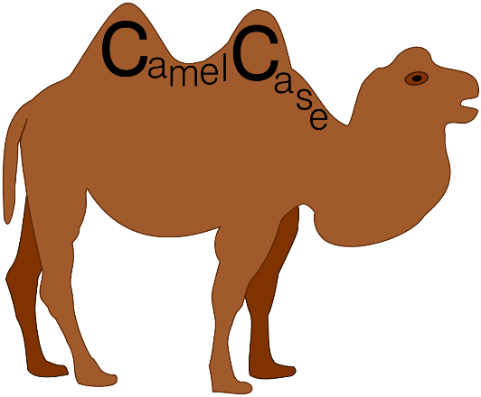
Identifier Conventions
Should be descriptive
AudioFile is a better class name than a
Should be easy to read and type
ClAsS is valid, but not a good idea
Multi-word names should use CamelCase
Class and method names should start with capitals: AudioFile
A.k.a. UpperCamelCase or PascalCase
Variable names should start with lowercase: myFile

